Slide 1
Confidence/Reliability-based Sampling in the Medical Device Industry
Feb 13, 2020
Patrick Giuliano

Slide 2

Introduction
The use of C&R-based sampling gives the quality engineer the ability to measure lot product quality and provides a risk-based approach to control outgoing product defective (this is not what Z1.4 and Z1.9 do!).
Re-elaborate the concept of C&R and introduce several approaches to C&R-based single sampling.
Notes:
The objective of this presentation to show the reader what is good about C&R based plans and what’s not so good about ANSI Z1.4 and Z1.9. To stop using classic sampling plans and to start using C&R based sampling plans.

Slide 3
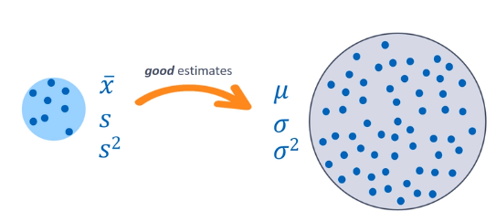
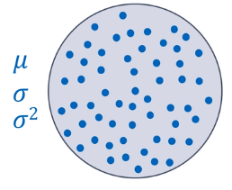
Outline
Regulatory Environment
Confidence + Reliability Interval Concept
  Confidence Interval Concept
  “Reliability” Interval (NIST Tolerance Interval)
  Context in GPS (Gauge-Process- Measurement Stability)
Traditional Single Sampling Plans
  AQL, RQL (LTPD)
C&R Based Plans
  Approach using Krishnamoorthy/Schilling
  Approach using Reliability Plotting (JZ)
Q&A
Sample
Population
Graphics courtesy of JMP STIPS Training Course entitled: Exploratory Data Analysis.

Slide 4
Acknowledgements
John Flaig, Ph.D. and Don Mintz, Ph.D. Co-Chairs of ASQ S/R Section
John Zorich, MS CQE (3-day Course at Ohlone College in Newark)
Mason Chen & Charles Chen, Ph.D., CQE, CRE, CMQ/OE, CRE…. (ASQ Cert. World-Record Holder)
APPLIED STATISTICS for R&D, QA/QC, and MFG.
JUNE 2, 3, 4, 2020 (Tue, Wed, Thu)
More info at www.JOHNZORICH.com
Youngest speaker ever at 14 y/o at 2019 IEEE FUZZ conference
        STEAMS ANNUAL EVENT
        JUNE 10 (Wed), 2020 at Applied Materials
        More info at stem2steams.weebly.com
        STEAMS = Science, Technology, Engineering, AI, Math, Stats
        STEM + TEAMS = STEAMS
Notes:
The objective of this presentation to show the reader what is good about C&R based plans and what’s not so good about ANSI Z1.4 and Z1.9.
To stop using classic sampling plans and to start using C&R based sampling plans.

Slide 6
What’s it like to work in Med Devices?
“De-Risk” the Regulatory Process
Fast Time to market
Product acquisitions by larger players
Emphasis on process control via sampling and not SPC
Standards and Regulations
  FDA, EUMDR,ISO
Warning Letters (483’s)
Prosecution/Distribution/Sale
Notes:
Theranos, Elizabeth Holmes. Perjury to grand jury, 10 years barred from being an executive for any medical device company. Probration and possible jail time for making false statements about the effectiveness and safety of a claimed ‘revolutionary’ blood test for diagnosis, screening and prevention
1. ISO5910 - Cardiovascular implants and extracorporeal systems — Cardiac valve repair devices
2. Non-Clinical Engineering Tests and Recommended Labeling for Intravascular Stents and Associated Delivery Systems - Guidance for Industry and FDA Staff https://www.fda.gov/MedicalDevices/ucm071863.htm (Statistically valid) rationale for sample size and Valid statistical techniques.
The key here is that in med device we operate at “fixed” settings and offer only adjustable control parameters but limited in number. We do not allow settings to vary in our processes, and therefore, we emphasize sampling to help control product quality, not process monitoring/adjustment within limits.
There are precious little regulatory requirements regarding statistics, and what does exist is not clearly written and not well understood, even by the regulatory bodies themselves (as shown in the quotes on next slides).

Slide 7
Slide courtesy of John Zorich, M.S., CQE

Slide 8
Slide courtesy of John Zorich, M.S., CQE

Slide 9

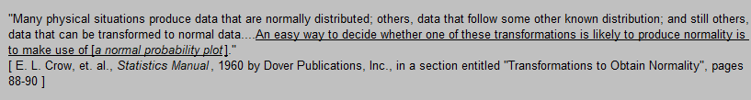
Confidence Interval Concept: Back to Basics
2-sided confidence interval
one-sided upper conf limit
LSL
USL
USL
“ ‘’, the population mean is not more than the stated limit.”
“95% of the time, the population mean is contained within the stated limits.”
Driven by:
Alpha risk : C = 1 – α
Sample size
Dispersion
one-sided lower conf limit
LSL
“ ‘’, the population mean is not less than the stated limit.”
NIST defines a “confidence limits” as “…as the UPPER AND LOWER limits within which we expect to find a given POPULATION PARAMETER value AT A PREDEFINED LEVEL OF CONFIDENCE”
Notes:
My interval brackets an interval with which I expect to find the true value with 95% confidence.
I am calculating a confidence interval, because strictly speaking I am calculating an interval in which I expect to find the population mean to lie.

Slide 10
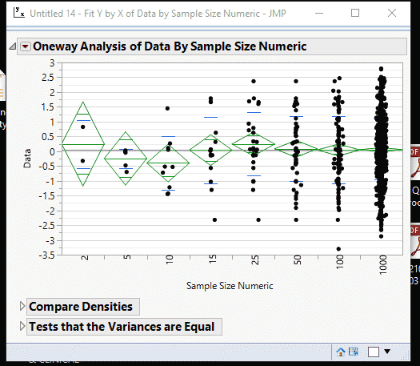
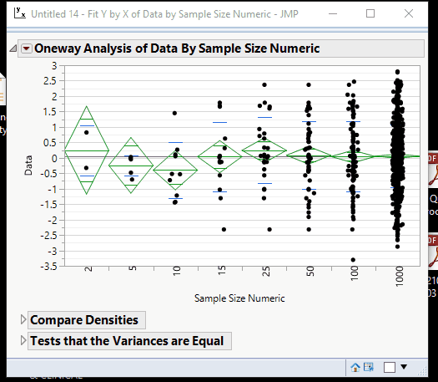
Confidence Interval: Effect of Sample Size and α-level
What happens if I increase/decrease n?
Larger sample, smaller confidence interval
Smaller sample, larger confidence interval
What happens if I increase/decrease α ?
Law of Large Numbers
Higher confidence, larger confidence interval
Lower confidence, smaller confidence interval
Increase α , smaller confidence interval
Decrease α, larger confidence interval
Notes:
If you’re willing to accept less risk that your interval will not capture the true mean, then you choose a larger confidence level. Said differently, the larger the confidence level you choose, the more likely your confidence interval is to capture the true mean.
The lower the confidence level you choose, the greater the risk of not capturing the true mean.
“If you are willing to accept more risk that your confidence interval will not capture the ture mean, you can use a 90% confidence level. If you are willing to accept less risk that your confidence interval will miss the true mean, you might use a 99% confidence interval.” -Julian Parris Decision Making with Data, Module 4, Demo: Calculating Confidence Intervals.

Slide 11

What is a “Reliability” Interval?
“Reliability” interval : statement about a specified proportion of the data within limit(s).
JMP Distribution Calculator (Help > Sample Data)
‘Reliability’ Interval: Consider the example of standard normally distributed population with (µ,σ) = (0,1)
$Z_{i}=\frac{(X_{i}− \overline{X}) }{S_{x}}$
Suppose my (2-sided) “Reliability” interval has boundaries that are -2 and +2 units from the mean.
“I can expect to find 95.45% of my data to fall within -2 to +2.”
This interval talks about where I can expect to find the data for individual observations within limit(s). The data could be an entire population or could be just a sample.
If we are talking about a sample, how confident can we be?
?

Slide 12
Confidence + “Reliability” Interval = Statistical Tolerance Interval
Showed skewed vs normal sample data and effect on tolerance interval.
If data is non-normal, how you handle your tolerance interval? How JMP handle that. How Minitab handle that?
If bimodal, how to handle
> Show with data!
A Confidence and Reliability (C/R) interval, is therefore a combined statement of a confidence interval plus ‘reliability’ interval.
Suppose I want to compute a 95/95 C/R interval.
Based on my sample data: “95% of the time, 95% of the individual values (in the population) are contained within stated limits.”
Where I can expect to find a stated proportion (R) of the individual values of my population, at a particular level of confidence (C).
So, Why do we care about individuals vs the mean?
    Every patient counts (S4/S5)
    Every unit counts ($$$)
Tolerance Interval :
Alpha risk + Beta risk (Customer Risk)
How?
If outlier risk is larger than Beta risk, then how can you trust your beta risk?? You cannot. Show with data.

Slide 13
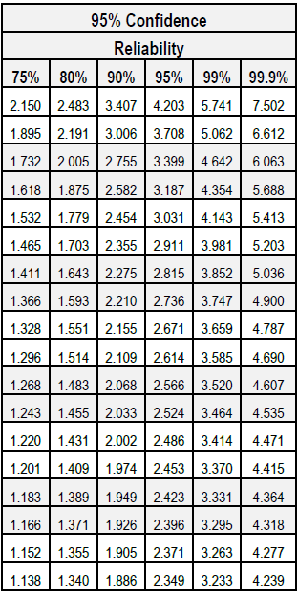

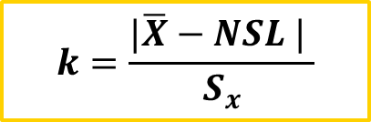

Observed k-values and k-factor tables
Observed k-values provide the lower 1-sided confidence limit on the observed %-in-spec (i.e. %Reliability), where the “observed” (aka “%Reliability”) value is derived from an Normal Distribution Z-table vs. Z value.
$Z_{i}=\frac{(X_{i}− \overline{X}) }{S_{x}}$
$$k=\frac{|\overline{X}−NSL | }{S_{x}}$$
k → Z as n → ∞
NSL
k- table values aka “k-factors” typically assume data comes from normal population.
∞
0.674 | 0.842 | 1.282 | 1.645 | 2.326 | 3.090
Notes:
To discuss the sample data and refer to the proportion of data within the sample data distribution we can refer to that data in the context of z-scoring it.
To guard against the sample having an odd mean and/or standard deviation compared to those of the population, we require that the sample mean be k standard deviations away from the specification.

Slide 14
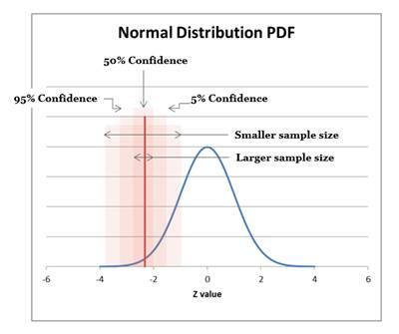




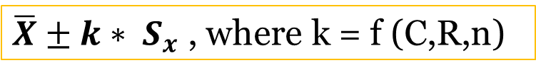

Calculation of Tolerance Intervals Themselves
The typical way we compute:
$\overline{X}±k∗ S_{x}$ , where k = f (C,R,n)
  continuous k-factors can be derived:
    Non-central t-distribution (1-sided case)
    Monte-Carlo simulation + Newton’s Method (2-sided case)
    4th order curvilinear interpolation of table values
    Other numerical estimation methods
$$Illustration for 1−sided Lower Case$$
$$C$$
Not discussed here.
“RELIABILITY (PROCESS CAPABILITY) STATISTICS BASICS” TAB G software (J. Zorich)
$R$
An equation for 1-sided tolerance limits for normal distributions (Link et al. 1985)
$C$&R
$$\overline{X} −k∗ S_{x}$$

Slide 15
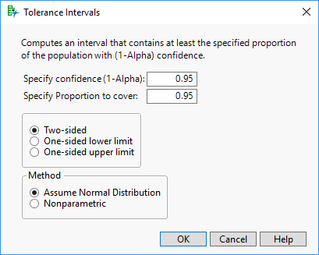
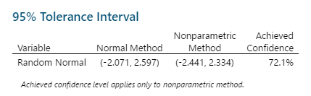
Calculation of Tolerance Intervals (using Software)
For example: Consider 95/95 C&R (2-sided case):
  “I am 95% confident that (at least) 95% of my population will fall [within the stated interval].”
Stat>Quality Tools>Tolerance Intervals….
Analyze>Distribution>Tolerance Interval

Slide 16
Grounding the Concept:
Calculation of Tolerance Intervals (Simulation Experiment)
26 samples of size 15, drawn from a random normal population with (µ, σ) = (25,3)
Analyze>Distribution>Tolerance Intervals
>Make Combined Data Table
>Stack Lower TI and Upper TI
>Graph Builder > Color by “Label”
95% of the time (for 95 of every 100 intervals), the Tolerance Intervals will contain 95% of the data in my population.

Slide 17
Simulation experiment of sample means: Confidence Intervals (1 of 2)
Ask JMP to compute 95%CIs
Ea. Blue dots are 500 sample means of size 2, 3…. 100

Slide 18
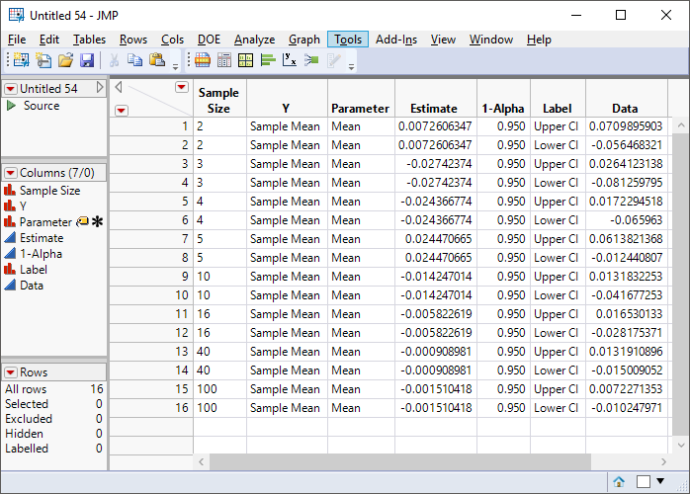
Confidence Intervals (2 of 2)
I don’t always get a mean of sampling distribution of means estimate closer to the true parameter mean (with inc. n), and I don’t always get a standard error closer to the true parameter standard error (with inc. n). Sampling Error exists!
Name Selection in Column, then Tables > Stack “Upper and Lower” Columns
Notes:
as my sample size increases, I get more and more certainty about my true population parameter mean, until eventually I am 100% certain and converge on it!
the CLT theorem also really helps me here, because it doesn’t matter what my individuals data distribution looks like, as n goes up, the distribution of means will become more and more normal so my confidence limits will give me a stable estimate of where the true population mean could be regardless of the shape of the parent population.

Slide 19
Simulation: Statistical Tolerance Intervals converge to Reliability Intervals as n → ∞
Calculate STIs in Distribution Platform, use Global Data Filter, Make Combined Data Table and Concatenate Results.
95/95% statistical tolerance limits
95% “reliability” interval
2-sided z-table value = 1.96
k → Z as n → ∞
Notes:
as sample size increases, I get more and more certain of my true population reliability, to the point where my confidence eventually becomes 100%!
I’m not so sure the CLT helps me here because if I want to infer on a proportion covered, then my data needs to be normally distributed! (or transformed to normal!)

Slide 20
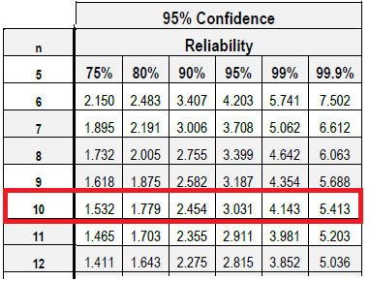
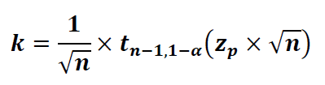
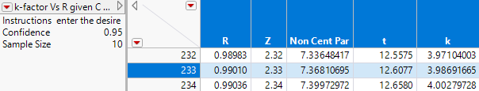

Example: Calculating C&R using k-observed (variables data)
$\overline{X}$ = 3 lbf. Sx = 0.75 lbf. USL = 6 lbf. n=10
K-observed = $\frac{\text{| 3 – }\text{6}\text{ |}}{0.75}$ = 4.00
From tables:
At 95% confidence, 1-sided spec, n = 10
K-observed of 4.00 is > 3.031 but < 4.143, so I can claim at least 95% Reliability at 95% Confidence.
What if I wanted to know more accurately what my Reliability is? I need to interpolate.
k can be determined for any given C&R (for one-sided and n≥2) using the non-central t-distribution
I can actually claim at least 99.01%R at 95%C
¹
NONCENTRALITY PARAMETER
¹Statistical Tolerance Regions, Krishnamoorthy & Mathew, 2009

Slide 21
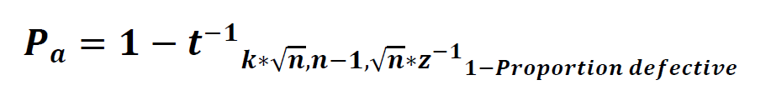
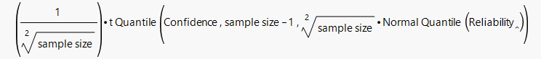
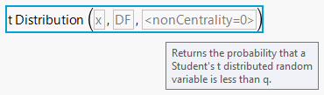
THE MATH
NONCENTRALITY PARAMETER
Pa =
k=
Pa (=Y) vs % defective (=X)

Slide 22
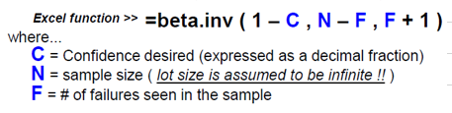
Statistical Tolerance Intervals for Attribute Data
KRISHNAMOORTHY provides an excellent treatment, using MS Excel’s “BETA.INV()” function.
Perhaps the most useful thing about the k-observed construct is that it shows us clearly that C&R are not unique to continuous variable data.
Reliability here refers to the lower one-tailed % Confidence limit on the “observed” % in spec.
In order for me to calculate this C/R, I can use near exact approximation to the binomial distribution.
    WHY?
Graphic above courtesy of John Zorich, M.S., CQE
Notes:
Be Careful!
Small samples > more skewed
Closer to zero or 1 > more skewed
Large samples and closer to zero or 1 → eventually large samples will make the distribution symmetric!

Slide 23
Attribute Sampling Plans – AQL and RQL: Some Basic Terminology
AQL – the maximum percent nonconforming that for the purposes of sampling, I consider acceptable as a process average, at ~95% confidence.
RQL (LTPD or LQL) – the minimum percent nonconforming (or more) that for the purposes of sampling, I will reject as a process average, at ~90% confidence.
Slide courtesy of John Zorich, M.S., CQE

Slide 24
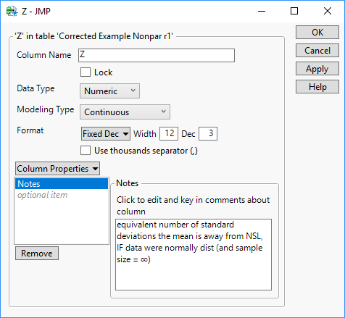
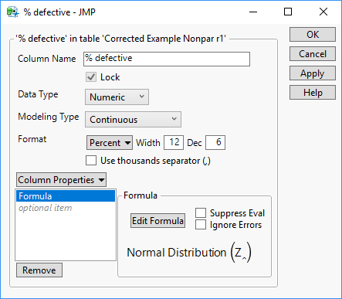


C&R Based Sampling: Operating Characteristics Curves for Attribute Data
$$Pa=$$
Pa = probability of accepting the sampling plan given….
C = 1- Pa = confidence that the plan will reject lots (or samples)
…. Lot % defective
R = 1- %defective (LQL)

Slide 25

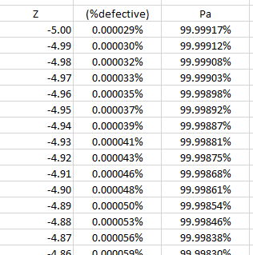
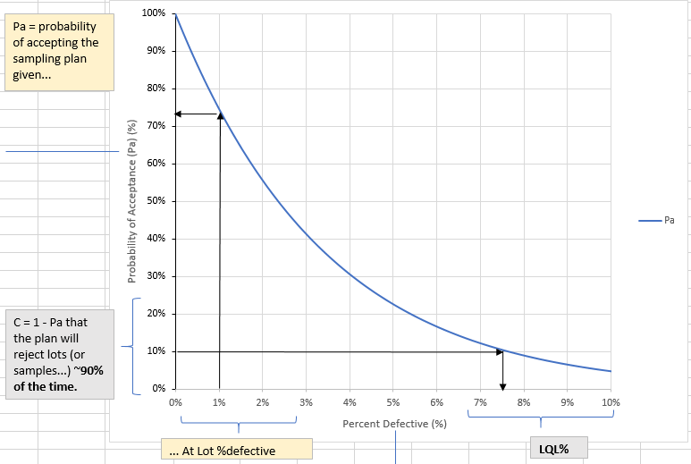


Do AQL/RQL achieve the lot quality what they “claim?”
AQL = 1.0 does not mean that I ensure ≤ 1.0% of my lot/batch will be defective if I pass the sampling plan! Why?
Suppose I have a lot size of 175. Per Zero Acceptance No. Sampling Plans, Squeglia (5th Edition), for AQL=1.0, n=29 for lot size = 151-280
  Suppose my lot defect rate = 1.0%
    ≈ 73% chance of passing the plan.
  Suppose my lot defect rate = 2.0%
    ≈ 55% chance of passing plan.
Single Sampling for LTPD 0.10 = 10%, n=21 for lot size = 101-200
  My plan states my LTPD is 10%
    But my Limiting Quality Level (LQL) achieved is ≈ 7.5%
%defective =
$NORMSDIST(Z$)
Still better than a coin flip!
Pa =
$BINOM.DIST(c,n,$ %defective, 1)
LTPD = LQL
Notes:
I passed LQL so I should be able to assert that I will reject lots that are 10% defective or more ~ 90% of the time. However, the LQL % that I got was actually 7.5%, not 10%.

Slide 26
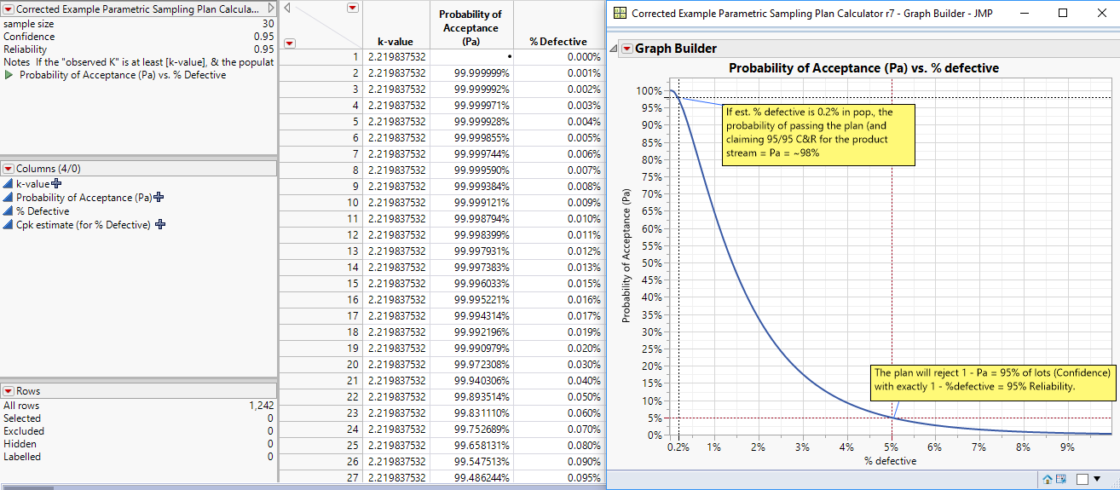
C&R Based Sampling: OC Curves for Variable Data
Ref. 2
Ref. 1
1
2
Krishnamoorthy, K., & Mathew, T. (2009). Statistical Tolerance Regions. Hoboken: John Wiley & Sons.
Schilling, E. G., & Neubauer, D. V. (2009). Acceptance Sampling in Quality Control. Boca Raton: Chapman & Hall.

Slide 27
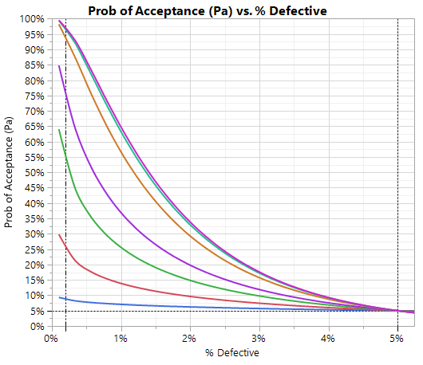
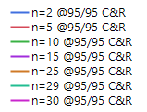
Putting it all together: C&R Based Sampling Plan for variables data
ONE APPROACH:
VARIABLES DATA
Risk of sampling plan acceptance
I am literally saying that (at least) 95% of my lots will be rejected given they have ≥ 5% defective, per this plan.
If I estimate my % defective is 0.3%, I will have ~98% chance of passing the plan (and therefore, being able to claim 95/95) for a sample size = 30.
Same concept can be implemented on OC curves for attribute data with the equations/logic similar to that detailed in a previous slide.
What happens if you don’t meet C&R?
  Investigate (Engineering!)
  100% sort
  Double sampling plan?
Customer risk

Slide 28
Sample Size Rationale
Suppose I need to meet 95/90 C&R based on risk (e.g. PQ requirement).
Suppose based on predicate testing my process % defective = 1.0%
Suppose I want to be at least 98% confident that I will be able to claim 95/90.
How many samples do I need to test?

Slide 29
Multi-Level Sampling: Combining different sampling plans in multiple tiers
Variable plan: C=0.95, R=0.95 n=6, k=3.708
Attribute plan: c=0, n=29
C_{Pa_1} + C_{Pa_2} = (Pa_1)*(Pa_2) =
= (0.61)*(0.99) = 0.6039
C = 60.4%
C_{pa_2} ~99.7% at 0.007% defective
C_{Pa_1} ~ 61% at 0.007% defective
C_{Pa_1} + C_{Pa_2} = (1 - Pa_1)*(1 - Pa_2)
= (1 - 0.05)*(1 - 0.21) = 0.7505
C = 75%
Pa ~ 21% at the max RQL of 5.1%
Pa ~ 5% at the max RQL of 5.1%
0.007% defective (Cpk = 1.27)
Specify max RQL level (min R level)
0.007% defective (Cpk = 1.27)
And my C_{Pa}= 60.4%
So this plan gives me 75%C/95%R
Est historical percent defective
Notes:
If I sample thousands and thousands of lots, at least 75% of them will rejected (on average) if they have at least 5.1% defective.
Said differently, with this plan: “I am at least 75% C that I will reject lots that are not more than 95% R.” One last piece! :
Given my historical process performance, I am 60.4% C that I will be able to make the sampling plan claim:
“I am at least 75% C that I will reject lots that are ≤ 95% R”.
But Wait!
The probabilities of each tier in a variable double sampling plan can not be calculated separately and combined because the results from the two tier are NOT independent. Therefore, Monte Carlo simulation is used to calculate the system performance for variable sampling plans.

Slide 30
Another Approach to C&R Based Sampling
ANOTHER APPROACH*:
VARIABLES DATA:
  Take Sample size = 10 from all incoming lots.
  Analyze using Reliability Plotting¹ (or k-values) vs. C/R Spec.
  If data cannot be adequately linearized, sample an additional 10 (n = 20 for RP analysis).
  If still cannot be linearized, then treat as attribute.
ATTRIBUTE DATA:
  Take Sample size required to achieve C/R at zero failures.
  Analyze using BETA.INV() fcn.
  If C/R not met with at least 1 failure, increase sample size needed to reach C/R at 2 failures.
  If C/R not met with at least 2 failures, increase sample size needed to reach C/R at 3 failures…
Use data from first n lots as a basis for establishing min. sample size/lot.
¹ See Tobias and Trindade: Applied Reliability Ch. 6, CRC Press (c)2012
*Leveraged / adapted from John Zorich, M.S., CQE
Notes:
I’m not specifying Pa (1-C) up front, and therefore, I am not making any claim on the Pa of my sampling plan given N assumed independent sampling events.
All I’m doing is sampling in n continuously to see if I can claim a certain R in the lot at a chosen C level. If I cannot claim the R at the desired C with ever increasing n, then I will end up 100% inspecting my lot!

Slide 31
Recommendation
Z1.4 and Z1.9 plans are not designed to estimate product quality.
If the goal is to infer on product quality, these plans are NOT the right ones to use.
C&R plans make direct inference about product quality! That’s their job!
BUT YOU NEED TO CHANGE THE PASS-FAIL REQS INTO THOSE CORRESPONDING TO A C&R PLAN.

Slide 32
Thank you!
QUESTIONS?

