Slide 1
IEEE-USA Area Meetings PACE 2020
Amber Orr
Region 6 PACE Chair
aorr@ieee.org

Slide 2
WHAT IS PACE? PROFESSIONAL ACTIVITIES COMMITTEES FOR ENGINEERS
A grassroots network of IEEE volunteers and committees organized at the section and chapter levels with support from Regions and IEEE-USA.

Slide 3
PACE Objectives (Professional Activities Committees for Engineers)
PACE promotes:
The professional interests of the U.S. members
The professional activities of Sections, Chapters, and Student Branches
A mechanism for communication of members' views on their professional needs.

Slide 4
Five PACE Topics
Government Activities
Career and Employment Enhancement Activities
Pre-University (K-12 STEM) Activities
Student Professional Awareness Activities
Technical Policy Activities

Slide 5
Career and Employment Enhancement Activities
Employment Assistance Programs
Career Assistance Programs
Employment Benefits and Career Workshops
Career Transitions Workshops
Retirement and Financial Management Workshops
Consulting, Leadership, Licensure Workshops
Communications Workshops
Any project which promotes careers of IEEE members
Job Fairs
Resume Writing and Job Interview Workshops
Job Listing services
Resume Listing services
Professional Awareness Workshops
Internship Location Listings

Slide 6
Pre-University (K-12 STEM) Programs
Future City Competition
First Robotics Competitions
Science Fair
Math Counts
Any STEM project promoting science, technology, and the image of the engineer
And more….

Slide 7
Student Professional Awareness Activities
Student Professional Awareness Experience (SPA-x)
Rising Stars Conference
Future Leaders Forum (EVO)
WIE ILC (International Leadership Conference)
Hackathons
Student Branch Activities

Slide 8
What is Changing for PACE?
In Short: Structure
In October 2019 there was a Proposal to Adopt to Establish an IEEE-USA Careers and Professional Development Committee and Charter; It was formally adopted in January 2020
Budget Will Remain likely be reduced
Committee will be 8 Regular Members (including Chair), plus liaison members, and non-voting members as approved by Chair
The Committee will try to recruit several YPs
There will be One PACE Representative designated as Champion to work with Regional representatives

Slide 9
What is Changing for PACE?
In Short: Structure – cont.
There will be one K-12 Representative designated as Champion to work with Regional representatives
There will be one STEM Representative designated as Champion to work with Regional representatives
There will be one Student activities designated as Champion to work with Regional representatives Representative
There will be One PACE Representative designated as Champion to work with Regional representatives

Slide 10
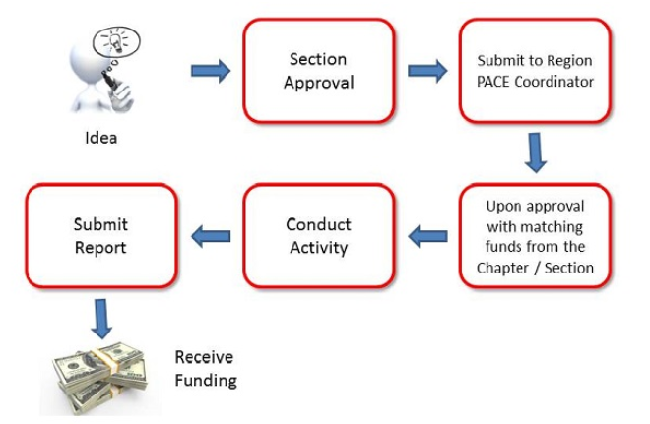
PACE Process

Slide 11
IEEE-USA Professional Activities
2020 PACE Project Funds Request Form
PROJECT INFO
Project Title:
Region: |  | VI |  | Section/Area: |  |  |  |  | Chapter:
Start Date: |  |  |  | End Date: |  |  |  |  | Project Location:
CONTACT INFO |  | Section Chair |  |  |  | PACE Chair |  |  |  | Project Manager
Name:
Email:
Cell Phone:
PROJECT DESCRIPTION |  |  | Project Type: |  |  |  |  |  |  | Expected Participation at the Event
Brief Description: |  |  |  |  |  |  |  |  |  | IEEE Members
 |  |  |  |  |  |  |  |  |  | Non Members
 |  |  |  |  |  |  |  |  |  | TOTAL: |  |  | 0
PROJECT ACTIVITIES AND FUNDING REQUIREMENTS |  |  |  |  |  |  |  | FUNDING SOURCES
Activity |  |  |  | Date |  | Amount |  | Sources of Income |  | Amount | Detail
 |  |  |  |  |  |  |  | Project Income:
 |  |  |  |  |  |  |  | Region:
 |  |  |  |  |  |  |  | Section:
 |  |  |  |  |  |  |  | PACE FUNDS: |  |  | PACE FUND REQUEST
 |  |  |  |  |  |  |  | Other1 (specify):
 |  |  |  |  |  |  |  | Other2 (specify):
 |  |  |  |  |  |  |  | Other3 (specify):
 |  |  |  |  |  |  |  | Other4 (specify):
TOTAL PROJECTED COST |  |  |  |  |  | $0.00 |  | TOTAL |  | $0.00
NOTE: PACE projects are normally paid out at the end of the project. Advance payment is available on request.
Section Chair must approve this funding request via email submission of this form to the Region PACE Chair.
Region PACE Coordinator Signature |  |  |  |  |  |  | Date

Slide 12
Questions/Comments
Amber Orr
Region 6 PACE Chair
aorr@ieee.org

