Slide 1
Industrial Power Converters
Committee Meeting
Baltimore, Maryland - USA
October 1st, 2019

Slide 2
IPCC Chairman Report
Grant Pitel
Call to Order
Attendee introduction
Attendance Circulation
Approval of 2018 Minutes
(http://sites.ieee.org/ipcc/minutes)
Agenda approval

Slide 3
Agenda
Call to order
Introduction of members in attendance
Approval of 2018 minutes (http://sites.ieee.org/ipcc/minutes) and Agenda
Officers Report
Subcommittee Reports
  Transactions
  Fellows and Award Nominations
  Standards
  Special Activities
Old Business
  Involvement with APEC
  More selective process for ECCE 2019 acceptance
New Business
  Secretary Nomination
  Call for industry participation in subcommittees
  Open the floor for additional motions
Announcements
  Prize Paper Award Distribution
  Promotions for IAS sponsored conferences
  Request for volunteers for ECCE2020
Adjournment

Slide 4
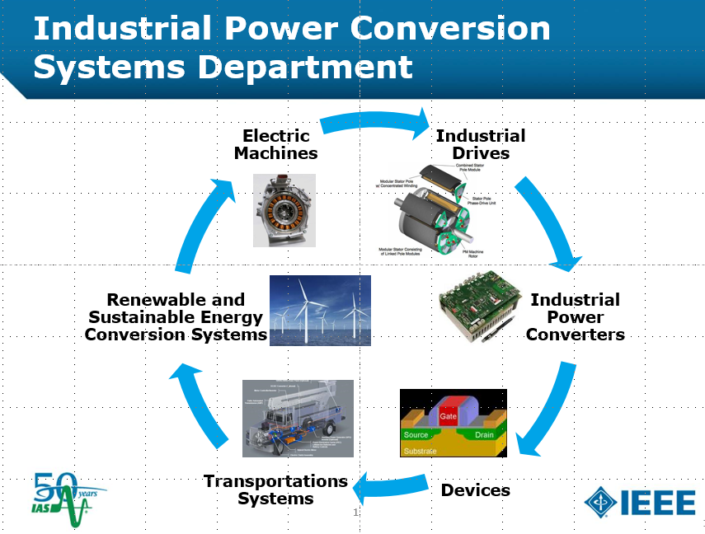
The Role of IPCC within IEEE/IAS
We are a committee within IPCSD specializing in power conversion.
Maintain a network of active volunteers.
Act as a power-converter specific technical resource for \conferences,
journals, and standards.
Continuity of organized leadership 6 year officer tenue rotation.
Collect input from members through
meetings and make recommendations.
Spearhead new initiatives through
special committees.

Slide 5
Membership
Membership roster is at 409 (+35 people since last meeting)
  Online registration: http://sites.ieee.org/ipcc/
  Attending the IPCC meeting held every year at ECCE.
Spread the word to friends, colleagues, and students.
Becoming an Active Member
Reviewer, track chair, officer.
Active within IEEE
Publishing at IAS sponsored conferences
Meeting attendance record

Slide 6
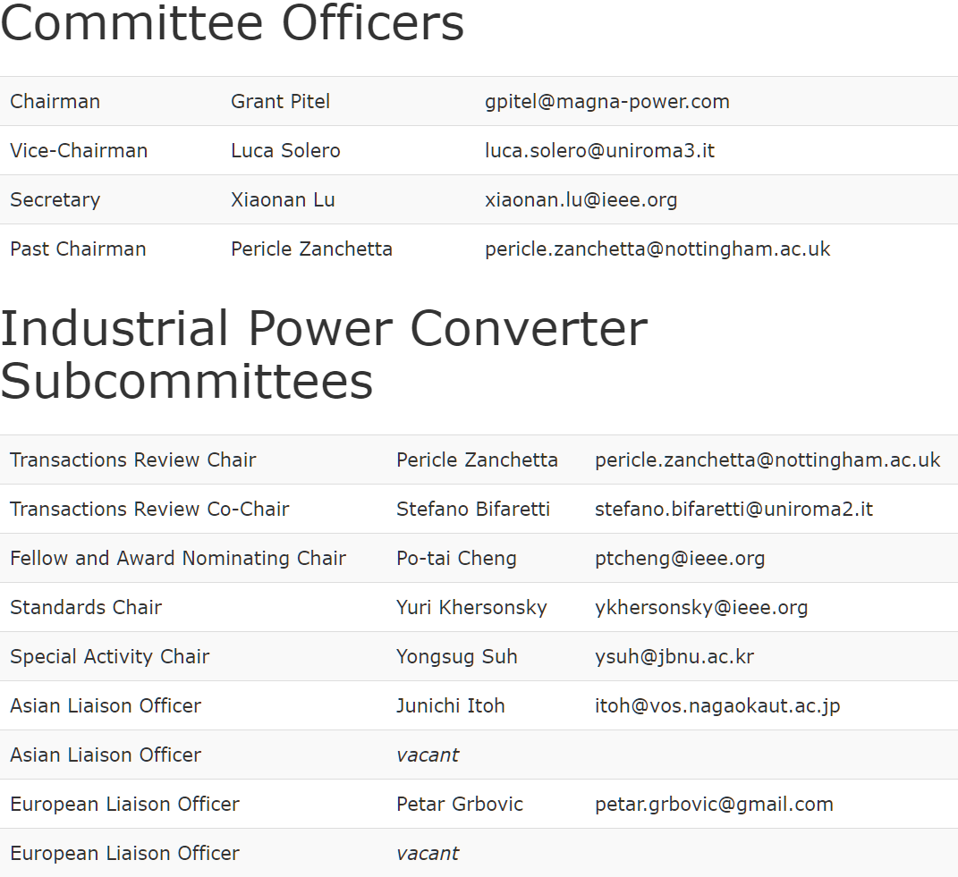
Committee for 2019
(Changes for 2020)

Slide 7
IAS Magazine
IEEE-IAS Magazine History Column Guest Authors
Barry Brusso (b.brusso@ieee.org)
A History of Computer Power Needs and the Rise of PFC
A History of Electric Vehicle Battery Power and Energy Density
A History of Grid Applications: From Individual Converters To Interconnected Converter Systems

Slide 8
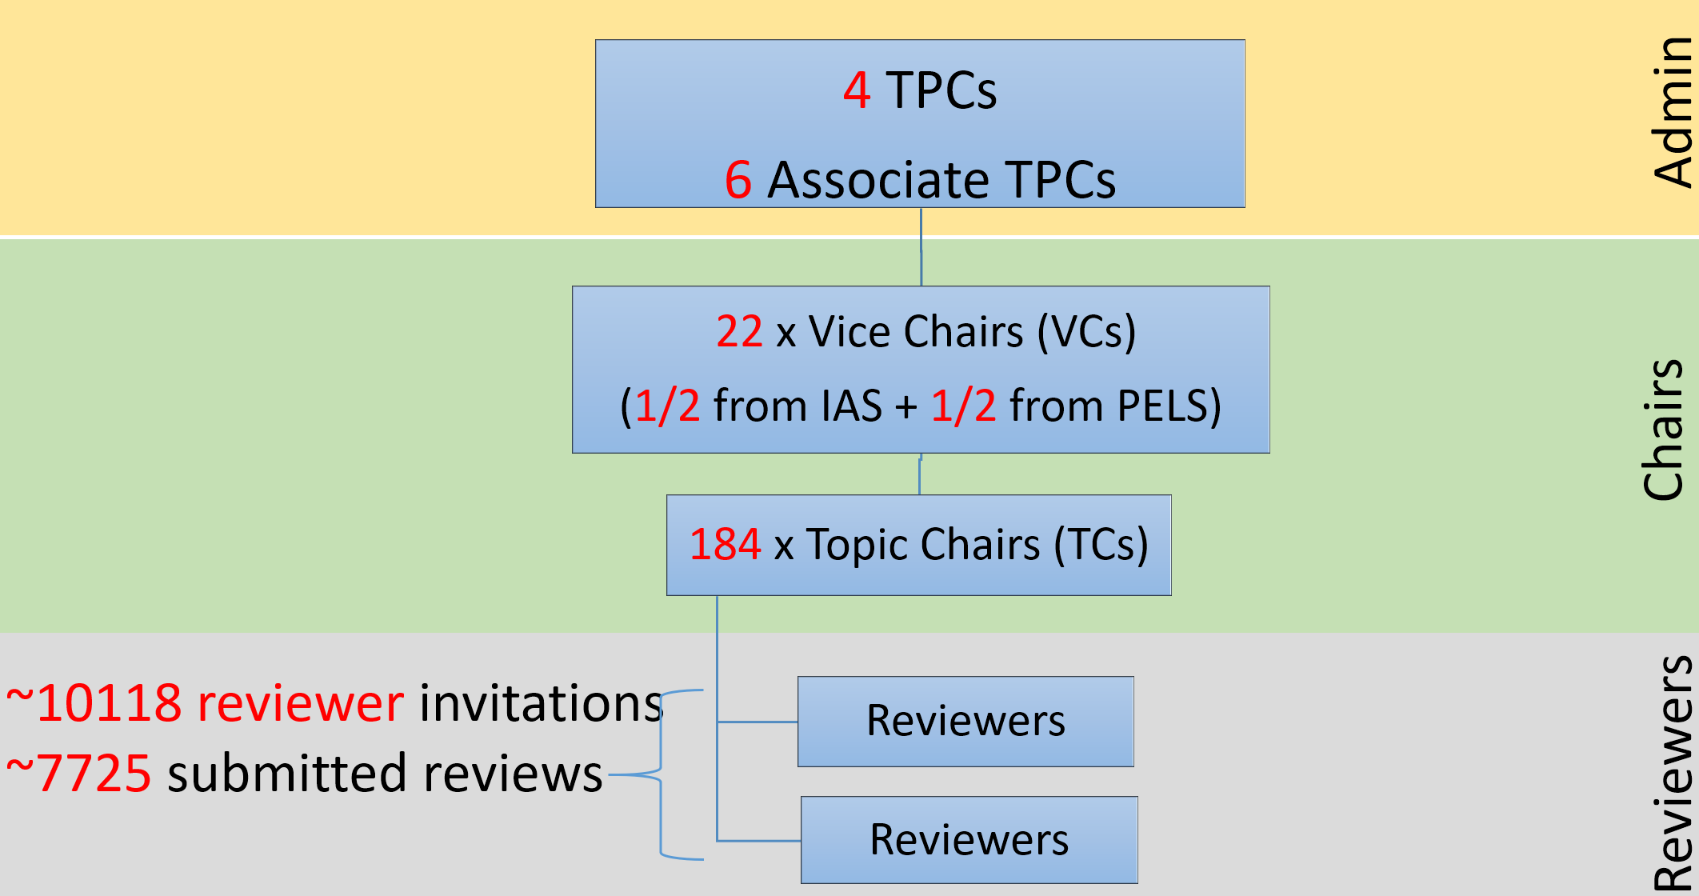
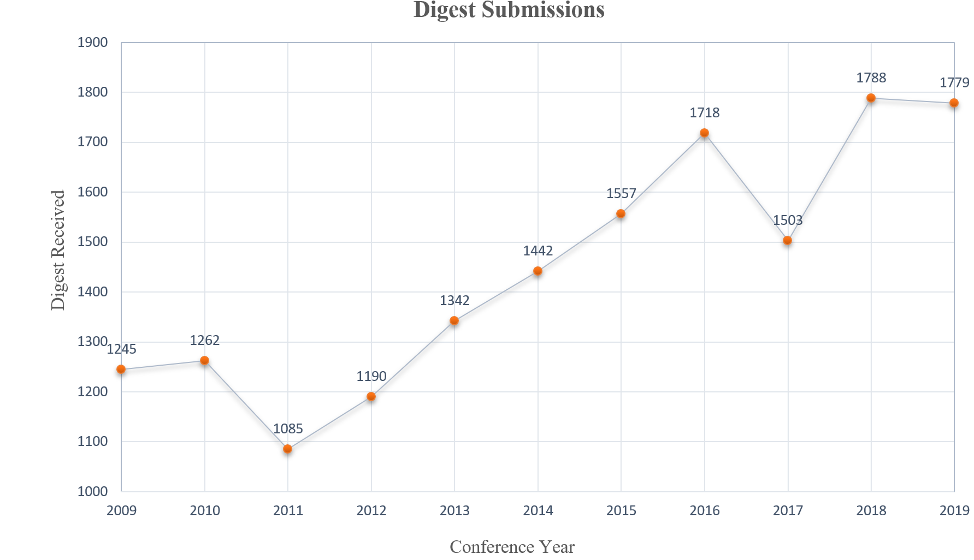
ECCE 2019
1779 Submissions
The program includes
1069 technical papers
presented in 15 parallel
oral sessions and 28
poster sessions.
Additionally, the
program also includes
18 presentation-only
special sessions that
are scheduled
throughout the week.

Slide 9
ECCE 2019
Power Converter Topologies (TRACK E) Vice Chair: Grant Pitel, Magna Power, United States Vice Chair: Luca Solero, University ROMA TRE, Italy Vice Chair: Gerry Moschopoulos, Western University, Canada Dong Cao, North Dakota State University, United States Jorge Garcia, University of Oviedo, Spain Li Zhang, Huazhong University of Science & Technology, China Sombuddha Chakraborty, Texas Instruments, United States Jen-Hung (Peter) Huang, National Taiwan Univ. of Sci. and Tech., Taiwan Diego G. Lamar, University of Oviedo, Spain Hidemine Obara, Yokohama National University, Japan Dongyuan Qiu, South China University of Technology, China Yan Xing, NUAA, China Jianwu Zeng, Minnesota State University, United States Wenkang Huang, Infineon Technologies, United States Brian Cheng, Texas Instruments, United States | Pritam Das, Binghamton University, United States Mohamed Youssef, University of Ontario Institute of Technology, Canada Zhiliang Zhang, Nanjing University of Aeronautics & Astronautics, China Daniel Costinett, The University of Tennessee, United States Srdjan Lukic, North Carolina State University, United States Daniel Costinett, The University of Tennessee, United States Zhiliang Zhang, Nanjing University of Aeronautics & Astronautics, China Alireza Safaee, Apple Inc., United States Leila Parsa, University of California Santa Cruz, United States Mahshid Amirabadi, North Eastern University, United States Lixiang Wei, Rockwell Automation, United States Petar Grbovic, University of Innsbruck, Austria Wuhua Li, Zhejiang University, China Roberto Petrella, University of Udine, Italy Yongsug Suh, Chonbuk National University, Korea (South) Jon Are Suul, Norwegian Univ. of Sci.& Tech., Norway Xiaofeng Yang, Beijing Jiaotong University, China Stefano Bifaretti, University of Rome Tor Vergata - C-PED, Italy
Submitted | Accepted | Percentage
295 | 172 | 58%

Slide 10
ECCE 2019
Control, Modeling and Optimization of Power Converters (TRACK F) Vice Chair: Khurram Afridi, Cornell University, United States Vice Chair: Xiaonan Lu, Temple University, United States Vice Chair: Henry Chung, City University of Hong Kong, Hong Kong Carl Ho, University of Manitoba, Canada Santanu Kapat, IIT Kharagpur, India Kyo-Beum Lee, Ajou University, Korea Hong Li, Beijing Jiaotong University, China Alessandro Lidozzi, ROMA TRE University, Italy Tomoyuki Mannen, Tokyo University of Science, Japan Vito Giuseppe Monopoli, Politecnico di Bari, Italy Rostan Rodrigues, ABB Inc, United States Teuvo Suntio, Tampere University, Finland Sheng Zheng, Oak Ridge National Laboratory, United States Hanchao Liu, GE Global Research, United States | Marcello Pucci, INM-CNR, Italy Hong Li, Beijing Jiaotong University, China Shuo Wang, University of Florida, United States Andrea Formentini, University of Nottingham, United Kingdom Dongsheng Yang, Aalborg University, Denmark Malik Elbuluk, University of Akron, United States Madhav Manjrekar, University of North Carolina - Charlotte, United States Dehong (Mark) Xu, Zhejiang University, China Alberto Castellazzi, University of Nottingham, United Kingdom Bilal Akin, University of Texas at Dallas, United States Faisal Khan, University of Missouri Kansas City, United States Dragan Maksimovic, University of Colorado Boulder, United States David Perreault, MIT, United States Juan Rivas Davila, Stanford University, United States Elisabetta Tedeschi, Norwegian Univ. of Sci. Tech. (NTNU), Norway Ali Khajehoddin, University of Alberta, United States
Submitted | Accepted | Percentage
294 | 182 | 61.9%

Slide 11
IEEE Transactions on Industry Applications
Industrial Power Converter Committee
Pericle Zanchetta
IEEE IAS IPCC Paper Review Chair
October 1, 2019
Baltimore, Maryland, USA

Slide 12
IPCC Associate Editors
Mahshid Amirabadi, USA
Vivek Agarwal, India
Stefano Bifaretti, Italy
Huang-Jen Chiu, Taiwan
Dong Jiang, China
Surin Khomfoi, Thailand
Xiaonan Lu, USA
Ke Ma, Denmark
Santanu Mishra, India
Marcello Pucci, Italy
Luca Solero, Italy
Xue She, USA
Yongsug Suh, Korea
Xiongfei Wang, Denmark
Zhiqiang Wang, USA
Junming Zhang, China
Maurizio Cirrincione, Fiji
Andrea Formentini, UK
Vito Giuseppe Monopoli, Italy
Babak Parkhideh, USA
Jiangbiao He, USA
Liang Du, USA
Xibo Yuan, UK
Dong Dong, USA
Zheyu Zhang, USA

Slide 13
Submitting a manuscript to IPCC
Paper first must be presented at an IAS-sponsored conference (within the last 12 months)
Send an email to pericle.zanchetta@nottingham.ac.uk with the request to submit a paper:
  Paper title
  List of authors and corresponding author’s email & institution
  Conference and date when paper presented
An email will be sent to you from S1M with instructions on uploading your paper for review (usually within 1 - 2 weeks)

Slide 14
Submitting a manuscript to IPCC
You must reference (cite) the conference paper version in your Trans. submission reference list.
Change title and Update/add new material to conference version. Papers needs to be different from the conference ones. There is no fixed amount of difference, it is at the discretion of the transaction chair. Be reasonable.
Please cite TIA papers!

Slide 15
All time submission by committee

Slide 16
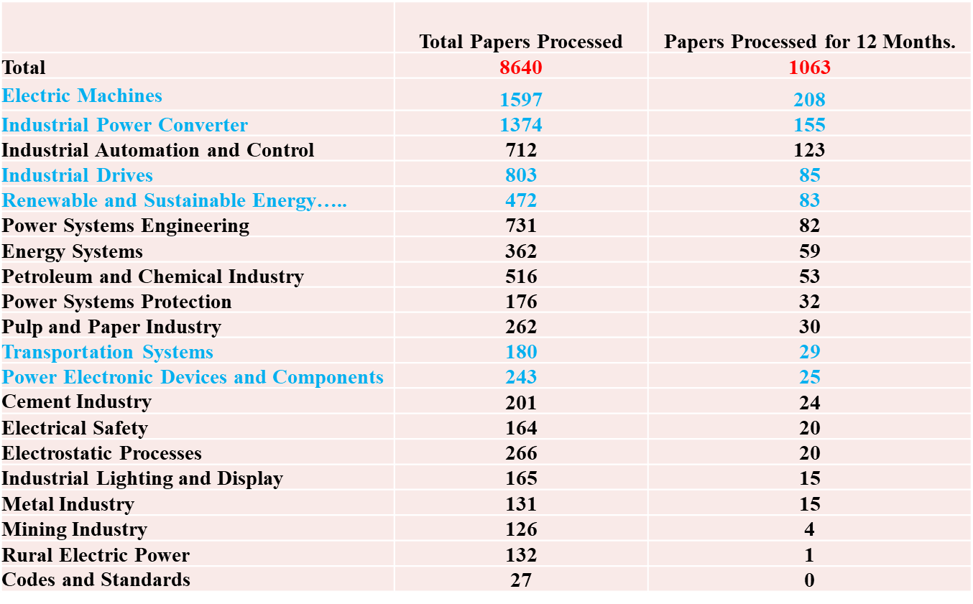

Regular papers submission
In Blue IPCSD committees

Slide 17
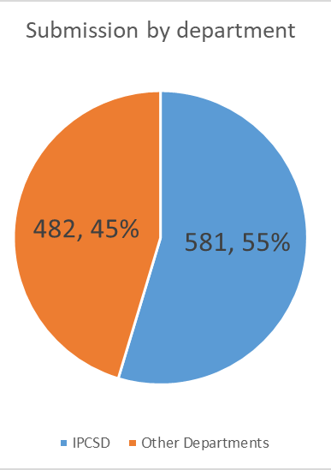
Regular papers submission
All submissions for this year are ‘post-presentation. Special issues paper are excluded. 2018 data included special issues. For IPCC in 2018 111 special issue papers

Slide 18
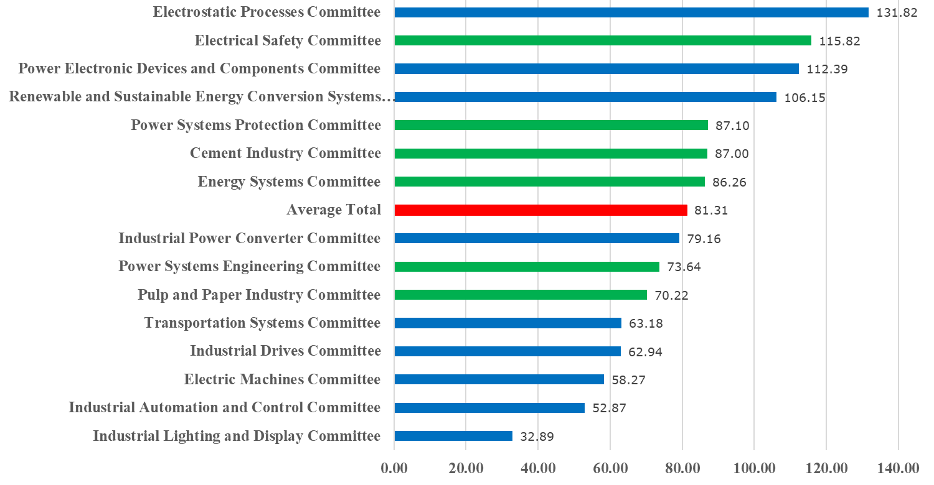
Average 1st Decision time last 12 months
Decision for 1st submission is 79 days for IPCC (was 65 in 2018)

Slide 19
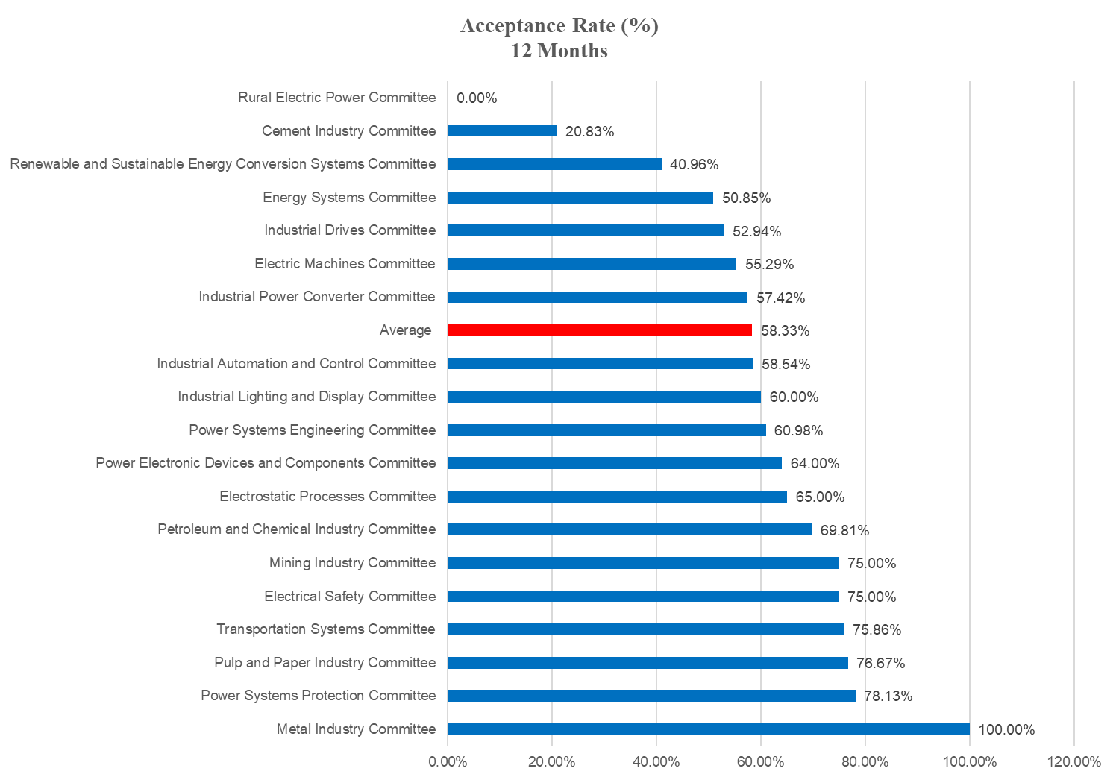
Acceptance rates (past 12 months)
Acceptance rate 58.3% in the past year just below average (was 53% in 2018)

Slide 20
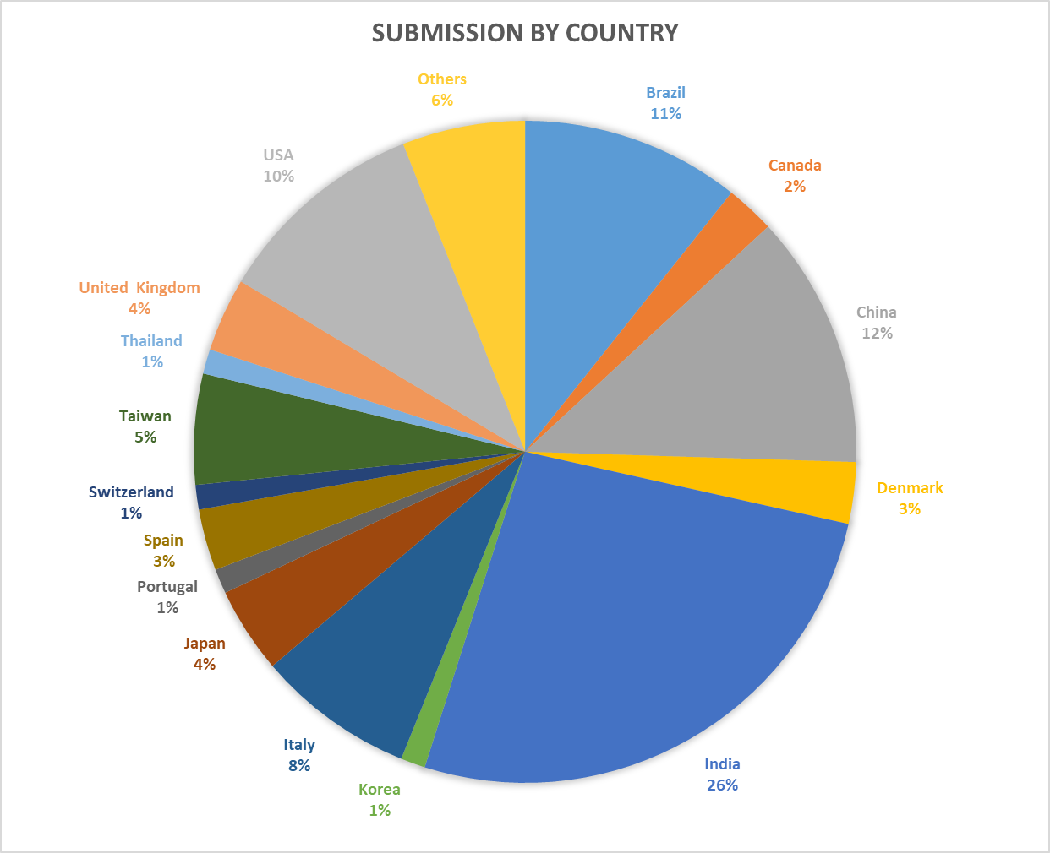
Percentage of submissions by country
Others (below 1%):
Algeria
Belgium
Chile
Croatia
Germany
Finland
Kazakhstan
Mexico
Russian Federation
Singapore

Slide 21

New Open Access Journal
Web Only Journal
No Conference Requirement
EiC: Pericle Zanchetta

Slide 22
How does it work?
Scope covers the entire scope of IAS
Papers are open access – everyone can read them without firewall
Anyone can submit, without conference requirements
  Like most other journals
Very fast response time
  Papers will be accepted, accepted with minor changes, or rejected
  Goal is to have papers on Xplore 7-8 weeks from submission date

Slide 23
Why are we launching this?
Response to EU “Plan S” and other funding agency open access mandates
Potential to bring IAS to a wider global audience of readers and authors

Slide 24
Open Access Fees
If paper is accepted, authors must pay an Article Processing Charge (APC)
Standard IEEE APC is $1750 USD
IEEE Members get a 5% discount
IAS Members get a 15% discount: $1487.50 per paper fee
There are no page charges for overlength papers

Slide 25
Governance
Editorial Board so Far
Steering Committee
Prof. Pericle Zanchetta, University of Nottingham, UK (Editor in Chief)
Prof. Luca Solero, Università Roma Tre, Italy (Deputy Editor in Chief)
Dr. Emmanuel Agamloh, Baylor University, USA
Prof. Fernando Briz, Universidad de Oviedo, Spain
Prof. Chiara Boccaletti, Sapienza Università di Roma, Italy
Dr. Shafiq Odahno, University of Nottingham, UK
Dr. Giovanna Oriti, Naval Postgraduate School, USA
Prof. Jean Luc Schanen, Grenoble Institute of Technology, France
Prof. Andy Knight,
  (Publications Dept Chair, IEEE IAS)
Prof. Pericle Zanchetta
  (Editor in Chief)
Prof. Luca Solero
  (Deputy Editor in Chief)
Prof. Fernando Briz
Prof Jean Luc Schanen

Slide 26
Next Steps
Need an Editor from IACC, MSDAD, I&CPSD
  Based on Transactions submission types
  Not sure of PID interest in open access
Manuscript Central is Open
  mc.manuscriptcentral.com/oj-ia

Slide 27
Summary data for 2018 – IEEE IAS IPCC
155 Regular papers Submissions in Last 12 months completed - Increase of 16.5% from 2018 (133 considering 111 special issue papers).
Average review time for initial submission ~79 days (65 in 2017).
Accepted 57.42% (53% in 2018 and 49% in 2017)
Manuscripts currently under review: 49
Special issue on Grid-Connected Power Electronics Systems: Stability, Power Quality, and Protection. Submitted 104, accepted 50 (Sep/Oct 2018)
Special issue on High performance power electronic converters: Topologies, Control, and Devices. Submitted 78, accepted 44 (Nov/Dec 2019)

Slide 28
Reports from subcommittees
Fellow and awards nomination
IPCC Fellow and Awards Committee Chair
Po-tai Cheng
Andrew W. Smith Outstanding Young Member Achievement Award (Deadline: March 15)
Outstanding Young Member Service Award (Deadline: March 15)
Distinguished Service Award (Deadline: March 15)
Outstanding Achievement Award ( Deadline: March 15)
Kliman Award (Deadline: June 1)
IAS Distinguished Lecturers (Deadline: March 31)
IEEE Fellow (Deadline: March 1)

Slide 29
Reports from subcommittees
Fellow and awards nomination
IEEE IAS Andrew W. Smith Outstanding Young Member Award (Deadline: March 15)
Established in 1996, renamed in 2009 and 2015.
Recognizes outstanding achievement and contribution to the profession through involvement in IEEE IAS activities by an IAS member less than 35 years of age.
Prize: $2,500, Plaque and travel expenses to attend an IAS sponsored conference for presentation and recognition.
Eligibility: Nominees must be age 35 or less at the specified award nomination due date. To be considered as a nominee, a one page form must be completed describing IAS activities and associated contributions made by the nominee. The form must be submitted and received by the IAS President before the specified due date of March 15. Self nomination is not permitted for this award.
Basis for Judging: Outstanding contribution to the profession in the form of IEEE/IAS activities such as (but not limited to) authorship of technical papers, IAS chapter leadership, IAS committee work, conference leadership, and standards working groups.

Slide 30
Reports from subcommittees
Fellow and awards nomination
IAS Outstanding Young Member Service Award
(Deadline: March 15)
Recognizes outstanding service and contribution to the profession through involvement in IEEE IAS activities by an IAS member less than 35 years of age.
Prize: $2,500, Plaque and travel expenses to attend an IAS sponsored conference for presentation and recognition. Funded by the IEEE Industry Applications Society.
Eligibility: Nominees must be less than age 35 at the specified award nomination due date. To be considered as a nominee, a one page form must be completed describing IAS activities and associated contributions made by the nominee. The form must be submitted and received by the IAS President before the specified due date of March 15. Self nomination is not permitted for this award.
Basis for Judging: Outstanding contribution to the profession in the form of IEEE/IAS activities such as (but not limited to) authorship of technical papers, IAS chapter leadership, IAS committee work, conference leadership, and standards working groups.

Slide 31
Reports from subcommittees
Fellow and awards nomination
IAS Outstanding Achievement Award (Deadline: March 15)
Honors an individual who has made an outstanding contribution in the application of electricity to industry in accordance with the scope of the IEEE Industry Applications Society.
Prize: $5,000 and engraved statuette, Funded by the IEEE Industry Applications Society.
Basis for Judging. Any of the following criteria apply: invention in the field as exemplified by issued patents; contribution to the general engineering or scientific basis of the technologies found within the scope of the IAS; executive or managerial contribution in the organization or operation of enterprises as associated with the scope of the IAS. Self nomination is not permitted for this award.

Slide 32
Reports from subcommittees
Fellow and awards nomination
IAS Distinguished Service Award
(Submission Deadline is March 15)
Recognizes an individual for dedication and service to the IEEE Industry Applications Society.
Prize: $5,000 and Plaque, Funded by the IEEE Industry Applications Society.
Basis for Judging. Exceptional administrative, managerial and leadership achievement; proposal and/or implementation of innovative new Society programs; dedication to the growth and advancement of the Society and/or its geographic and technical entities. Self nomination is not permitted for this award.

Slide 33
Reports from subcommittees
Fellow and awards nomination
IAS Distinguished Lecturer (Deadline: March 31)
Nominator and Candidate contact informations
One page BIO of the Candidate with a colour photo in the upper left corner and contact email address
List of the lecture topics with the titles and short abstracts ( max. 600 characters each)

Slide 34
Reports from subcommittees
Fellow and awards nomination
IEEE Fellow (Deadline: March 1)
Any person, including non-IEEE members, is eligible to serve as a nominator. The following are exceptions: Members of the IEEE Board of Directors, members of the IEEE Fellow Committee, IEEE Society/Technical Council Fellow Evaluating Committee Chairs, members of IEEE Society/Technical Council Fellow Evaluating Committee reviewing the nomination, or IEEE Staff.
The nominator is responsible for preparing the IEEE Fellow Grade Nomination Form.
The nominator is responsible for soliciting at least three, but no more than five, references capable of assessing the nominee’s contributions. References must be IEEE Fellows.
There is the option of soliciting no more than three endorsements capable of supporting the nomination. Any person, including non-IEEE members, may submit an endorsement. The following individuals are ineligible to serve as endorsements: members of the IEEE Board of Directors, members of the Fellow Committee, members of the IEEE Society/Technical Council Fellow Evaluating Committee reviewing the nomination or IEEE Staff. In addition, a nominator may not serve as an endorser for a nomination he/she is submitting.

Slide 35
Reports from subcommittees
Fellow and awards nomination
Congratulations to Kouki Matsuse, an IPCC Member, for being awarded the IEEE Richard Harold Kaufmann Award - recognizes outstanding contributions in industrial systems engineering. Citation: “For pioneering contributions to the advancement of sensorless vector control of AC drives and multilevel inverters for industrial applications.”
Congratulations to Jiangbiao He, an IPCC Member, for being awarded the IAS AWS Outstanding Young Member Achiev. Award.

Slide 36
Reports from subcommittees
Fellow and awards nomination
Congratulations to Iustin Radu Bojoi, an IPCC Member, who was elevated to the IEEE Fellow grade, Class of 2019. Congratulations to his Nominator, too.
Congratulations to Jinjun Liu, an IPCC Member, who was elevated to the IEEE Fellow grade, Class of 2019. Congratulations to his Nominator, too.
Congratulations to Pericle Zanchetta, an IPCC Member, who was elevated to the IEEE Fellow grade, Class of 2019. Congratulations to his Nominator, too.
Congratulations to Richard Zhang, an IPCC Member, who was elevated to the IEEE Fellow grade, Class of 2019. Congratulations to his Nominator, too.

Slide 37
Standards Chair
Yuri Khersonsky
Reports from subcommittees
Standards Chair
Work Group N^{o.} P1662
Work Group Name Power Electronics Working Group
Work Group N^{o.} P1709
Work Group Name DC Power Systems on Ships
Chair Yuri Khersonsky
Vice Chair Norbert Doerry, Terry Ericsen
Secretary Joseph Piff
Progress toward deliverables IEEE 1709-2018 Recommended Practice for 1 kV to 35 kV Medium-Voltage DC Power Systems on Ships approved 27 September 2018 & published
PAR for revision of IEEE 1826-2012 Standard for Power Electronics Open System Interfaces in Zonal Electrical Distribution Systems Rated Above 100 kW has been approved June 19 2019
Of Note PAR expiration 31 December 2023

Slide 38
Reports from subcommittees
Special Activities
Special Activities Chair
Yongsug Suh
Main purpose
  To enhance the collaboration between IPCC and regional power electronics societies in the world
Strategies
  To boost the participation of IPCC members in ECCE Asia and ECCE Europe conferences
Actions
  Supported to implement technical co-sponsorship of IAS to ECCE Europe
  Had IAS IPCSD & KIPE (Korea) collaboration meeting during ICPE 2019 – ECCE Asia (Busan, Korea / May 27-30, 2019)
  Nominated IPCC members for technical programs of ICPE 2019 – ECCE Asia (Korea) -> Organized session chairs, Tutorials, Topic chairs

Slide 39
Reports from subcommittees
Special Activities
Actions (…continued)
  Continue to promote the participation of IPCC members in ECCE Asia and ECCE Europe conferences
    IPEMC 2020 – ECCE Asia in Nanjing city, China
    ECCE Asia 2021 in Singapore
    IPEC 2022 – ECCE Asia in Japan
    EPE ECCE Europe 2020 in Lyon
    EPE ECCE Europe 2021 in Ghent
    EPE ECCE Europe 2022 in Hannover

Slide 40
Old Business

Slide 41
APEC Involvement
1. AC-DC Converters: a. Single-Phase and Three-Phase Input b. Power Factor Correction,
CCM, DCM, CRM/BCM Control, Bridgeless c. Embedded AC-DC Power Supplies d. External AC-DC Adapters
(1) Petar Grbovic, Center of Power Electronics and Drives, petar.grbovic@gmail.com
(2) Arijit Banerjee, University of Illinois at Urbana-Champaign, arijit@illinois.edu
2. DC-DC Converters: a. Hard- and Soft-Switched b. Resonant Converters c. Point-of-Load
(PoL) and Multi-Phase Converters d. Voltage Regulator Modules (VRM)
(1) Chengcheng Yao, Tesla, chyao@tesla.com
(2) Jianwu Zeng, Minnesota State University, jianwu.zeng@mnsu.edu
8. Control: a. Control of Power Electronic Converters b. Current-Mode and Voltage-Mode Control c. Digital Control d. Sensor and Sensor-less Control e. Gate Drive Circuits f. Control ICs g. MCUs,DSPs, FPGAs, ASICs
(1) Xiaonan Lu, Temple University, xiaonan.lu@temple.edu
(2*) Roberto Petrella, University of Udine, roberto.petrella@uniud.it
12. Power Electronics Applications: a. Lamp Ballasts and LED Lighting b. Network and
Telecommunication Power Electronics c. Defense and Military Power Electronics d. AC-DC-AC Applications and Matrix Converters e. Portable Power f. Energy Harvesting
(1) Rostan Rodriguez, ABB, rostan.rodrigues@us.abb.com
(2) Dong Cao, North Dakota State University, dong.cao@ndsu.edu

Slide 42
Hard Limit on Paper Acceptance
  2018 motion approved to reduce acceptance to 50%
  IAS and PELS have been equally splitting tracks E and F as part of our partnership.
  IPPC has influence over track chair nominations and final decision on marginal papers.
  IPCC informed their tracks chairs of the 50% target acceptance rate.
  Technical Program Chair has never imposed a hard limit for all tracks (to my knowledge).

Slide 43
Hard Limit on Paper Acceptance
  Propose motion be amended to be 55 ± 5% and apply for only Tracks E and F, where this committee has direct influence.
ECCE 2018
Track | Submitted | Accepted | Percentage
E | 292 | 170 | 58.2%
F | 311 | 203 | 65.3%
ECCE 2019
Track | Submitted | Accepted | Percentage
E | 295 | 172 | 58%
F | 294 | 182 | 61.9%

Slide 44
New Business

Slide 45
Call for Volunteers
Call of Nominations
Industry Power Converter Committee NEEDS industry representation!!!!
  Desire to contribute back to community
  Attend ECCE regularly
Accepting nominations and recommendations for 2020. Submit by December 1st to gpitel@magna-power.com, decisions made before my term ends.
  2nd Asian and European Liaison Officers
  Standards
Special Activities responsible for promoting special events aimed at promoting and disseminating knowledge in the field of interest of IPCC and favor Industry-Academia links (panel groups, tutorials, special session at IAS sponsored conferences, etc.). The special activities subcommittee chair will be supported by two European Liaison officers and two Asian Liaison officers.
Standards Subcommittee The scope of the Standards Subcommittee shall be to do liaison work with standard making and code-making bodies in the electrical field as related to the industrial power converter industry, and to participate in the work of the Industrial Power Converters Committee pertaining to Codes and Standards.

Slide 46
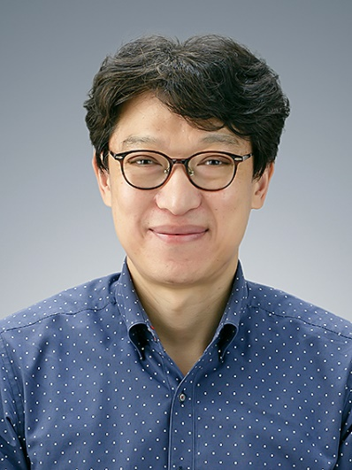
New Secretary Voting
  Professor at Chonbuk National University, Korea (2008-Present)
  Senior Engineer at ABB (2004-2008)
  Ph.D. Univ of Madison Wisc. (2004)
  IPCC Special Activities Chair (2017-2019)
  Associate Editor IEEE Transactions on Industrial Applications (2014-Present)
  Activate member in many IAS activities and committees.

Slide 47
Open the Floor for Discussion?

Slide 48
Annoucements

Slide 49
Prize Paper Awards for ECCE 2018
Industrial Power Converter Committee
Stefano Bifaretti
IEEE IAS IPCC Paper Review Co-Chair
October 1, 2019
Baltimore, Maryland, USA

Slide 50
IPCC ECCE Paper Award Committee
Stefano Bifaretti, Transaction co-Chair, University of Rome Tor Vergata, Italy
Babak Parkhideh, University of North Carolina , USA
Dong Jiang, Huazhong University of Science and Technology, China
Jiangbiao He, GE Global Research, USA
Marcello Pucci, Institute of Marine Engineering, Italy
Maurizio Cirrincione, University of the South Pacific, Fiji
Liang Du, Temple University, USA
Xiaonan Lu, Argonne National Laboratory, USA
Xu She, United Technologies Corporation, USA
Yongsug Suh, Chonbuk National University, Korea

Slide 51
IPCC ECCE 2018 Paper Award
The papers presented at ECCE 2018 in Portland, submitted to IAS Transactions before December 31st, 2018 and successively accepted were taken into consideration for the IPCC prize paper ballot.
Only 9 papers have satisfied this rule and have been included in the ballot
Papers have been evaluated by the award committee and the final ranking, (only for the first 3 positions) obtained by averaging their scores is:

Slide 52
IPCC
ECCE Prize Paper Award
Third IPCC Prize Paper Award
Yu Shan Cheng, Tomoyuki Mannen, Keiji Wada, Koutaro Miyazaki, Makoto Takamiya, Takayasu Sakurai
Optimization Platform to Find a Switching Pattern of Digital Active Gate Drive for Full-Bridge Inverter Circuit

Slide 53
IPCC
ECCE Prize Paper Award
Second IPCC Prize Paper Award
Riccardo Leuzzi, Vito Giuseppe Monopoli, Luca Rovere, Francesco Cupertino, Pericle Zanchetta
Effects of Electrical Ageing on Winding Insulation in
High-Speed Motors: Analysis and Modelling

Slide 54
IPCC
ECCE Prize Paper Award
First IPCC Prize Paper Award
Diego Perez-Estevez, Jesus Doval-Gandoy
AC Voltage Sensorless Method With Bumpless Start for Current-Controlled Converters Connected to Microgrids

Slide 55
IPCC ECCE prize paper awards 2019
Selection Procedure
Remember to submit your ECCE 2019 Baltimore paper before December 31st 2019 to be included in the award evaluation (announced at ECCE 2020 in Detroit)
Among these, up to 10 (accepted) papers with the highest score from the first IAS Transaction review will go in final ballot
The Transactions Co-Chair will select an award committee and each member will score each paper
The score from the committee members will be averaged to obtain the final list

Slide 56
IAS Sponsored 2020 Conferences

Slide 57
  10% increase in IAS sponsored conferences
    2018 -> 56
    2019 -> 66
  Reminder – publishing at these conferences makes your work eligible for Journal submission.
  Lots of conferences, promoting ones of interest to IPCC

Slide 58



Sponsored
Conferences 2020 (USA)
2020 IEEE Power and Energy Conference at Illinois (PECI)
Champaign, IL USA
Abstract Submission Date: Oct 20, 2019
2020 IEEE Kansas Power and Energy Conference (KPEC)
Manhattan, KS USA
Abstract Submission Date: Feb 5, 2020
2020 IEEE Texas Power and Energy Conference (TPEC)
College Station, TX USA
Abstract Submission Date: Nov 7th, 2019

Slide 59

Sponsored
Conferences 2020 (Asia)
2020 International Conference on Electrical Machines and Systems
Abstract Submission March 1st 2020

Slide 60



Sponsored
Conferences 2020 (Europe)
2020 International Symposium INFOETH
Jahorina, Russia
Abstract Submission Date: December 15th, 2019
2020 International Workshop on Electric
Drives (IWED)
Moscow Ru, Russia
Abstract Submission Date: December 15th, 2019
2020 International Conference on Power Electronics, Machines, and Drives (PEMD)
Nottingham, UK

Slide 61


Sponsored
Conferences 2020 (Europe)
2020 Industrial Engineering, Applications, and Manufacturing (ICIEAM)
Sochi, Russia
Abstract Submission Date: December 31th, 2019
2020 International Conference on Smart Energy and Technologies (SEST)
Istanbul, Turkey
Abstract Submission Date: December 15th, 2019

Slide 62

Flagship Conference
APEC 2020 (Asia)
2020 IEEE 9th International Power Electronics
and Motion Control Conference
(IPEMC2020 - ECCE Asia)
May 31 - Jun. 3, 2020
Nanjing, China
  Deadline for digest submission: Oct. 31, 2019
  Deadline for tutorial proposals: Jan. 31, 2020
  Deadline for industry session: Jan. 15, 2020
  Notification of acceptance: Jan. 12, 2020
  Final paper submission: Mar. 15, 2020

Slide 63

Flagship Conference
APEC 2020 (USA)
IEEE’s 35th annual APEC will highlight the latest in power electronics technology
APEC 2020, to be held in New Orleans, LA, from March 15-19, 2020, continues the long-standing tradition of addressing issues of immediate and long-term interest to the practicing power electronics engineer.
https://www.apec-conf.org/

Slide 64
IEEE Energy Conversion
Congress and Exposition - ECCE 2020
Oct 11 (Sunday)-Oct 15 (Thursday), 2020
TCF (Cobo) Convention Center
Detroit, USA
Flagship Conference
ECCE 2020 (USA)
General Chair
Yunwei (Ryan) Li

Slide 65

Detroit with a Revitalized
Downtown Core
This is a different Detroit with culture, history, entertainment, beautiful buildings, grit and determination.
Top-ranked airport and convention center
Some 5,000 hotel rooms downtown
An very industrial city
Best in travel in 2018 top cities

Slide 66
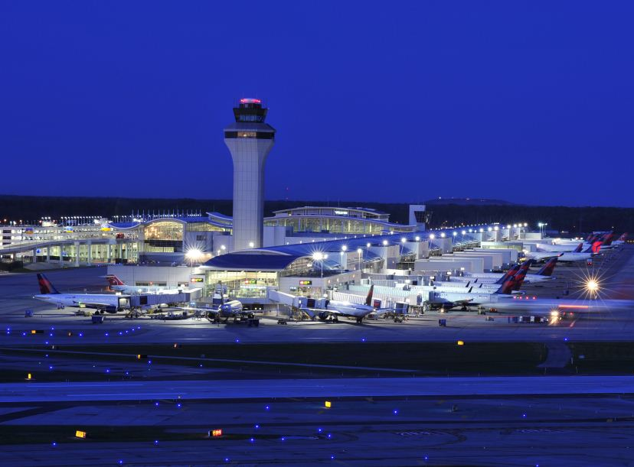
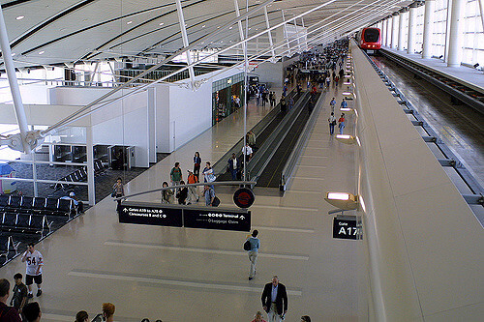

Detroit with a Revitalized
Downtown Core
Detroit Metro Airport (DTW) Non-stop Flights from 111 U.S. Cities and 16 Countries:
Brazil, Canada, China, France, Germany, Italy, Japan, South Korea, Mexico, Netherlands, UK, and more.
Excellent public transit system:
The People Mover has 13 stops in downtown, with a station on the 4th floor of conference Convention Center.

Slide 67
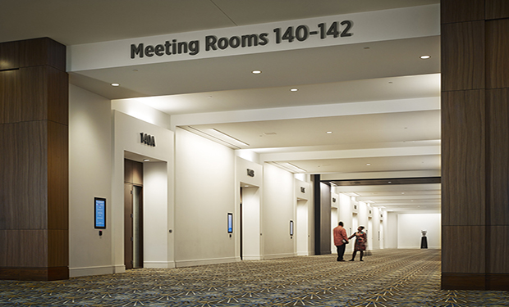
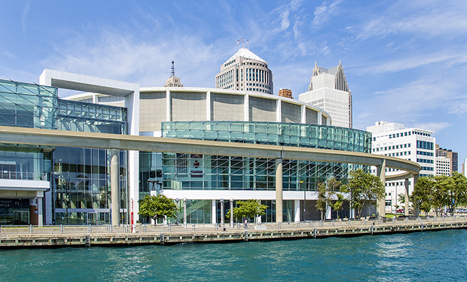
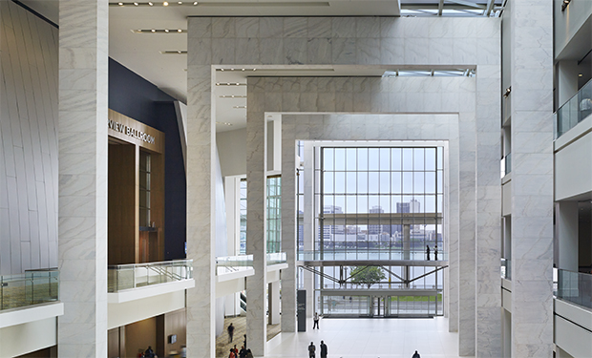
Detroit Convention
Center
Previously known as Cobo center. Recently has a new name TCF Center.
Located right in the heart of downtown Detroit - The TCF Center waterfront is a phenomenal experience.
The 17th largest convention center in the United States. Completely renovated in 2010-2015 with $279 million budget.
ECCE 2020 meeting rooms are at the water front side.

Slide 68
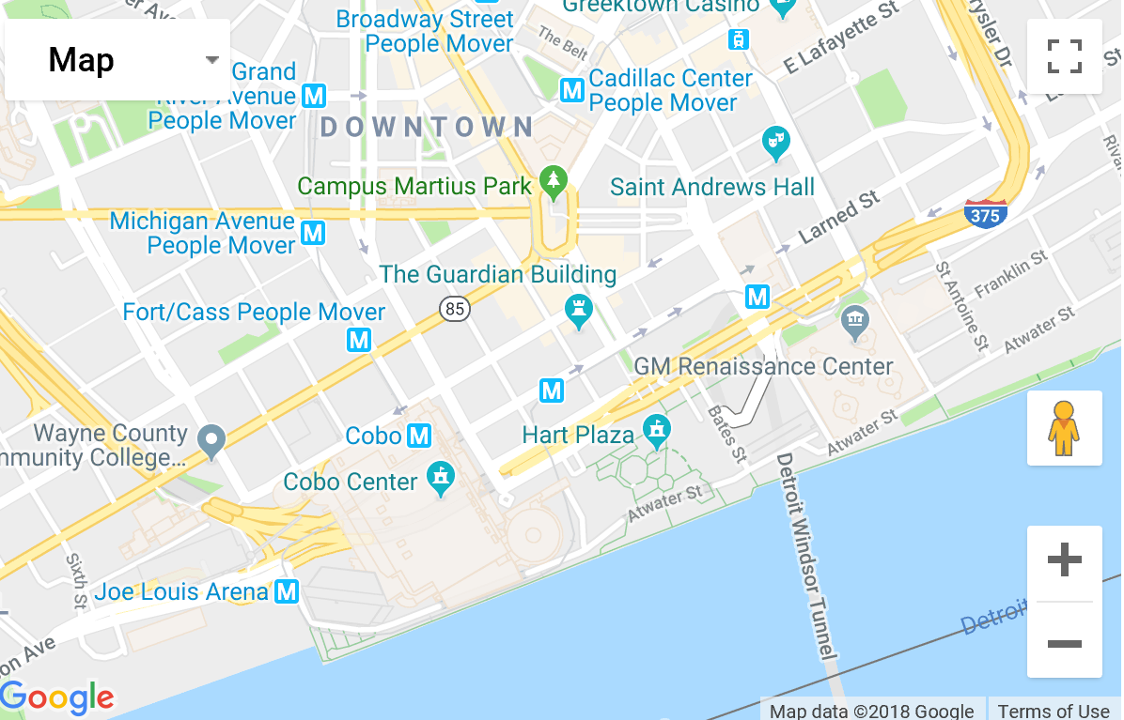
Detroit TCF (Cobo)
Convention Center
22 miles from the airport
3.5 mile Riverwalk with Canadian neighbors to the south
2.4 million square feet of usable space

Slide 69
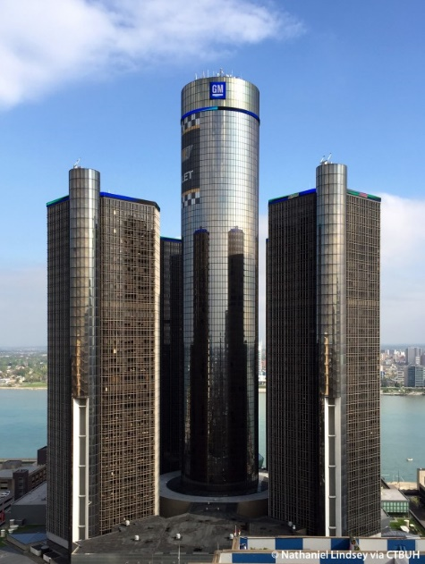




Hotels
Numerous hotels within walking distance:

Slide 70


Winners selected from 20 designs:
Xiaonan Lu & Yangdi Wang
Thanks you and congratulations!
ECCE 2020 Logo Design Competition
Vehicle representing the leading automatic industry in the conference venue Detroit
Robotic Arm showing the world-leading manufacturing facilities in Detroit
Notes of Music highlighting the famous music practice in Detroit and also illuminate the advancement of power electronics industry
– fusion of tech and art

Slide 71
ECCE 2020
Organization
General Chair
Yunwei (Ryan) Li
TPC Chairs
Emmanuel Agamloh
Henry Chung
Navid Zargari
Martin Ordonez
Exhibit & Partnership Chairs
David Morrison
Grant Pitel
Kevin Taylor
Finance Chair
Mark Scott
Industrial Partnership Chair
Peter Wung
Plenary Session Chairs
Liuchen Chang
Tomy Sebastian
Publicity / Social Media Chairs
Kai Sun
Yongheng Yang
Awards Chair
John Shen
Special Session Chairs
Bulent Sarlioglu
Xiongfei Wang
Publication Chairs
Xiaonan Lu
Carl Ho
Xu She
Tutorial Chairs
Xinbo Ruan
Ali Khajehoddin
Local Arrangement Chairs
Al-Thaddeus Avestruz
Abraham Gebregergis
Student Activities Chair
Zheyu Zhang
Webmaster Chairs
Jennifer Vining
Dong Cao
Yuan Li
WIE Chairs
Norma Anglani
Jin Ye
Moya Dai

Slide 72

ECCE 2020
Important Dates
Important Dates:
  January 15, 2020, submissions of digests
  February 17, 2020, tutorials proposals
  March 31, 2020, special session proposals

Slide 73
Planning of ECCE 2020
Tutorial and special session suggestions/proposals for ECCE 2020
Volunteers and subjects:
Submit proposals to the committee chair by November 15th gpitel@magna-power.com

Slide 74
Planning of ECCE 2020
Topic chairs and session chairs needed for ECCE 2020
Business cards collected for candidate topic chairs and session chairs. Names and email addresses will be collated.

Slide 75



Adjournment
Motion to Adjourn.
THANK YOU MEMBERS!
THANK YOU VOLUNTEERS!
FAREWELL!
SEE YOU IN DETROIT!!!!

