Slide 1
UC BERKELEY MEDIUM VOLTAGE GROUNDING SYSTEM
PRESENTATION TO IEEE EDUCATION AND HEALTHCARE FACILITIES COMMITTEE
JERRY JIMENEZ, P.E.
SUPERVISOR, ELECTRICAL ENGINEERING
UTILITY ENGINEERING DEPARTMENT
UNIVERSITY OF CALIFORNIA, BERKELEY
SEPT. 20, 2016

Slide 2
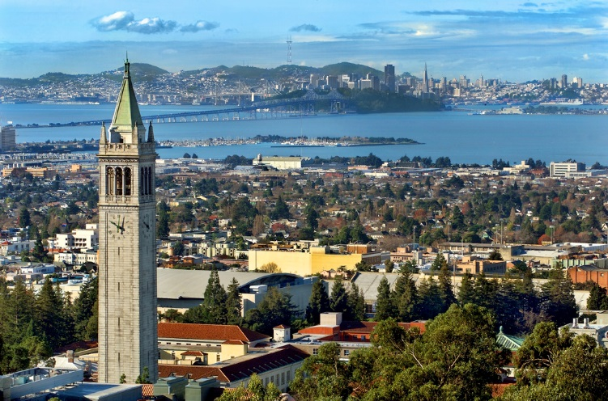
UC Berkeley Campus, with San Francisco in background.

Slide 3
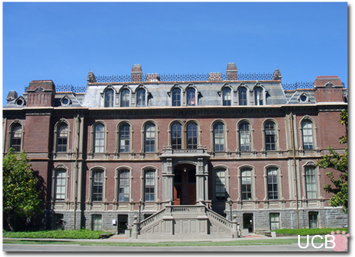
Oldest remaining of the original buildings – South Hall. Built 1886. Several other buildings built in 1870’s and 1880’s were destroyed by fire or earthquakes. First building (other than Mechanical Arts Building) to receive electric power (around 1894).

Slide 4
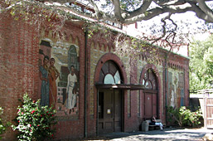
Steam Plant, built in 1904. Provided steam and electricity to campus from 1904-1930. The exterior is noted for its WPA mosaic murals depicting street musicians and artisans.

Slide 5
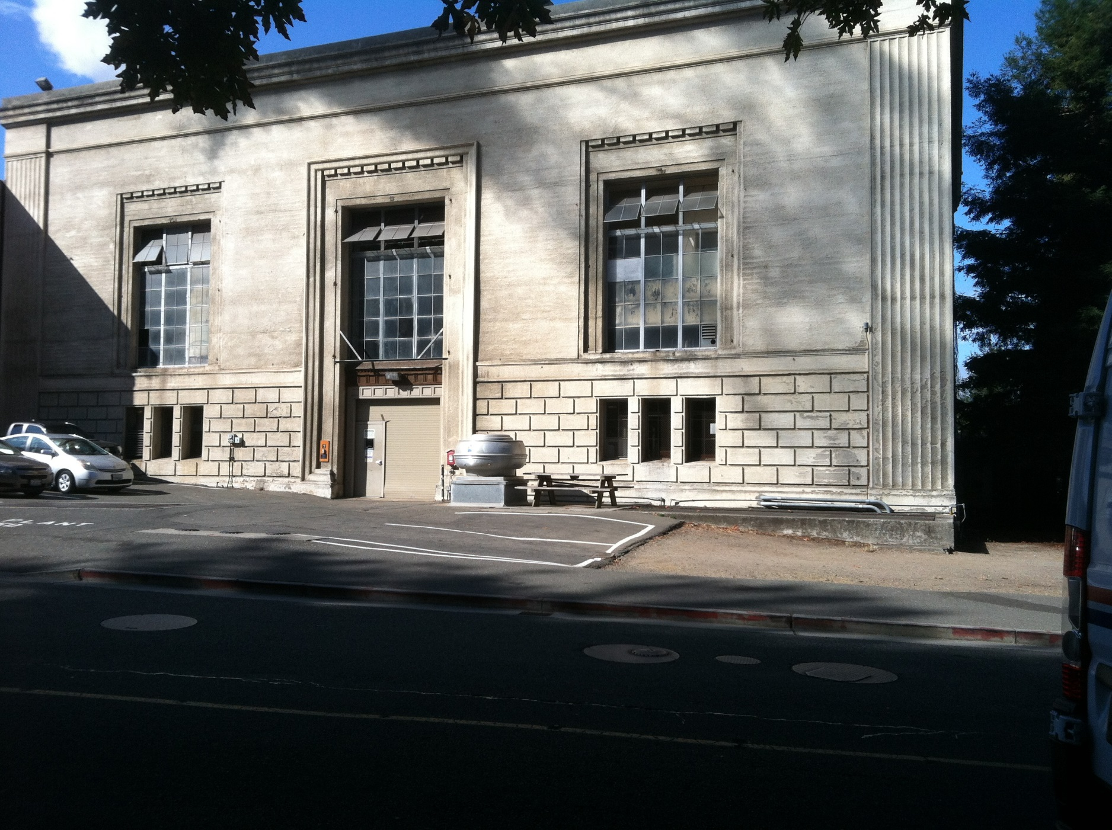
Steam Plant, built in 1930

Slide 6
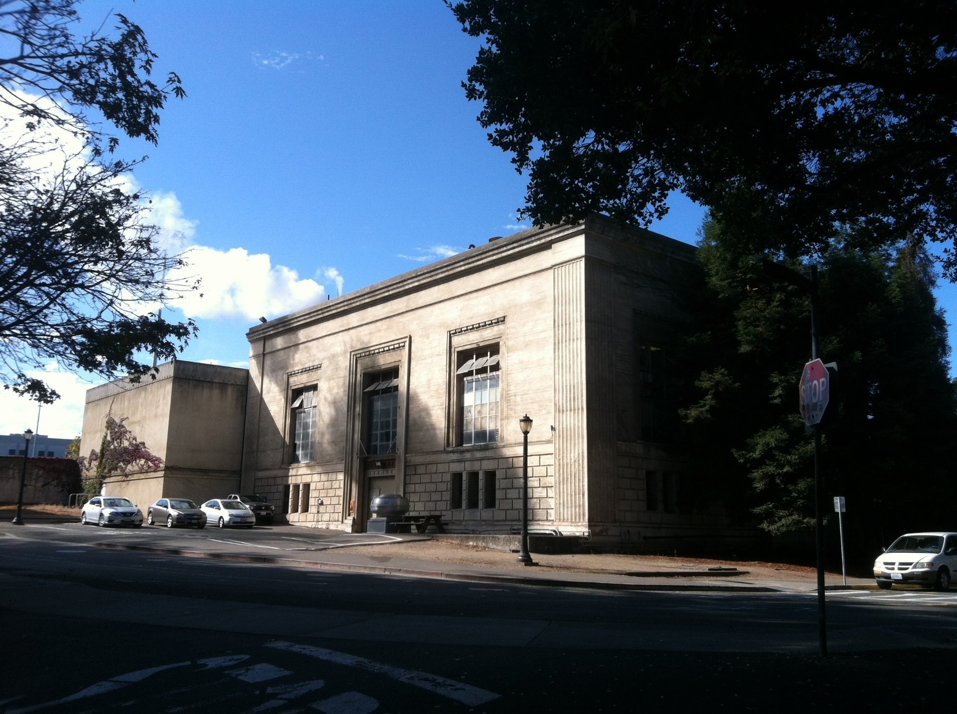
Steam Plant with Addition of Cogen, to the left. Cogen added in 1986.

Slide 7
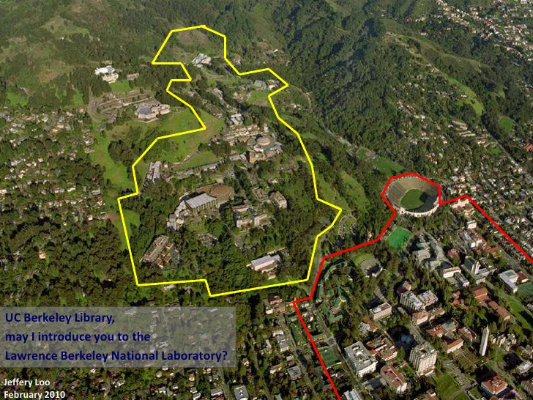
Lawrence Berkeley Lab (LBL) yellow perimeter; UC Berkeley red perimeter.

Slide 8
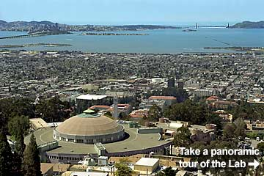
LBL Cyclotron, built in 1931. First Cyclotron ever built. Current application is as the Advanced Light Source. LBL was founded by Ernest Orlando Lawrence in 1931. LBL is the oldest of the National Laboratories. LBL is funded by DOE and managed by the University of California. It is a completely separate entity from UC Berkeley.

Slide 9
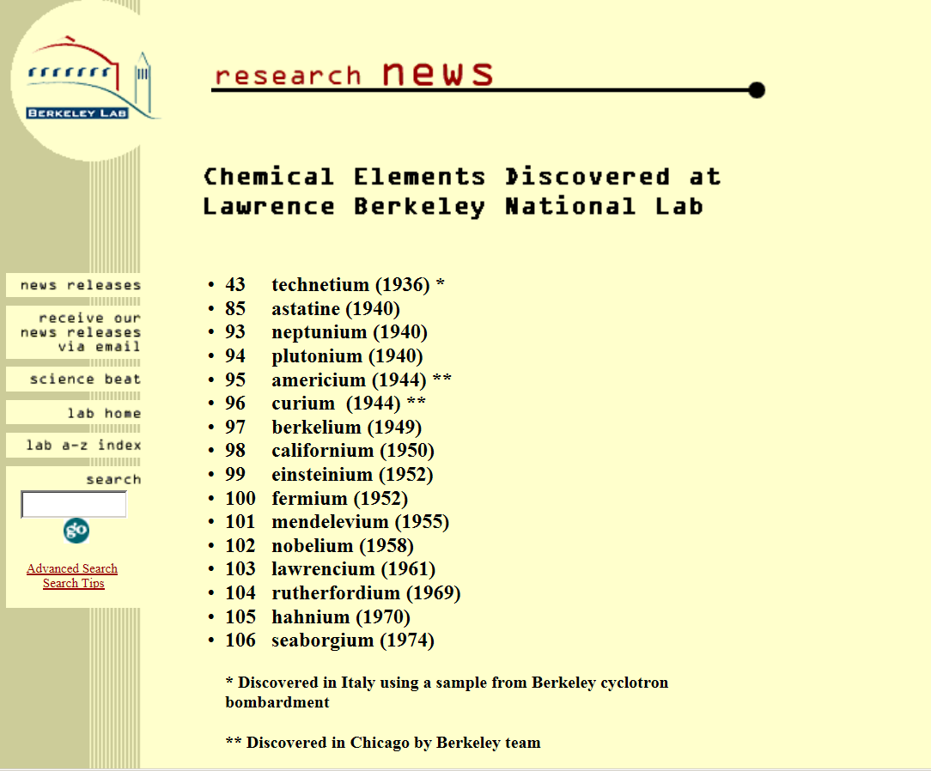
16 Chemical Elements have been discovered at Lawrence Berkeley Lab

Slide 10
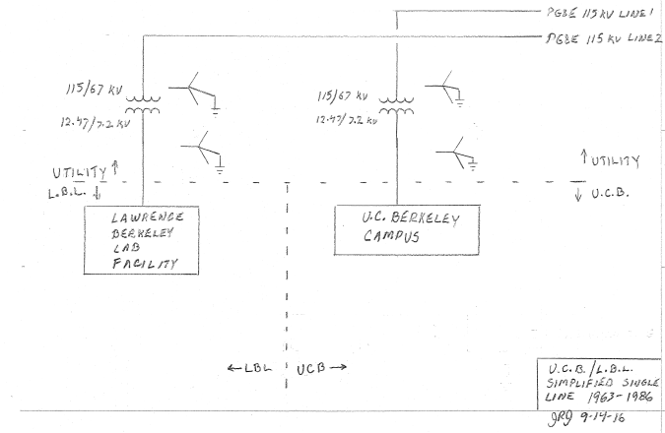
UCB/LBL Single Line 1963-1986

Slide 11
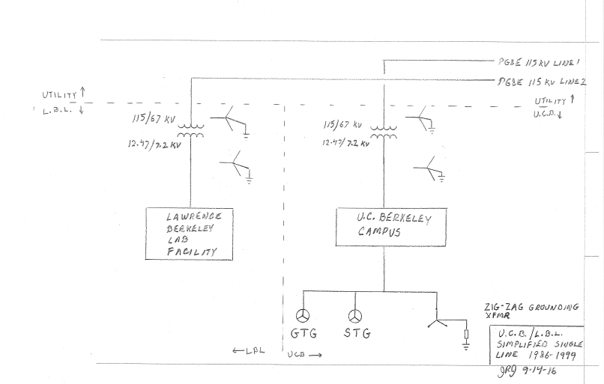
UCB/LBL Single Line 1986-1999

Slide 12
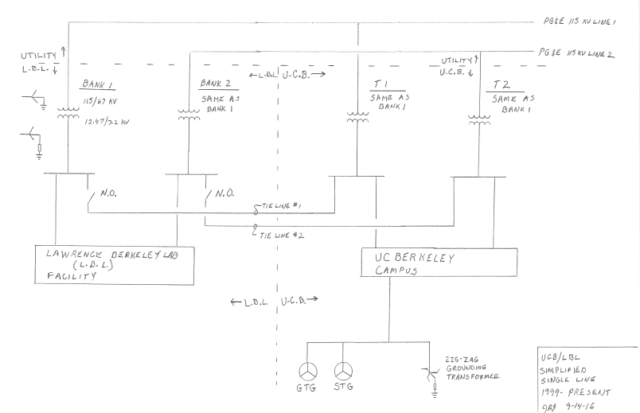
UCB/LBL Single Line Diagram 1999- Present

Slide 13
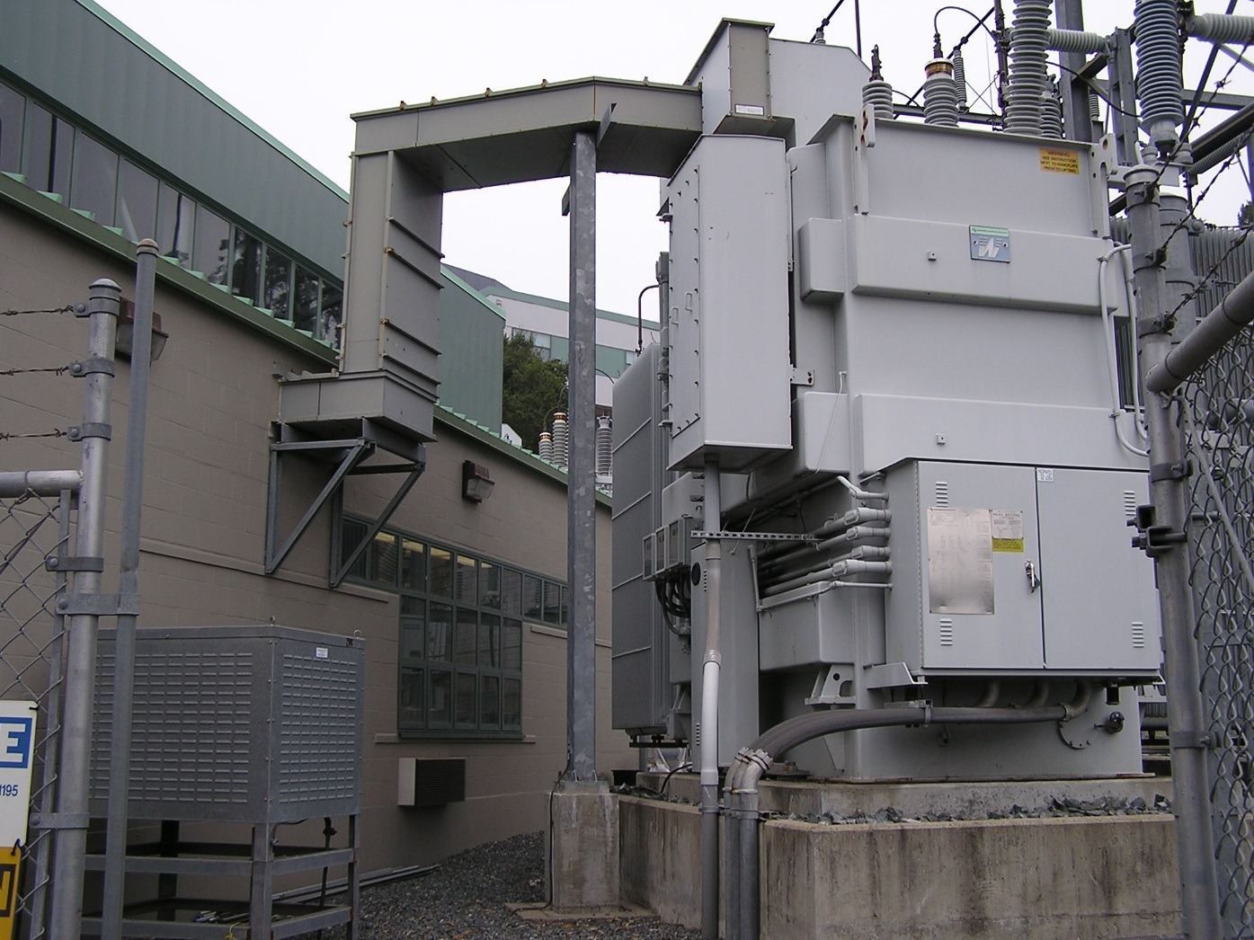
7.2 Ohm Grounding Resistor shown to left of transformer. Resistor is connected from transformer X0 bushing to ground.

Slide 14
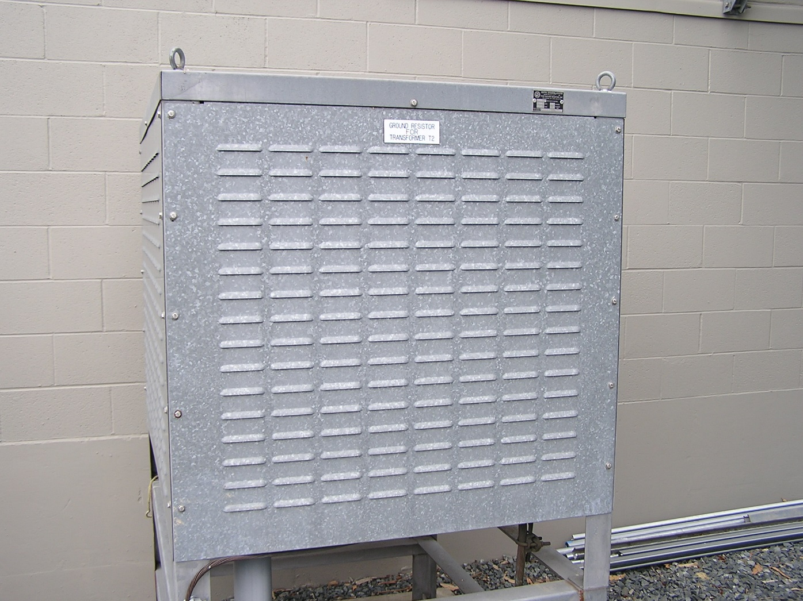
Grounding resistor has a 10 second rating. Note ventilation louvers. I² R = 7.2 MW!

Slide 15
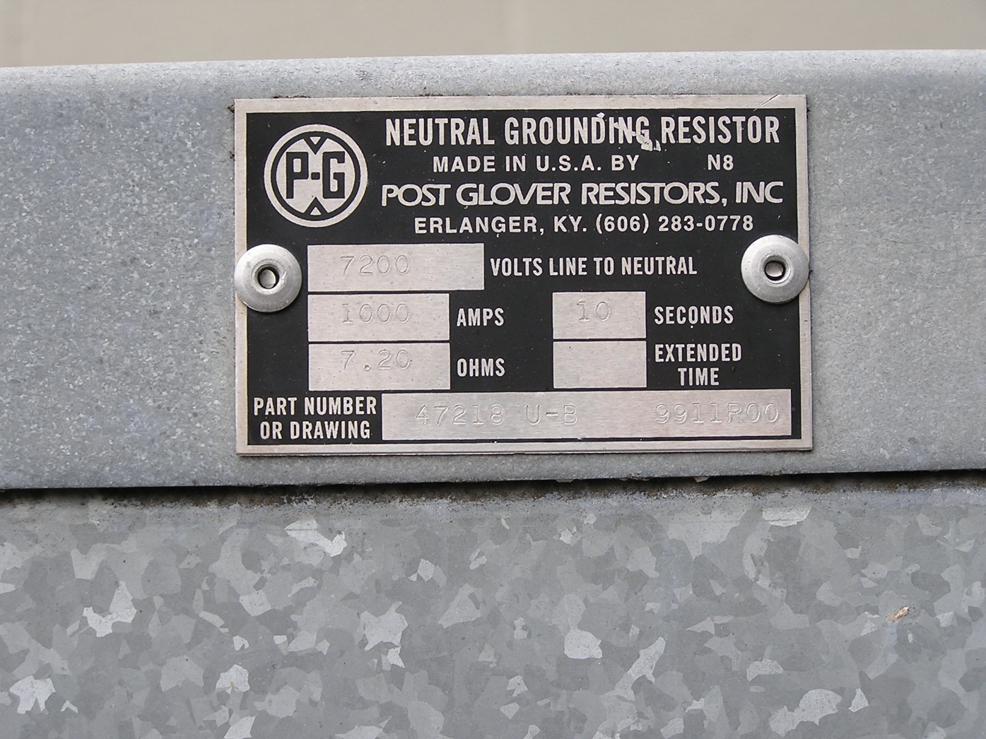
Grounding resistor nameplate. Provides 1000 amps of current for a solid ground fault.

Slide 16
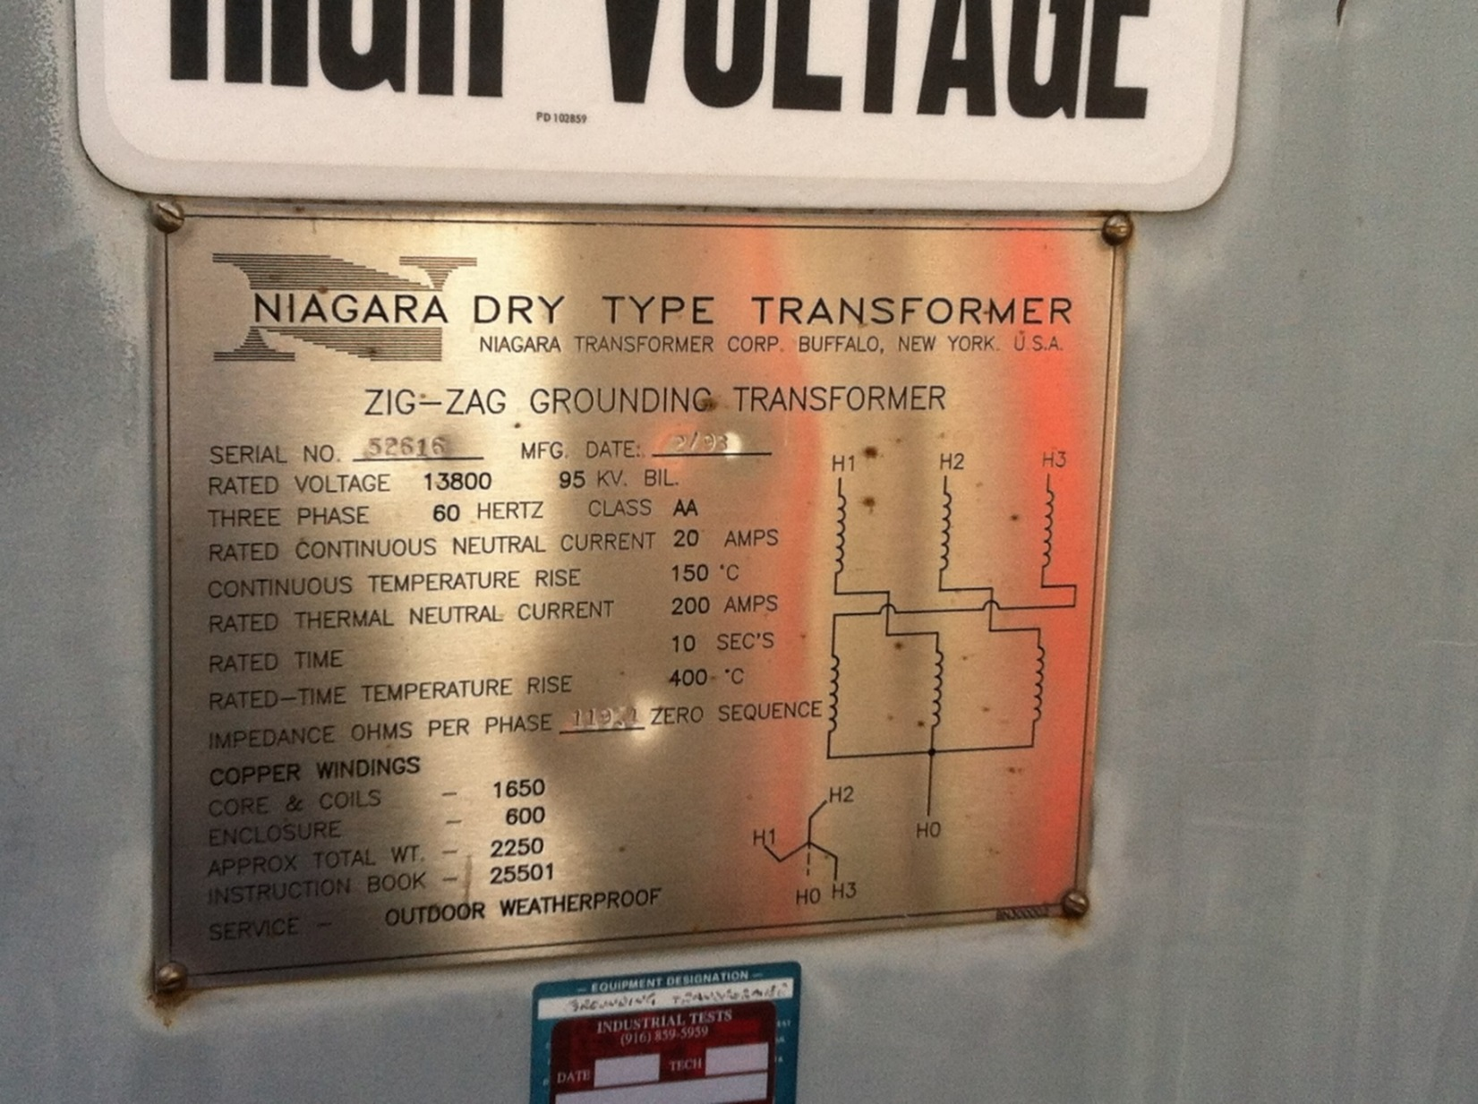
Zig-Zag grounding transformer for Cogen Plant. 119.4 ohms Zero Sequence. Also connected is a 36 ohm, 7.2 kV rated resistor from H0 to ground. Provides 180 amps of current for a solid ground fault.

Slide 17
Advantages of a Low Resistance Grounding System
Limits ground fault current and damage
CT’s do not saturate during ground faults. Prior to converting to low resistance grounding from solid grounding, we had several instances of CT’s saturating due to high level faults. This resulted in upstream breakers tripping, which caused a larger outage than should have occurred. Note that we have high available fault current of approximately 26,000 amps, partially due to the contribution of the Cogen Plant.

Slide 18
Disadvantages of Low Resistance Grounding
When a ground fault occurs, the voltage to ground on the unfaulted phases increases to 12.47 kV. With a solidly grounded system, the voltage to ground on the unfaulted phases remains close to 7.2 kV. For this reason, we utilize 133% insulation on our 15 kV cable.
Most of our 12 kV switchgear PT’s are connected wye-wye, with the primary side connected phase-to-ground. As a result, during a ground fault on the 12 kV system, the voltage across the primaries of the PT’s for the unfaulted phases increases from the normal value of 7.2 kV to as high as 12.47 kV. We have had several occasions where PT fuses blew following a ground fault on the 12 kV system.
Distribution Transformers should have delta winding for 12 kV primary (not wye).
Surge arresters must be rated 12 kV with a 10.2 kV MCOV. With a solidly grounded system, they would be of a lower rating.

