Slide 1
110.16 First Draft Language
(B) Service Equipment.
In addition to the requirements in (A), service equipment shall contain the following information:
(1) Nominal system voltage
(2) Arc flash boundary
(3) At least one of the following:
(a) Available incident energy and the corresponding working distance
(b) Minimum arc rating of clothing
(c) Site-specific level of PPE
Informational Note No. 1: NFPA 70E-2012, Standard for Electrical Safety in the Workplace, provides guidance, such as determining severity of potential exposure, planning safe work practices, arc flash labeling, and selecting personal protective equipment.
Informational Note No. 2: ANSI Z535.4-1998, Product Safety Signs and Labels, provides guidelines for the design of safety signs and labels for application to products.

Slide 2
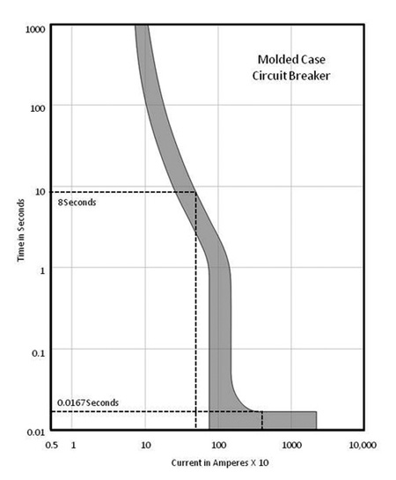
1. Fault current on primary side
2. Fault current at secondary terminals of transformer.
3. Fault current based upon maximum transformer that can be installed

Slide 3
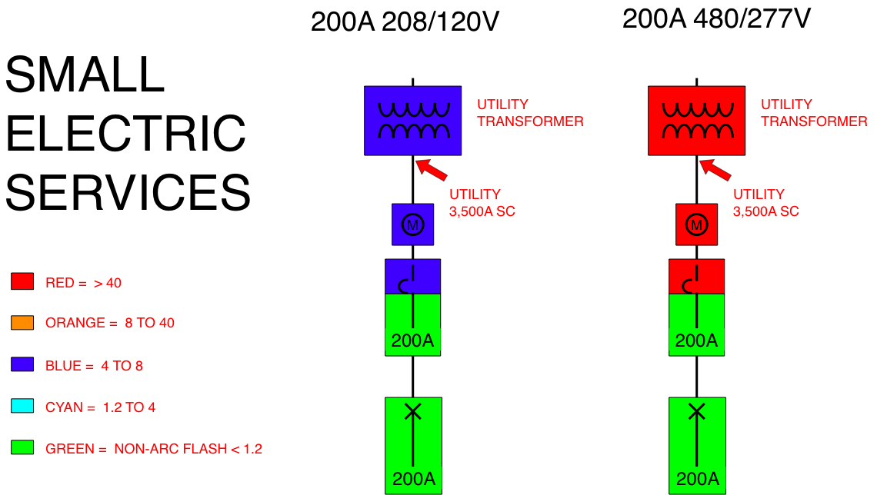

Slide 4
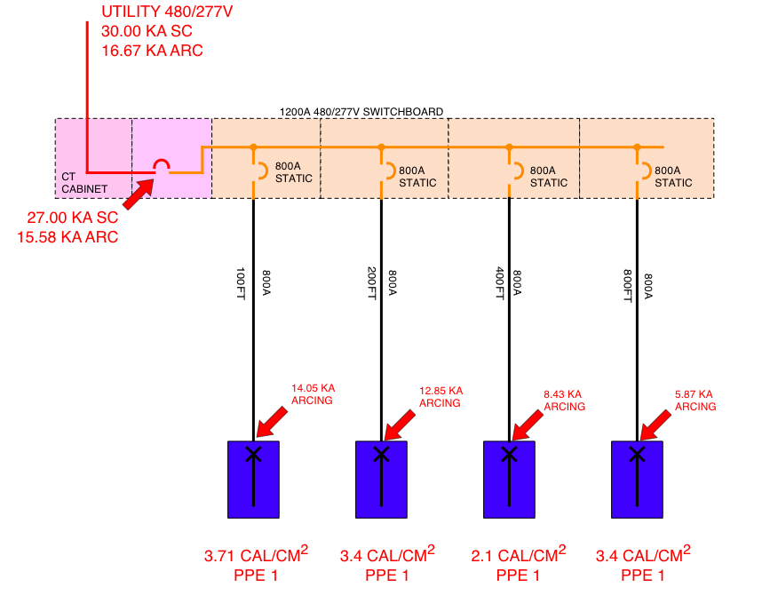
33.0
33.0
12.5
12.5
12.5
12.5

Slide 5
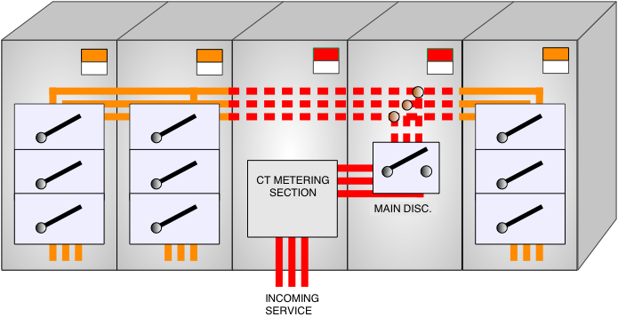

Slide 6
Section | Source | Limitations/Parameters
D.2 | Lee “ The Other Electrical Hazard: Electrical Arc Flash Burns” | Calculates incident energy and arc ﬂash boundary for arc in open air; conservative over 600 V and becomes more conservative as voltage increases
D.3 | Doughty, et al., “Predicting Incident Energy to Better Manage the Electrical Arc Hazard on 600 V Power Distribution Systems” | Calculates incident energy for three-phase arc on systems rated 600 V and below; applies to short-circuit currents between 16 kA and 50 kA
D.4 | IEEE 1584, Guide for Performing Arc Flash Calculations | Calculates incident energy and arc ﬂash boundary for: 208 V to 15 kV; three-phase; 50 Hz to 60 Hz; 700 A to 106,000 A short-circuit current; and 13 mm to 152 mm conductor gaps
D.5 | Doan, “Arc Flash Calculations for Exposure to DC Systems” | Calculates incident energy for dc systems rated up to1000 V dc

Slide 7
130.5(D) Labeling (NFPA 70E)
(D) Equipment Labeling. Electrical equipment such as switchboards, panelboards, industrial control panels, meter socket enclosures, and motor control centers that are in other than dwelling units and that are likely to require examination, adjustment, servicing, or maintenance while energized shall be ﬁeld-marked with a label containing all the following information:
(1) Nominal system voltage
(2) Arc ﬂash boundary
(3) At least one of the following:
Available incident energy and the corresponding working distance, or the arc ﬂash PPE category in Table 130.7(C)(15)(A)(b) or Table 130.7(C)(15)(B) for the equipment, but not both
Minimum arc rating of clothing
Site-speciﬁc level of PPE

Slide 8
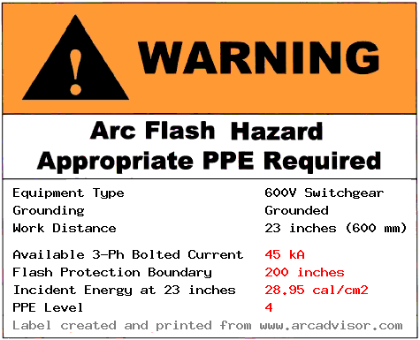
Equipment Category | Risk Category | AFB
Panelboards or other equipment rated 240 V and below Maximum of 25 kA short-circuit current available; maximum of 0.03 sec (2 cycles) bolted-fault clearing time; working distance 18 inches | 1 | 2
Panelboards or other equipment rated > 240 V and up to 60 Maximum of 25 kA short-circuit current available; maximum of 0.03 sec (2 cycles) bolted-fault clearing time; working distance 18 inches | 2 | 3
600-V class motor control centers (MCCs) Maximum of 65 kA short-circuit current available; maximum of 0.03 sec (2 cycles) bolted-fault clearing time; working distance 18 inches | 2 | 5
600-V class motor control centers (MCCs) Maximum of 42 kA short-circuit current available; maximum of 0.33 sec (20 cycles) bolted-fault clearing time; working distance 18 inches | 4 | 14
600-V class switchgear (with power circuit breakers or fused switches) and 600 V class switchboards Maximum of 35 kA short-circuit current available; maximum of up to 0.5 sec (30 cycles) bolted-fault clearing time; working distance 18 inches | 4 | 20

Slide 9
Issues with proposed 110.16
Too many ways to calculate Incident Energy from Fault Current.
First Draft Language missing Arc Flash PPE Categories
Most dangerous part of electrical system is line side of service disconnect and we are ignoring this.
Most installers do not even use the label
In our opinion we are not ready for 2017. Recommend a task group to address all concerns and see if common ground can be achieved to achieve a more clear, easier approach to address the issue.

