Slide 1
NEC Historical Lighting Allowance
1959 Lighting allowance for Offices - 5.0 W / ft²
1984 Lighting allowance for Offices reduced to 3.5 W / ft²
30 years of significant technology advancement
2011 Exception added for lighting designed with energy code but with building automation alarming

Slide 2
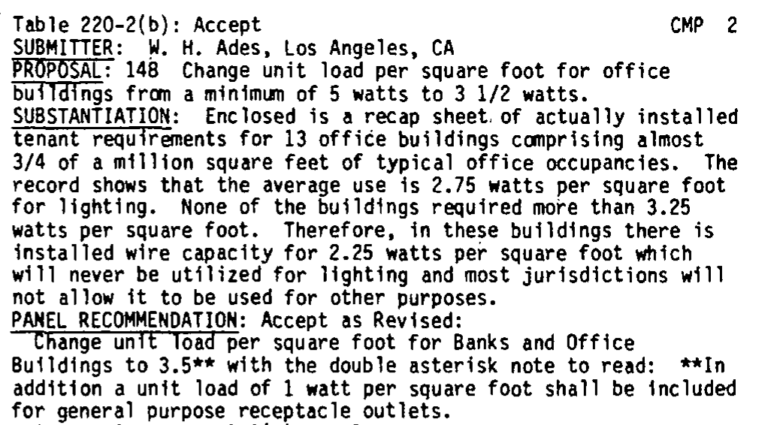

Slide 3
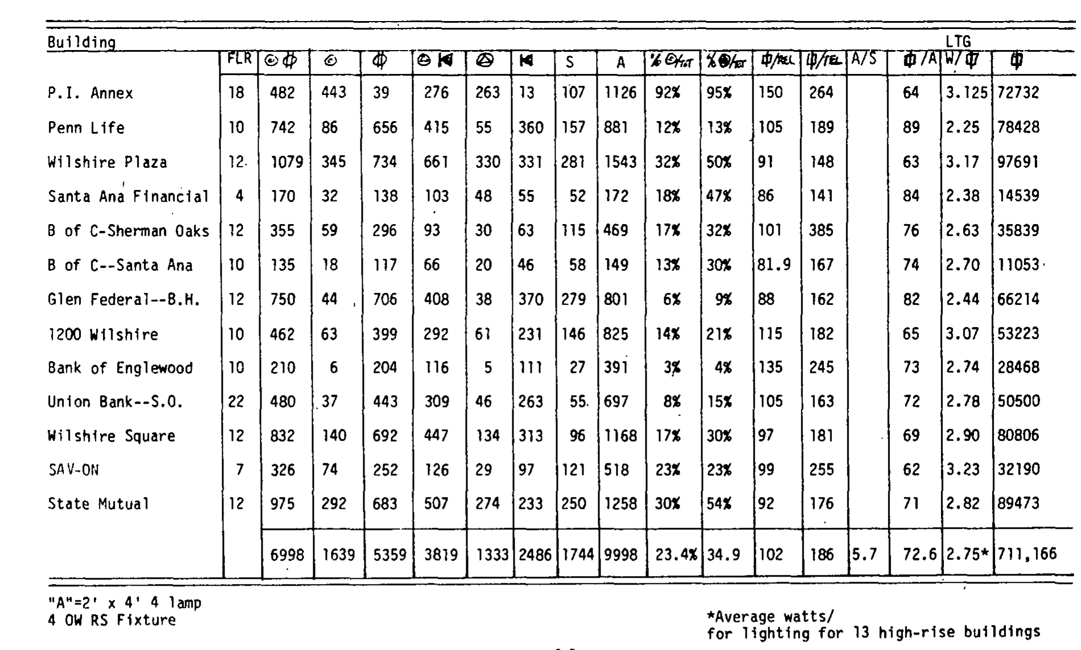

Slide 4
Lighting design since 1980’s
1980’s IES (Illuminating Engineering Society) 70-90 footcandle level for office and bank type facilities.
At present IES levels have dropped to 30-50 footcandle range.
New technologies start such as LED’s have been brought to market.
Old - 2’x4’ Fixtures 4-Lamp typically spaced at 8’x8’ (64 s.f.) or 8’x10’ (80 s.f) on center
New – 2’x4’ Fixtures 2-Lamp typically spaced at 8x10 or greater.

Slide 5
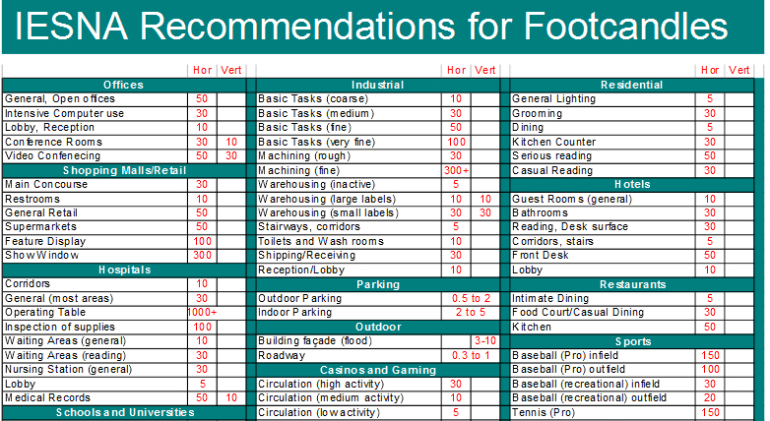

Slide 6
Type of 2’x4’ | Fixture Wattage | Wattage per 80 s.f. design
F40T12 – 4 Lamp | 196 watts | 2.45
F40T8 – 4 Lamp | 178 | 2.25
F32T8 – 4 Lamp | 131 | 1.64
F32T8 – 3 Lamp | 93 | 1.16
Equivalent 4 lamp LED | 75 | .94
Equivalent 2 lamp LED | 47 | .58
HVAC System | kW/Ton | W/ft²
Packaged Roof top unit - 24 Ton | 2.77 | 6.925
10 Ton | 2.5 | 6.25
5 Ton | 2.3 | 5.75
Chiller Air-Cooled | 1.8 | 4.5
Water Source Heat Pump | 1.2 | 3
Chiller Water-Cooled | 1.15 | 2.875
Variable Refrigerant | 1.1 | 2.75
Ground Source Heat Pump | 0.9 | 2.25

Slide 7
Building Area Type | W/ft²
Automotive Facility | .80
Convention Center | 1.01
Courthouse | 1.01
Dining: Bar lounge/leisure | 1.01
Dining: Cafeteria/Fast Food | .90
Dining: Family | .95
Dormitory | .57
Exercise Center | .84
Fire Station | .671
Gymnasium | .94
Health Care Clinic | .90
Hospital | 1.05
Hotel/Motel | .87
Library | 1.19
Manufacturing Facility | 1.17
Building Area Type | W/ft²
Motion Picture theater | .76
Multifamily | .51
Museum | 1.02
Office | .82
Parking Garage | .21
Penitentiary | .81
Performing Arts Theater | 1.39
Police Station | .87
Post Office | .87
Religious Building | 1.00
Retail | 1.26
School University | .87
Sports Arena | .70
Town Hall | .66
Transportation | 1.19
ASHRAE 2013 – 90.1

Slide 8
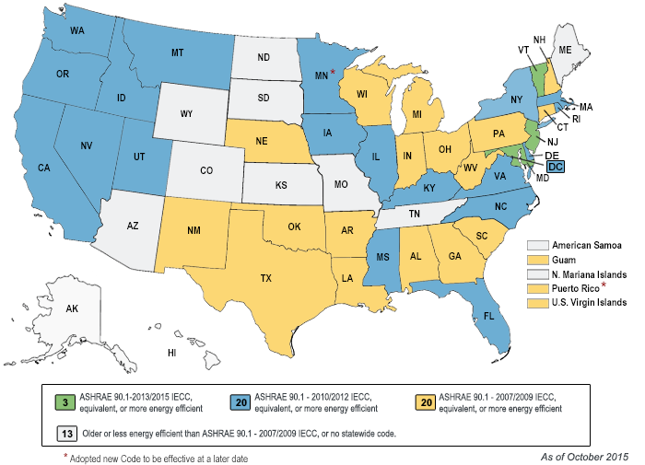

Slide 11
Description | Location | ft² | HVAC system | Actual Demand | Demand kW/ft² | Calculated NEC | Calculated NEC kW/ft²
Police Station | KY | 22,400 | VRF | 76,300 | 3.40 | 277,330 | 12.38
Office Building | NJ | 250,000 | Chiller | 1,550,000 | 6.2 | 3,706,000 | 14.82
Bank | KY | 42,535 | VRF | 161,800 | 3.80 | 453,990 | 10.63
Bank | OH | 3,500 | Split Systems | 20,250 | 5.79 | 88,000 | 24.65
Office Building | OH | 160,000 | Water Source Heat Pump | 680,000 | 4.25 | 2,135,000 | 13.34
Bank | In | 3282 | Split Systems | 12,800 | 3.90 | 54,000 | 16.45
Change in 2’x4’ Fixture Wattage

Slide 12
Task Group wording
Exception No. 2: Where a building is entirely an office or a bank type occupancy and the lighting is designed and constructed to comply with an energy code adopted by the local authority with a lighting density of less than 13.5 Volt-Amperes/Square Meter (1.2 Volt-Amperes/Square Foot), the unit lighting load for those type occupancies in Table 220.12 shall be permitted to be reduced by 11 Volt-Amperes/Square Meter (1 Volt-Amperes/Square Foot)
Suggested Change
Exception No. 2: Where a building is entirely an office or a bank type occupancy and the lighting is designed and constructed to comply with an energy code adopted by the local authority with an overall lighting density of less than 13.5 Volt-Amperes/Square Meter (1.2 Volt-Amperes/Square Foot), the unit lighting loads in Table 220.12 for office and bank type areas within the building those type occupancies in Table 220.12 shall be permitted to be reduced by 1 Volt-Amperes/Square Meter (1 Volt-Amperes/Square Foot)

