Slide 1
Environmental Stewardship and Sustainability at the UW
Created by Finance and Facilities

Slide 2
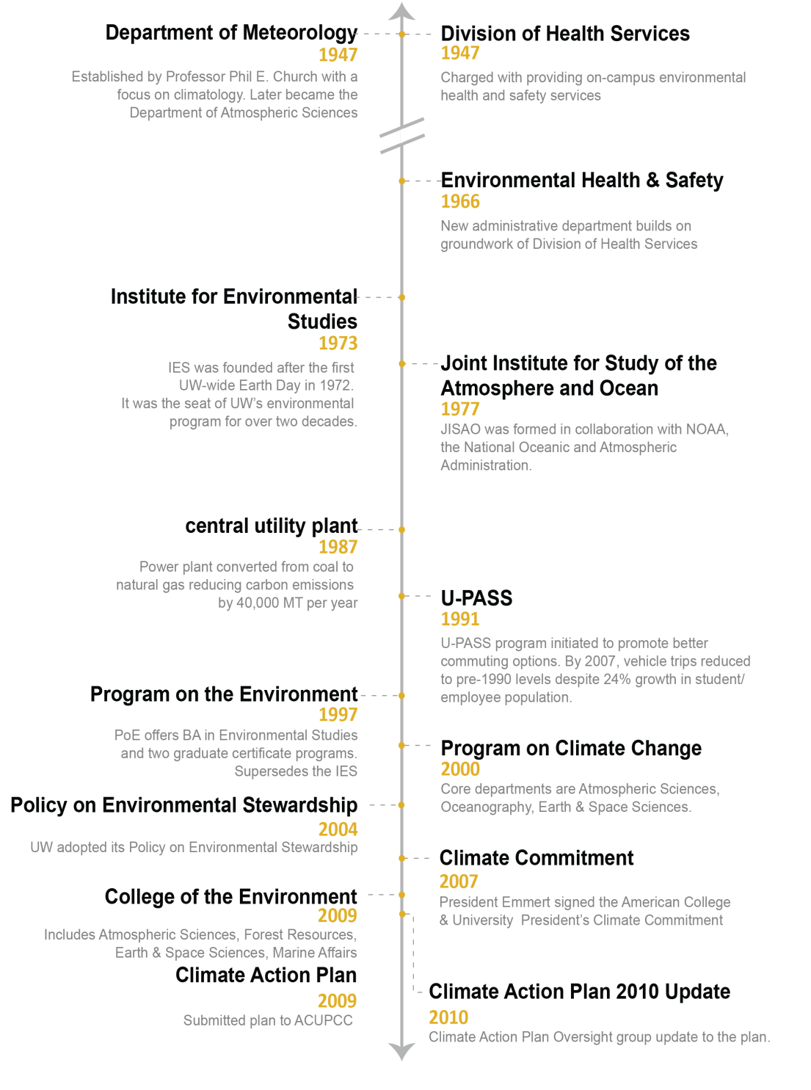
Climate Action History at the UW
The University of Washington has a rich history of environment related teaching, climate related research, environmental stewardship and energy and resource conservation.

Slide 3
Environmental Stewardship and Sustainability at the UW
Sponsored and advised by the Environmental Stewardship Advisory Committee (ESAC)
Chaired by the Dean of the Evans School of Public Affairs
Membership comprised of faculty, students and staff at all three campuses
Formed in conjunction with the UW’s Environmental Policy Statement (2004): http://green.washington.edu/ess/inform/esac
Guided by the Climate Action Plan
The UW is a charter signatory of American College & University Presidents’ Climate Commitment (ACUPCC), Leadership Circle Member.
Sponsored by President, Provost, Senior Vice President, ESAC
Goal is to achieve climate neutrality (date TBD by UW, looking at 2050) http://green.washington.edu/ess/inform/uw-climate-action-plan

Slide 4
Climate Action Plan Goals
Become carbon neutral by 2050 and/or be in alignment with State of Washington 2009 Bill 5560:
By 2020, reduce emissions 15% before 2005 levels
By 2035, reduce emissions 36% below 2005 levels
By 2050, reduce emissions the greater of 57% below 2005, or 70% below businesses as usual levels projected for 2050
Reduce campus energy supply and demand and comply with State of WA law, Chapter 39.35D RCW High-performance Public Buildings.
Requires State Funded Buildings to be designed to US Green Building Council’s Leadership in Environmental Design (LEED) Silver standards
Decrease single occupancy commuting
Encourage alternatives to professional travel
Reduce power consumption from information technology
Engage the academic community through research, curriculum and outreach
Identify alternative funding methods to finance the plan
Report progress to ACUPCC every two years

Slide 5
University Planning Initiatives

Slide 6
Climate Action Plan 2011 Goals: Policy Development
Scope: Develop sustainability policies for Buildings/Energy, Land Use and Computing/IT
Plan: 3 sub-committees worked to develop, vet and communicate policies UW-wide under the direction of ESAC, CAP Oversight, and Paul Jenny and V’Ella Warren
Who’s Involved: Faculty and students, as well as Facilities Operations and CPO, including representation from UW Bothell and UW Tacoma; UW Landscape Architect (Land), UW IT(Computing/IT), Office of Planning & Budgeting, University Architect, Environmental Stewardship Advisory Committee (ESAC), Finance & Facilities Environmental Stewardship and Sustainability Office (ESS)
Timeline:
Completed drafts in Fall 2011
Communicate to UW starting 2012

Slide 7
Energy Futures Committee
Scope: Energy Futures is a planning effort that currently focuses on modernizing, expanding and making the UW’s Seattle campus District Energy System more environmentally and financially sustainable.
Plan: Compare technical and financial low-carbon alternatives primarily for heating and cooling new and existing buildings. Storm and waste water systems are also being studied. Providing thermal energy services to adjacent areas like the West of 15th planning area is also being considered.
Who’s involved: Office of Planning and Budgeting, Treasury, Facilities, Built Environments, Attorney General’s Office, College of Engineering
Timeline: Feasibility study summer 2011. Future timeline TBD.

Slide 8
West of 15th Planning
Scope: Integrated planning effort intended to catalyze economic growth and environmentally sustainable development in the University Distinct West of 15th and use the eco-district concept as a framework for planning.
Plan: Coordination of academic, civic and private sector development is envisioned. The UW Energy Futures Planning effort includes extending low/no carbon thermal energy to the West of 15th area by including it in an expanded district energy system.
Who’s involved: Office of Planning and Budgeting, Real Estate Office, Facilities, External Affairs, and staff at Seattle Dept. of Planning & Development
Timeline: Next round of planning 2011-2013, pending further discussions with the City and community
https://www.washington.edu/regents/meetings/2011/march/items/fin/f-13.pdf

Slide 9
Energy Research Committee
Scope: Focused on research, researchers, getting grants, and potentially submitting a grant to Department of Energy/Pacific Northwest National Laboratory for the UW campus to be used as test bed to create a net zero campus.
Plan: unknown
Who’s Involved: Electrical Engineering, Integrated Design Lab, College of the Environment, College of Engineering, College of Arts &Sciences
Timeline: unknown
Office of Research Energy website: http://www.washington.edu/research/energy/
Office of Research Energy fact sheet: http://www.washington.edu/research/.SITEPARTS/.documents/.or/energy_fact_sheet.pdf

Slide 10
Better Building Challenge & Community Power Works Program
Scope: The City of Seattle is partnering with the Seattle business community to create a high-performance downtown building district to reduce energy use, greenhouse gas (GHG) emissions, and water use from buildings.
Plan: The UW is in talks with UNICO about both projects
Who’s involved: King County, City of Seattle, major property owners. UW involvement is minimal to date: represented by External Relations, Office of Planning and Budgeting and Built Environments.
Timeline:
New buildings would reduce energy use 60% by 2015, achieve carbon neutrality by 2030
Existing buildings would reduce energy use 50% by 2030
All buildings: 10% reduction in energy use by 2015 and 50% by 2030

Slide 11
University Projects

Slide 12
Smart Grid
Scope: The Pacific Northwest Smart Grid Demonstration Project is 50% funded by a grant from the US Department of Energy, and the regional project is being managed by Battelle Memorial Institute.
Plan: Electrical sub-metering will be installed on all major Seattle Campus buildings. Additional sub-metering will be installed in student housing units as a test case. A secure communications network will be installed to gather electrical energy consumption data and other future metering data such as steam, chilled water, and domestic water.
Who’s involved: CPO, Facilities Services, McKinstry, UW IT, College of Engineering, Housing and Food Services
Timeline:
Nov 2009: Notification of award of Pacific Northwest Smart Grid
June 2012: Completion of equipment and metering installation projects
August 2012: August 2014: Two-year Smart Grid Test period
January 2015: End of Regional Smart Grid Project

Slide 13
Solar Projects
Scope:
2 existing photovoltaics (PV’s) on Merrill Hall (Urban Horticulture) and Mechanical Engineering.
Now installing PV’s on top of the power plant and the IMA roof.
Also retrofitting the Odegaard dual duct vents into variable air volume system.
Plan: Proof of concept: if the installations are successful, PV’s and retrofits will be expanded to other legacy buildings.
Who’s involved: Facilities Services, Capital Projects Office, College of Engineering
Timeline: Complete initial installations during Summer 2011

Slide 14
Paper Reduction
Scope: House Bill 2287 requiring state agencies to purchase 100% recycled content white cut sheet bond paper; develop and implement a paper conservation program and a paper recycling program, with the goal of recycling 100% of all copy and printing paper. State agencies are encouraged to give priority to purchasing from companies that produce paper in facilities that generate energy from a renewable energy source.
Plan: Paper Conservation Project Team established in January 2010 to implement paper reduction program for Seattle, Tacoma and Bothell.
Who’s involved: Procurement Services, Creative Communications, UWIT, UWEO, Recycling & Solid Waste, Bothell, Tacoma, UW Medical Center, Harborview, College of Engineering, Environmental Stewardship and Sustainability Office.
Timeline:
July 2009: House Bill 2287 took effect
Dec 2009: Requirement to purchase only 100% recycled paper
Jan 2010: Project Team created
July 2010: Paper reduction implementation plan developed

Slide 15
Power Management
Scope: Support CAP and save money by reducing desktop power usage and GHG emissions, improving computer security through patch management and reporting on estimated power savings.
Plan: Through the RFP process, the supplier BigFix was identified to assist with implementing power management on UW laptops and desktops. Contract will include maintenance and support for deployment and reporting.
Who’s involved: UW Technology, Environmental Stewardship and Sustainability Office, Purchasing, and Facilities Services
Timeline:
Sign contracts with Seattle City Light , Sirius/IBM -- June 2011
Complete server testing and pilot – June/July 2011
Begin campus-rollout – October 2011

Slide 16
Campus Sustainability Fund
Scope: Launched in October 2010, the fund was allocated $339,805 from Student Activities Fees (SAF). Funded projects are selected based on high student leadership, engagement and environmental impact. Program managed by ESS Office.
Plan: SAF approved $300,000 allocation for Year 2 (2011-2012)
Who’s involved (only applies to Seattle Campus):
Voting Members: Appointed by: Associated Students of UW (ASUW) Senate; ASUW Board of Directors ; Graduate and Professional Student Senate; ESAC.
Non-voting Members Appointed by: Faculty Senate; Facilities Services; Provost’s Office; ESS Representative or Fund Coordinator
Timeline:
FY 2011 Student outreach campaign/ $339,805 approved by SAF
May 2011 $300,000 approved by SAF (Year 2)
Oct 2011 UW Sustainability Summit
FY 2012 Accept proposals and allocate funds

Slide 17
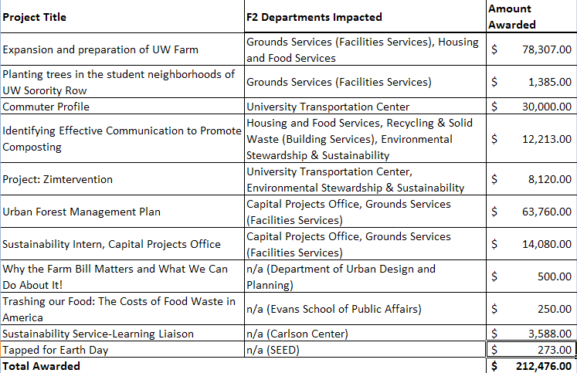
Campus Sustainability Fund
Awarded in FY 2011

Slide 18
Activities at UW Bothell
Scope: Many activities are underway at UW Bothell to align with the Climate Action Plan and to create a campus learning lab for students, in addition to purchasing renewable energy credits
Plan: Manage ESCO projects which include re-commissioning systems, power management, metering, and dashboards with the goal of reducing carbon footprint by 920+ tons annually; purchasing Renewable Energy Credits (RECs), and creating a Greenhouse and Wetlands Interpretive Center (Conservatory) for teaching, research and community engagement
Who’s Involved: Bothell Facilities Manager
Timeline: In scoping phase now

Slide 19
Activities at UW Tacoma
Scope: Many activities are underway at UW Tacoma to align with the Climate Action Plan and create a central plant for the UW Tacoma campus that uses a low temperature geothermal exchange and energy loop
Plan: Manage ESCO projects that include replacing existing chillers and heat pumps with more energy efficient and environmentally friendly units, providing LED lighting along the Hood Corridor, and adding energy metering and monitoring capabilities; finalizing a Zip Car contract along with as many as 21 electric vehicle recharge stations, and implementing the UW Tacoma infrastructure master plan
Who’s involved: Tacoma Facilities , Capital Projects Office, UWIT
Timeline: ESCO Projects 2011 -2012:Central Energy System with Phase 4 of Campus Development.

Slide 20
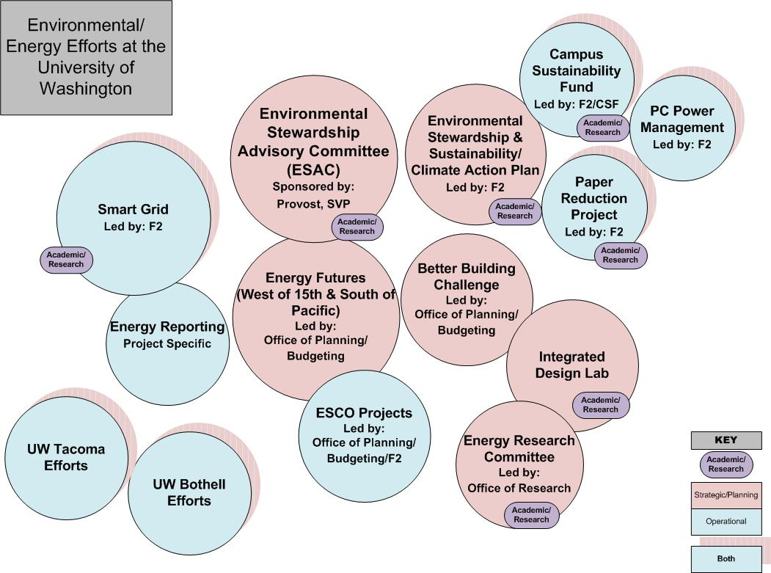

Slide 21
Environmental Stewardship & Sustainability (ESS) Contacts
V’Ella Warren, Senior Vice President, vwarren@uw.edu, 206 543-876
Sandra Archibald, Dean, Evans School of Public Affairs, sarch@u.washington.edu, 206 616-1648
Ruth Johnston, Associate Vice President, ruthj@uw.edu, 206 685-9838
Claudia Frere, ESS Manager, frerec@uw.edu.edu, 206 221-0391
Elise Glassman, Climate Action Plan Project Manager, elisd2@uw.edu, 206 616-9194
Environmental Stewardship & Sustainability Office
Website: http://green.washington.edu
Email: oess@uw.edu

Slide 22
Project Contacts
Project | Contact | E-mail | Phone
Better Building Challenge | Kirk Pawlowski | kpawlow@uw.edu | 206 543-6277
Campus Sustainability Fund | CSF Coordinator | uwcsf@uw.edu | 206 221-0392
Climate Action Plan | Ruth Johnston | ruthj@uw.edu | 206 685-9838
Energy Futures | Kirk Pawlowski | kpawlow@uw.edu | 206 543-6277
Energy Research | Mani Soma | manisoma@uw.edu | 206 543-3842
Paper Conservation Project | Claudia Frere | ccfrere@uw.edu | 206 221-0391
Power Management | Elise Glassman | elised2@uw.edu | 206 616-9194
Solar Projects | John Chapman | jchapman@uw.edu | 206 543-3860
Smart Grid | John Chapman | jchapman@uw.edu | 206 543-3860
UW Bothell | Tony Guerrero | aguerrero@uwb.edu | 425 352-3557
UW Tacoma | Milt Tremblay | milt@uw.edu | 253 692-4754
West of 15th | Rebecca Barnes | rgbarnes@uw.edu | 206 543-4382

