Slide 1
SAC

Slide 2
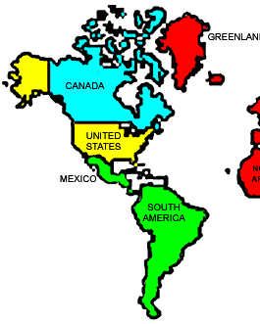
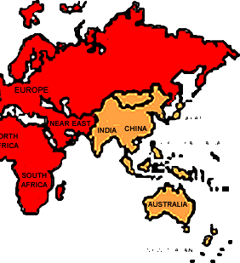
IEEE
Regions 1 – 6
Region 7
Region 8
Region 9
Region 10

Slide 3
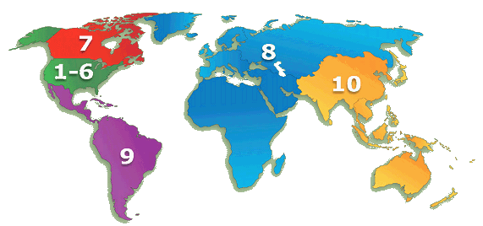
Membership by Region
R7 – 16,259
R1 to 6 – 209,857
R10
73,662
R1 – 37,050
R2 – 32,137
R3 – 30,557
R4 – 23,204
R5 – 28,765
R6 – 58,144
R8 – 67,221
R9 – 15,401
Reflecting the global nature of IEEE, R8 and R10 are now the two largest IEEE Regions
TOTAL MEMBERSHIP – 400,000
Notes:
3

Slide 4
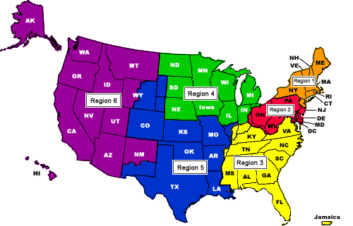
IEEE

Slide 5
IEEE Organization
MEMBERS
Board of Directors
Assembly
PSPB*
IEEE-USA
Educational Act.
Standards Assoc.
Member Geographic Act.
Technical Act.
Executive Comm.
Regions & Sections
Societies & Tech. Councils
Staff & Society Executive Directors
*Publication Services & Products Board

Slide 6
IEEE Revenues
Dues Fees
  Institute Dues
  Society Fees
  Regional Assessments
Publications
Conferences
Educational Courses
Services
Investments

Slide 7
IEEE Expenditures
Member Activities
Member Services (Technical, Professional, Regional & Local)
Publishing
Standards
Education
Administration

Slide 8
Geographic & Technical Unit Relationship
Geographic Unit Structure
Technical Activities
Board
Member and
Geographic Activities
Board
IEEE Societies
Regions
Parents - WIE,
Consultants,
YP, LMC
Areas
Sections
Chapters
Affinity Groups
Sub-Sections
Student Branches
Councils
SB Chapters
SB Affinity Groups

Slide 9
Responsibilities of the Regional Student Activities Chair
The Regional Student Activities Chair (RSAC) is the coordinator and manager of student activities and communications in the Region. There are currently ten RSAC's, one for each Region in IEEE. Their responsibilities include:
Overall coordination of all Regional Student Activities
Regional Student Paper Contest
Regional Student Design Contest
Supporting Regional Meetings
Preparing Annual objectives and budget
Communication with Student Branches
Conducting Leadership Workshops
Formation of new Branches and Chapters
Developing Branch Activity Program
Providing policy recommendations on student activities (Institute SAC)

Slide 10
Responsibilities of the Regional Student Representative to Student Activities Committee
The Regional Student Representative (RSR) supports the RSAC Chair in managing, coordinating, and carrying out responsibilities for the student affairs in the Region. These responsibilities include:
Organizing or coordinating the Regional Student Conference meeting
Coordinating the Student Branch Officer leadership workshop
Communicating with Branches through the Regional Student Newsletter
Contacting and reactivating inactive Branches
Aiding in recognizing effective Student Branches
Aiding the RSAC in defining objectives and plans for the coming year and developing the budget to support them.
Contributing to the Institute student programs and policy by making recommendations to the RAB SAC based on involvement and experiences with Regional programs and Branch activities.

Slide 11

Student Activities Committee (SAC) Mission
To deliver a common, high quality IEEE Student Member experience globally, for lifelong, professional success through IEEE.
The SAC Vision is: To be recognized as the global platform to inspire, enable, develop, and support students as the future leaders of our profession.

Slide 12

IEEE Students At a Glance
100,000+ student and graduate student members
25% of overall IEEE membership
In 100+ countries and at 3200+ institutions
Provides pipeline to Higher Grade membership (~5,000/year)
Graduate Student Membership on the rise
Retention continues to be a challenge

Slide 13
Student Membership Statistics
(as of 31 January 2019)
Undergraduate Student Membership: 81,169 members
Change from January 2018: 0.3% decrease
Graduate Student Membership: 48,032 members
Change from January 2018: 5.7% increase

Slide 14
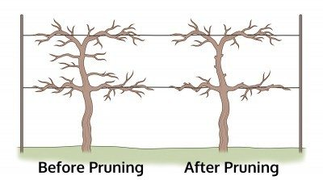

2018 Accomplishments
New Student Website - students.ieee.org
Formal launch of New Student Visual Identity
Strengthening the Section Branch Connection
  Best practices videos for Branches and Sections
  Preparation for changes to annual reporting and rebate timelines
  Development of new volunteer training modules in CLE
  Clean up of student rosters and compliance with Ops Manual
  Work requests made for improved reporting via OU Analytics
  Branches reporting to sections
  Dissolving and rejuvenating Branches

Slide 15
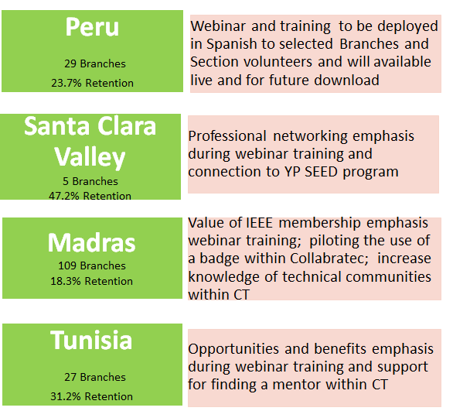
Student Retention Initiative
Goals/Measures of Success
▸ By the end of the 2019 membership year:
- Increase first-year student retention by 3%
  •August 2018 retention rate = 26.3%, 2019 goal = 29.3%
- Increase overall student member retention by 5%
  •August 2018 retention rate = 37.4%, 2019 goal = 42.4%
- Outcome: Incremental increase of 4,600 student renewals = ~$138k in dues revenue
▸ For the four Sections:
- Did the tests have an impact on retention?
- Specific measures developed based on the test chosen

Slide 16

2019 SAC Priority Projects
1. Continuation of Student Retention and Branch Section Connection Initiatives
2. Adopt SPAx from IEEE-USA
3. Increase Student Engagement in Collabratec
  Ambassadors Program
  Partnership with Potentials Magazine
  Student Branch Discussions
  expand the Global Student Network.
4. Address needs of Southern Hemisphere members and volunteers
5. Awards Program
  Revise procedure and transparency
  New submission platform: Open Water
← Need Region help !
← Need Region help !
Notes:
Student Member Retention (2019 Membership Year initiative) and Section Branch Connection (2016 multi-year initiative)

Slide 17
2019 SAC Priority Projects
6. Speakers Bureau (live)
7. Soft Skills mini Tech talks (recorded)
8. Student Branch Chapter Vitality
9. Xtreme
10. Potentials
Notes:
Student Member Retention (2019 Membership Year initiative) and Section Branch Connection (2016 multi-year initiative)

Slide 18
Student Member Benefit: Potentials Magazine
Potentials Magazine is a publication directed to all students and addresses global issues, technology trends, and career development topics.
2019 Focus:
Closer collaboration with SAC
Readership survey and analysis
Discussion forums in Collabratec
Mobile Delivery
2019 Schedule of Publications:
  March/April The Internet of Things
  May/June Sports Science and Technology
  July/Aug New Frontiers in Radar
  Sept/October Imagineering
  November/December Careers and Graduate Education

Slide 19

Marketing and Communications
Student Web site: students.ieee.org
Student Branch Leader News (released monthly) has a reach of 4,000+ volunteers (Open Rate - 35%)
New Student Branch Counselor’s News (released quarterly)
IEEE Collabratec Global Student Exchange has 13,000+ users
Global Student Facebook page 380,000+ followers
Student Video Assets:
New Member Orientation: IEEE Students
Student Branch Leadership: IEEE Students
Section Leadership: IEEE Students

Slide 20

Educational Resources
Technical training demos
Educational resources/webinars
IEEE.tv recordings
Try computing.org
Trynano.org
Tryengineering.org
IEEEXplore Digital Library
Itunes University
E-learning Library
English for Language Learners
Note: some may have additional costs associated.
http://ieee-elearning.org

Slide 21

Transitioning to Young Professionals
IEEE Young Professionals (YPs)
Graduated from their first professional degree within the last 15 years. There will be an opt-in option available for members that do not meet this criteria.
Connecting Students and Young Professionals:
Local YP Affinity Groups and the local IEEE Section can collaborate with their local Students Branches to host an annual Student Transition Elevation Program (STEP) event. These events introduce graduating students to the YP Program and is the first step to building a lifelong and diverse professional network. Some examples of events can include:
  Networking Mixers
  Professional Seminars
  Panel Discussions
  Guest Lecturers
  Careers Fairs
                yp.ieee.org

Slide 22
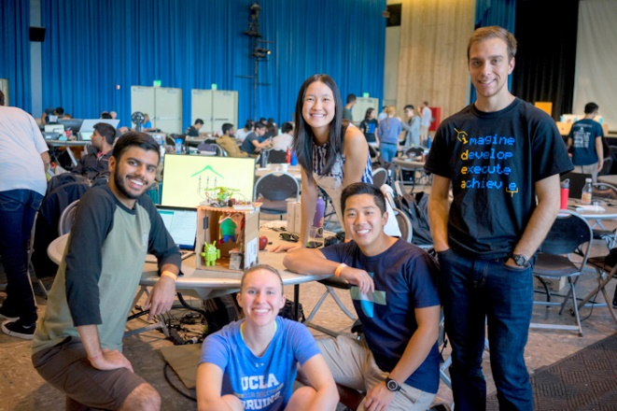
Become an IEEE Student volunteer
Gain confidence
Make a difference
Meet new people
Become part of a larger community
Hone your soft-skills
Take on a challenging experience
Have fun!
ieee-elearning.org/CLE/

Slide 23
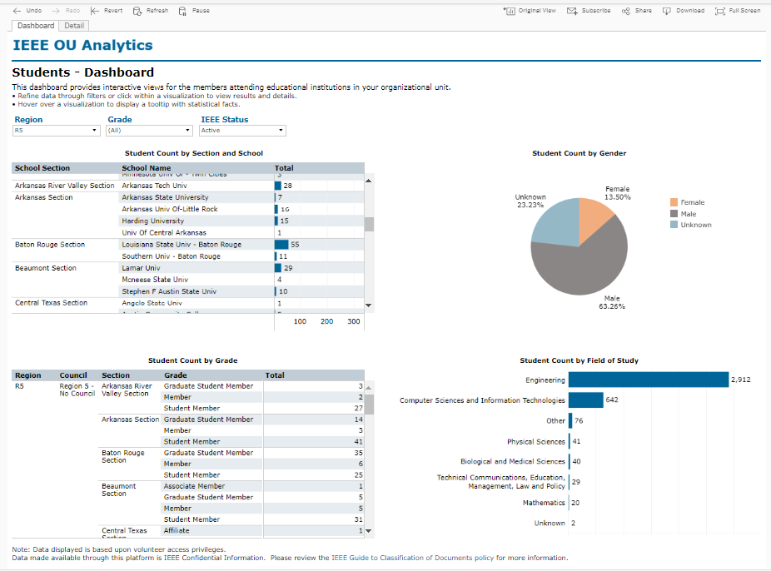
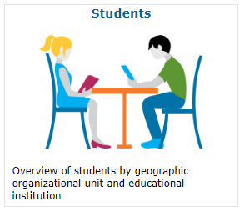
Key Resources for Student Volunteers
Student Branch Membership Data
  OU Analytics - Student Tab
* Tutorials are available

Slide 24
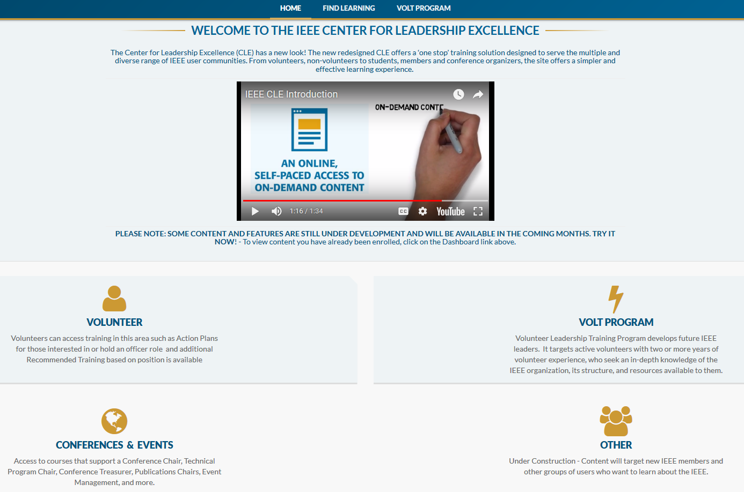
Key Resources for Student Volunteers
Branch Leadership Training – IEEE Center for Leadership Excellence (CLE)

Slide 25
Volunteer Roles Action Plans available in CLE
Section Chair
Section Vice Chair
Section Treasurer
Section Secretary
Section Technical Chapter Chair
Section Membership Development Chair
Section Student Activities Chair -SSAC
Section Nominations & Appointments Chair
Section Professional Activities Chair
Section Awards and Recognition Chair
Section Educational Activities Chair
Section Industry Relations Chair
Student Branch Chair
Student Branch Vice Chair
Student Branch Secretary
Student Branch Treasurer
Student Branch Counselor
Student Branch Chapter Chair
Section Student Representative -SSR
Section Young Professionals AG Chair
Section Life Member AG Chair
Section Women in Engineering AG Chair
Section Consultants Network AG Chair
Content targeted to: Section, Chapter, Student Branch, Affinity Group

Slide 26
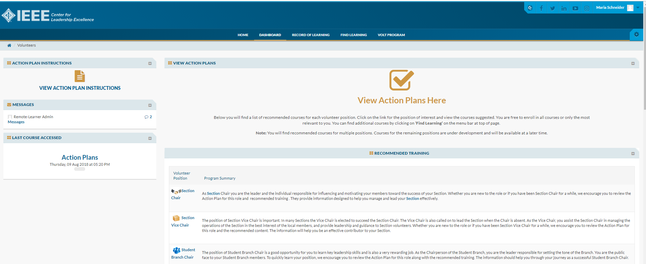

Slide 27
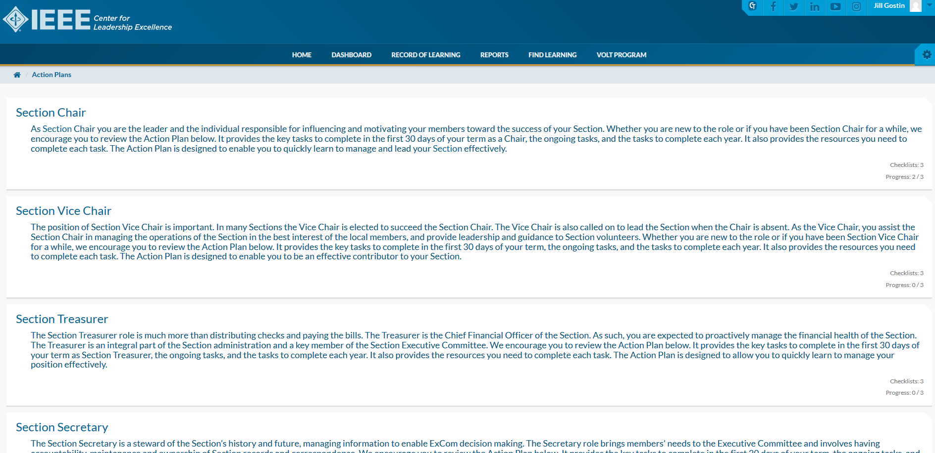

Slide 28
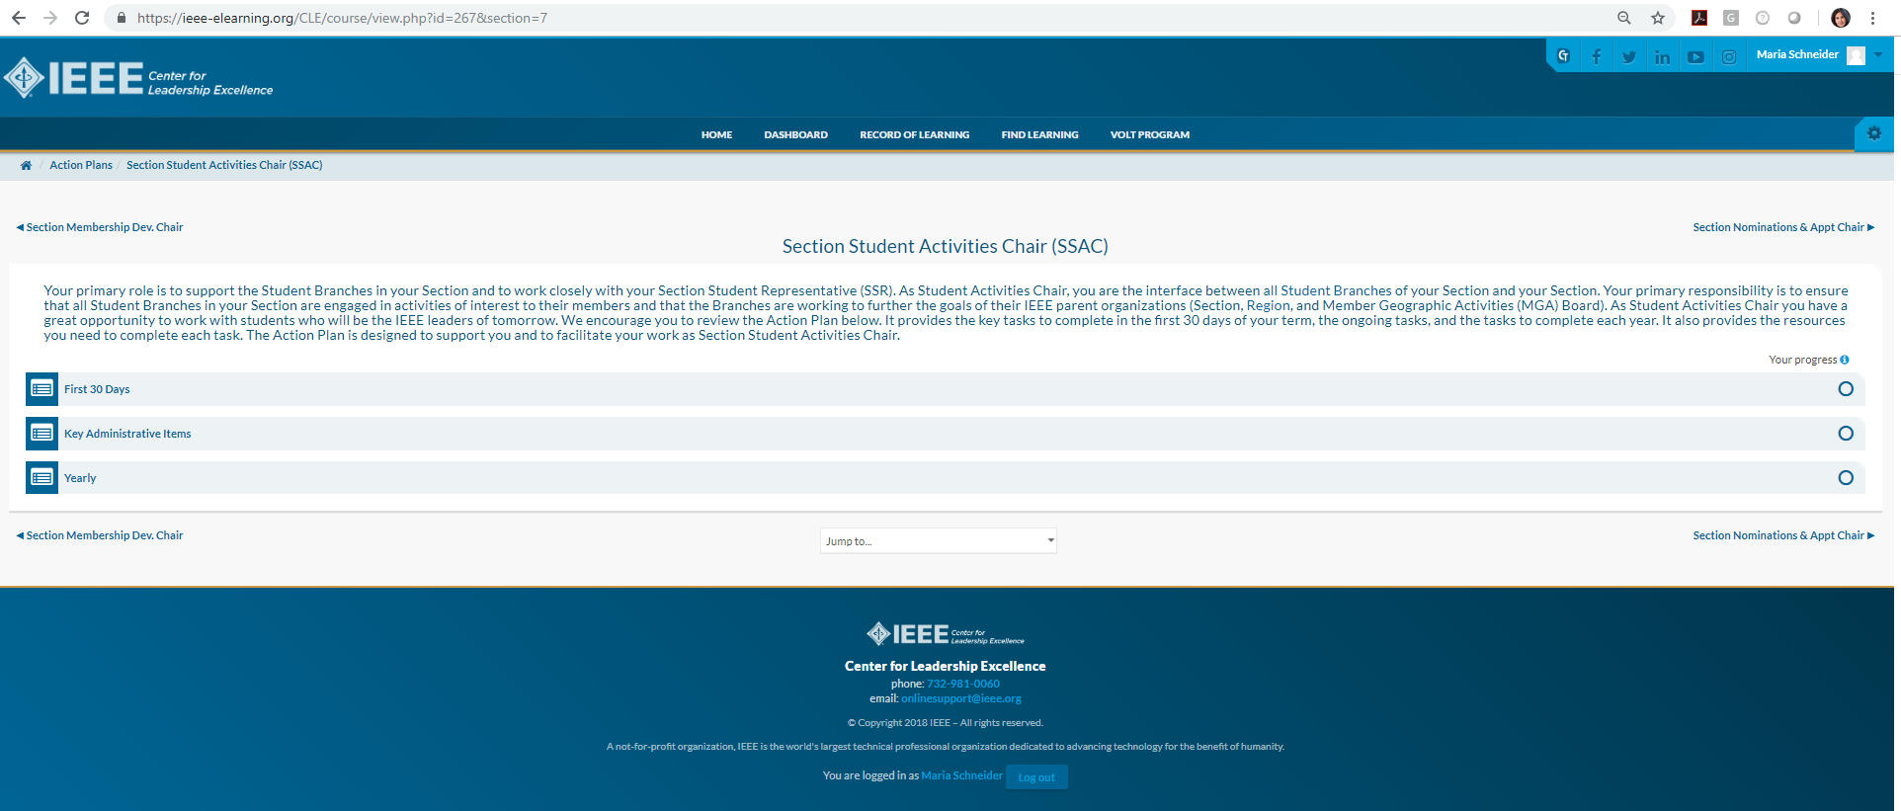

Slide 29
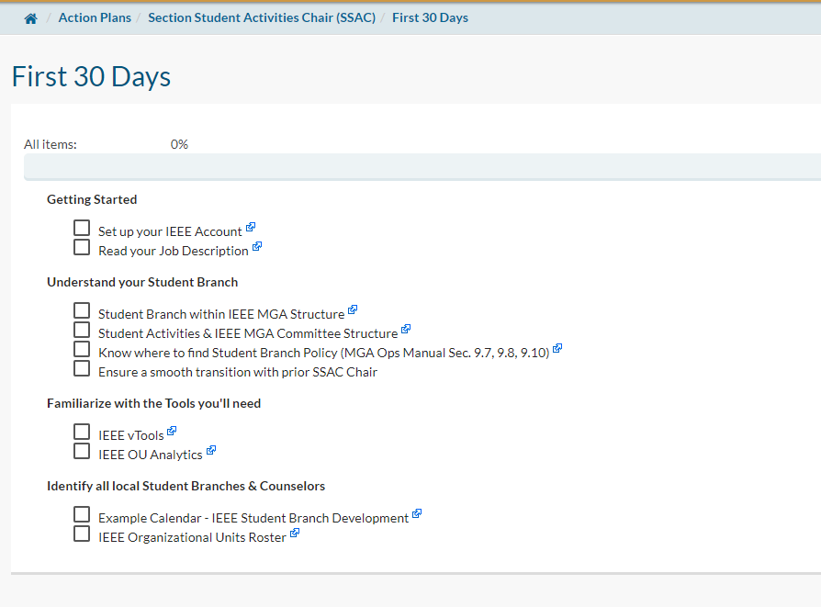



Slide 30
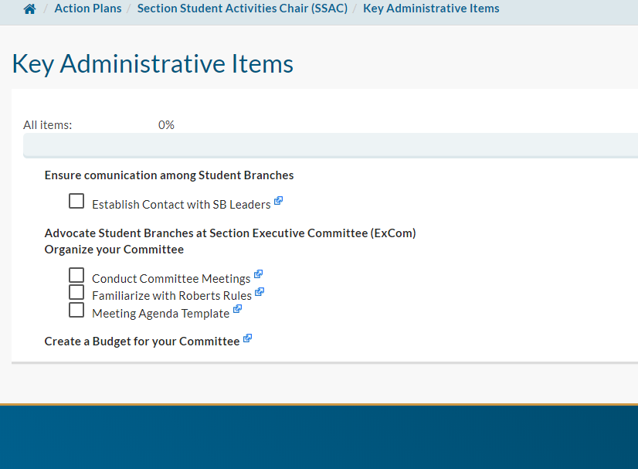

Ongoing tasks

Slide 31
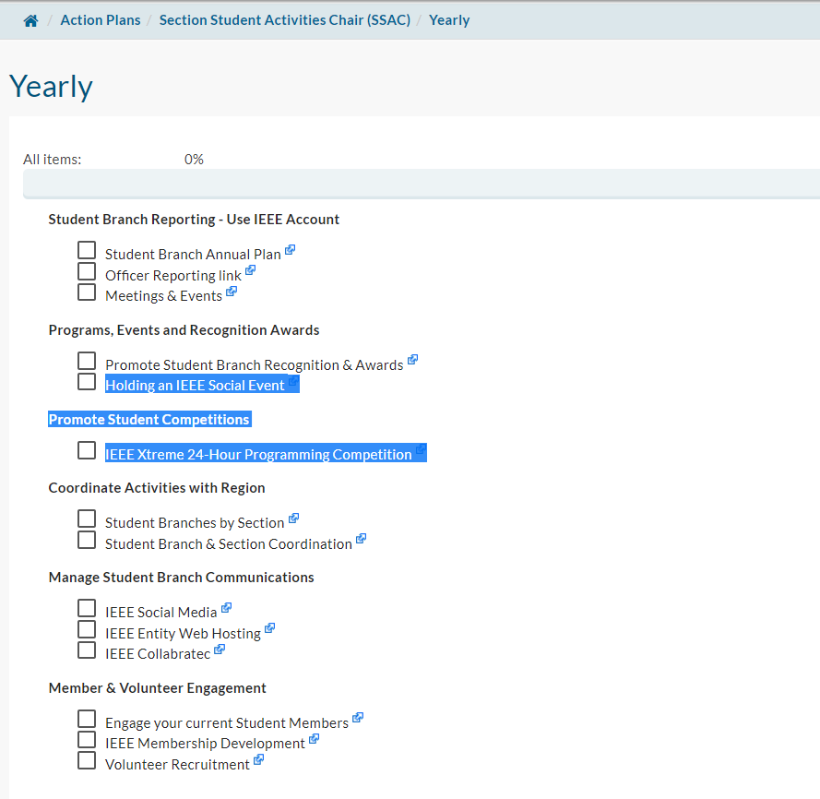


Slide 32
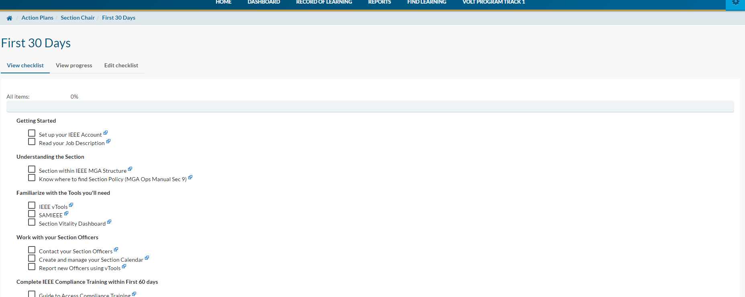
Tasks have links to Information Resources
Takes you to the content source

Slide 34
Recommended CLE Training (Courses)
Sorted by Category
Leadership (strategic, interpersonal)
Management (day-to-day)
IEEE Awareness (incl. tools)
Business & Technology (incl. finance, ethics)
Member Engagement
Communication (verbal, written)

