Slide 1
IEEE-USA Area Meetings PACE Fall, 2019
Amber Orr
Region 6 PACE Chair
aorr@ieee.org

Slide 2
WHAT IS PACE? PROFESSIONAL ACTIVITIES COMMITTEES FOR ENGINEERS
A grassroots network of IEEE volunteers and committees organized at the section and chapter levels with support from Regions and IEEE-USA.

Slide 3
PACE Objectives (Professional Activities Committees for Engineers)
PACE promotes:
The professional interests of the U.S. members
The professional activities of Sections, Chapters, and Student Branches
A mechanism for communication of members' views on their professional needs.

Slide 4
Five PACE Topics
Government Activities
Career and Employment Enhancement Activities
Pre-University (K-12 STEM) Activities
Student Professional Awareness Activities
Technical Policy Activities

Slide 5
Government Activities Programs
Congressional Visits Day
Communications with Legislative Delegates
Legislative Issues Communications
IEEE Member initiated Issues Communications
Any project which promotes the communication of IEEE member legislative issues.

Slide 6
Career and Employment Enhancement Activities
Employment Assistance Programs
Career Assistance Programs
Employment Benefits and Career Workshops
Career Transitions Workshops
Retirement and Financial Management Workshops
Consulting, Leadership, Licensure Workshops
Communications Workshops
Any project which promotes careers of IEEE members
Job Fairs
Resume Writing and Job Interview Workshops
Job Listing services
Resume Listing services
Professional Awareness Workshops
Internship Location Listings

Slide 7
Pre-University (K-12 STEM) Programs
Future City Competition
First Robotics Competitions
Science Fair
Math Counts
Any STEM project promoting science, technology, and the image of the engineer
And more….

Slide 8
Student Professional Awareness Activities
Student Professional Awareness Experience (SPA-x)
Rising Stars Conference
Future Leaders Forum (EVO)
WIE ILC (International Leadership Conference)
Hackathons
Student Branch Activities

Slide 9
Technology Policy Programs
Technology Policy Workshops
AI
Internet of Things (IOT)
Aerospace Policy
Communications and Information Policy
Energy Policy
Medical Technology Policy
Research and Development Policy
Regulatory Policy
Any project which promotes the communication of IEEE member technology policy issues

Slide 10
TEMS
Technology and Engineering Management Society
Funding Initiatives Pair with Pace

Slide 11
TAB
Technical Activities Big Goal
Develop a volunteer-led environment where technical thought leaders converge and create communities for people working in our fields (Connections)
Solicit, refine and disseminate quality technical information (Content/Curation)
Organize technical gatherings to foster innovation and interchange (Competency/Coverage)
Nurture and promote innovative technical ideas and new technical fields (Coverage)
(So far, vague guidance on funding opportunities)

Slide 12
EPICS
Encouraging the Pursuit of Engineering for Community Improvement
Multi-discipline Involvement of Engineering Groups
Entire University (or Multi-University) Cooperation Necessary
Funding is Available from IEEE and must be sourced from externally, as well, to be successful
This is an IEEE Foundation funded program
(The most recent EPICS Expo is next week at the Arizona State University)

Slide 13
SIGHT
IEEE Special Interest Group on Humanitarian Technology (SIGHT) provides IEEE members with the opportunity to work with a large network of volunteers around the world carrying out and/or supporting impactful humanitarian activities on the local level.
(It is difficult to answer questions on funding opportunities here unless we the specific nature of the request. This is due to the fact that it is a special interest group. Define the nature of your Humanitarian work/project, which can vary greatly, and then we can start asking about the amount of funding that is available for your type of project.)

Slide 14
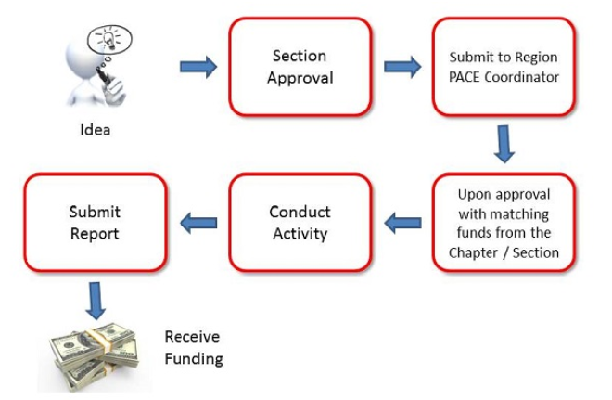
PACE Process

Slide 15
PACE FUNDING STATUS

Slide 16
Questions/Comments
Amber Orr
Region 6 PACE Chair
aorr@ieee.org

