Slide 1
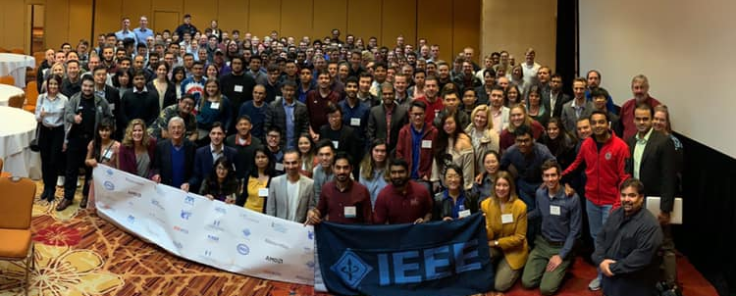
2020 IEEE Rising Stars Conference
A premier student and young professionals conference from IEEE Region 6
January 3-5, 2020
Tropicana, Las Vegas

Slide 2
Leadership – 2019
The Conference leadership team met weekly and includes individuals from several regions.
Ramesh Nair – Chair
Matt Smith – Vice chair
Skyler Nix – Special Events chair
Peijung Tsai – Treasurer
Phil Bautista – Production director
Anis Ben Arfi – 2020 Chair
Michael Andrews – Executive producer

Slide 3
Overview of Rising Stars:
2020 will be the 6th IEEE Rising Stars Conference, first one happened in 2015. Dates are Jan 3-5. Venue is Las Vegas.
Conference has grown significantly over the past several years.
The 3 day event aims at student and young professionals technical and professional development and competitions.
Increase in number of Young Professionals YoY. 38% attendees at 2019 RS were YP’s.
Partnership and collaboration with several IEEE OU’s and industry.
Attendees receive support from Region 6 and IEEE-USA PACE.

Slide 4
2018 IEEE Member & Geographic Activities (MGA) Achievement Award
“For the successful creation and implementation of the Rising Stars Conference and it’s positive impact on membership”
Analysis of Rising Star attendees over the last 3 years shows students who attend YP events have higher retention rates
2018 attendees
o Retention : 90% vs IEEE total: 68% in May 2018
2017 attendees
o Retention: 84% vs IEEE total: 69% in 2017
2016 attendees
o Retention: 82% vs IEEE total: 68% in 2016
Notes:
2018 has been a great year for Rising Stars – where we got a global recognition by winning the IEEE MGA Achievement award for the successful creation and implementation of the Rising Stars Conference and it’s positive impact on membership.
As you can see we have data from last 3 Rising Stars which shows that attendees of Rising Stars tend to have higher IEEE retention rate. For example when 68% was the general IEEE retention rate for 2018, 90% of Rising Stars attendees renewed their IEEE membership.

Slide 5
2019 IEEE Rising Stars at a glance
The biggest ever!
Number of attendees – 337
Students and young professionals from all the 6 US Regions, Canada (R7), Europe (R8) and Asia Pacific (R10).
38% attendees are young professionals (graduate students or early career)
45+ schools represented.
40 world class industry speakers.
3 workshops, 3 keynotes, 20 breakout sessions and 3 panel discussions.
100% volunteer driven conference!
Notes:
2019 has been the biggest Rising Stars conference we have ever had. We have a record 321 attendees from all the 6 US Regions, Canada and Asia-Pacific.
This is a 100% volunteer driven conference → starting from planning to execution is entirely done by volunteers.

Slide 6
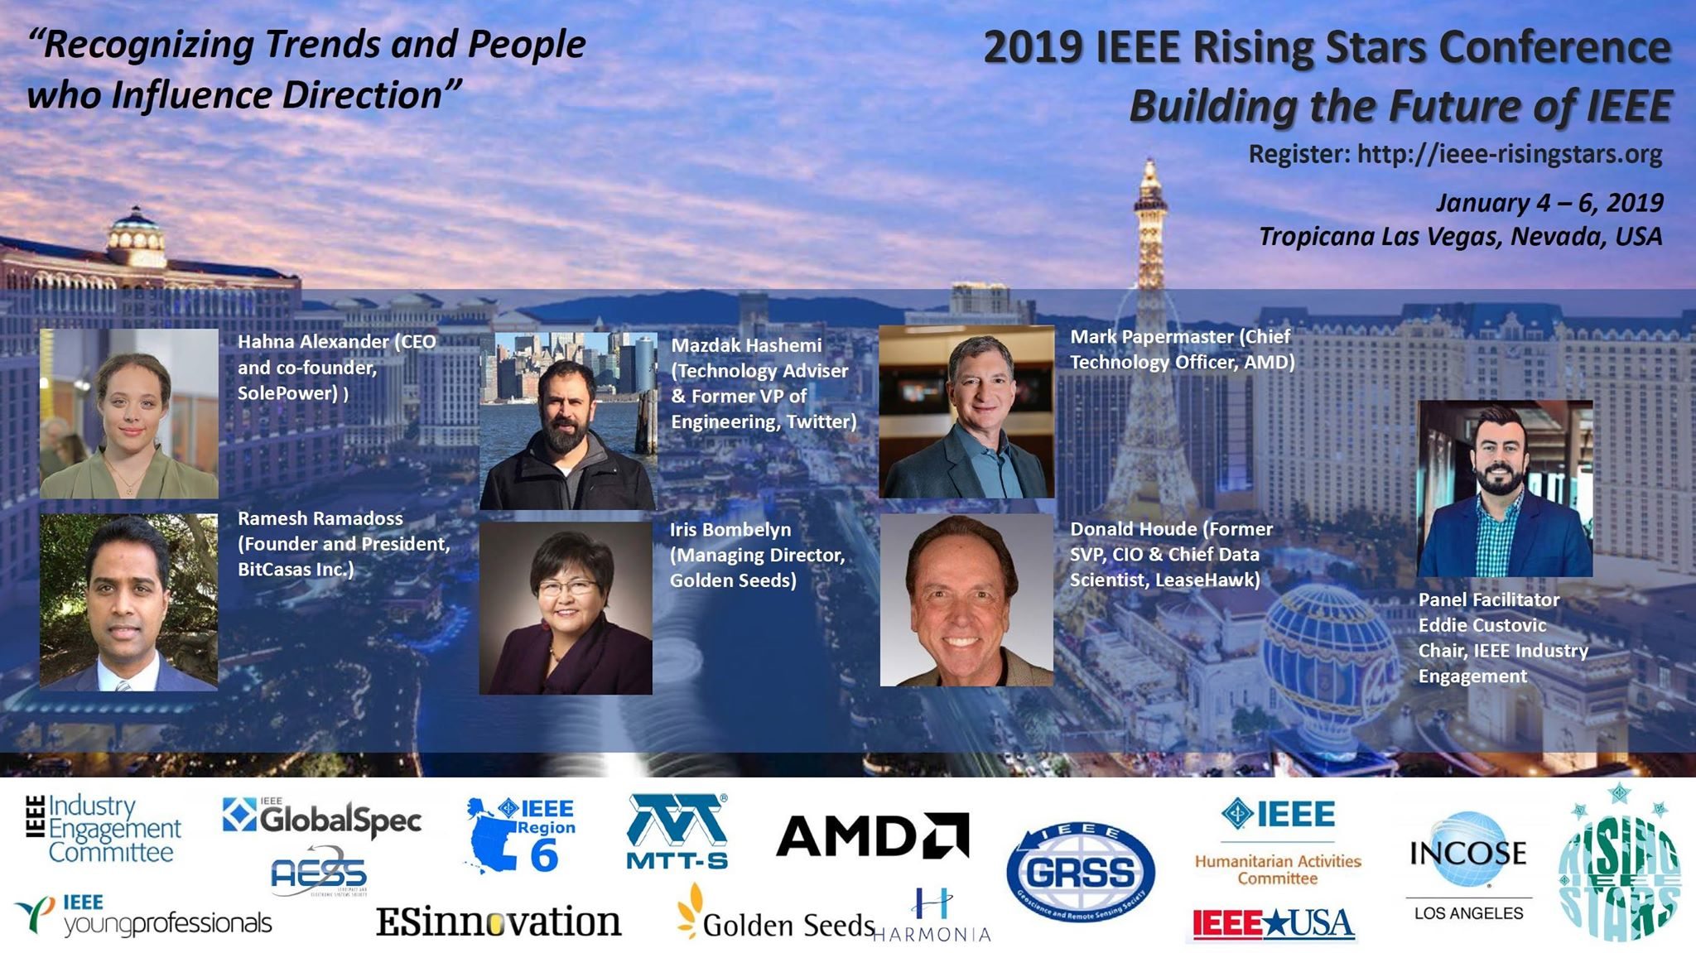
Panel Discussion:
Notes:
Followed by our welcome, we have a panel discussion on “Recognizing Trends and People who Influence Direction” – moderated by Eddie Custovic and featuring some of the industry experts.

Slide 7
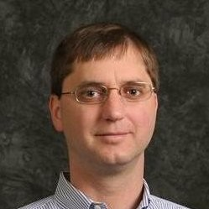
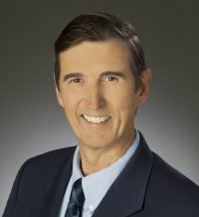
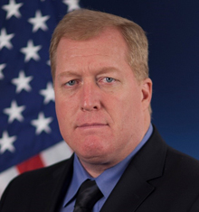
Conference Keynotes:
The Future of Memory & Data Storage
Richard New, VP of Research in the office of CTO, Western Digital
Four or More Ways to Go Out of Business – All Performed by the Same Company
John Treichler, Chief Technology Officer
Applied Signal Technology (Raytheon)
Proliferated Low Earth Orbit; Next Big Thing in Space
Paul Thomas, Program Manager
DARPA, Tactical Technology Office
Notes:
The conference has 3 keynotes – two keynotes are happening tomorrow and one on Sunday. Tomorrow’s morning keynote is by Richard New from Western Digital. The Lunch keynote is by John from Applied Signal Technology and the Sunday morning keynote is by Paul Thomas from DARPA.

Slide 8
Speaker topics:
Four tracks – Technical and Professional Development
Technical | Professional Development | Technical | Professional Development
5G – future wireless technology | Failing to succeed | Power & cyber security | Project management
Medical Technology & Digital senses | Adding value and leading | Smart Cities/IoT | Managing your career
Blockchain – hype to reality | Finance & wealth education | Space discovery/Aviation | Personal networking strategy
Next gen computing using machine learning | Humanitarian Technology | History & Future of radar | Driving decisions at work
Graphics Artificial Intelligence | Selling a creative idea and vision | Digital Intuition through predictive analysis | Making presentations that work
Notes:
The program is designed in such a way that gives you a complete package for your technical and professional development for both students and young professionals. The stellar speakers of this conference covers technical topics such as Machine Learning, Artificial Intelligence, Internet of Things, Autonomous Driving, Space Discovery and Computer Software. These are all top technology trends for 2019 leading the world forward. Our professional development track is developed to answer the following questions - what to expect in a job interview, how do I switch jobs and negotiate a salary with my employer, how do I startup my own company and how to evolve yourself in the ever-changing job environment. Our speakers and sessions would help answer most of these questions.
All the keynotes and the common session will happen at this very same ballroom and the breakout session rooms would have a maximum capacity of 70 people.

Slide 9
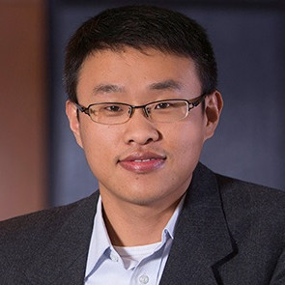
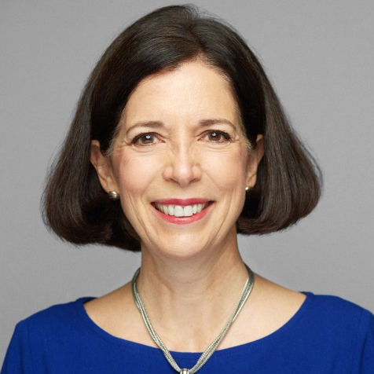
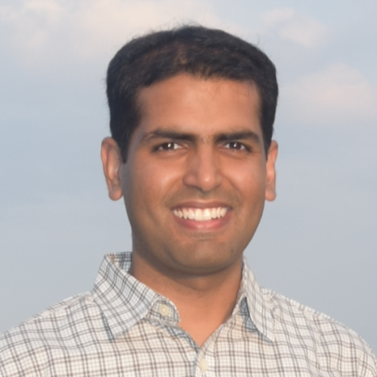
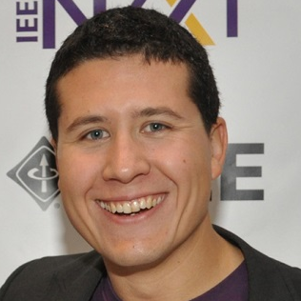
Career Aspirations Panel Discussion
Jan 5, Saturday at 5 PM followed by Corporate Mixer
Jay Guo
Reliability Engineer, Lam Research
Kathy Murphy
Independent Management Consultant
Ravendar Bhojwani
Senior Product Manager, Amazon.com
Sanna Gaspard
Founder & CEO, Rubitection Inc.
Moderator: Mario Milicevic, Ph.D.
Staff Comm. Systems Engineer, MaxLinear Inc. Chair, IEEE Public Visibility Committee
Notes:
Our program also features a Career aspirations panel discussion and networking sessions. The corporate mixer will give you a chance to sit 1X1 with one on one with prospective employers that are willing to provide tips to improve your resume and also answer any questions that you might have.

Slide 10
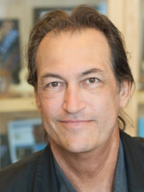
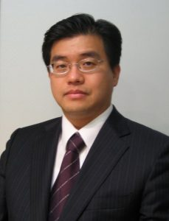
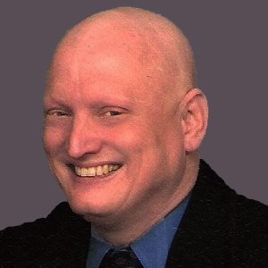
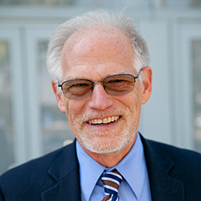
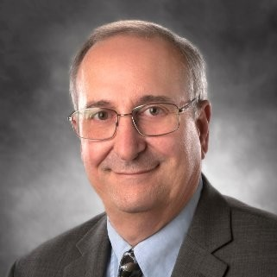
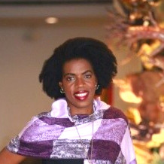
The Next Big Thing Panel Discussion
Jan 6, Sunday at 10:45 AM
Skip Rizzo
(USC Institute
of Creative Technologies)
Peter Pyun
(NVIDIA)
Mark Schneider
(Bentley Systems)
Tom Coughlin
(Coughlin Associates)
John Treichler
(Applied Signal Technology)
Allen Samuels
(Western Digital)
Sanna Gaspard
(Rubitection Inc.)
Notes:
Our conference ends on Sunday with the Next Big Thing panel discussion where our panelists would talk about the future in their areas of interest.

Slide 11
Special Events – Workshops
Cyber Security competition
Job Search and Resume Building
Arduino hardware
Conference attendees registered in advance for the workshops

Slide 12
Cybersecurity Competition
Cyber Security competition to test real world security skills, organized in collaboration with The Anfield Group
Will rely less on leveraging technology, and more on organizing good responses to cyber threats.
Competition takes place on Jan 4, from 2pm to 6pm.
Details of the competition available on - http://ieee-risingstars.org/2019-competition/
Students and young professionals in all majors are welcome to participate.

Slide 13
Workshops
Arduino/Hardware workshop & Job Search/Resume Building workshop
2 workshops happening in parallel – on Jan 4 from 2pm to 6pm
Students and YP’s can indicate which workshop they want to participate when they register for the conference.
Details of the workshop available on our website - http://ieee-risingstars.org/2019-competition/
Arduino workshop was organized by Intel
Job Search/Resume Building workshop is organized by Andrews & Associates.

Slide 14
Personal Funding Support
Talk to your school first. Most departments have funding available for students to attend these type of conferences.
Young Professionals – talk to your employer.
IEEE members (students and YP’s) should approach their section for support. Region 6 will match the section funding up-to $1000 per section by a PACE project.
For more details about funding, please visit us at http://sites.ieee.org/risingstars/registration/how-to-receive-funding-for-students-and-young-professoinals/

Slide 15
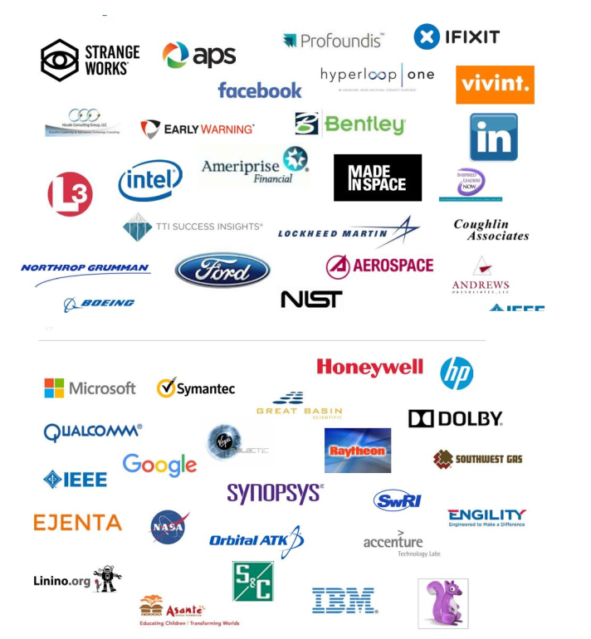
Corporations Involved

Slide 16
Will you help us?
The Rising Stars Conference program is driven by volunteers, industry forecasts, your interests, company and desired speakers
There are numerous opportunities to demonstrate commitment to the conference success
Volunteer on a conference committee
Become a Sponsor or help create a relationship with your employer
Provide speaker and topic suggestions
Encourage your section to support students and YP’s to attend Rising Stars.
Help us spread the word!

Slide 17
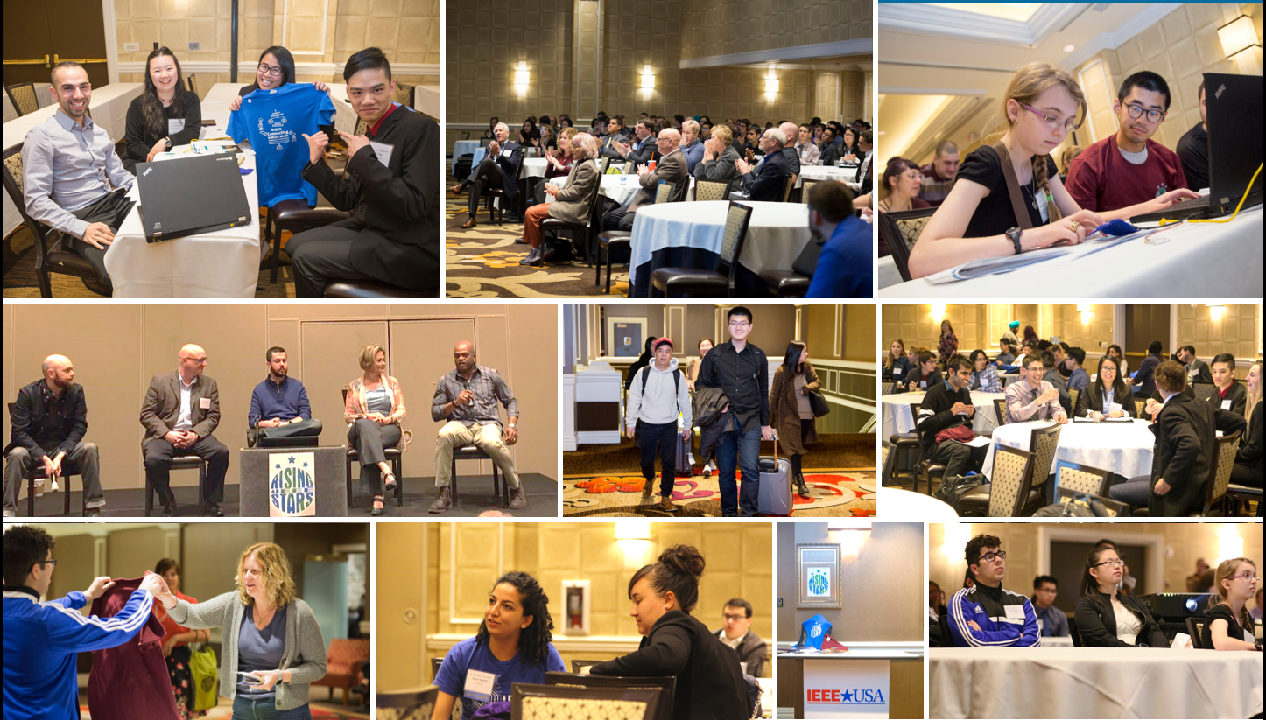
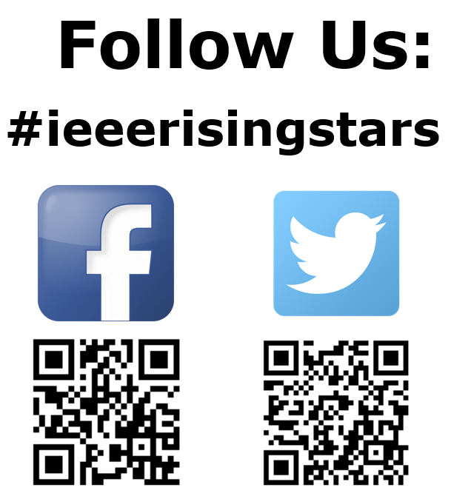
For additional information, please contact
Ramesh Nair – rameshnair@ieee.org
Mike Andrews - m.andrews@ieee.org
Anis Ben Arfi - anis.b.a@ieee.org

