Slide 1
vTools Updates Chris Gunning cgunning@ieee.org MGA vTools Committee member, Region 6

Slide 2
Topics
IEEE WordPress Hosting Migration
Survey tool replacement
vTools.Events, vTools.Voting, vTools.eNotice updates
OU Analytics
Where to find more information, report problems, etc.

Slide 3
IEEE WordPress Hosting Migration
Sites hosted on sites.ieee.org will be migrated to more secure server for better security and performance
Notifications have been sent to list of known site owners
You must opt in ASAP for migration
Else your site will go dark after Dec 31st
A redirect will be set up to redirect traffic from your current site to your new site after it’s been migrated
If you have a custom domain, its CName will need to be updated later

Slide 4
Survey tool replacement update
Checkbox is FluidSurveys replacement
Accounts are created per request from vTools portal
54 accounts have been created so far
IEEE staff is using Checkbox as well

Slide 5
vTools.Events updates
@Event is a new on-site registration feature
Available via Events web page; works on mobile devices too
View registrations
Add new registrations
Check-in attendees
Update registration information
For more details see http://sites.ieee.org/vtools/event-enhanced-on-site-registration-using-a-mobile-tablet-device
GDPR Compliance changes
Events registration includes IEEE Privacy Policy
Event Management includes Data Access and Use Policy consent for volunteers

Slide 6
vTools.Voting updates
Enhancements
Added auto-load option for voter list
Updated links for required reporting for local election results and voter instructions
GDPR Compliance changes
Removed voter status option
Voting Dashboard includes Data Access and Use Policy consent for volunteers

Slide 7
vTools.eNotice updates
Expanded usage of eNotice to support Societies
Added Express option for Student Branches and HKN Chapters

Slide 8
IEEE OU Analytics
What is OU Analytics
In May, OU Analytics replaced SAMIEEE as the tool for volunteers to access membership data and statistics
OU Analytics is built on Tableau business intelligence tool
OU Analytics uses the same data sources used by SAMIEEE
Accessible via browser and mobile app
Access is based on the volunteers’ position and OU.
User will only obtain data for their OU unit(s) and position level.
For a list of volunteer positions, go to: http://www.ieee.org/about/volunteers/samieee/samieee_positions.html
OU Analytics allows users to view and further define visualizations based on IEEE membership data
Users can also download detailed data such as membership lists

Slide 9
OU Analytics updates
Recent access issues
There were issues with the process that synchronizes user access to OU Analytics which impacted volunteer access for several days
All existing access to volunteers have been restored
Staff adding missing functionality, improving FAQ page, and developing short “how-to” videos
See what's coming in the future
OU Analytics User Group
Purpose: identify the top issues affecting user productivity, and provide a communication path between users and IEEE staff
Issues are added to vTools committee prioritized issue list
The user group is currently meeting twice a month via WebEx.
If you are interested in participating, contact Chris Gunning (cgunning@ieee.org) or Larry Hamerman (l.hamerman@ieee.org)
IEEE Collabratec Group: IEEE OU Analytics
Foster communication between IEEE staff and volunteers

Slide 10
Finding more information
Learning about tools, reporting problems, getting help
Portal: http://sites.ieee.org/vtools (quick tip: Google “ieee vtools”)
Home – overview, video introduction
Tools – list and description of tools
Tutorials – on-demand “quick start” web tutorials
FAQ
Blog – news and tips
Feedback – submit feature requests and bug reports
Contact – send message to vTools staff

Slide 11
Q&A

Slide 12
Backup

Slide 13
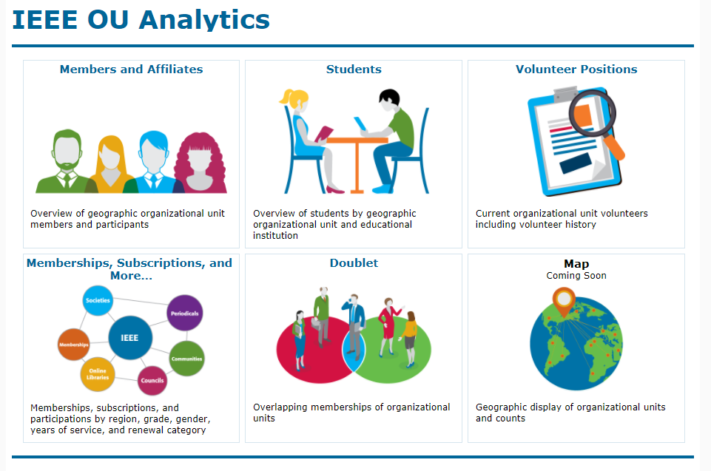
IEEE OU Analytics
How to access
Convenient link available on SAMIEEE Home Page at:
https://mga.ieee.org/resources-operations/volunteer-tools/samieee
Or access the Dashboard Landing Page directly at: https://tblanalytics.ieee.org/#/site/IEEE/views/LandingPage_0/LandingPage?:iid=1

Slide 14
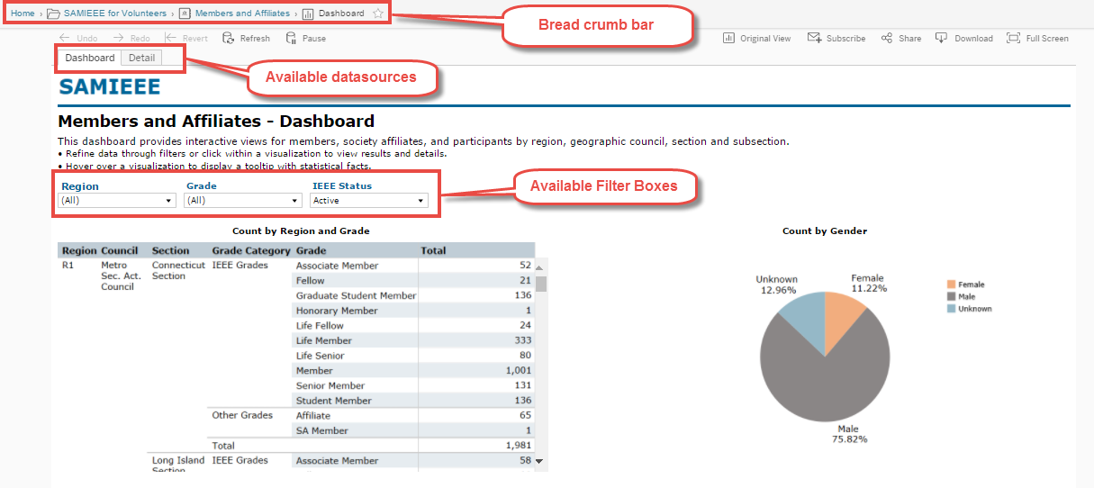
IEEE OU Analytics
How to navigate the dashboards
On the dashboard pages (example: “Members and Affiliates” link.) users will see . . .

Slide 15
IEEE OU Analytics
Now for a closer look at the
individual dashboards

Slide 16
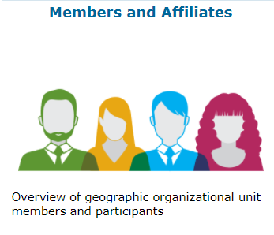
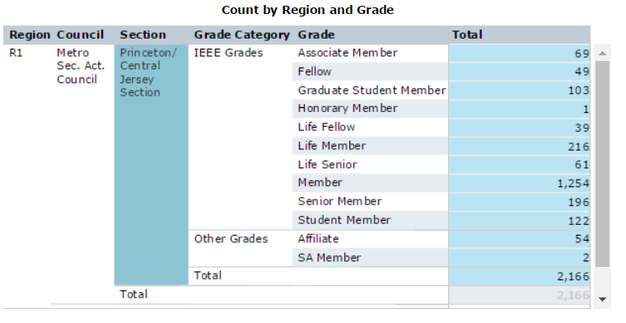
IEEE OU Analytics
Members and Affiliates Dashboard
The Members and Affiliates Dashboard provides an overview of IEEE members, society affiliates, and SA members by their geographic organizational units.
An overview count of members by Region, Council, Section and Subsection is available.

Slide 17
IEEE OU Analytics
Members and Affiliates - Dashboard
There are two tabs available.
Dashboard – shows the predefined tables and charts available for a breakdown view of your members.
Detail – contains the individual member information. Access the member information by clicking on “View Details” in Tool Tips or clicking on “Detail” tab.
Detail shows member contact information.
Download contains additional fields depending on dashboard.

Slide 18
IEEE OU Analytics
Downloading Data
Tableau provides many tools for displaying, filtering, and manipulating data. However, if you need to download, there are several options found under the Download button.
The following options are available:
Image – downloads the image on your screen to a png file.
Data – (not recommended) downloads the data to a csv file. This option requires multiple steps for downloading to a text file and does not retain format.
Crosstab – (recommended download option) downloads the data to a csv file.
PDF – downloads the image on the screen to a PDF file.
Important note, if you do not select the title of the visualization before clicking Download, the data and crosstab options will be grayed out.

Slide 19
IEEE OU Analytics
Students - Dashboard
The Student Dashboard provides information regarding members (any grade) attending educational institutions. Information is grouped by Region, Section and School.
There are two dashboard tabs available:
Dashboard – shows the predefined tables and visualizations available for a breakdown view by School, Grade, Gender and Field of Study.
Detail – contains the individual member information.
Top level filtering is on Region, Grade and IEEE Status.

Slide 20
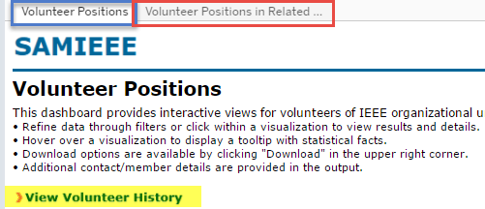
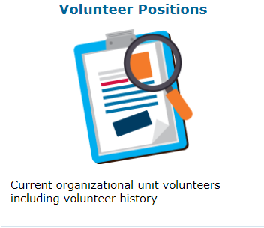
IEEE OU Analytics
Volunteer Positions - Dashboard
The Volunteers Dashboard has two tabs and one link available.
Volunteer Positions – lists “all” current IEEE volunteer positions. Use filter options to select a specific OU type and OU Name.

Slide 21
IEEE OU Analytics
Memberships, Subscriptions, and More… - Dashboard
Renewal Category Dashboard – provides product renewal information based on filters selected. Renewal categories provided are: Renew, First Year Renewed, New, Reinstated, Not Yet Renewed and Cancelled.
Filters provided are Product Type, Product Name, Region, Grade, and Status.
Overview of Product Renewals (bar chart) – provides a breakdown by renewal categories. Hover over to view additional statistical information.
Product Summary by Region by Renewal Category (data table) – provides a count of members by Region by Renewal Category.
Recommendation: Downloading Column and Row Totals default to “Grand Total” counts, which can be significant and provide excess data. Use Filters to refine data per OU.

Slide 22
IEEE OU Analytics
Questions & Assistance
If you have any questions regarding OU Analytics or need further assistance send an email to ouanalytics@ieee.org

Slide 23
Other recent vTools changes (2017)
Events
New support for custom registration questions
New support for student branches and IEEE-HKN
Registration payment data now includes price description and restriction
eNotice
Personalization of eNotice messages
Customization of ‘From’ and ‘Reply To’
Send test eNotice
Link to view an event included in eNotice messages
Officer Reporting
Updated look and feel

