Slide 1
Section Vitality Dashboard – OA Analytics Side-by-Side Comparison

Slide 2
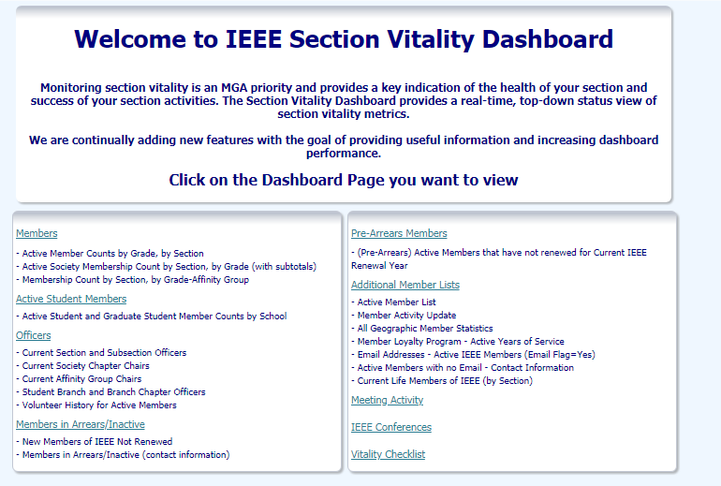

Slide 3
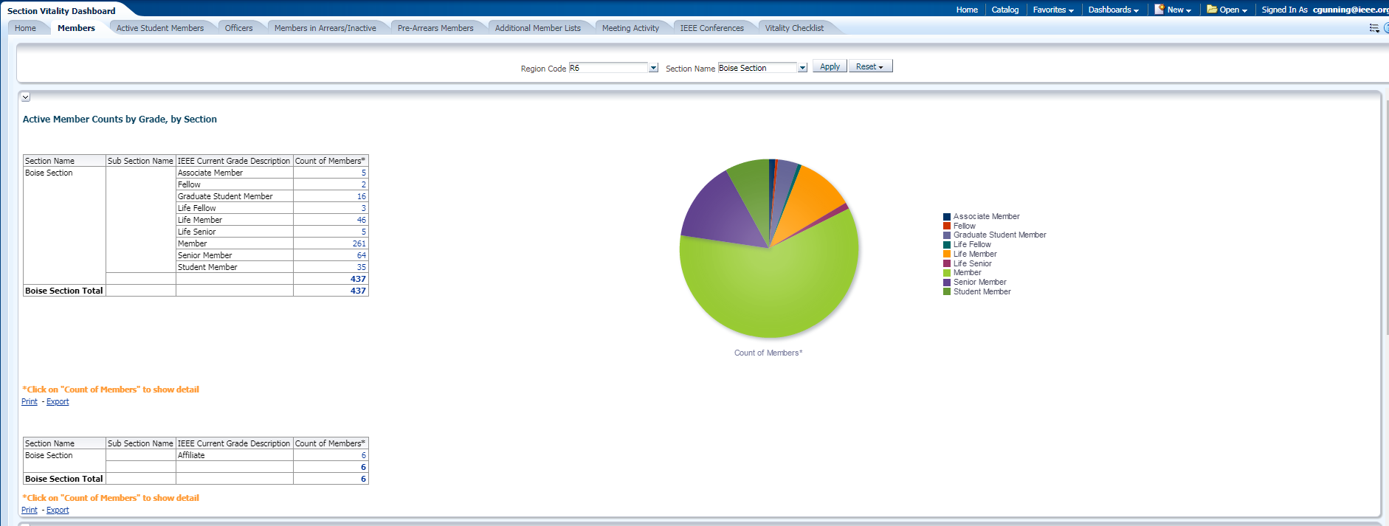
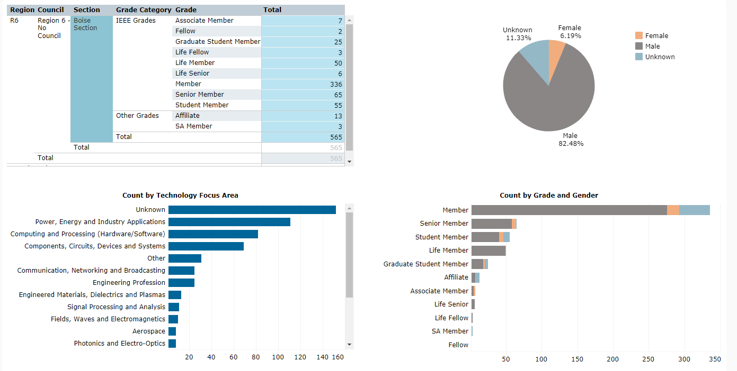
Members - Dashboard

Slide 4
Comparison
How to get section membership data by technical society?
A: See “Memberships, Subscriptions, and More – Product Summary”. But no way to filter at the section level except by downloading data and applying a filter in Excel.
How to get affinity group membership data? (YP, WiE, SA, Consult N/W)
A: Same way as society membership data

Slide 5
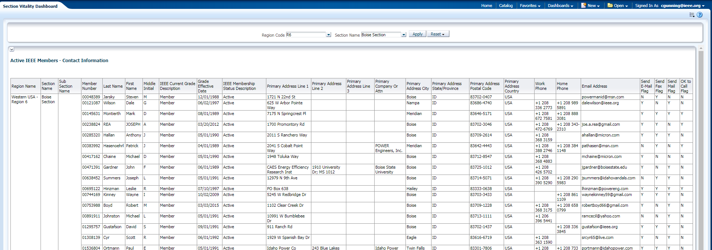
Members - details

Slide 6
Comparison
OU Analytics downloaded detail data appears to be a superset of Section Vitality dashboard details data.
Member primary address, technology focus area, and OK to email/mail/call values only available via download.

Slide 7
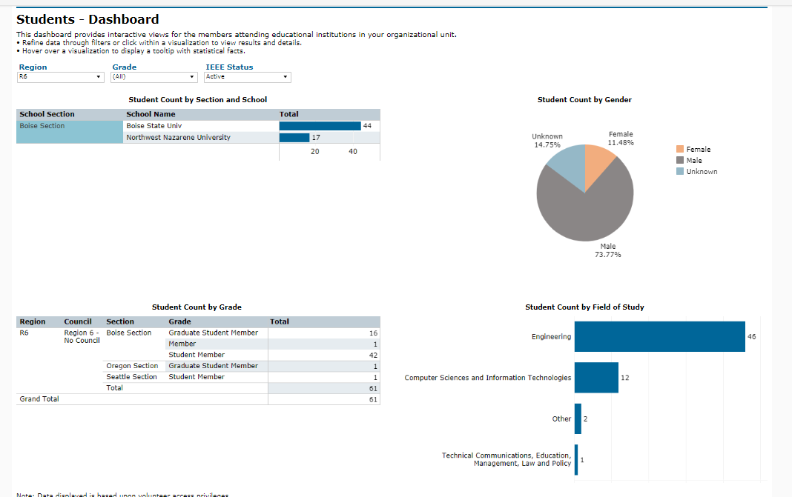
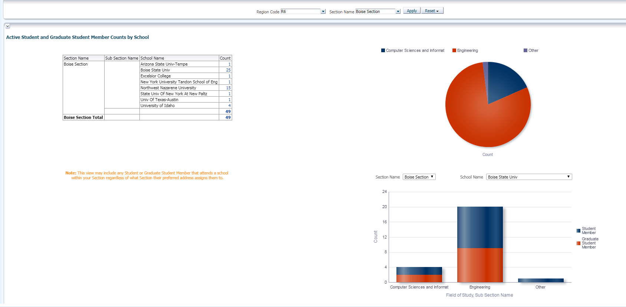
Active Student Members – Dashboard

Slide 8
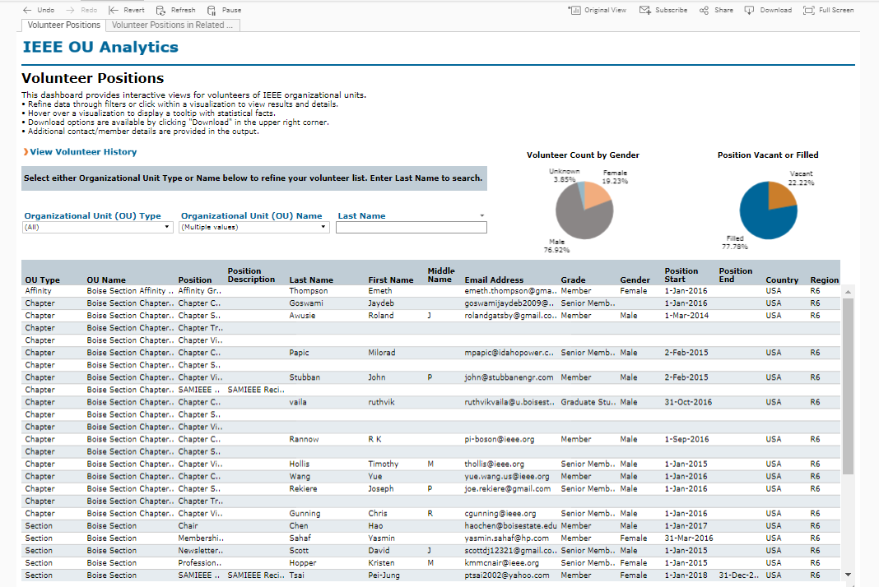
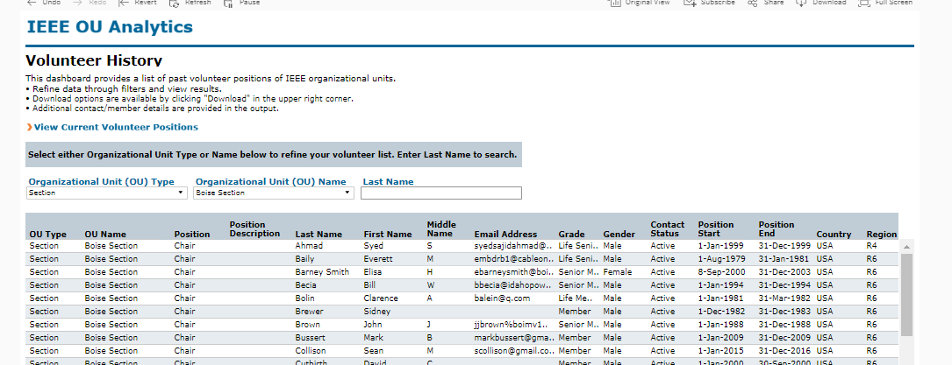
Officers - Dashboard
Not clear how to get volunteer history for only active members without downloading and filtering data

Slide 9
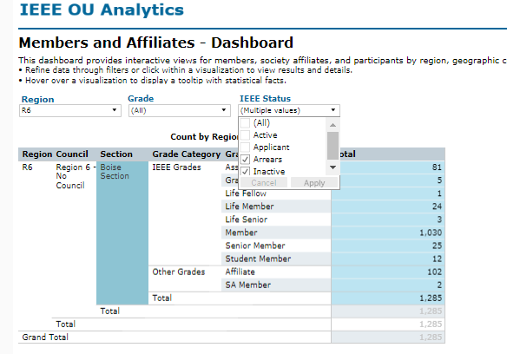
Members in Arrears/Inactive - Dashboard
Simple filter on members dashboard. Details available on “Detail” tab. However, the totals look far too large.

Slide 10
Pre-Arrears Members - Dashboard
After 10 minutes, Oracle BI still hadn’t displayed results.
Not directly available on OA Analytics dashboard. Had to download active member list into Excel and filter on renewal year == last year

Slide 11
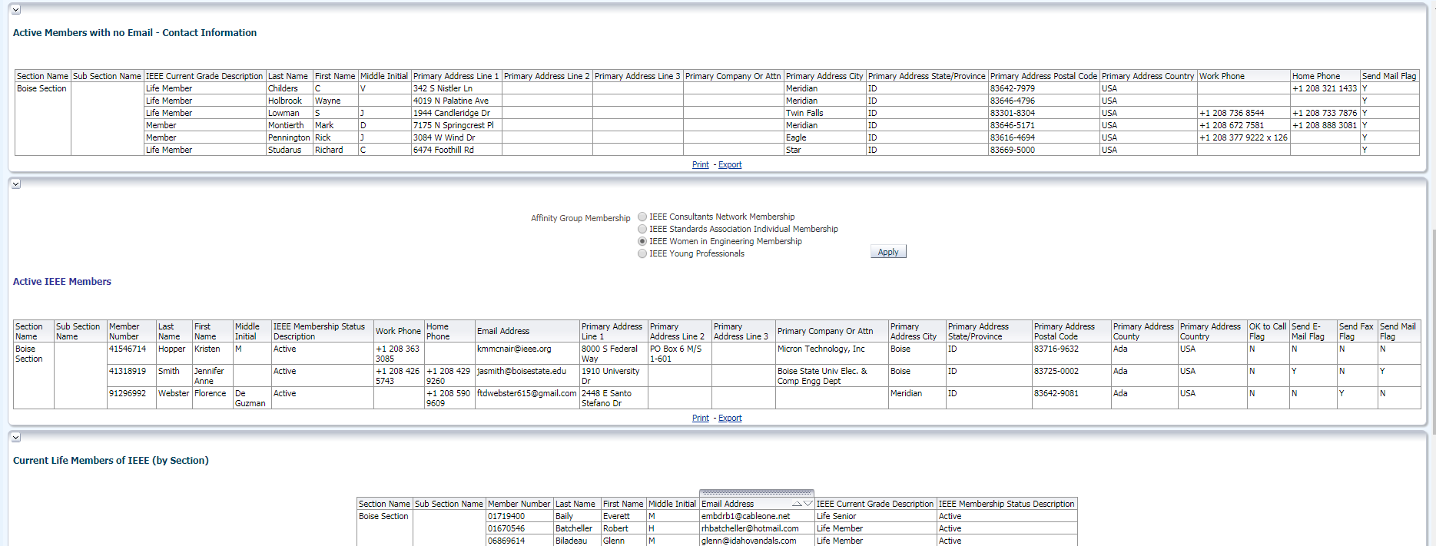
Additional Member Lists
Not available on OA Analytics dashboard. Have to download member list into Excel and filter on desired criteria.
Can’t find any way to generate a Member Loyalty Program report – no information available about cumulative years of service???

Slide 12
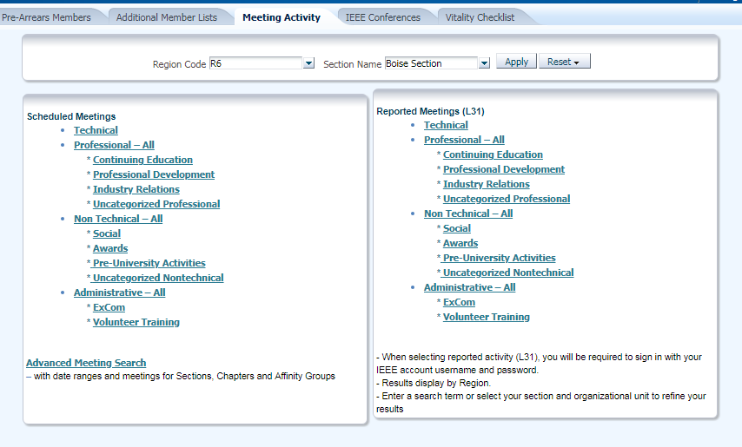
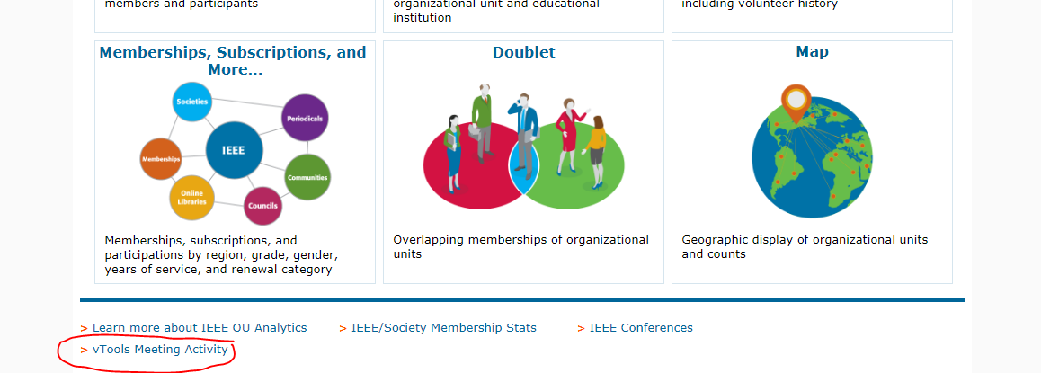
Meeting Activity - Dashboard
OU Analytics links back to Oracle BI

Slide 13
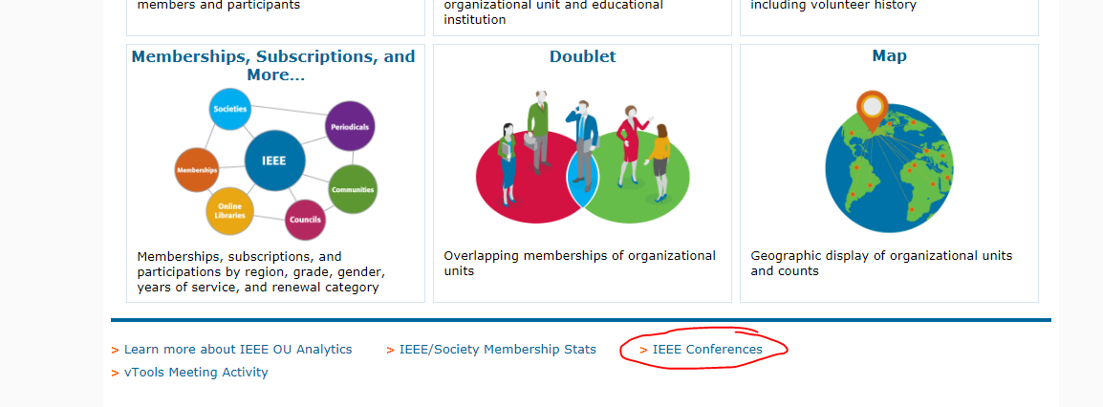
IEEE Conferences – Dashboard
OU Analytics links back to Oracle BI

Slide 14
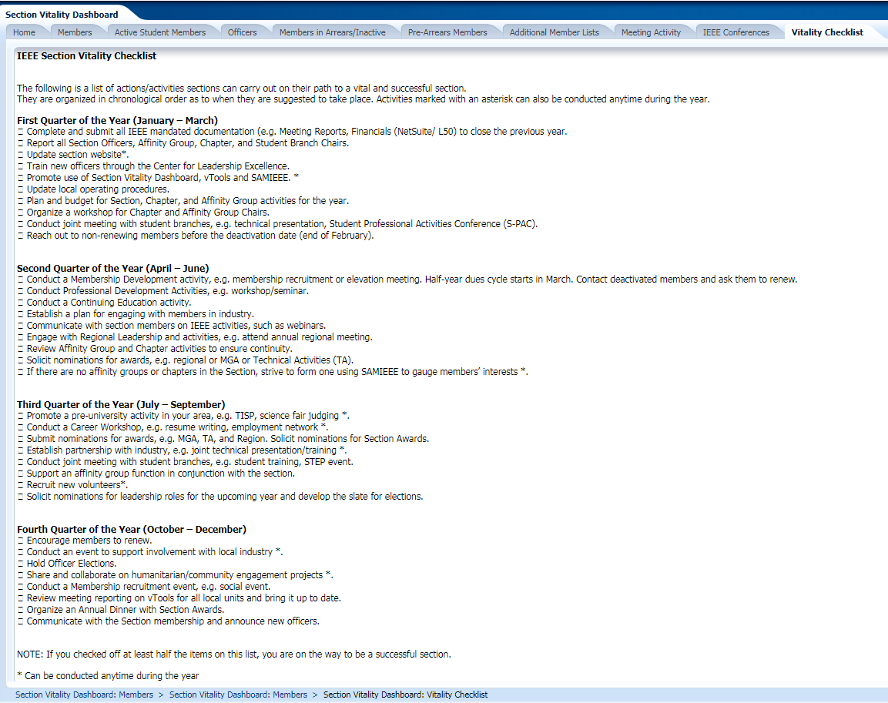
Vitality Checklist
Nothing comparable in OU Analytics? Seems like this could easily be added as a link on the dashboard landing page.

