Slide 1
2018 IEEE R6 NEA Fall Meeting
Peijung Tsai ptsai@ieee.org

Slide 2
Agenda
 |  | Cascade 1
8:30-8:45 | Introductions & Welcome | Peijung
8:45-9:30 | Director’s Update | Kathleen
9:30-9:45 | SAC | Elisa
9:45-10:00 | YP | Ravendar
10:00-10:15 | EAB | Mosttafa
10:15–10:30 | Morning Break
10:30-10:45 | Pace | Mostafa
10:45-11:00 | MISC update | Peijung
11:00-11:15 | MD update | Peijung
11:15-11:30 | Section Vitality | Elisa
11:30-12:00 | Vtool | Chris
12:00–13:15 | Lunch
13:30-14:00 | OUAnalytics | Chris
14:00-15:00 | Section Update & Best Practices | All
15:00- 15:15 | Afternoon Break
15:15-15:45 | Best practices & 2019 meeting dates/Wrap up | All
15:45-16:00 | Wrap UP & Action item review

Slide 3
Agenda – student training
 | Cascase 2 | Cascade 2
8:30-8:45 | Introductions & Welcome | Peijung
8:45-9:30 | Director’s Update | Kathleen
9:30-9:45 | SAC | Elisa
9:45-10:00 | YP | Ravendar
10:00-10:15 | EAB | Mosttafa
10:15–10:30 | Morning Break
10:30- | Branch operations
 | Student activities opportunities 2018-2019
- 12:00 | funding opportunities
12:00–13:15
13:15 | SPAx
- 16:00 | brainstorming and branch planning exercise

Slide 4
Logistics
Coffee/Drink: hotel lobby
Lunch
Restrooms

Slide 5
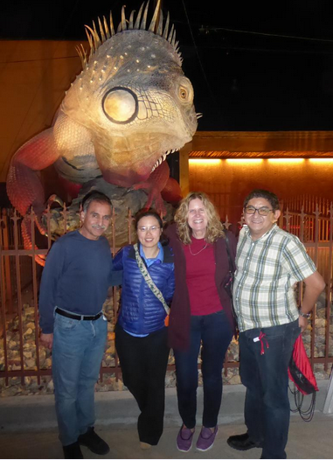
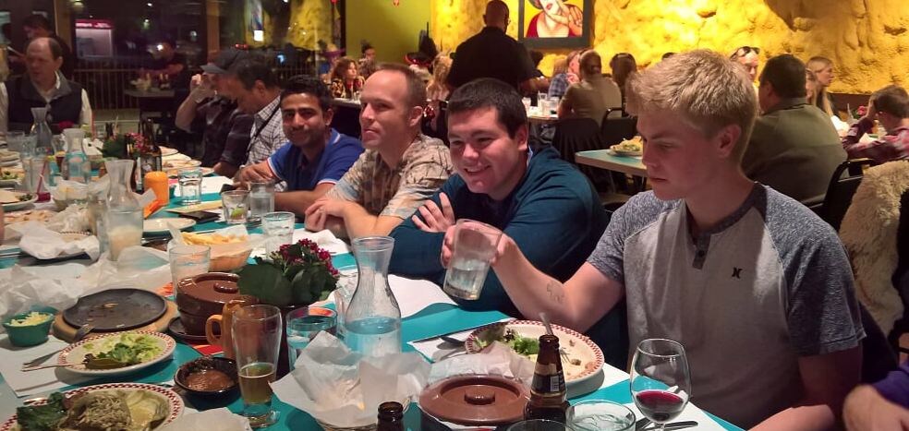
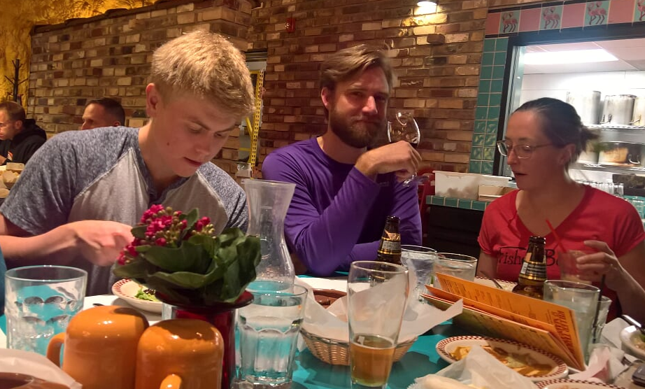
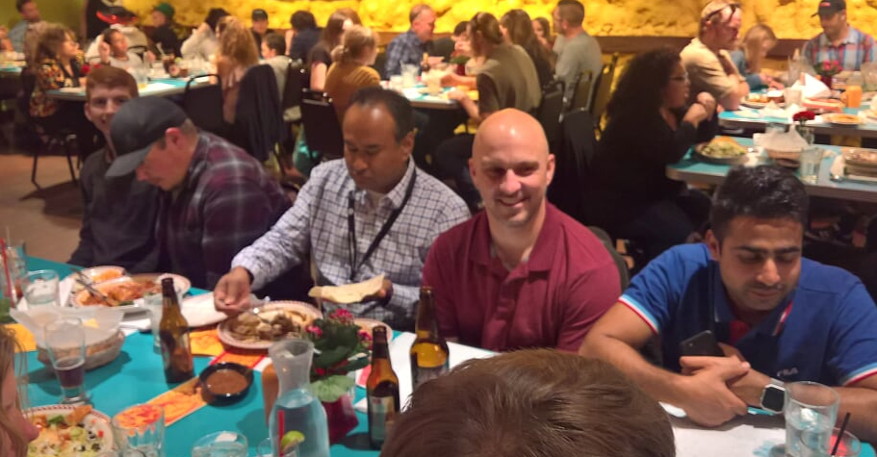
https://photos.app.goo.gl/oAAS3yxReA27Mb3Y7

