Slide 1

2018 IEEE R6 NEA Fall Meeting
Peijung Tsai ptsai@ieee.org

Slide 2
WiE
EEE WIE Summit at Los Alamos (Aug 7th 2018)
  government sector and National Labs.
  This talented vertical employs such a large percentage (15% of all engineers, 1/3 of all CS)
  Similar event for 2019
IEEE WIE ILC 2019- Lead Beyond
  May 23-24, 2019; Austin, TX
  Speaker requests are open, so please encourage potential speakers to sign up on the site by Nov 20, 2018 http://ieee-wie-ilc.org/call-for-speakers/
  This is also the time to engage sponsors

Slide 3
Awards
MGA awards – Oct 15, 201
  MGA Larry K. Wilson Transnational Award
  MGA Innovation Award
  MGA Leadership Award - up to 3
  MGA Achievement Award – up to 3
  MGA Young Professionals Achievement Award – up to 6
  https://mga.ieee.org/awards/mga-awards

Slide 4
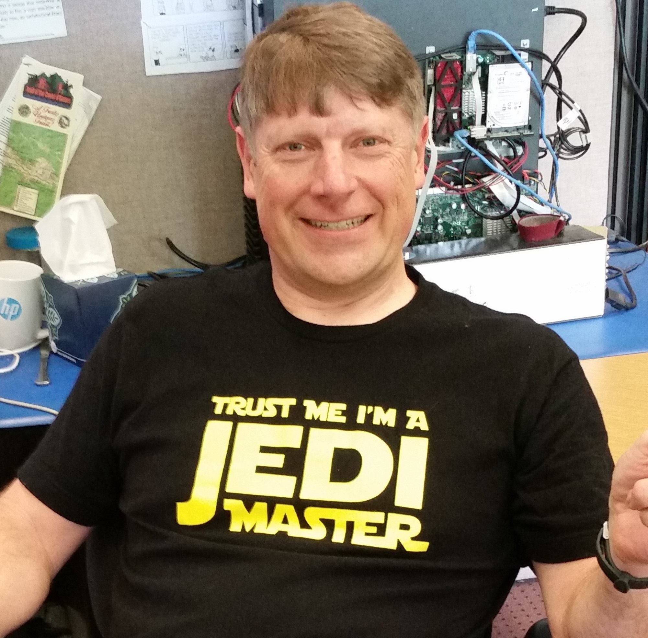
Region 6 Outstanding Service & Leadership – Chris Gunning

Slide 5
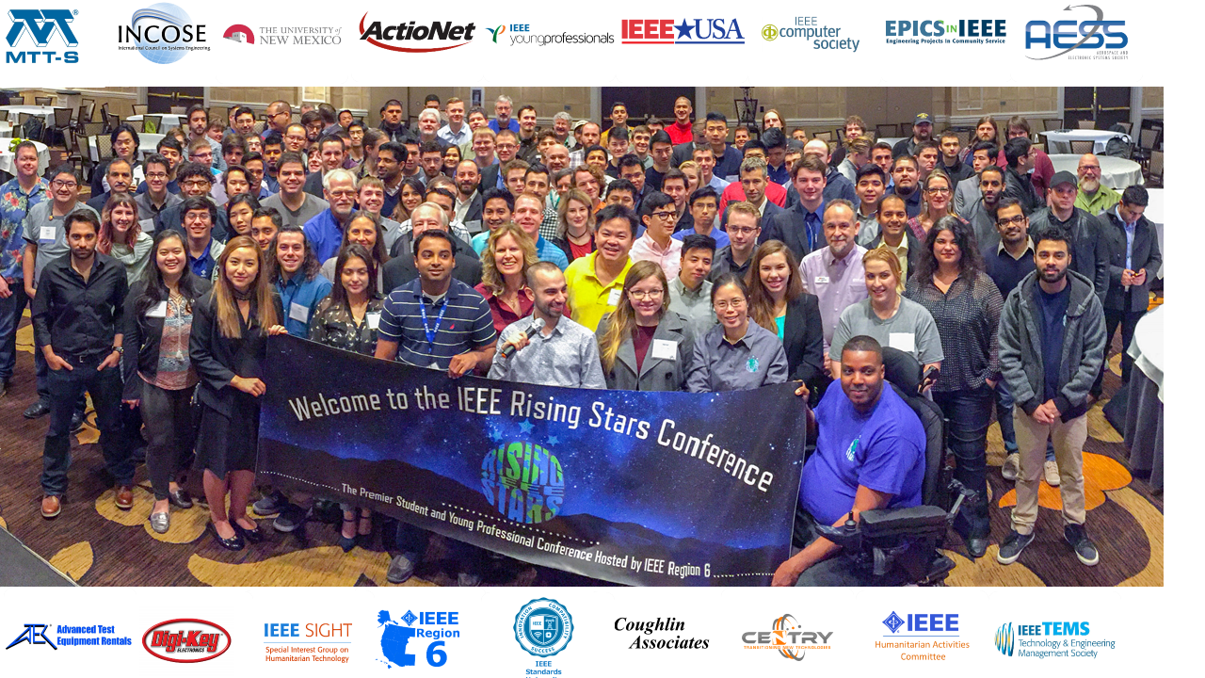
2019 IEEE Rising Stars Conference
A premier student and young professionals conference from IEEE Region 6
January 4-6, 2019
Tropicana, Las Vegas

Slide 6
Overview of Rising Stars:
2019 will be the 5th IEEE Rising Stars Conference, first one happened in 2015. Dates are Jan 4-6. Venue is Las Vegas.
Conference has grown significantly over the past several years.
The 3 day event aims at student and young professionals technical and professional development and competitions.
Increase in number of Young Professionals YoY. 40% attendees at 2018 RS were YP’s.
Partnership and collaboration with several IEEE OU’s and industry.
Attendees receive support from Region 6 and IEEE-USA PACE.

Slide 7

Conference Highlights
2 parallel tracks – Technical track and Professional Track
1 competition & 3 workshops – Cybersecurity competition, RISC-V workshop by Western Digital, Arduino workshop by Intel & Resume/job search workshop.
Keynotes – Tamara Dull (SAS Institute), Robin O’Neill (Head of Emerging Systems & Software, Western Digital)
Speakers and sponsors from -

Slide 8

Conference Topics
Technical track topics
  Autonomous Vehicles
  Cyber security
  5G communication
  Space discovery
  AI/VR & Machine learning
  Radar Electronic warfare and much more…
Professional track topics
  Entrepreneurship
  Making good presentations
  Soft skill development
  Professional networking
  Financial education
  Completing a powerful interview
  Decision making

Slide 9
Speakers
James Kimery - Director of Wireless Research National Instruments
Dan Schweiker - President and Founder, China Mist
Kathy Murphy - Merryck & Co
Rick Hefner - Program Director, California Institute of Technology
Terence Yeoh - The Aerospace Corporation
Skip Rizzo - Research Director – USC Institute for Creative Tech
Tom Coughlin – President, Coughlin Associates
Carolyn Andrews - CEO, Inspired Leaders Now
Keith Moore - US Army Information Systems Engineering Command
Mark Schneider - Bentley Systems
Ramesh Ramadoss - Bitclass Inc.
Mathew Allred - Ameriprise Financial
Sid Msihra - Scientist, JPL/NASA
Iris Bombelyn - Managing Director, Golden Seeds
Guarav Pandey - Technical Specialist Robotics and AI, Ford Motors
Lorenzo Lo Monte - Chief Scientist, Telephonics
Rick Hefner - Program Manager, Caltech
Mario Milicevic - Communications Systems Engineer, MaxLinear
Michael Andrews - Managing Partner, Andrews & Associates

Slide 10

Cybersecurity Competition
Cyber Security competition to test real world security skills, organized in collaboration with The Anfield Group
Will rely less on leveraging technology, and more on organizing good responses to cyber threats.
Competition takes place on Jan 4, from 2pm to 6pm.
Details of the competition available on - http://ieee-risingstars.org/2019-competition/
Students and young professionals in all majors are welcome to participate. Just indicate that you are participating in the competition when you register for the conference!

Slide 11



Workshops
RISC-V workshop, Arduino workshop & Job search workshop
3 workshops happening in parallel – on Jan 4 from 2pm to 6pm
Students and YP’s can indicate which workshop they want to participate when they register for the conference.
Details of the workshop available on our website - http://ieee-risingstars.org/2019-competition/
RISC-V workshop is organized by Western Digital, Arduino workshop is organized by Intel and Job search/resume building workshop is organized by Andrews Associates.

Slide 12
Funding Opportunities:
Talk to your school first. Most departments have funding available for students to attend these type of conferences.
Young Professionals – talk to your employer.
IEEE members (students and YP’s) should approach their section for support. Region 6 will match the section funding up-to $1000 per section by a PACE project.
For more details about funding, please visit us at - http://ieee-risingstars.org/registration/how-to-receive-funding-for-students-and-young-professoinals/

Slide 13
Register TODAY:
Early bird registration ends Nov 15!!
Registration link - http://ieee-risingstars.org/registration/
2019 Rising Stars Registration Fee - Early Bird Discount Rates (until Nov 15, 2018)
  IEEE Life/Student/Grad Student Member $295
  IEEE Member $349
  Non-Member $499
Price goes up after 11/15/2017 as follows
  IEEE Life/Student/Grad Student Member $345
  IEEE Member $399
  Non-Member $499

Slide 14

Thanks to our Sponsors:

Slide 15
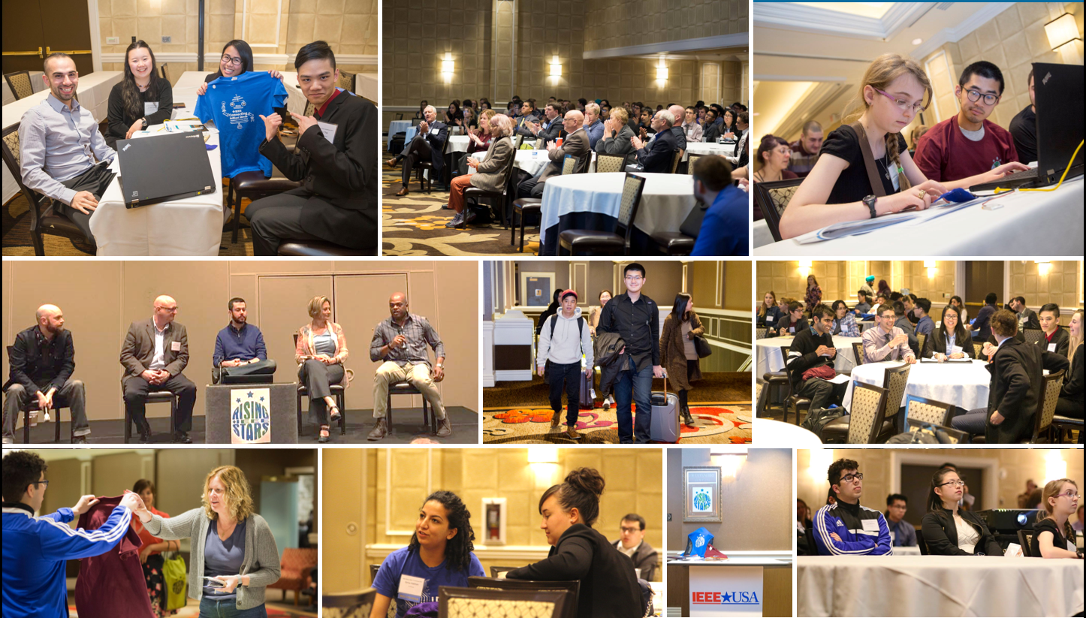

www.ieee-risingstars.org
For questions, please contact
Ramesh Nair – rameshnair@ieee.org

Slide 16
Rising Stars Member Retation
2018 attendees
  Retention (as of May 2018) : 90% vs IEEE total: 68% in May 2018
2017 attendees
  Retention: 84% vs IEEE total: 69% in 2017
2016 attendees
  Retention: 82% vs IEEE total: 68% in 2016

Slide 17
NEA Conference - 2019
name | Location | date | Society
Aerospace Conference | Big Sky, MT | Mar 2-9 2019 | AESS, AIAA, PHM

