Slide 1
IEEE Branch Training
Elizabeth Johnston
Region 6 Student Activities Chair
Lise.johnston@ieee.org
Fall Area Meetings

Slide 2
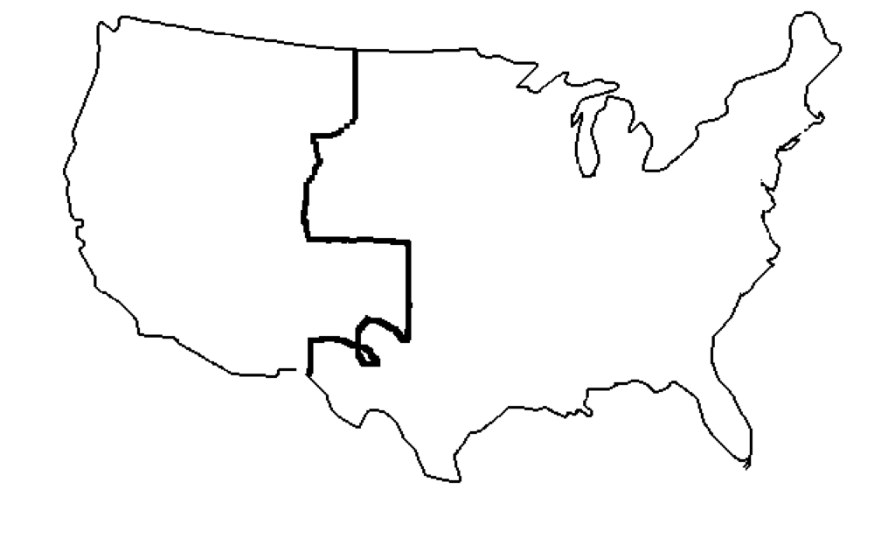
Geographic entities of the IEEE
Southwest Area of Region 6
Region 6
Areas
Regions
Student Branches
Sections
Univ. of Calif.
at San Diego
IEEE Student
Branch
San Diego Section
of Southwest Area
of Region 6
Note: Not drawn to scale and
boundaries are only approximate
Region 6 in the World

Slide 3
Region 6 Student Activities
Student Activities Chair
Elizabeth Johnston lise.johnston@ieee.org
Student Representative
Mariela Saviola msaviola@sandiego.edu
SPAx Chair (Student Professional Awareness)
Paulo Vasconcelos Paulo.Vasconcelos@ieee.org

Slide 4
Student Activities Committee Region 6
Ramesh Nair rameshnair@ieee.org
Charlie Mayer cemayer@alaska.edu
TBD - Peijung Tsai ptsai2002@yahoo.com
Xun Luo xun.luo@ieee.org
Walter Lu walteriu@ieee.org

Slide 5
E-communication
R6 SAC Facebook
https://www.facebook.com/ieeer6students/

Slide 6
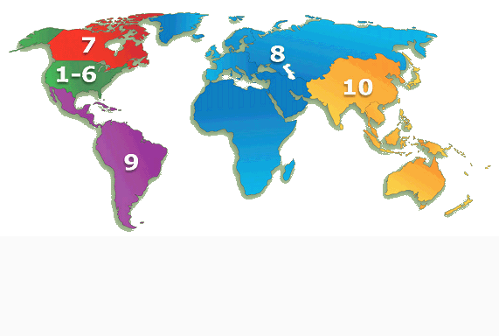
IEEE & THE WORLD
Students (08/18)
92,018
>24%
Total
383,674
100% were Students at one point
65% joined as Student Members

Slide 7
What is IEEE?
The biggest engineering professional association worldwide
The only truly trans-national of its kind
A network of engineers (and future engineers) from diverse fields of knowledge
One of the world’s most known fosters of engineering knowledge, due to its publications and conferences
Holder of one of the most famous standards associations
(you know, like WiFi or Firewire)

Slide 8
Who qualifies for IEEE student
Membership?
Undergraduate or graduate students taking at least
50% of a normal full-time course of study in IEEE
designated field (going to school at least part-time)
Listed below are the IEEE designated fields. These are important because it is from these areas that you can recruit new student members.
Engineering
Computer Science and Information Technology
Physical Sciences
Biological and Medical Sciences
Mathematics,
Technical Communications, Education, Management, Law and Policy

Slide 9
Who can tell me what this means?
GSM

Slide 10
Introduction
Name
Branch or Section
Your IEEE Position
What is your number one goal this year?
OR: Why did you become an IEEE member?

Slide 11
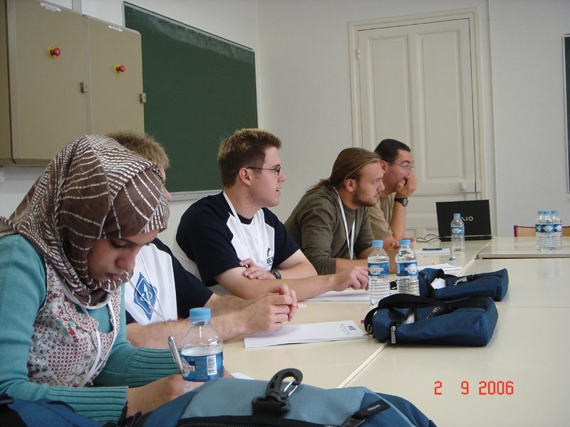
Goals & Objectives for Today
Inform you of existing activities and benefits
Help with communication between existing branches, chapters and Sections
Help you plan your upcoming year

Slide 12
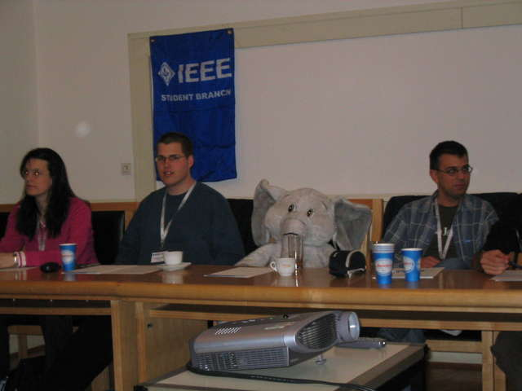
Officially How to Run an B+ Branch
Hold this year’s elections Submit report:
https://officers.vtools.ieee.org/
by Nov 1
Hold 4 events, record process
http://sbr.vTools.ieee.org
Hold next year’s elections Give new officers “Event Planning for Dummies” Repeat

Slide 13
Due NOVEMBER 1st

Slide 14
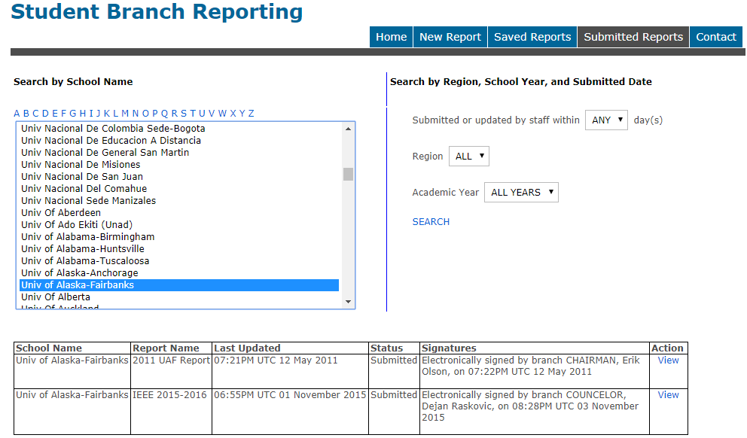

Slide 15
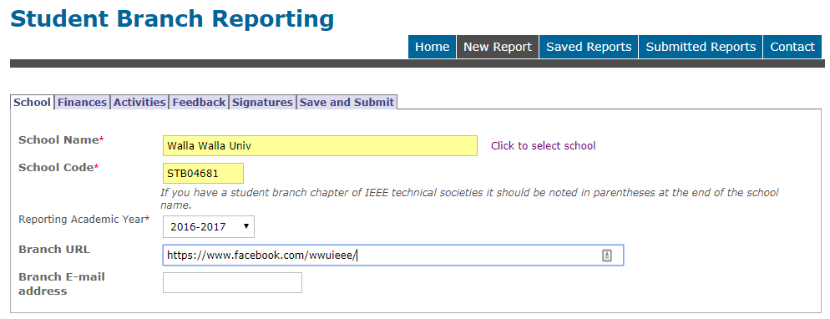
If you have trouble contact your Area SAC or Region SAC team.

Slide 16
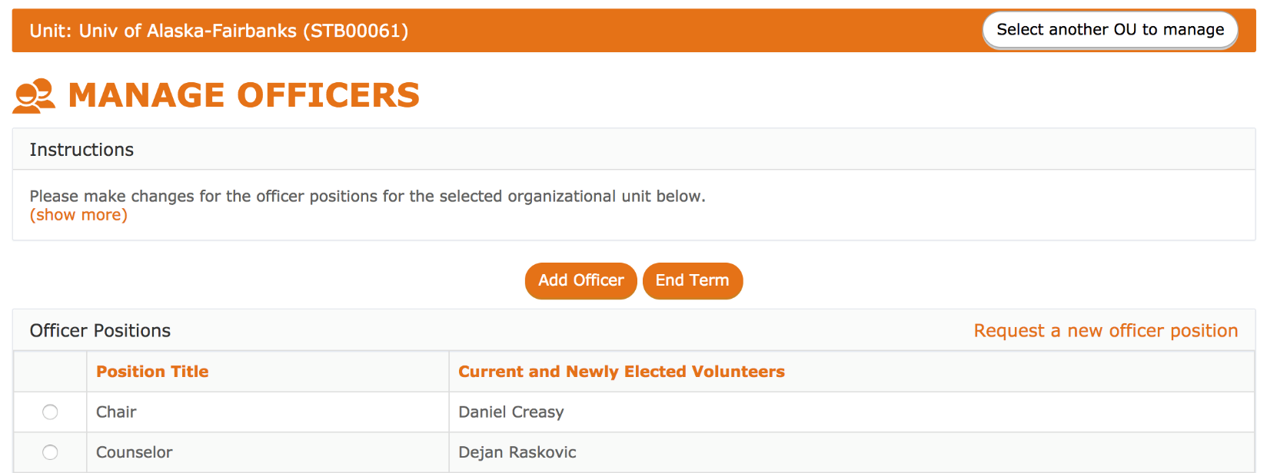
https://officers.vtools.ieee.org/
ASAP

Slide 17
How do I run a A+ branch?
B+ branch activities plus....
Nominate people for awards
Do community service (EPICS)
Hold good meetings*
Go to Section meetings
Mentor successors (officer shadowing)
Raise money to attend conferences
Raise professional awareness (self & others) Host
STEP receptions & network with YPs

Slide 18
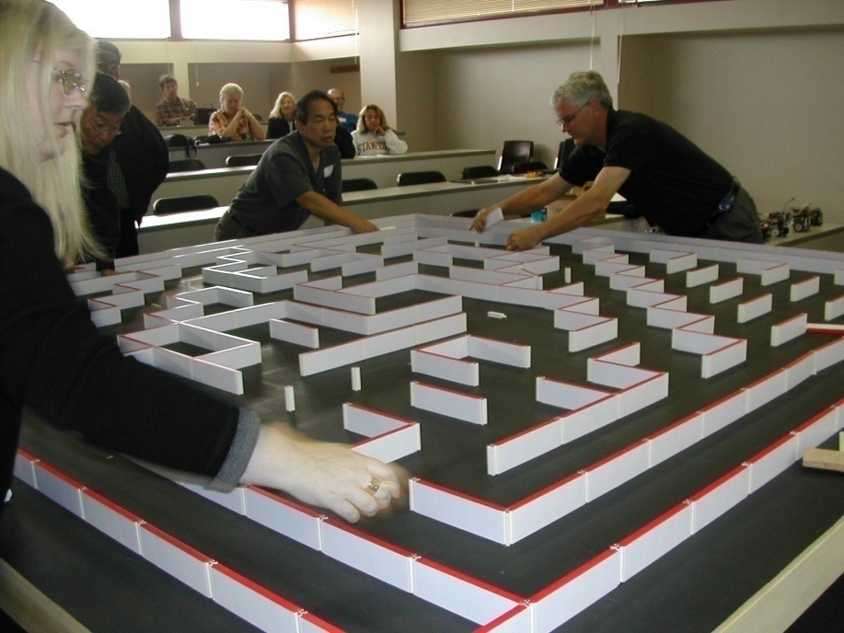
Student Activities
IEEE Student Activities are COOL!
Educational Activities
Professional Activities
Technical Activities
Social Activities

Slide 19
Branch Planning Workshop (today)
Develop a set of goals for the branch
Brainstorm to find events
Evaluate and create Branch plan and timeline of events
State your assumptions!
In second meeting, plan one event in detail; all resources and
timeline with milestones (and a second presentation!)

Slide 20
Branch Planning
Assess the state of your Branch (resources: people and money)
Identify the major objectives for your Branch for this year (e.g., membership increase, some big event, retain existing members, seek new equipment)
Identify the specific goals that will help you meet your objectives and identify the events that will make up your Branch Program to achieve these goals
For each event, develop an Action Plan
Allow free form brainstorming!

Slide 21
The IEEE Student Branch Calendar
A useful tool for planning purposes.
Put the events where your students find them:
Facebook/Slack/???
Don’t forget to announce IEEE non-branch activities.
Student Branch Secretary should keep it current.

Slide 22
Suggested Branch Activities
Invite speakers on technical or professional subjects.
Enter design competitions
Hold a Student Professional Awareness Activity
Organize field trips to Industry.
Mentor junior students.
Organize sales of lab kits, lab manuals, resume books, solved past exams.

Slide 23
Suggested Branch Activities (continued)
Raise funds for charity or Student Branch projects.
Publish a Student Branch Newsletter on the web.
Develop a Student Branch web site. Free hosting web space at http://sites.ieee.org/vtools/
Participate in engineering awareness programs. E-week
Visit and organize joint activities with other Student Branches.
Volunteer at a conference and help staff a membership booth.
Host an annual “Welcome Back” or “End of School” picnic.
Work with the local IEEE Section and YP affinity group to welcome graduating students into the next stage of their career. (STEP)

Slide 24
Student Transition Elevation Partnership
STEP event🤑
visit: https://yp.ieee.org/step/
The goal of this program is to provide a standardized yet localized
program for facilitating the transition from Student Member to Young
Professional, by introducing the opportunities and benefits of IEEE
membership during the onset of a career.
$500+ Funding is available for STEP activities, including the graduation
reception for groups holding an event with a minimum of ten recent
graduates.
Complete the STEP Event Funding Application Form online

Slide 25
Student Branch Awards
MGA Awards all due February 1st
https://ieee-student-awards.myreviewroom.com/

Slide 26
IEEE Regional Exemplary
Student Branch Award
Award designed to encourage, through public recognition, exemplary Student Branch operation.
Good goal to guide Branch planning efforts.
Nomination must be by an Officer of the Branch.
2018 awardees
Portland State University
University of California Los Angeles
USC
Oregon State University

Slide 27
Outstanding Student Branch
Counselor and Advisor Award 🤑
To recognize the important contributions of the Counselor / Advisor.
Up to 1 Counselor per Region recognized each year
with a cash prize. $$$
Students submit a nomination narrative
2017 & 2018 NO awardees 😥

Slide 28
Larry K. Wilson Regional
Student Activities Award 🤑
To recognize the student most responsible for an extraordinary
accomplishment associated with student activities.
One winner per region.
Commemorative plaque and 3-year free membership in the IEEE.
2018 Awardee
Matthew Harrison of
Oregon State University

Slide 29
The Darrel Chong Exemplary Student Branch Activity Award
Award encourages and recognizes all IEEE student activities
High quality of these activities fosters knowledge sharing among Student Branches
All IEEE Student Branches/Student Branch Chapters are eligible

Slide 30
Outstanding Student Certificate
Available free from IEEE Student Services; lettering done by IEEE for your
Branch. Give them to deserving Student Members !
Student services will provide 4 certificates. Takes 2-3 weeks.
To order:
Branch counselor/officer e-mails student-services@ieee.org with:
Names
member numbers
positions held
years of service
mailing address

Slide 31
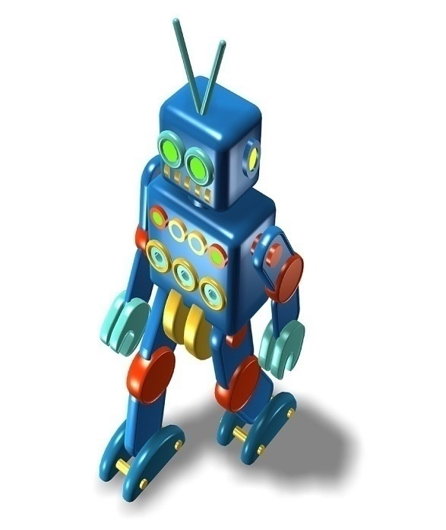
Student Enterprise Award (on hold)
Does your Student Branch have an idea for a community service program, robotics project or other idea?
Submit your proposal in the IEEE Student Enterprise Award
Topics may be of technical or non-technical, ranging from research on state-of-the-art technology to community service programs
Encourages IEEE Student members to work with others on an engineering project of their choice - teamwork
Request up to $1,500 in your project proposal

Slide 32
2018-2019 Student Branch Calendar

Slide 33
Student Activities calendar overview
September: Rush/recruiting events
October: Student Leadership Training IEEE Day, IEEEXtreme
November/December: Prepare reporting by 11/1
January: Rising Stars
February: apply for awards by 2/1
March/April: Area Meeting & competitions
May: Elections & graduation event; present awards

Slide 34
2 OCT 2018
Photo Contest ($1k, $750, $500)
Video Contest ($1k, $750, $500)
Print IEEE Day T-Shirts
Plan your own celebration for October 2019
http://www.ieeeday.org/

Slide 35
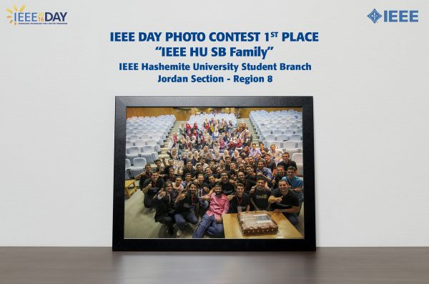
2016 Photo Contest Winner – Can you do better?

Slide 36
IEEEXTREME Programming Contest
October 20th, 2018
Registration extended until October 12th
Only 1 R6 team registered so far 😥
Region 6 only had 17 teams in 2017 😥
Special Region 6 winner will win a trip to Rising Stars🤑 Conference🌴

Slide 38
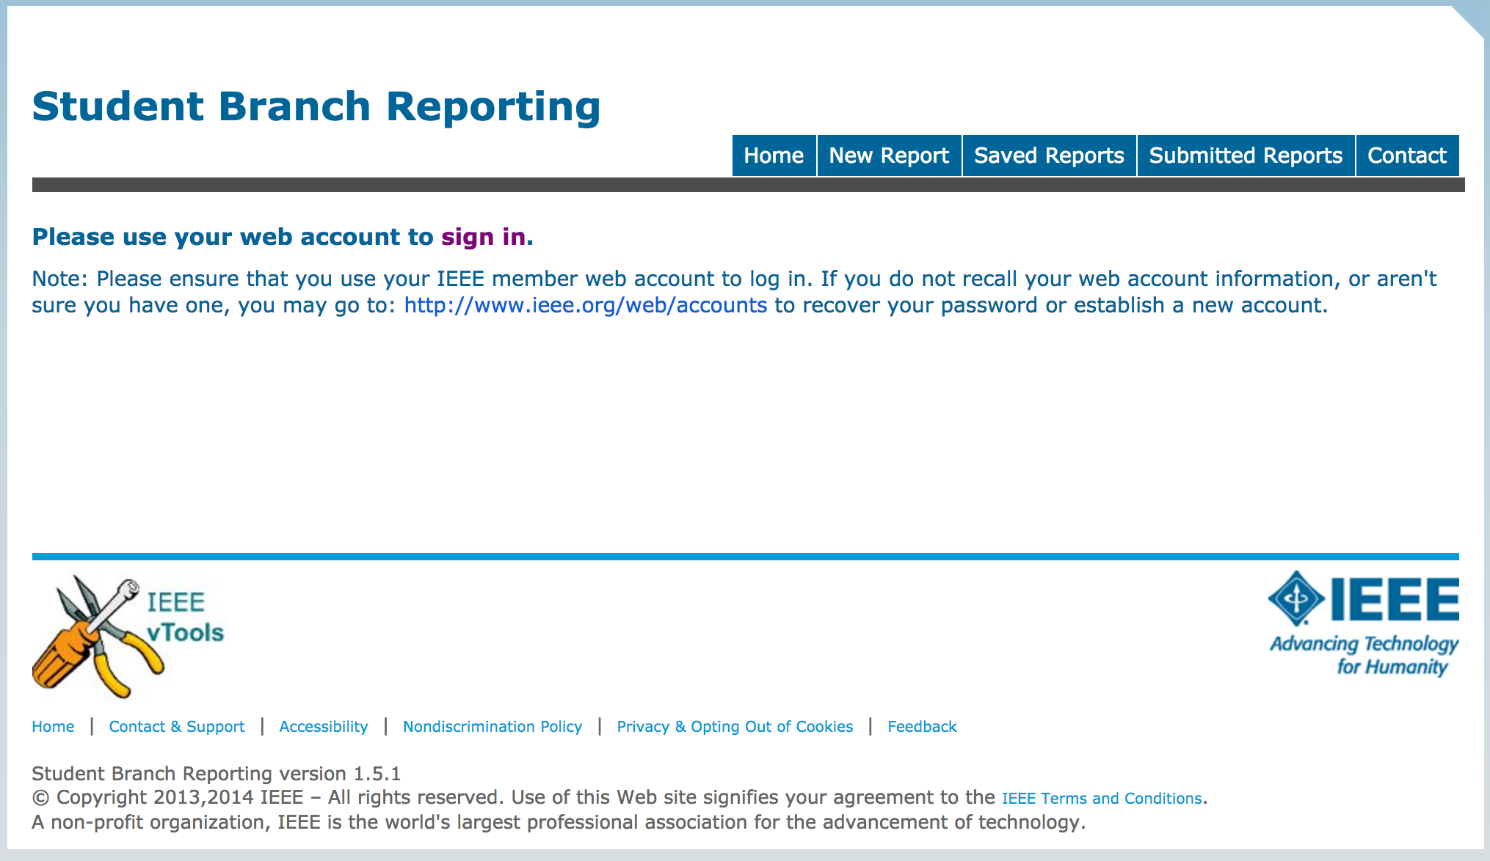
https://sbr.vtools.ieee.org/
Prepare reporting by November 1

Slide 39
WISE (Washington Internships for Students of Engineering) Intern Program DUE 31 DECEMBER
Students spend a summer in Washington, DC learning how government officials make decisions on complex technological issues and how engineers can contribute to legislative and regulatory policy decisions
Students meet with leaders in Congress and the Administration, prominent nongovernmental organizations, and industry.
Student prepare a paper on a current engineering related public policy issue.
Stipend, local travel allowance and all housing costs covered

Slide 40
WISE (Washington Internships for Students of Engineering) Intern Program
Offers a unique opportunity for students to spend a summer in Washington learning how government officials make decisions on complex technological issues and how engineers can contribute to legislative and regulatory policy decisions
Students meet with leaders in Congress and the Administration, prominent nongovernmental organizations, and industry.
Each student prepares a paper on a current engineering related public policy issue that is important to their sponsoring society.
Stipend, local travel allowance and all housing costs covered

Slide 41
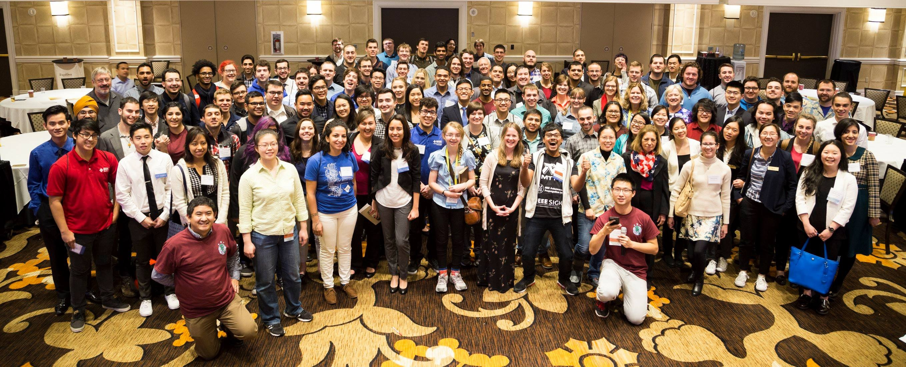
Special Event Highlight (2019 Rising Stars Conference – RSC): JANUARY 4-6, 2019, LAS VEGAS, NV
Registration Now Open
Notes:
The IEEE Rising Stars Conference serves as a launch pad for top performing students and young professioals. Attendees at the event will gain insight on how best to further their careers by networking and learning from industry professionals and executives from leading international companies. Rising Stars Conference attendees will leave the event with better preparation to face the challengs presented to them and armed with the appropriate contacts needed to gain the insight to be successful in the post-graduation career.

Slide 42
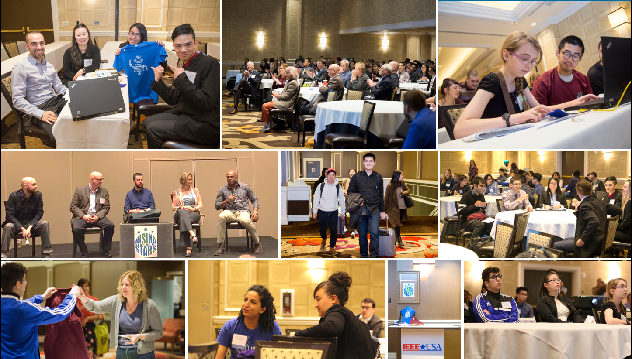
RSC 2019

Slide 43
Student Branch Awards
Awards all due February 1st

Slide 44
September 2019
IEEEmadC is a Mobile App Development contest for all students.
Teams of up to 3 students can win up to $6000 award.
Register at idea.ieeemadc.org.

Slide 45
Student Ethics Competition
Foster familiarity with IEEE Code of Ethics and concepts
Promote a model for discussing and analyzing ethical questions
Learn about ethics in a “fun” context
Provide experience in applying ethical concepts to hypothetical professional situations
Supplement Regional/Sectional ethics programs

Slide 46
SEC Guidelines & Requirements www.ieee.org/about/ethics/competition.html
Competition is suggested to be between 4 to 6 teams made up of 2 to 3 IEEE Student/Graduate members
Each team is sequestered & given a period of time to prepare a presentation and defense of an ethical situation provided by the sponsor
Each team’s presentation/defense will be judged by a group of 3 to 6 judges using a standardized judging form.

Slide 47
Support Provided by IEEE Ethics & Member Conduct Committee
Provide materials for contest organizers
Judging forms, guidelines & requirements, optional case studies, student analysis format and general descriptive information and advice
Posters, guidelines & customizable poster files
Certificates of participation to all participants signed by EMCC Chair & IEEE President
Funding for prizes

Slide 48
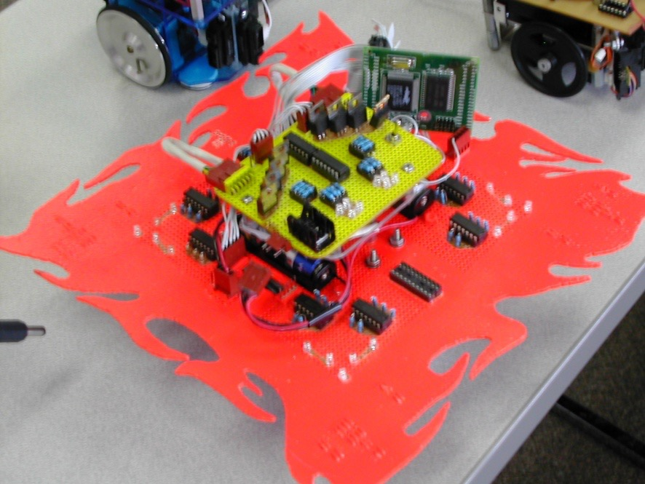
Run your own competitions
Micromouse Robotics Competitions

Slide 49
Where to get $$$
IEEE Headquarters
US$100.00 (if your Branch has more than 50 members)
US$50.00 (if your Branch has less than 49 members)
US$2.00 per student member at your Branch
(based on your membership on 31 December of the previous year).

Slide 50
Section/Region
They get $3/student & graduate student member
Ask for it!
Region PACE
Area SAC

Slide 51
Other sources
Your school
Local industry
Region PACE funds
Society travel grants/fellowships/scholarships
http://www.ieee.org/membership_services/membership/students/awards/student_travel_grants.html

Slide 52
Fundraising
There are 4 different kinds of money you may need to raise:
Operating money - for continual expenses.
Seed money - an “advance” for an event.
Subsidy money - to reduce the cost for members.
Capital money - to buy things.
Student Branch Operations Guide has a list of 19 ideas.
Brainstorming is a good way to think of ideas.
Need to be aware of University Fundraising constraints
Need to be careful not to tarnish the image of engineering.

Slide 53
Fundraising (2)
Money Sources ($$ and/or in-kind contributions):
Branch bank account
Money from Branch Plan, and Rebate from Annual Report
Fundraising events or activities
School
- Department Head, Dean, Student’s Association,
Engineering Student’s Association
IEEE
- Local Section, Region
- For S-PACs and S-PAVes: IEEE USA SPAC and
MGA/SAC/SPAA
Local Industry

Slide 54
Fundraising (3)
When asking for money….
Put the request in writing and include a brief budget
Convince them of the merits of your cause and how their
involvement will help both you and them
Show them that your proposal is well-thought out and that you are
soliciting from others as well
Give them time to make a decision and then follow-up

Slide 55
EPICS
Engineering Projects in Community Service🤑
Up to $60k per project
Organizes university and high-school students to work on engineering-related projects for local area non-profit organizations. Seed funding is provided through the EPICS-in-IEEE committee. This funding may be multi-year depending on quarterly project report submissions.
Projects fall under Human services, Access and abilities, Education and outreach, and Environment.
www.ieee.org/epics
Sample Project: Air-quality microsensors for Earth Observations, University of Pretoria (UP), US $ 9,300

Slide 56
Humanitarian Activities🤑
The IEEE Humanitarian Activities Committee (HAC) has added some additional funding opportunities to the end of the year.
SIGHT Projects-15 October (subject to available funds)
HAC Projects-15 October (subject to available funds)
Conference Participation Program-03, 17, 31 October (subject to available funds)
HAC Events-25 October (subject to available funds)

Slide 57
Ask IEEE Society Chapters

Slide 58
Membership Group Discussion
Q1. Why did you join the IEEE and why did you become active?
Q2. Why do some students neglect to renew their IEEE membership?
Q3. How would you encourage a student to renew membership after it
has lapsed (expired)?
Q4. How would you attract a first year student to join IEEE?
Q5. How would you persuade students in other departments to join IEEE?

Slide 59
Branch Resources
Distinguished Lecturers Program sponsored by IEEE and other IEEE Societies.
IEEE Computer Society Distinguished Lecturers Program.
IEEE Program Resources Guide.
IEEE Student Concourse Website (www.ieee.org/students)

Slide 60
Branch Resources (continued)
Membership Development Order Form: http://ewh.ieee.org/forms/md/supplies.php
IEEE SAMIEEE to access your Student Branch membership data
http://www.ieee.org/samieee
MyIEEE: http://www.ieee.org/myieee
IEEE.tv: http://www.ieee.org/web/membership/IEEEtv/about.html
memberNet: http://www.ieee.org/membernet
IEEE Entity Web Hosting: http://www.ewh.ieee.org
IEEE Job Site: http://careers.ieee.org
Student Branch Awards: http://www.ieee.org/scholarships

Slide 61
IEEE - Membership Development Kits
To order materials online, visit
http://ewh.ieee.org/forms/md/supplies-ondemand.php
For the latest information as a Student Branch leader, visit the IEEE Student Concourse http://www.ieee.org/students

Slide 62
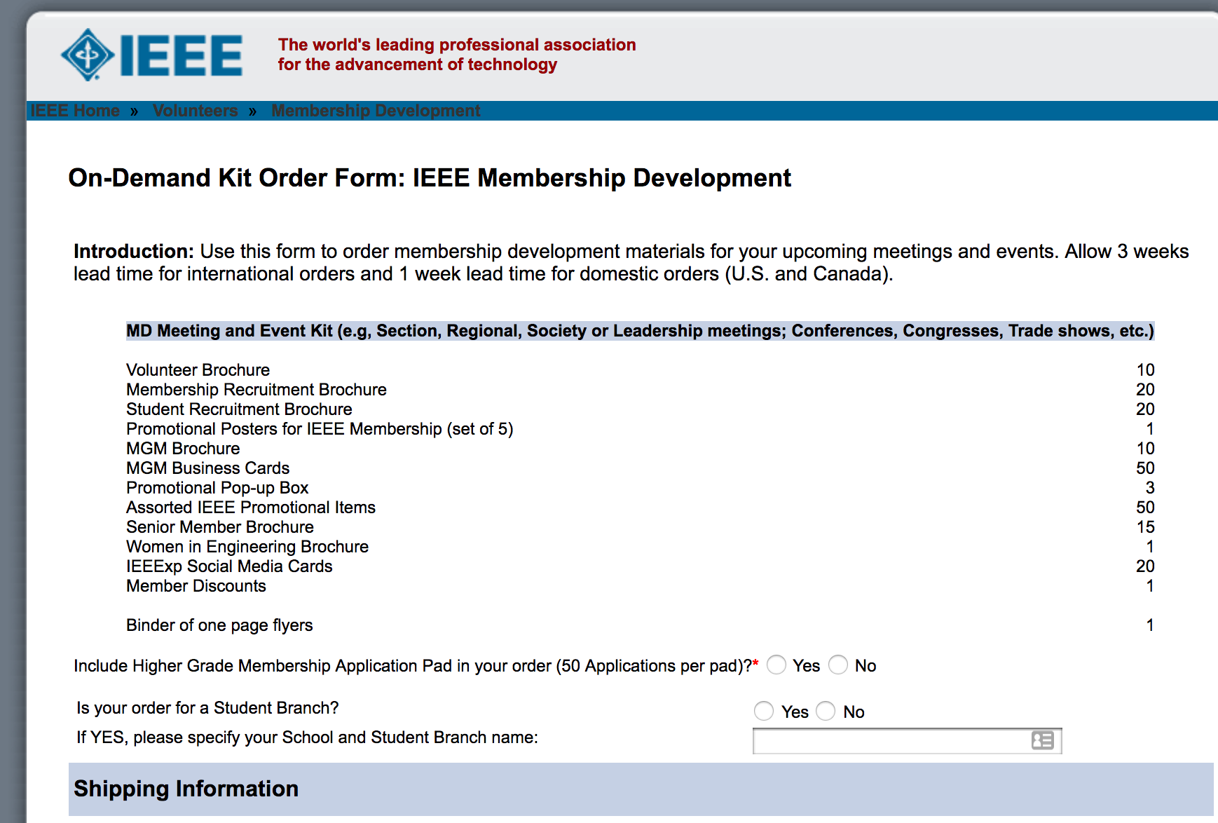
http://ewh.ieee.org/forms/md/supplies-ondemand.php

Slide 63
Today’s Students are Leaders of IEEE, Today and in the Future
Our work and world are constantly changing -- young members are becoming more important than ever before.
IEEE cannot stay vibrant without keeping you, the leaders of tomorrow, actively engaged.
Members who stay involved reap the greatest benefits from IEEE

Slide 64
STEP Events
www.ieee.org/step
$500/event available, more if +25 attendees
apply 4-weeks in advance

Slide 65
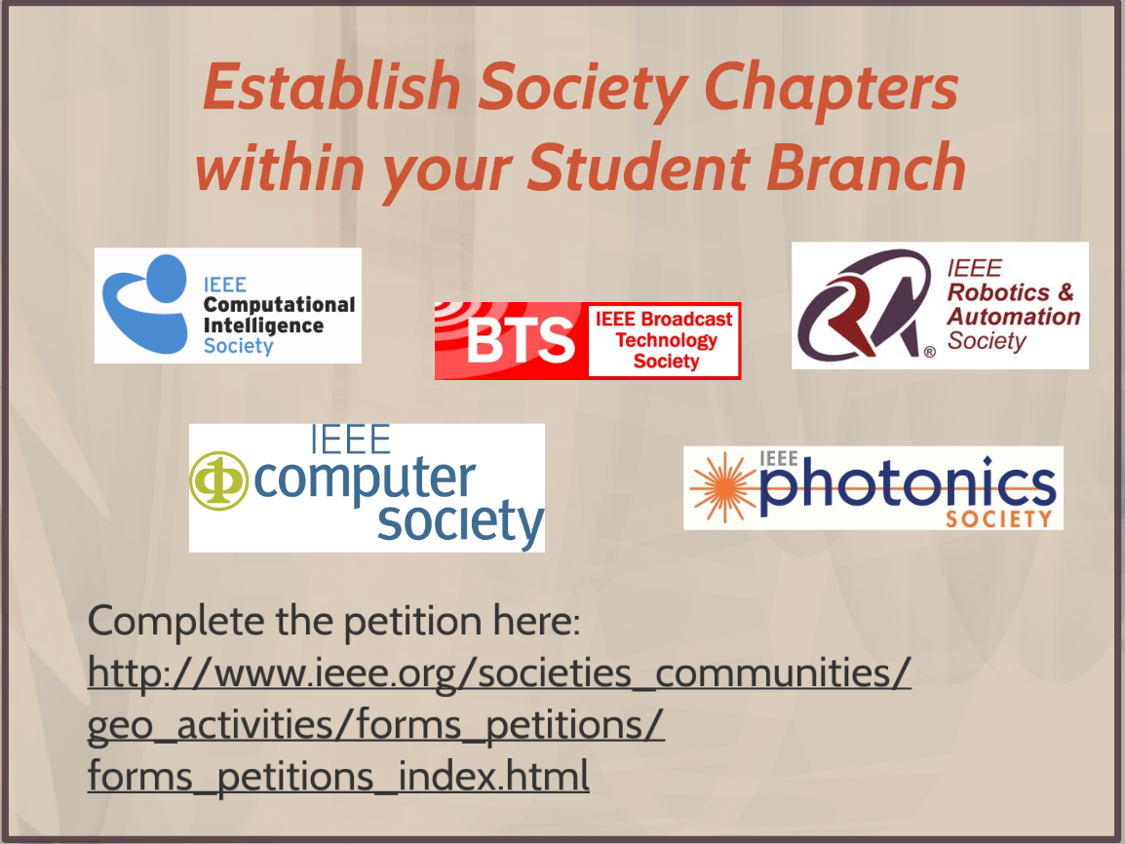

Slide 66
EPICS
Engineering Projects in Community Service
Organizes university and high-school students to work on engineering-related projects for local area non-profit organizations. Seed funding is provided through the EPICS-in-IEEE committee. This funding may be multi-year depending on quarterly project report submissions.
Projects fall under Human services, Access and abilities, Education and outreach, and Environment.
More information: http://www.ieee.org/education_careers/education/preuniversity/epics_high.html
Sample Project: Air-quality microsensors for Earth Observations, University of Pretoria (UP), US $ 9,300

Slide 67
Products & Services for Young Professionals Webinars

Slide 68
Products & Services for Young Professionals Career-Based Services
http://mentoring.ieee.org/
Online career mentorship tool for both mentors and mentees
Mentor and mentees connect based on
technical/professional interests
Mentees: 402, Mentors: 338 (as of 2014 Sept. 19)
www.ieee.org/resumelab
Suite of online resume/CV development tools for
each step of the job seeking process
4,899 accounts (as of 2014 Sept. 19)

Slide 69
So How Do I Get Members
???

Slide 70
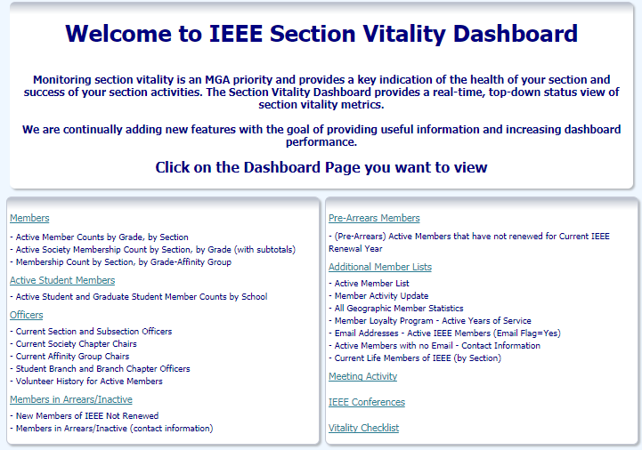
How do we know who our members are?
https://www.ieee.org/societies_communities/geo_activities/dashboard.html

Slide 71
So How do I get Volunteers?
What is a Refreshing Approach To
Volunteer Recruitment?
ICED TEA

Slide 72
I
C
E
D
T
E
A
dentify a potential volunteer
ontact them personally
nlist their help
esignate a small task for them
hank them profusely afterwards
ncourage them to stay involved
sk them to help again

Slide 73
ICED TEA
It’s Cool !
…….and it works !

Slide 74
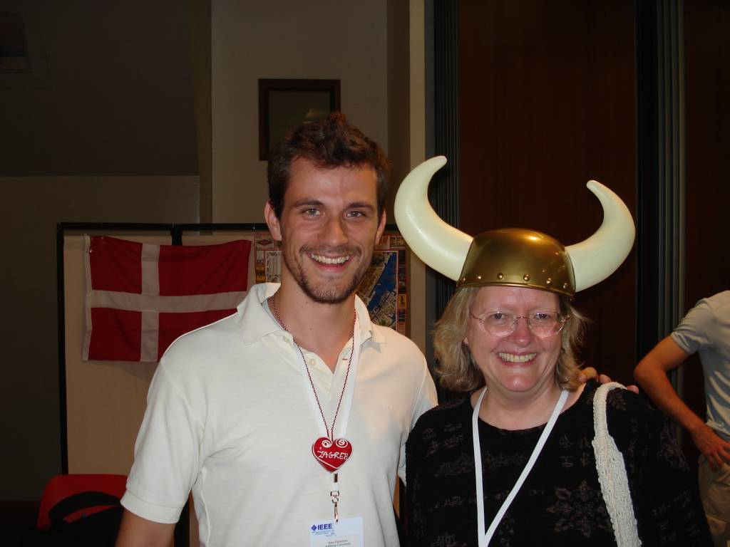
What are the benefits of IEEE (intangible)
IEEE is your professional home
It is a place for you to be among your peers, to network, and to advance yourself professionally and personally
IEEE Volunteers have FUN!

Slide 75
So how do I get officers?

Slide 76
Branch Administration
Key individuals in your Student Branch include:
Student Officers
Chair (not President!)
Vice-Chair
Secretary
Treasurer
Branch Counselor and/or Branch Chapter Advisor
Branch Mentor
Committee Chairs (also Student members)
Notes:
The key officers of the Student Branch are the Chair, Vice-Chair, Secretary and Treasurer. All Student Branches (and all other entities within IEEE) are required to have these four positions filled. While it is not required, it is strongly recommended that each Student Branch flush out a significant list of other officer positions and create as many other positions on the Student Branch Executive Committee as possible.

Slide 77
Student Branch Chairs
Serves as the Executive Officer of the Student Branch.
Manages the general operations of the Branch.
Presides at all meetings of the Branch.
Appoints committee chairs.
Involved in “forward planning” for the Branch.
Prepares necessary reports for IEEE Student Services.
Arranges for election of new Officers before leaving office.
Communicates frequently with other Officers.
Works with Branch Counselor in dealings with the Department
and Faculty, as well as the local IEEE Section and GOLD
Affinity Groups.

Slide 78
Student Branch Vice-Chairs
Serve as the junior Executive Officer of the Student Branch.
Chair the Program or Membership Committee.
Monitor the progress of Branch programs.
Fill in for the Student Branch Chair as required.
At some Branches, may run for Chair next year for continuity.

Slide 79
Student Branch Secretary
Keep detailed records of all Branch meetings, activities.
Carry out all necessary communications of the Branch, including the filing of reports with IEEE Headquarters.
Maintain posters, forms and other supplies as required.
Post a calendar of events to keep all members informed of Branch activities on the web site and other areas on campus.
Ensure that all Branch activities are conducted under the provisions of the current Branch policies for IEEE and the university.
Arrange for orderly transfer of all Branch records to incoming
Secretary.

Slide 80
Student Branch Treasurers
Responsible for ensuring the Branch’s finances are in order.
Ensure that the Student Branch account has co-signing authority
with the Student Branch Chair, Student Branch Counselor.
Deposit all monies received promptly in the Student Branch
account.
Prepare a budget at the start of the school (or fiscal) year.
Prepare end-of-year Financial Statements.
Chair the Fundraising Committee.
are Co-signing Officers (jointly with the Student Branch Chair).
Arrange for orderly transfer of all accounts and records to incoming
Treasurer.

Slide 81
Student Branch Counselors
Faculty members, active in the IEEE, who serve as an advisor to the
Branch and its Officers.
Appointed by the local Section Chair, upon the recommendation of the
Student members and the Regional Student Activities Chair (RSAC).
Normal term of appointment (or re-appointment) is two years.
Provide a sense of continuity to the Branch.
Inform other faculty members of Branch activities.
Promote student awareness of membership benefits, awards, contests.
Help the Branch establish Industrial contacts and works closely
with the Branch Officers and the Branch Mentor.

Slide 82
Branch Mentors
Designed to maximize the interaction between the Student Branch
and the local Section.
Branch Mentor must be from Industry.
Appointed by the local Section Chair, in consultation with the
Branch members.
A recent graduate with firsthand experience in Student Branch
operations is an ideal candidate.
Meet regularly with the Branch members and the Branch Counselor.
Assist the Branch to develop effective programs.
Provide a bridge between the Branch and the local Section by
working with GOLD Affinity Group Chairs.

Slide 83
STUDENT PROFESSIONAL AWARENESS ACTIVITIES
SPAC, SPAV, SPAA, PACE
= SPAx

Slide 84
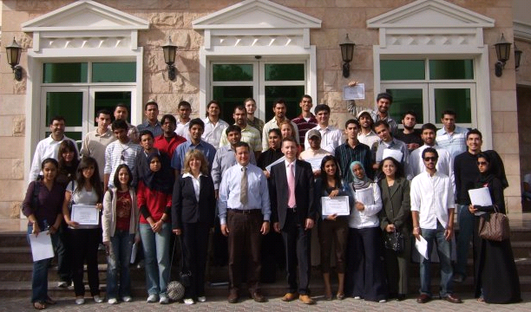
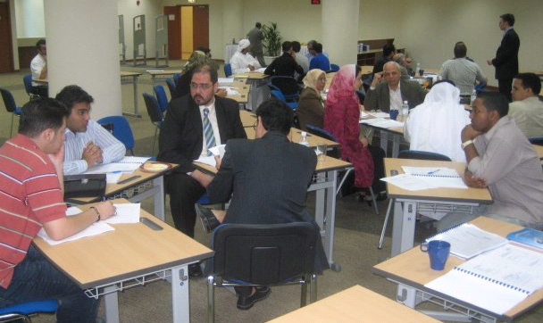
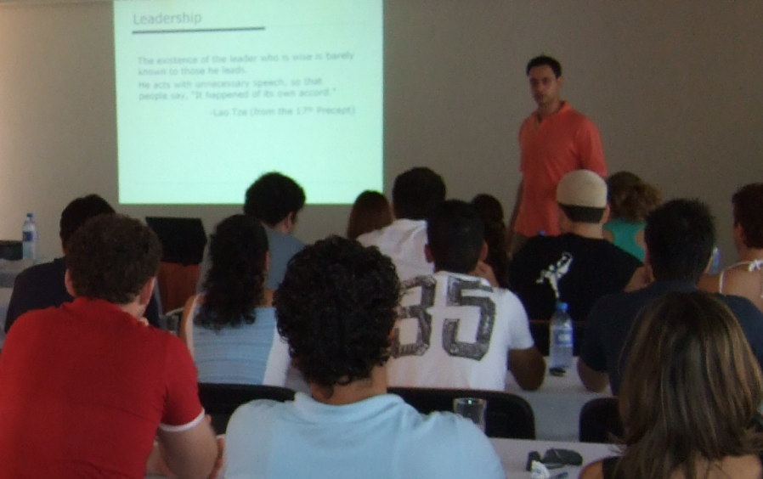
Questions? Comments? Talk to us!
lise.johnston@ieee.org

Slide 85
Section Student Branch Relationship

Slide 86
No Man (Branch) is an Island!
You belong to a Section
Most likely, other schools also belong to that Section
If not, there are other schools in your Area
You belong to a Region (6)
Talk to us and vice versa

Slide 87
Communicate With Your Section
Section Chair
Section Treasurer
Section Student Activities Chair
(F, SM, M or GSM)
Section Student Representative
(STM, GSM)

Slide 88
Section Student Representative
Coordinate sending a copy of branch reporting to the Section
Send news from the branches to the Section
Help coordinate activities between branches within the Section
Give students’ perspectives at Section Excom or Opcom meetings

Slide 89
Sections - Student Activities
Why should our IEEE Sections be involved?
Financial obligation
$3.00 Rebate for every student member
But more importantly…

Slide 90
More Compelling Reasons
Students and YP Members account for 33% of our Membership
This same group accounted for 62% of non-retained (arrears) memberships

Slide 91
Correct Conclusions
Membership is NOT silver- centric
IEEE Student membership is thriving
1st year member retention is abysmal
GOLD, SAC, Sections - WE ALL NEED TO HELP!

Slide 92
Issues – Student Branches
Students fail to develop a sense of belonging to the larger IEEE community → Fall in membership retention post graduation
Limited understanding of the roles & responsibilities by the SB officers → Need for training & improved understanding of IEEE beyond SB level

Slide 93
Issues - Sections
Lack of volunteers to coordinate Section activities → Same people end up running the Section until retirement
Sections get a feeling that Student Branches are connected in a “Give me money” way → Lack of synergy and mismatch of objectives

Slide 94
Possible Solutions
Joint Annual meetings between Section and Student Branches
1. Beginning of year: Formal introduction and Welcome
2. End of year: Informal gathering in the form of Graduation Reception
Immense networking and mentoring opportunities available to members
Reinforce a sense of belonging to the larger IEEE community
Development of an effective communication model

Slide 95
Possible Solutions
IEEE Recognition Award per Student Branch annually to be awarded by the Section at the Graduation Reception
Recognize IEEE Student Branch leaders
Nurture & inspire potential leaders who can take up key IEEE positions in future

Slide 96
Possible Solutions
Section Newsletter which adequately covers the activities and events conducted by the Section and its Student Branches
Make information readily available to all IEEE members
Act as a unifying force between the Section and its Student Branches

Slide 97
Recommended Section Initiatives
Link Section Web Page to Student Branch Web Site
Section officers to attend Student Branch event(s)
Section officers evaluate Student Branch activities
Section members offer mentoring to students
Section to host a social activity for former student branch officers and new YP members
Section to provide professional education to Student Branches

Slide 98
Recommended Section Initiatives
Student Branch assists Section with Pre-college Program
Scholarships to Student Members
Invite Student Branch Officers to attend Section Excom Meetings, YP Meetings and Chapter Meetings
Section to hold Student Night once a year
Publicize Section Activities to Student Branches
Section to organize an event for the Student Branch

Slide 99
Recommended Student Branch Initiatives
Branch to provide accurate Student Branch contact information to their Section
Branch to invite Section Officers to Student Leadership Training Workshops
Branch to provide list of graduating students contact information to their Section
Branch to organize a “graduation Party” and invite Section Officers

Slide 100
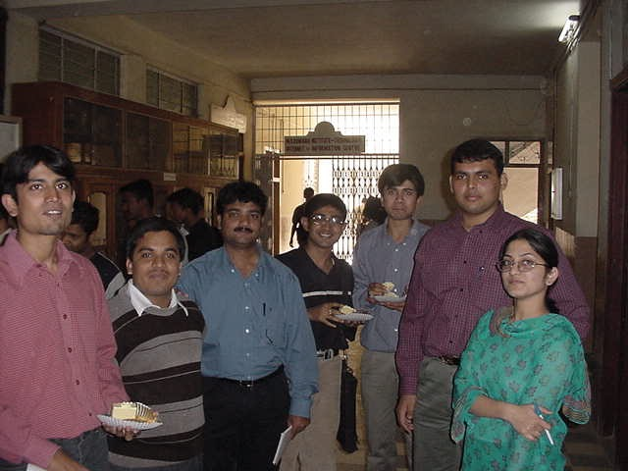
How You Can Use Your IEEE Membership
As active members, you
Gain opportunities to learn skills not learned in academic courses or on the job
Share knowledge to enhance your creativity
Have access to individuals at all levels of the profession

