Slide 1
SAMIEEE Replacement And other vTools updates Mike Fallenstein m.fallenstein@ieee.org - Region 4 Chris Gunning cgunning@ieee.org – Region 6

Slide 2
Topics
SAMIEEE replacement - IEEE OU Analytics
Today’s talk provides a brief overview, not a full-blown training session. For training, we recommend the slides and 1-hour training video available on the SAMIEEE home page at https://www.ieee.org/about/volunteers/samieee
Other recent vTools changes
Where to find more information, report problems, etc.

Slide 3
Credits
Material drawn from excellent presentations by Helen Shiminsky, Vera Sharoff, Marguerite Gargiula, Khanh Luu, and other IEEE staff on the vTools web site and talks given at 2017 Sections Congress
Links to their presentations are given later in this slide deck

Slide 4
IEEE OU Analytics
SAMIEEE transition
SAMIEEE is transitioning from Oracle Business Intelligence Enterprise Edition (OBIEE) to Tableau
OBIEE issues: Poor performance, not intuitive
Tableau provides fast, reliable, efficient access to information
Tableau is available now. Both systems are running concurrently. OBIEE must be retired by end of May because of GDPR (new European privacy requirements)
Volunteers no longer required to run queries. Data provided via various visualizations which link to member details.

Slide 5
IEEE OU Analytics
What is Tableau
Tableau is an Online Business Analytics program that allows users to view and further define visualizations based on IEEE data
Users can also download detailed data such as membership lists
Tableau uses the same data sources used by SAMIEEE/OBIEE
Access continues to be based on the volunteers’ position and OU.
User will only obtain data for their OU unit(s) and position level.
For a list of volunteer positions, go to: http://www.ieee.org/about/volunteers/samieee/samieee_positions.html

Slide 6
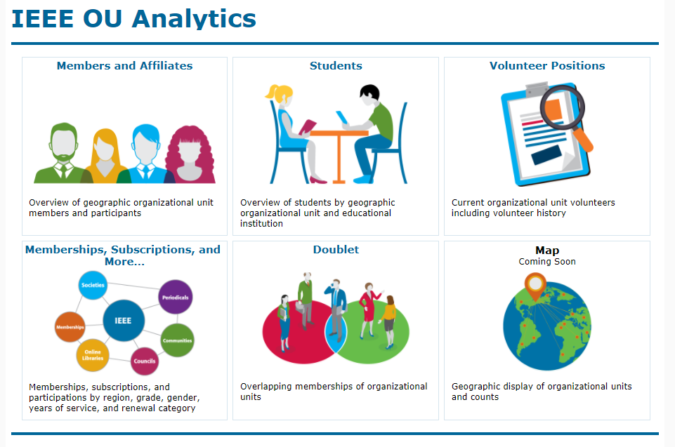
IEEE OU Analytics
How to access the new tool
Convenient link available on SAMIEEE Home Page at:
https://www.ieee.org/about/volunteers/samieee
Or access the Dashboard Landing Page directly at: https://tblanalytics.ieee.org/#/site/IEEE/views/LandingPage_0/LandingPage?:iid=1

Slide 7
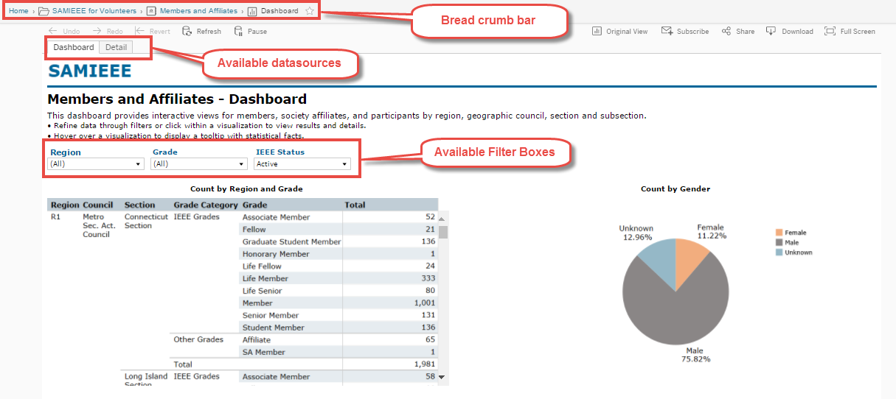
IEEE OU Analytics
How to navigate the new dashboards
On the dashboard pages (example: “Members and Affiliates” link.) users will see . . .

Slide 8
IEEE OU Analytics
Now for a closer look at the
individual dashboards

Slide 9
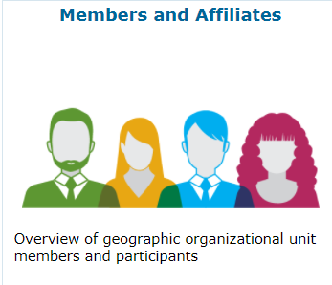
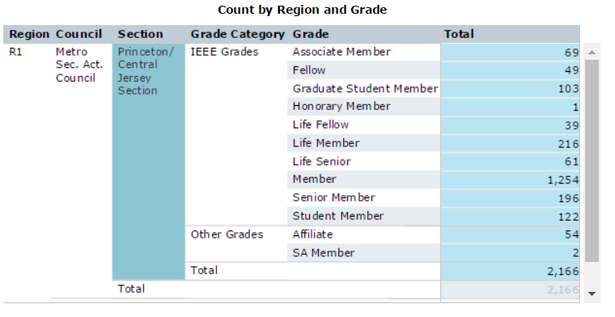
IEEE OU Analytics
Members and Affiliates Dashboard
The Members and Affiliates Dashboard provides an overview of IEEE members, society affiliates, and SA members by their geographic organizational units.
An overview count of members by Region, Council, Section and Subsection is available.

Slide 10
IEEE OU Analytics
Members and Affiliates - Dashboard
There are two tabs available.
Dashboard – shows the predefined tables and charts available for a breakdown view of your members.
Detail – contains the individual member information. Access the member information by clicking on “View Details” in Tool Tips or clicking on “Detail” tab.
Detail shows member contact information.
Download contains additional fields depending on dashboard.

Slide 11
IEEE OU Analytics
Downloading Data
Tableau provides many tools for displaying, filtering, and manipulating data. However, if you need to download, there are several options found under the Download button.
The following options are available:
Image – downloads the image on your screen to a png file.
Data – (not recommended) downloads the data to a csv file. This option requires multiple steps for downloading to a text file and does not retain format.
Crosstab – (recommended download option) downloads the data to a csv file.
PDF – downloads the image on the screen to a PDF file.
Important note, if you do not select the title of the visualization before clicking Download, the data and crosstab options will be grayed out.

Slide 12
IEEE OU Analytics
Students - Dashboard
The Student Dashboard provides information regarding members (any grade) attending educational institutions. Information is grouped by Region, Section and School.
There are two dashboard tabs available:
Dashboard – shows the predefined tables and visualizations available for a breakdown view by School, Grade, Gender and Field of Study.
Detail – contains the individual member information.
Top level filtering is on Region, Grade and IEEE Status.

Slide 13
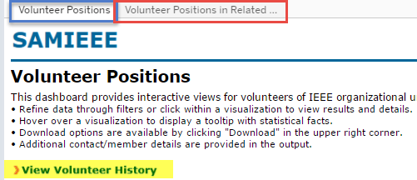
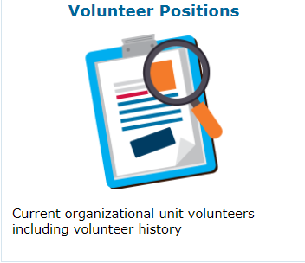
IEEE OU Analytics
Volunteer Positions - Dashboard
The Volunteers Dashboard has two tabs and one link available.
Volunteer Positions – lists “all” current IEEE volunteer positions. Use filter options to select a specific OU type and OU Name.

Slide 14
IEEE OU Analytics
Memberships, Subscriptions, and More… - Dashboard
Renewal Category Dashboard – provides product renewal information based on filters selected. Renewal categories provided are: Renew, First Year Renewed, New, Reinstated, Not Yet Renewed and Cancelled.
Filters provided are Product Type, Product Name, Region, Grade, and Status.
Overview of Product Renewals (bar chart) – provides a breakdown by renewal categories. Hover over to view additional statistical information.
Product Summary by Region by Renewal Category (data table) – provides a count of members by Region by Renewal Category.
Recommendation: Downloading Column and Row Totals default to “Grand Total” counts, which can be significant and provide excess data. Use Filters to refine data per OU.

Slide 15
IEEE OU Analytics
Questions & Assistance
If you have any questions regarding the new tool or need further assistance send an email to samieee@ieee.org

Slide 16
Other recent vTools changes
Events
New support for custom registration questions
New support for student branches and IEEE-HKN
Registration payment data now includes price description and restriction
eNotice
Personalization of eNotice messages
Customization of ‘From’ and ‘Reply To’
Send test eNotice
Link to view an event included in eNotice messages
Officer Reporting
Updated look and feel
Surveys
FluidSurveys no longer available. FourEyes recommended as interim solution

Slide 17
Finding more information
Learning about tools, reporting problems, getting help
Portal: http://sites.ieee.org/vtools (quick tip: Google “ieee vtools”)
Home – overview, video introduction
Tools – list and description of tools
Tutorials – on-demand “quick start” web tutorials
FAQ
Blog – news and tips
Feedback – submit feature requests and bug reports
Contact – send message to vTools staff

Slide 18
Useful links
IEEE vTools: http://sites.ieee.org/vtools/
IEEE OU Analytics (SAMIEEE home page): https://www.ieee.org/about/volunteers/samieee
Sections Congress 2017 vTools presentations: http://sites.ieee.org/vtools/2017/10/03/sections-congress-2017-vtools-presentations/

Slide 19
Q&A

