Slide 1
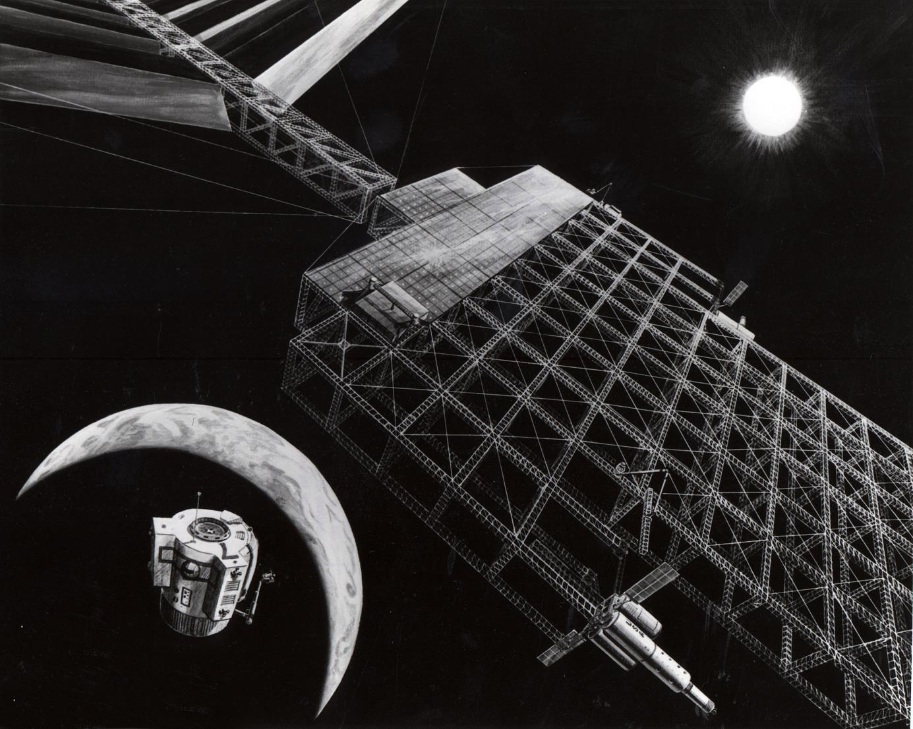
Region 6 Director Candidate
Charlie Jackson
https://en.wikipedia.org/wiki/Space-based_solar_power#cite_note-72

Slide 2
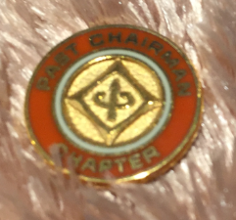
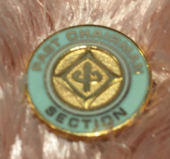
Qualifications- Charlie Jackson
Deep Commitment to IEEE, Showing a Balance Between Standard and Innovative Solutions.
Region 6, SUSTECH Local Arrangements Chair 2018
IEEE Region 6 Southern Area Coordinator 2016-2018
Region 6, Leadership & Professional Service Award 2015
Coastal Los Angeles Section 1-Day Conference 2008-2018
IEEE International Wireless Symposium (Beijing) 2013
IEEE Radio and Wireless Symposium Chair 2010
Coastal Los Angeles Section Treasurer 2008-2017
Coastal Los Angeles Section Chair 2007-2008
Fellow of IEEE 2007
MTT Strategic Planning Chair 2009-2012
Long Beach, IEEE Int’l Microwave Symposium Chair 2005
IEEE Conferences Committee Chair 2003
Cancer 2002
MTT Society President 2001
Digitization Project for MTT 1997-2000
MTT Chapter Chair 1994
Coastal Los Angeles Section Secretary 1996
MTT Chapter Chair 1987-1989

Slide 3
MAJOR ACCOMPLISHMENTS
Led the Coastal Los Angeles Section MTT and APS 1-day meeting for 10 years. This meeting allows engineers in the Southern California to hear interesting talks, network with old and new colleagues, and have good food.
Led the effort to combine two dormant sections into what became the Coastal Los Angeles Section.
Served in all Coastal Los Angeles Section elected roles. During his years of service he fostered 1-day conferences for the Systems Council Chapter, the Computer Society Chapter and the MTT/APS Chapters. These provide networking opportunities for engineers in the area. The section has maintained good fiscal responsibility policies while supporting student branches, chapters, and member development.
Chaired 3 major IEEE conferences. The largest was the International Microwave Symposium in Long Beach.
Led the MTT effort to convert 50 years of the MTT Transactions to a digital archive; they were later entered into IEEE Xplore.

Slide 4
Position Statement- Support the Community
- Why is IEEE worth supporting?
IEEE is here to provide a framework to enrich our community and advance our membership by providing networking opportunities
I want to support networking in IEEE, since it has had a huge effect on my career, and make sure it is there to help others.
- I’d like to think strategically and choose what to keep, what to fix, what to cut, and what to add.
- Improve Officer Training
Follow the example of the student training package that has been developed in the past few years.
We can work to collect input and make a package for Section Officer training.
We can develop a resume package for students and mid-career engineers
- Region 6 is a powerful and vibrant place for Electrical Engineers.
We are a community of universities, companies, innovators , and consultants.
I’d like to make Region 6 even better by strategically selecting activities that stimulate our community.
Let’s support all phases of our careers, starting with students, young professionals entering the workforce, mid careers, and retirement.
- Conferences provide a tangible member benefit. I will:
Support regional conferences such as Rising Stars, SUSTECH, and GHTC.
Improve society involvement with conferences,
Work with TAB initiatives like the IoT and 5G; and help facilitate society conferences in Region 6.
- I will support the IEEE Community

Slide 5
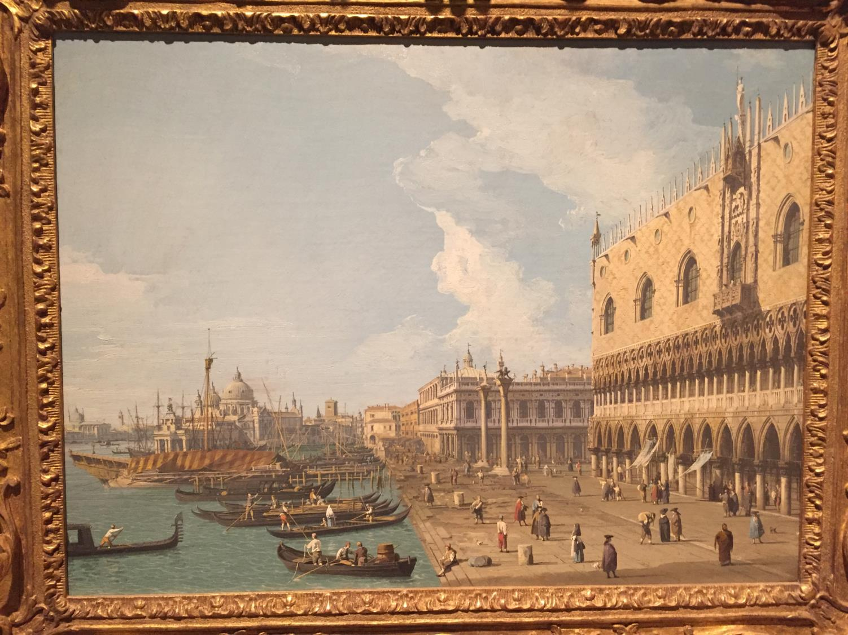
Thanks for your time.
Charlie Jackson

