Slide 1
IEEE Region 6 Joint Meeting NorthEast and Southwest Areas
Director’s Welcome – Fall 2017
Kathleen A. Kramer

Slide 2
Why are we here? We Share a Mission
Advance technological innovation and excellence for the benefit of humanity
IEEE is behind the technology that drives innovation and better living.
IEEE is a global thought leader on prominent technology advancements and issues
Inspire, Enable, Empower and Engage Members of IEEE
The people, the industry and the culture of our region have global impact and responsibility
These are our whys
Notes:
This slide provides our IEEE mission. It drives home the key message that IEEE is present everywhere in our IEEE lives. IEEE members and their work enable emerging technologies.
IEEE:
- Enables the advancement of technology
Makes possible local and global solutions
Is behind technologies we live with everyday

Slide 3
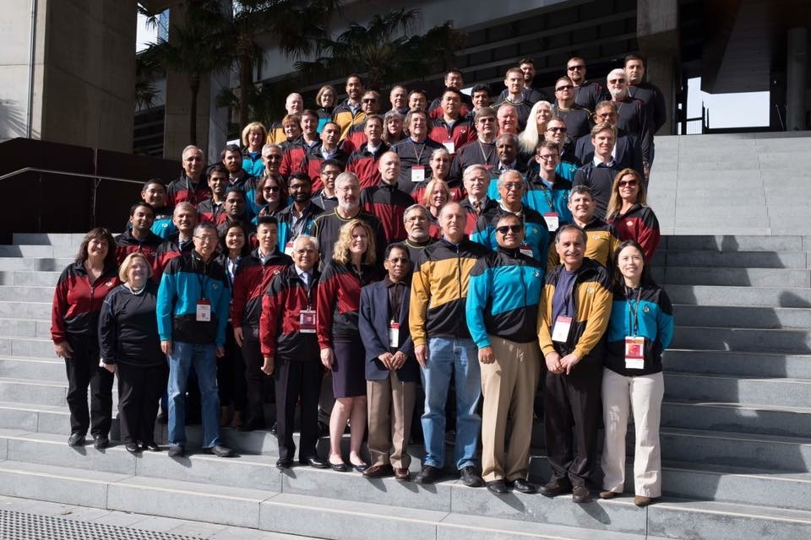
IEEE - Advancing Technology for Humanity
Actions speak louder than taglines.
We help our members to advance technology-
Technical Activities underlies all our activities
We advance the public imperatives --
Educational Activities
Student and College Activities,
STEM/Pre-College Activities,
Humanitarian Activities
Government Relations
History
Ethics
(Public Visibility)

Slide 4
IEEE – Our Plan for Today
Sharing successes, opportunities and lessons learned…
Region 6
Conferences
Students (Leadership Training, Branch Vitality, Competition)
Sections Congress
Budget and More
Young Professionals and Professional Activities (PACE)
Advancing Technology – VR/AR Tech Talk
Area Breakouts
Section Vitality

Slide 5
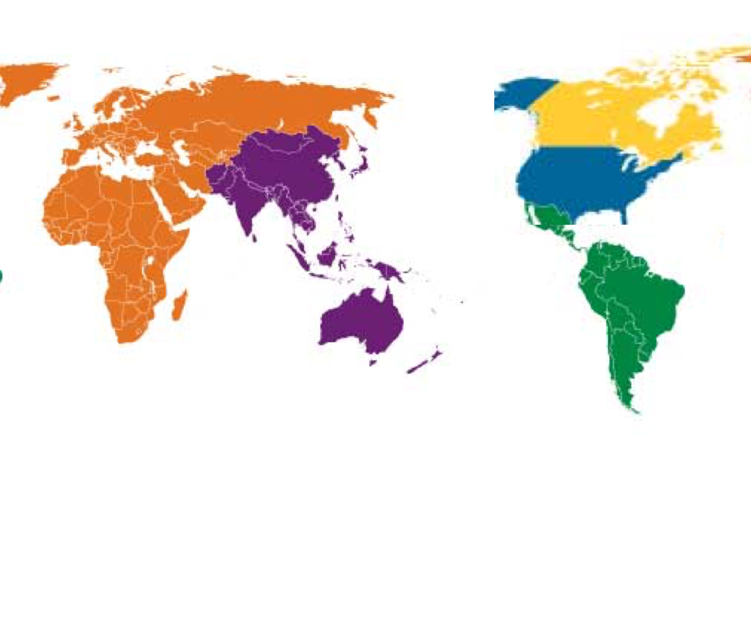
IEEE Region 6
Anchorage
You are here!
12.5% of IEEE
Over 52,000 members
Notes:
This slide highlights IEEE medal of honor recipients and their high level accomplishments.
IEEE recognizes its best and brightest
The IEEE Medal of Honor is our most prestigious recognition of achievement.
-The work IEEE members are doing every day is so important – Public Visibility works to help spread the work on the cutting edge developments and achievements that results from the work of IEEE members.
Presenter, you can reference the following for further details:
Details of each IEEE Medal of Honor winner:
http://www.ieee.org/about/awards/bios/moh_recipients.html
IEEE past presidents, who enabled the innovation of past technologies. Links to and details of each president from 1963 – 2012 are here:
http://www.ieeeghn.org/wiki/index.php/Presidents_of_the_Institute_of_Electrical_and_Electronics_Engineers_(IEEE)
AIEE past presidents, 1884 – 1961, with links and details:
http://www.ieeeghn.org/wiki/index.php/Presidents_of_the_American_Institute_of_Electrical_Engineers_(AIEE)
IRE past presidents, 1912 – 1962, with links and details:
http://www.ieeeghn.org/wiki/index.php/Presidents_of_the_Institute_of_Radio_Engineers_(IRE)

Slide 6
IEEE Region 6
Anchorage
We are here!
Seattle
Spokane
Portland
Billings
Boise
Sacramento
Salt Lake City
San Francisco
San Jose
Las Vegas
Los Angeles
Albuquerque
San Diego
Phoenix
Tucson
Honolulu
Notes:
This slide highlights IEEE medal of honor recipients and their high level accomplishments.
IEEE recognizes its best and brightest
The IEEE Medal of Honor is our most prestigious recognition of achievement.
-The work IEEE members are doing every day is so important – Public Visibility works to help spread the work on the cutting edge developments and achievements that results from the work of IEEE members.
Presenter, you can reference the following for further details:
Details of each IEEE Medal of Honor winner:
http://www.ieee.org/about/awards/bios/moh_recipients.html
IEEE past presidents, who enabled the innovation of past technologies. Links to and details of each president from 1963 – 2012 are here:
http://www.ieeeghn.org/wiki/index.php/Presidents_of_the_Institute_of_Electrical_and_Electronics_Engineers_(IEEE)
AIEE past presidents, 1884 – 1961, with links and details:
http://www.ieeeghn.org/wiki/index.php/Presidents_of_the_American_Institute_of_Electrical_Engineers_(AIEE)
IRE past presidents, 1912 – 1962, with links and details:
http://www.ieeeghn.org/wiki/index.php/Presidents_of_the_Institute_of_Radio_Engineers_(IRE)

Slide 7
Anchorage
Seattle
Spokane
Portland
Billings
Boise
Central Area
Sacramento
Salt Lake City
Northwest Area
San Francisco
San Jose
Northeast Area
Las Vegas
Southwest Area
Los Angeles
Albuquerque
Southern Area
San Diego
Phoenix
Tucson
Honolulu
Notes:
This slide highlights IEEE medal of honor recipients and their high level accomplishments.
IEEE recognizes its best and brightest
The IEEE Medal of Honor is our most prestigious recognition of achievement.
-The work IEEE members are doing every day is so important – Public Visibility works to help spread the work on the cutting edge developments and achievements that results from the work of IEEE members.
Presenter, you can reference the following for further details:
Details of each IEEE Medal of Honor winner:
http://www.ieee.org/about/awards/bios/moh_recipients.html
IEEE past presidents, who enabled the innovation of past technologies. Links to and details of each president from 1963 – 2012 are here:
http://www.ieeeghn.org/wiki/index.php/Presidents_of_the_Institute_of_Electrical_and_Electronics_Engineers_(IEEE)
AIEE past presidents, 1884 – 1961, with links and details:
http://www.ieeeghn.org/wiki/index.php/Presidents_of_the_American_Institute_of_Electrical_Engineers_(AIEE)
IRE past presidents, 1912 – 1962, with links and details:
http://www.ieeeghn.org/wiki/index.php/Presidents_of_the_Institute_of_Radio_Engineers_(IRE)

Slide 8
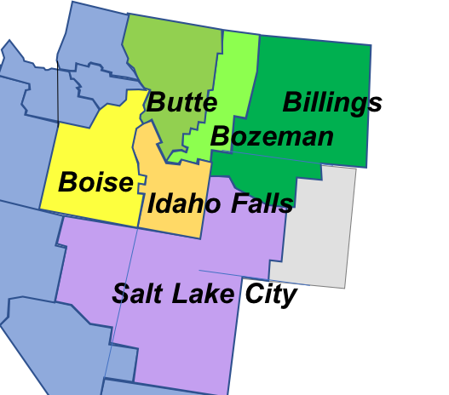
North East Area
Boise
Central Montana
Eastern Idaho
Eastern Montana
Western Montana
Utah
Notes:
This slide highlights IEEE medal of honor recipients and their high level accomplishments.
IEEE recognizes its best and brightest
The IEEE Medal of Honor is our most prestigious recognition of achievement.
-The work IEEE members are doing every day is so important – Public Visibility works to help spread the work on the cutting edge developments and achievements that results from the work of IEEE members.
Presenter, you can reference the following for further details:
Details of each IEEE Medal of Honor winner:
http://www.ieee.org/about/awards/bios/moh_recipients.html
IEEE past presidents, who enabled the innovation of past technologies. Links to and details of each president from 1963 – 2012 are here:
http://www.ieeeghn.org/wiki/index.php/Presidents_of_the_Institute_of_Electrical_and_Electronics_Engineers_(IEEE)
AIEE past presidents, 1884 – 1961, with links and details:
http://www.ieeeghn.org/wiki/index.php/Presidents_of_the_American_Institute_of_Electrical_Engineers_(AIEE)
IRE past presidents, 1912 – 1962, with links and details:
http://www.ieeeghn.org/wiki/index.php/Presidents_of_the_Institute_of_Radio_Engineers_(IRE)

Slide 9
Southwest Area
Sacramento
San Francisco
Alamogordo - Holloman
San Jose
Albuquerque
Las Vegas
Fort Huachuca
Los Alamos/
Northern New Mexico
Las Vegas Montana
Los Angeles
Phoenix
Los Alamos / Northern New Mexico
San Diego
Albuquerque
Phoenix
Tucson
Alamogordo-Holloman
San Diego
Fort Huachuca
Tucson
Notes:
This slide highlights IEEE medal of honor recipients and their high level accomplishments.
IEEE recognizes its best and brightest
The IEEE Medal of Honor is our most prestigious recognition of achievement.
-The work IEEE members are doing every day is so important – Public Visibility works to help spread the work on the cutting edge developments and achievements that results from the work of IEEE members.
Presenter, you can reference the following for further details:
Details of each IEEE Medal of Honor winner:
http://www.ieee.org/about/awards/bios/moh_recipients.html
IEEE past presidents, who enabled the innovation of past technologies. Links to and details of each president from 1963 – 2012 are here:
http://www.ieeeghn.org/wiki/index.php/Presidents_of_the_Institute_of_Electrical_and_Electronics_Engineers_(IEEE)
AIEE past presidents, 1884 – 1961, with links and details:
http://www.ieeeghn.org/wiki/index.php/Presidents_of_the_American_Institute_of_Electrical_Engineers_(AIEE)
IRE past presidents, 1912 – 1962, with links and details:
http://www.ieeeghn.org/wiki/index.php/Presidents_of_the_Institute_of_Radio_Engineers_(IRE)

Slide 10
STATISTICS – Region 6, Sections
Region 6 | 2016 | 2015 | 2014 | 2013
Alamogordo-Holloman Section | 18 | 16 | 16 | 20
Alaska Section | 371 | 440 | 459 | 435
Albuquerque Section | 1150 | 1180 | 1206 | 1220
Boise Section | 562 | 580 | 546 | 569
Buenaventura Section | 770 | 782 | 797 | 829
Central Coast Section | 857 | 924 | 993 | 1073
Central Montana Section | 129 | 140 | 157 | 150
Central Washington Section | 78 | 76 | 88 | 86
China Lake-Bakersfield Section | 209 | 220 | 243 | 216
Coastal Los Angeles Section | 2235 | 2310 | 2345 | 2452
Eastern Idaho Section | 200 | 211 | 199 | 193
Eastern Montana Section | 122 | 119 | 127 | 124
Foothill Section | 1250 | 1211 | 1202 | 1353
Fort Huachuca Section | 101 | 107 | 102 | 113
Hawaii Section | 651 | 653 | 685 | 753

Slide 11
STATISTICS – Region 6, Sections (cont.)
Region 6 | 2016 | 2015 | 2014 | 2013
Las Vegas Section | 521 | 550 | 556 | 566
Los Alamos/Northern New Mexico Section | 255 | 266 | 271 | 269
Metropolitan Los Angeles Section | 1545 | 1594 | 1699 | 1750
Northern Nevada Section | 377 | 379 | 375 | 364
Oakland-East Bay Section | 4141 | 4325 | 4161 | 4225
Orange County Section | 2946 | 3015 | 3065 | 3194
Oregon Section | 3563 | 3657 | 3796 | 3913
Palouse Section | 326 | 334 | 339 | 340
Phoenix Section | 3085 | 3113 | 3239 | 3282
Richland Section | 345 | 345 | 368 | 376
Sacramento Valley Section | 1652 | 1668 | 1665 | 1793
San Diego Section | 4091 | 4319 | 4382 | 4437
San Fernando Valley Section | 1043 | 1102 | 1156 | 1175
San Francisco Section | 1962 | 2047 | 2030 | 2074

Slide 12
STATISTICS – Region 6, Sections (cont.)
Region 6 | 2016 | 2015 | 2014 | 2013
Santa Clara Valley Section | 11492 | 11923 | 11972 | 12181
Seattle Section | 4223 | 4338 | 4306 | 4388
Spokane Section | 263 | 266 | 283 | 280
Tucson Section | 813 | 845 | 838 | 859
Utah Section | 1254 | 1308 | 1344 | 1396
Western Montana Section | 134 | 142 | 153 | 160
Grand Total | 52734 | 54505 | 55163 | 56608
35 sections, 14 of them in NE and SW Areas

Slide 13
NorthEast Student Branches
 |  | UG | G | TOTAL
Boise Section | Boise State Univ | 23 | 14 | 37
Boise Section | Northwest Nazarene University | 3 | 0 | 3
Central Montana Section | Montana State Univ-Bozeman | 22 | 11 | 33
Eastern Idaho Section | Brigham Young University-Idaho | 47 | 0 | 47
Eastern Idaho Section | Idaho State University | 13 | 1 | 14
Utah Section | Brigham Young University-Provo | 27 | 19 | 46
Utah Section | Utah State University | 12 | 21 | 33
Utah Section | Utah Univ Of | 34 | 78 | 112
Utah Section | Utah Valley University | 35 | 0 | 35
Utah Section | Weber State Univ | 21 | 0 | 21
Western Montana Section | Montana Tech Of The Univ of Montana | 3 | 3 | 6

Slide 14
Southwest Student Branches – p1
 |  | UG | G | TOTAL
Albuquerque Section | New Mexico Inst of Mining & Tech | 8 | 5 | 13
Albuquerque Section | New Mexico Univ of | 58 | 49 | 107
Fort Huachuca Section | University of Arizona South | 6 | 3 | 9
Las Vegas Section | Nevada Univ of-Las Vegas | 17 | 17 | 34
Phoenix Section | Arizona State Univ-Polytechnic | 22 | 9 | 31
Phoenix Section | Arizona State Univ-Tempe | 92 | 219 | 311
Phoenix Section | DeVry University-Phoenix | 24 | 0 | 24
Phoenix Section | Embry Riddle Aeronautical Univ-Arizona | 23 | 0 | 23
Phoenix Section | Northern Arizona Univ | 18 | 4 | 22

Slide 15
Southwest Student Branches
 |  | UG | G | TOTAL
San Diego Section | San Diego State Univ | 34 | 14 | 48
San Diego Section | San Diego Univ Of | 10 | 4 | 14
San Diego Section | Univ California Of-San Diego | 212 | 139 | 351
Tucson Section | Arizona Univ of | 25 | 48 | 73

Slide 16
Strategic Planning – Galactic Level
What should IEEE look like in 2025 to appeal to and serve young professionals and other underserved communities globally, and what should IEEE do to get there?
IEEE Proprietary

Slide 17
Strategic Initiatives – Going Local
Lead the way by bringing more together
Our mission is to enable and inspire all members from all types across our geography --.
We represent all kinds of members and are transforming our activities to draw and and serve underrepresented and affinities.
Our mission is to enable and inspire from pre-college through career
We are called to lead the way. SPA-X, PACE-X, STEM-X.
We are unique among all regions in the degree to which we regard our members not based upon where they were born but where they are contributing to advancing technology for humanity.

Slide 18
Our Strategic Initiatives
Inspire, Enable, Empower and Engage Members of IEEE
Advance technological innovation and excellence for the benefit of humanity
Transformation started with students.
Young Professionals, Women in Engineering, and Professional Activities next
Public Visibility
Sections Congress
18

Slide 19
Carrying Out Our Strategic Initiatives
Advance technological innovation and excellence for the benefit of humanity
Be cool. Be creative.
Use our superpowers for good.
Don’t be boring.
19

