Slide 1
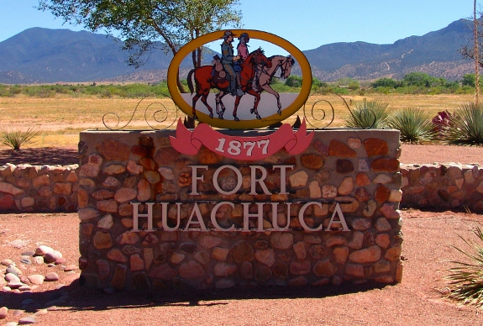
Fort Huachuca – R6
The Ft. Huachuca section major accomplishments:
  Two senior members have been published and received recognition for an article on the importance of industry certifications.
  Supported Future Cities, Cyber Patriot, and University of Arizona South Speaker Series(10+ unique events projected), Sections Congress, and Rising Stars 2018
  Recently accepted into the Joint Service Clubs of Greater Sierra Vista, AZ
Exciting opportunities: Partnering with other technical organizations like ITEA
Challenges: Decrease in membership, reduced participation
A new section chair, Jim Richmann, has been voted in by the ExCom for a two-year period of service beginning 1 JAN 2018

