Slide 1
Surinder Tuli, Section Chair & Vasudeva Prasad Atluri, Awards & MD Chair
IEEE Phoenix Section Presentation

Slide 2
Section Achievements During 2017
Prioritized our focus on the Chapters, Affinity Groups, and Student Branches that make up the Section.
Supported the Regional Engineering community by organizing technical, social, and professional activities for Working Engineers and Technologists, Researchers, Academicians, and College / Pre-College Students.
Section Officers are spear heading IEEE SusTech 2017 Conference scheduled for November 12-14, 2017, at Hilton Phoenix Airport
Focuses on Sustainability and Related Technologies
Around 100 participants expected to attend IEEE SusTech 2017
Conference included Invited Speakers, Sessions, and Student Poster Papers
For additional information access sites.ieee.org/sustech/
Notes:
2
Enhance presence in Social media
Phoenix Section Monthly meetings
Valley Megaphone newsletter
Phoenix Section website
LinkedIn
Facebook

Slide 3
Section Achievements During 2017
Annual Banquet was held on February 11, 2017 with a focus on
Showcasing IEEE and Phoenix Section Activities
Providing a forum for member networking
Recognizing contributions of members, non-members, faculty, students, and corporations
Presented Student Scholarship Awards
Acknowledged the work of section officers and volunteers
Included a Keynote Presentation Titled “The Strategic Landscape for Healthcare: Balancing Technological Innovation and the Cost of Care” by Dr. George Poste, Regents Professor, Arizona State University, Tempe, Arizona
Enabled Women In Engineering (WIE) Affinity Group
2017 IEEE Region 6 WIE Award Presented to Dr. Leslie A. Polka, Intel Corporation
Notes:
3
Enhance presence in Social media
Phoenix Section Monthly meetings
Valley Megaphone newsletter
Phoenix Section website
LinkedIn
Facebook

Slide 4
Section Achievements During 2017
Emphasized on STEM education through participation with Schools and Universities.
Arizona Science Laboratory
Supported Future City Competition
Participate in eWeek at the Arizona Science Center with support from Student Branches
Provided $50 K through (IEEE Foundation) to KJZZ/NPR Radio Station to broadcast stories on technology
Membership Development
Five Members Achieved Fellow Status
Nominated 78 Members to Senior Member Grade with 100% Success
Supported Student Participation in Area Meetings
Enhanced Section Communication using Valley MegaPhone Newsletter, Phoenix Section Website, and Social Media (LinkedIn and Facebook)
Notes:
4
Enhance presence in Social media
Phoenix Section Monthly meetings
Valley Megaphone newsletter
Phoenix Section website
LinkedIn
Facebook

Slide 5
IEEE Phoenix Section Plans for 2018
Enhancement of Section Activities with a focus on
STEM Activities and Programs
Student Branch Leadership
Start a new Strudent Branch at Grand Canyon University
Recruiting Activities to increase all levels of membership
Continue with elevation of members from one grade to higher grade
Participation in Region 6, MGA, and IEEE-USA Awards Programs
Notes:
5
Enhance presence in Social media
Phoenix Section Monthly meetings
Valley Megaphone newsletter
Phoenix Section website
LinkedIn
Facebook

Slide 6
IEEE Phoenix Section Challenges
Recruitment of Volunteers for Section Activities
New Section Officers and Committee Chairs
Recruitment of new Chapter Officers
Some Chapters Officers are continuing in the same position for many years
Few dedicated volunteers are carrying most of work load to keep the Section Active
Multiple Chapters and Affinity Groups have less than three meetings or no meetings in a year
Need additional funding from IEEE to improve activities and programs
Participation at Section monthly Section ExComm meetings is low
Leadership training at the Area level is not reaching to many volunteers at Section level
Notes:
6
Enhance presence in Social media
Phoenix Section Monthly meetings
Valley Megaphone newsletter
Phoenix Section website
LinkedIn
Facebook

Slide 7
Backup

Slide 8
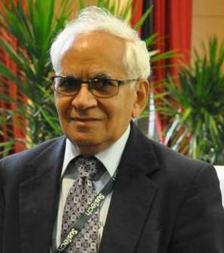
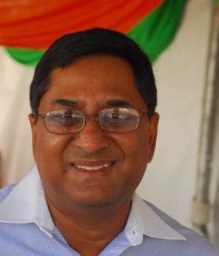
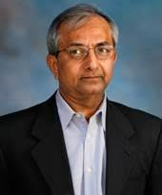
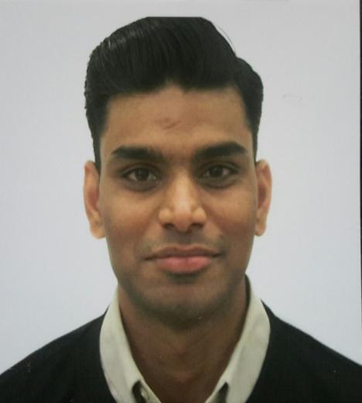
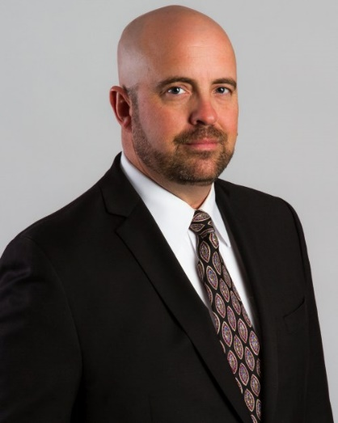
2017 Executive Committee
Surinder Tuli Vivek Gupta Mahesh Shah
Chair Vice Chair Secretary
Bharat Penmecha
Treasurer
Bruce Ladewig
Past Chair

