Slide 1
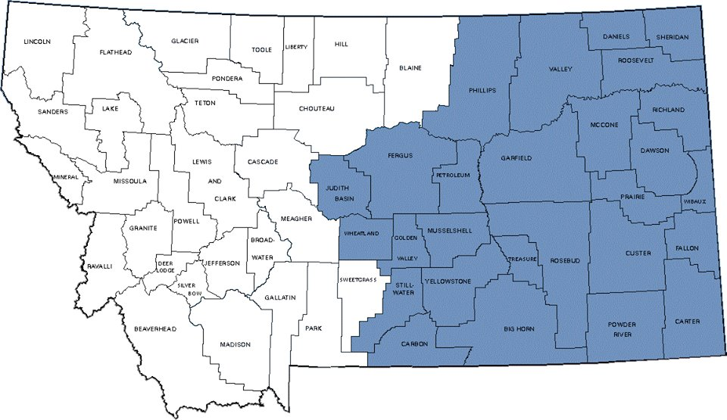
Kristopher Kenney – Eastern Montana Chair
October 15, 2016

Slide 2
Community Outreach
Project Lead the Way Robot Programming
The Eastern Montana Section has been working on building our own robots as a part of the PLTW curriculum.
Two teams will be competing for bragging rights with the goal to learn the programming and teach it to the educators so they can help their students.
STEM Community Outreach
The 15th of October we will be volunteering our time to STEM Billings for a community outreach program
Target audience is 5th and 6th elementary students to get them involved in the areas of science, technology, engineering and math.
Building Electrical Projects
We are developing several new electrical presentation projects for future outreach opportunities.
Notes:
Project Lead the Way is a school outreach program that has changed the way teachers approach the sciences. They no longer read the same old science books that we all had, but instead are taking a hands on approach in demonstrating the principals of physics. The 5th and 6th grade students are learning how to build and program robots that have to complete tasks. The issue that they are running into is that most elementary school teachers have little to no programming experience. This section has purchased several of these kits and has begun the process of building and competing against each other so that we will be able to teach the educators how to teach programming to their students.
The electrical projects that the STEM outreach groups have been using were in pretty poor shape. Our section cleaned up the existing projects and now have started the process in taking on new projects that will need to be designed and built for future outreach events.

Slide 3
Building the Section
Continuing IEEE Activities
Rebuilding
Getting people involved
Notes:
The Eastern Montana section had been inactive for several years when Kristopher picked it up last year. The first part of the year was difficult trying to get people involved but slowly with each event they had more and more attendees. During the final spring event they hosted a family picnic that was very well attended until the wind came and blew away all of the food/ chairs and eventually people.
We took the summer off (in Montana people don’t attend events when the weather is nice because they are out enjoying the best state in the country) but we will begin our community outreach and IEEE activities once again. We will be focusing on rebuilding by finding out what people would like to do at future events.
Also, we would like to see an active community of professionals that are interested in once again building relationships.

