Slide 1
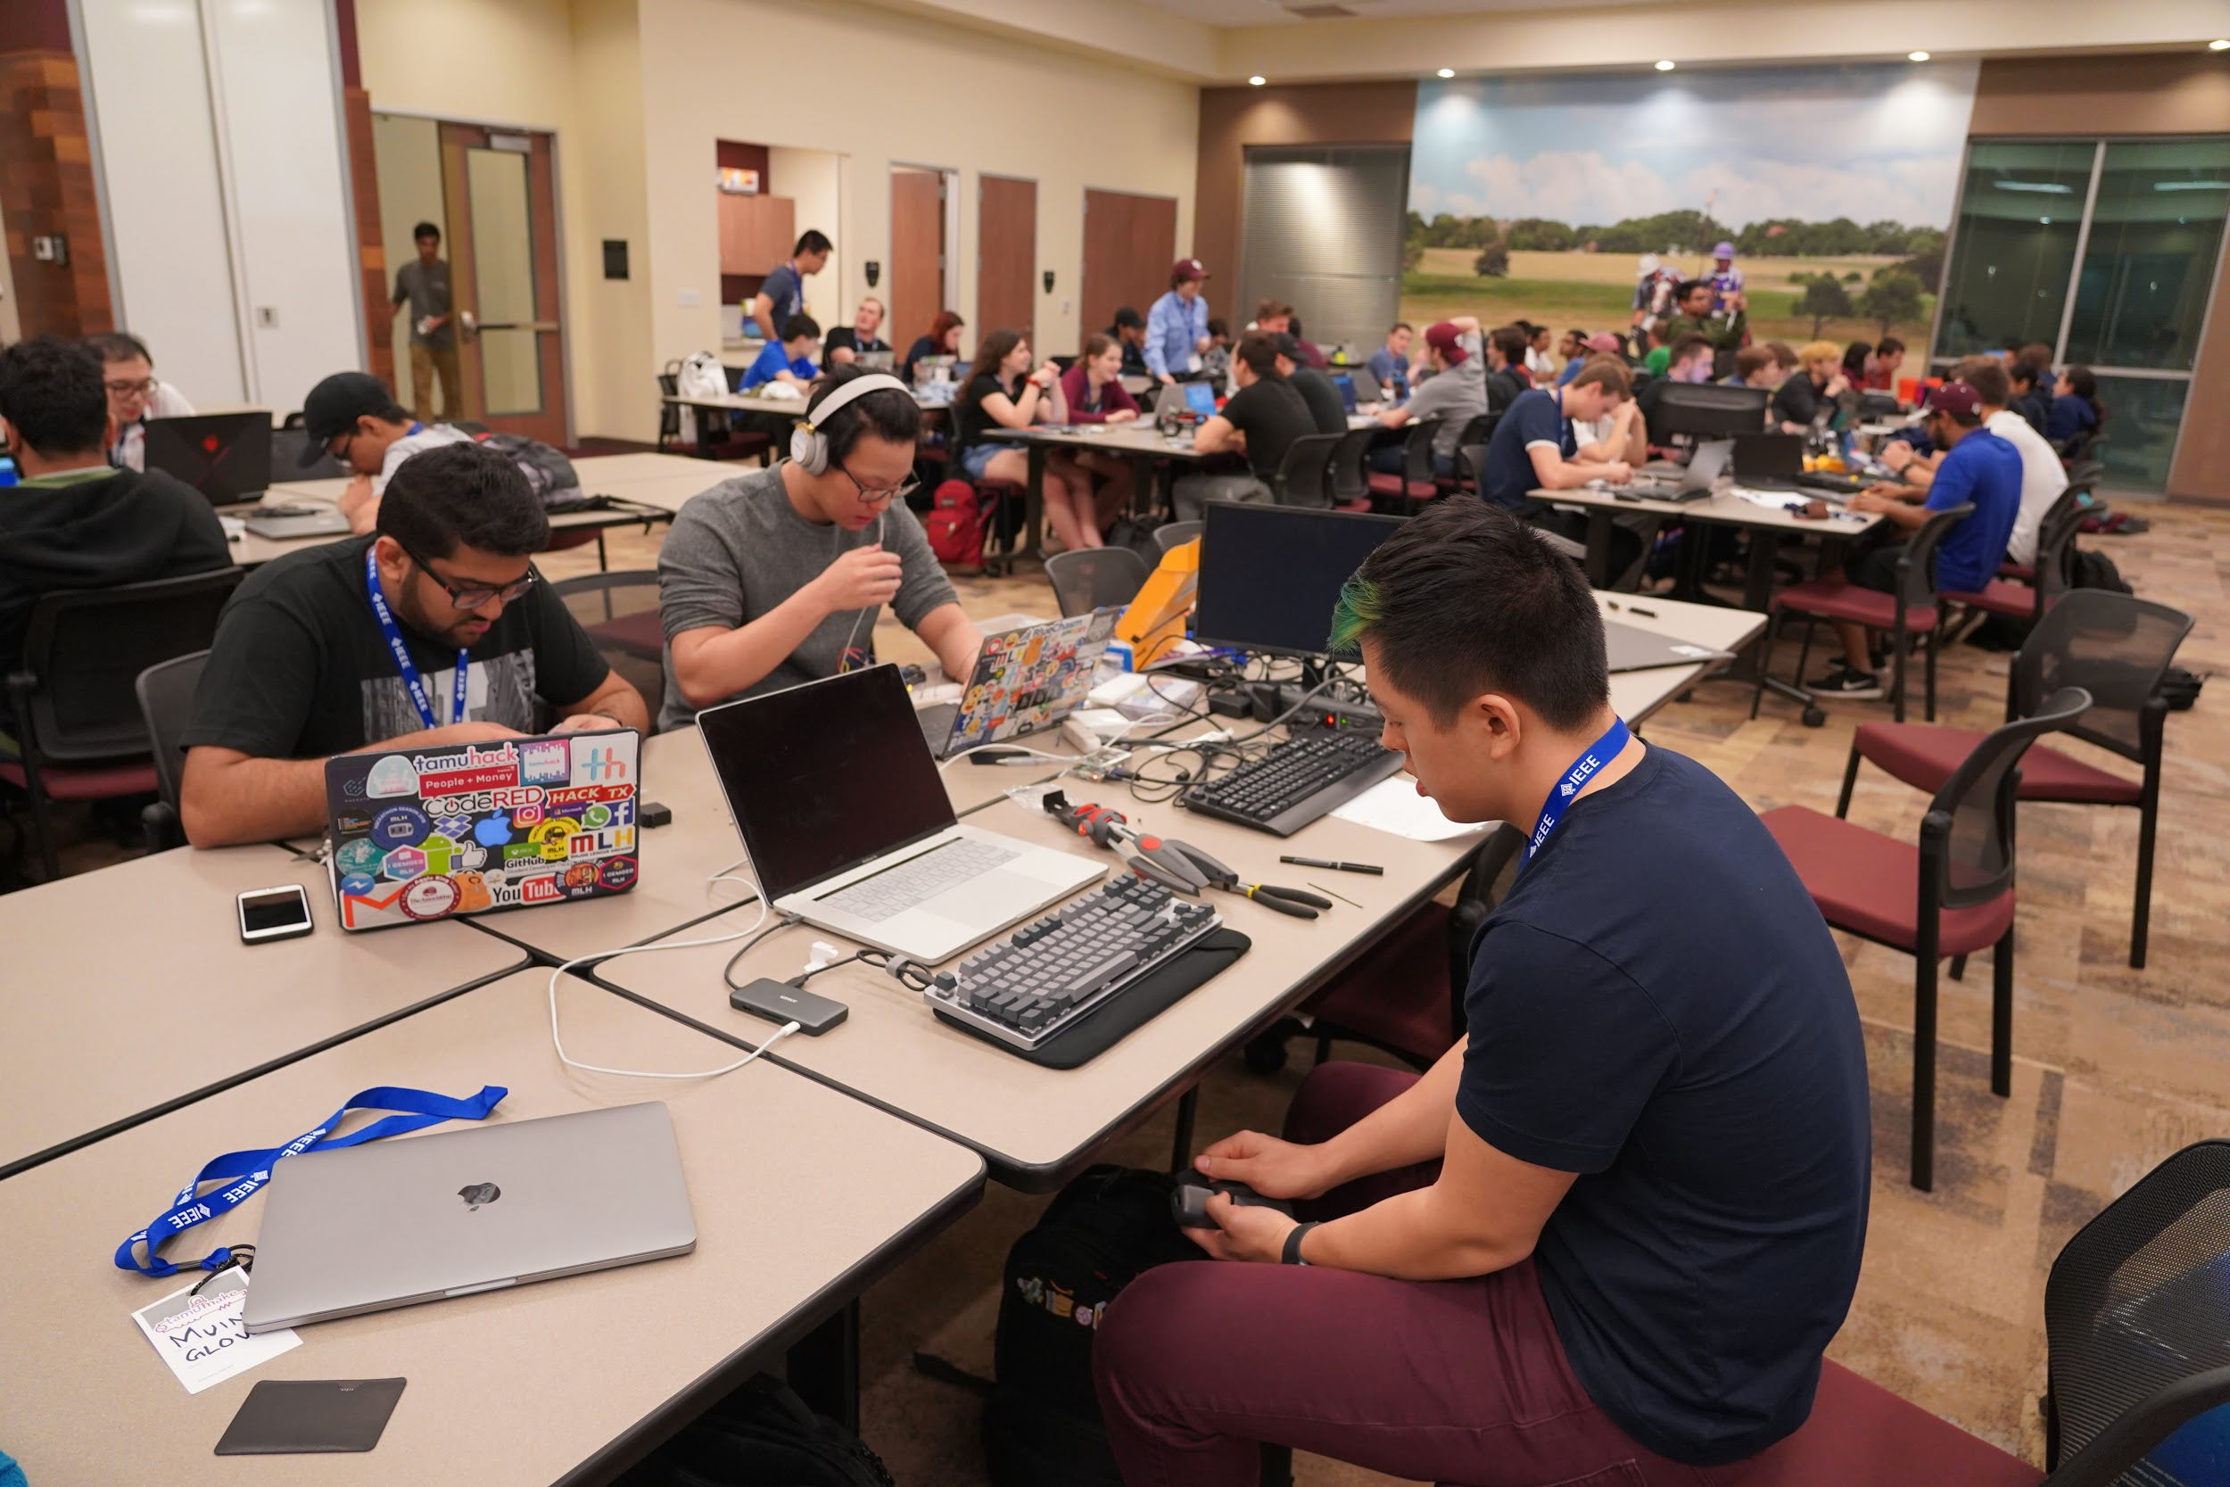
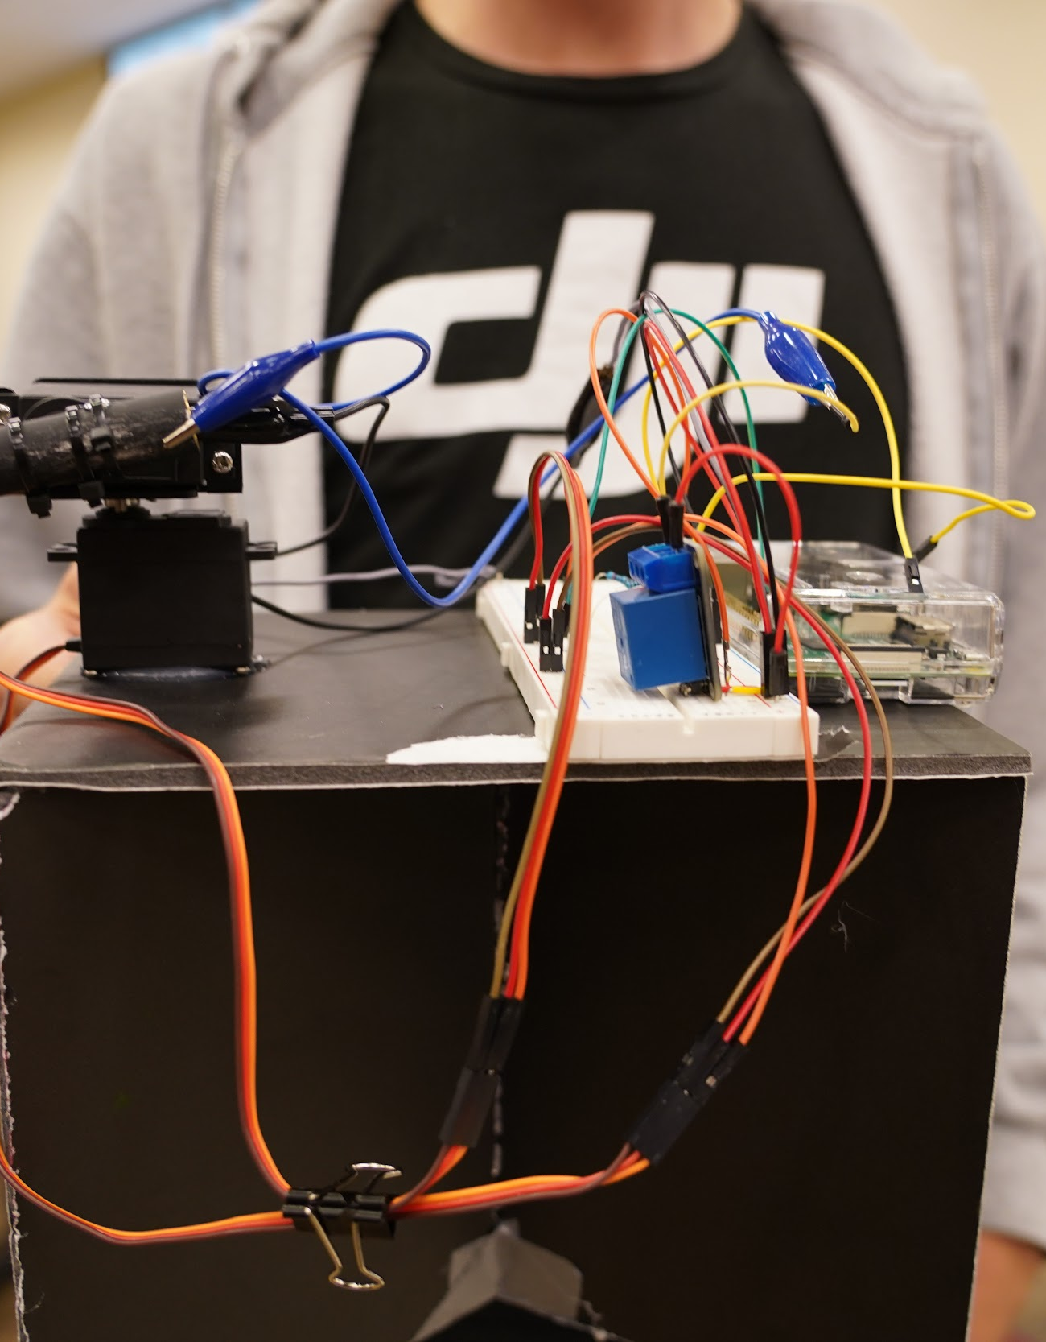
IEEE Texas A&M Hosts TAMUmake
Supported by the IEEE Houston Section
It was a Friday, February 15, 2019, at 8pm CST when the IEEE Student Branch at Texas A&M University hosted TAMUmake. TAMUmake is an annual hardware hackathon and competitive programming challenge in which teams of student members, supported by Volunteer Proctors who are IEEE members, industry professionals, and Texas A&M Electrical Engineering professors, compete in a 24-hour time span against each other to design and build a product.
TAMUmake was first organized in 2018 by Stephanie Wilcox who, at the time, was an officer in the Texas A&M IEEE Student branch. The first TAMUmake hackathon was held in 2018 with over 100 contestants and over 20 teams participating.
The 25 teams comprised of more than 80 registered participants at this year’s TAMUmake saw little sleep, but plenty of excitement, nervousness, and even some frustration throughout the 24 hour competition. But on Saturday, February 16, 2019 at 10pm the results were in….the 3rd place winners, a team of two, created a simple yet effective firearm security method based on RFID technology. 2nd place went to a team that built an module that would sit on top of trash cans and determine if the item placed on the surface was compost, recyclable, or trash and then deposit that item into the corresponding bin. The 1st place went to a laser drawing system that could be controlled remotely from an iPad. The user could draw a design on their smart device and the high intensity laser would draw that design on a fluorescent surface that would maintain the design for up to 30 seconds.
Continue to page 2
IEEE R5 Article: Published 02/20/2019

Slide 2
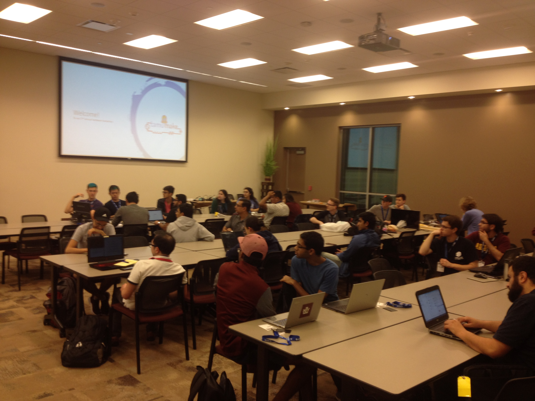
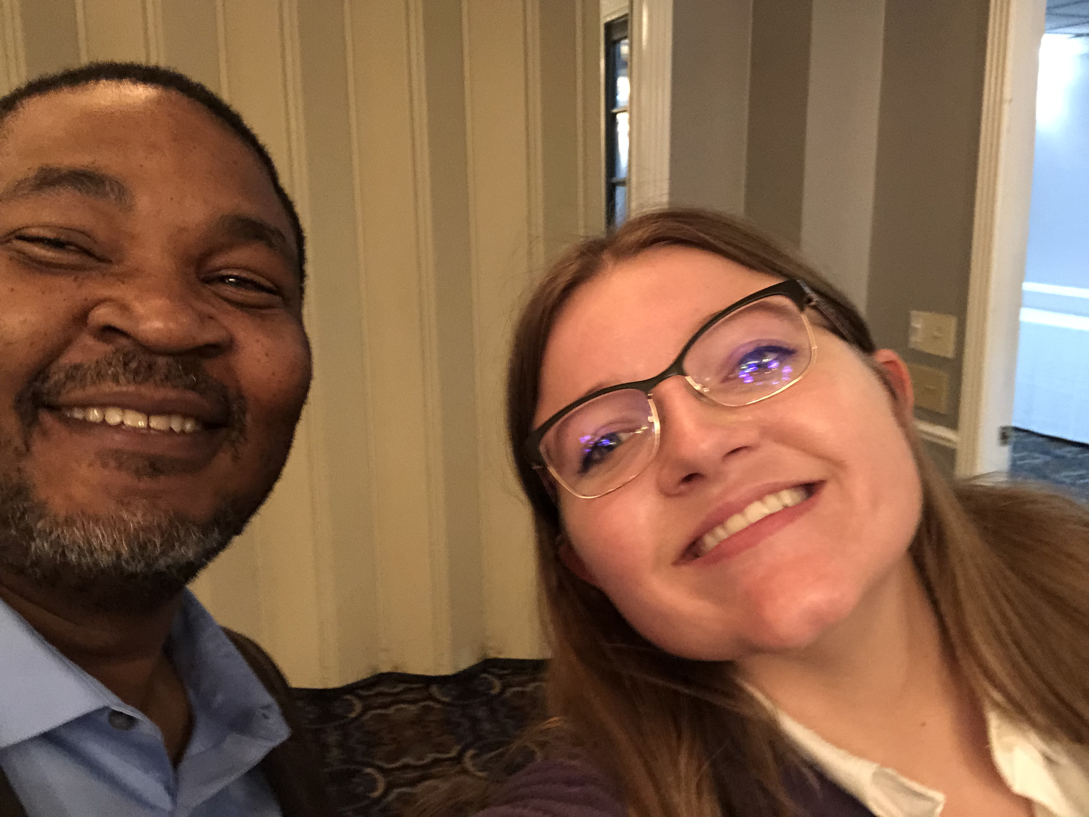
IEEE Texas A&M Hosts TAMUmake
Supported by the IEEE Houston Section
“It was very exciting to see so many TAMU community participants, volunteers and leaders working together, supporting one another, and having a little fun in the process. I would love to find a way for all of the other IEEE Student Branches to share this Best Practice.” Says Christopher Sanderson, IEEE South Area Chair and HOU Sec. Vice-Chair.
This year’s TAMUmake hardware hackathon could not exist without the outstanding efforts of Christopher Sanderson, HOU Sec Secretary Moriah Hargrove-Anders, and IEEE Senior University Partnership Program Manager Kristen MacCartney. Additional thank you support from Texas A&M University Student Branches representatives Gerardo Montemayor and Bijan Nekovei for their leadership and coordination of the event.
About IEEE Region 5 (R5)
IEEE R5 serves more than 23,000 IEEE Members, over 3,600 IEEE Student, more than 90 Student Branches and Eta Kappa Nu Chapters associated with the 26 Local IEEE Sections. It is comprised of R5 Officers and Program Coordinators.
IEEE R5 Article: Published 02/20/2019

