Slide 1
American Nuclear Society
SPECIAL COMMITTEE ON ADVANCED REACTOR POLICY (SCARP)
Setting the Right Bar: How Consensus Standards Help Advanced Reactor Development
Steven A. Arndt
Chairman, ANS Standards Board
January 29, 2020

Slide 2
SCARP Background
Chartered in 2018, by former ANS President John Kelly
Surveyed existing advanced reactor-related legislation and policy proposals in order to develop integrated policy-related recommendations
As a first product, developed an eight-page report aimed at accelerating the deployment of advanced reactors in the U.S. and abroad that best represent the consensus position of the U.S. nuclear community

Slide 3
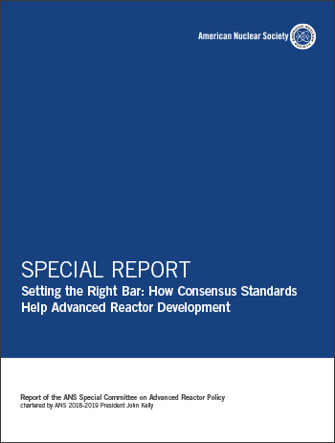
SCARP Roster
Marvin Fertel, Chair
Art Wharton, Vice Chair
Steven Arndt
Robert Budnitz
Daniel Carleton
Michael Corradini
George Flanagan
Steve Nesbit
Craig Piercy
Piyush Sabharwall
Mike Tschiltz
Patrick White

Slide 4
In General…
The standards report was developed because it is essential all stakeholders, particularly the federal government, including the U.S. Department of Energy actively support the accelerated development of advanced reactor standards by standards development organizations that the U.S. NRC would incorporate into its regulatory policies, guidelines, and activities so as to not delay or complicate the timely licensing of the first generation of advanced reactor

Slide 5
Reasoning
Numerous countries are showing interest in the development of advanced nuclear energy designs
There is a consensus in the U.S. that its leadership and involvement in carbon-free advanced reactor development is crucial to achieve key policy objectives related to nuclear safety, national security, and nonproliferation
The U.S. has led the development of nuclear energy from its earliest days in the 1950s, but unless near-term actions are taken, U.S. leadership will be lost

Slide 6
Codes & Standards
Have historically played a crucial role in designing, licensing, and operating light water reactors
Reduce economic burden by avoiding unnecessary changes to designs
Facilitate the establishment of technically appropriate safety margins
Provide credibility for marketing advanced reactors internationally
Help advanced reactor suppliers demonstrate and market the significantly reduced risks associated with regulatory burdens and first-of-a-kind implementation challenges

Slide 7
Challenges
Developers may be concerned that the time required to develop the necessary codes and standards may impact project schedules
In some cases, SDOs and advanced reactor developers may not have resources to commit to fully develop the desired codes and standards on the timelines needed
Information needed to support early development of standards may not be available
Regulators need to be more proactive in endorsing relevant codes and standards of interest

Slide 8
Opportunities
The Future of Nuclear Energy in a Carbon-Constrained World — An Interdisciplinary MIT Study concluded that significant project cost savings could be achieved if specific codes and standards were updated and developed to reflect current technologies
An ANS/NRC workshop in the spring of 2018 was held to develop a strategic vision for advanced reactor standards
NEI Advanced Reactor Codes and Standards Needs Assessment (NEI 19-03)

Slide 9
Workshop Findings
The workshop identified some of the key standards that must be developed or updated to support development of advanced reactors, including the following:
ASME/ANS RA-S-1.4, “Probabilistic Risk Assessment Standard for Advanced Non-LWR Nuclear Power Plants”
ANS-30.1, “Integrating Risk and Performance Objectives into New Reactor Nuclear Safety Designs”
ANS-30.2, “Categorization and Classification of Structures, Systems, and Components for New Nuclear Power Plants”
ANS-53.1, “Nuclear Safety Design Process for Modular Helium-Cooled Reactor Plants”
ACI 349, “Code Requirements for Nuclear Safety Related Concrete Structures (ACI 349-13) and Commentary”

Slide 10
SCARP Recommendations
In developing this report, the ANS Special Committee on Advanced Reactor Policy has worked with the ANS Standards Board and advanced reactor experts and reached out to a wide range of stakeholders from the commercial suppliers and utility community to validate our concerns and inform our understanding about the need for action
Based on this effort SCAPR developed five recommendations

Slide 11
SCARP Recommendations
(1) Congress should authorize and appropriate funding for a DOE program to assist SDOs and advanced reactor developers in conducting accelerated development of and/or updates to key standards needed to implement a technology-neutral licensing framework before 2027, as mandated by the Nuclear Energy Innovation and Modernization Act (NEIMA).
(2) The DOE, in coordination with SDOs, should solicit input from the advanced reactor developers, nongovernmental organizations, and other stakeholders to identify and prioritize key codes and standards for creation/improvement and an overall time frame for their development and regulatory acceptance.

Slide 12
SCARP Recommendations
(3) The DOE should provide incentives to national laboratories to ensure proactive participation in developing the new data and methods needed to support a comprehensive overhaul of priority advanced reactor codes and standards.
(4) The NRC should implement process improvements and/or provide the resources needed to ensure timely adoption of advanced reactor standards. The NRC should reevaluate the need for imposing margins in excess of the margins in endorsed standards and determine whether they are justified from a perspective of reasonable assurance of adequate protection of public health and safety.

Slide 13
SCARP Recommendations
(5) The DOE and/or the NRC should establish a formal process with the SDOs for achieving harmonization of safety margins among new and/or updated consensus standards.

Slide 14
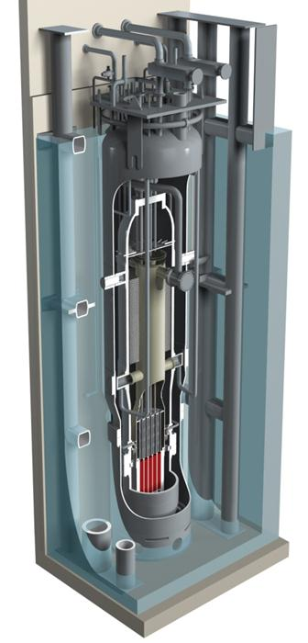
Follow-up
Work with ANS and other SDOs to develop a plan to support the implementation of the recommendations (particularly 1, 2 and 5)
Work with ANS and other SDOs to use the current inputs and other resources to identify the highest priority standards
Work with ANS to ensure this work is priorities with stakeholders

Slide 15
QUESTIONS?
steven.arndt@nrc.gov
or
jstarkey@ans.org

