Slide 1

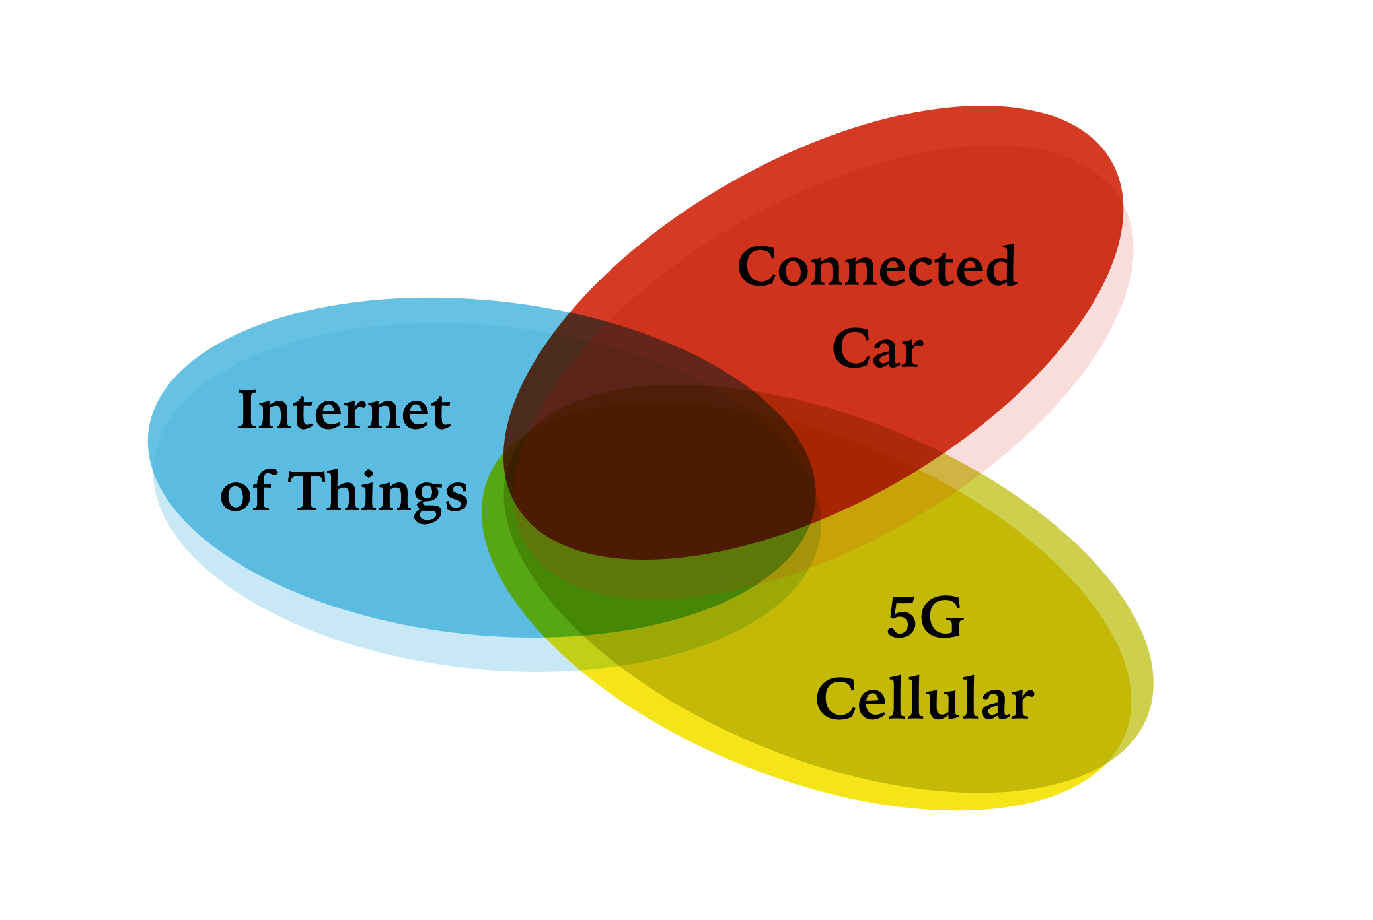

Kay Das
Systems Research, Development, and Innovation
The Connected Vehicle Revolution
IEEE Orange County Communications and Signal Processing Society,
Santa Ana CA, 6 Dec 2016

Slide 2
Agenda
What’s going on…
Industry Snapshots
  The Automobile Industry
  The Communication/ Consumer Industry
  The Aviation Industry
Technology Snapshots
  Current Technology
  Data vs Computation Approaches
  More than Moore
  Shannon’s Law
  Location Systems
The Need for Validation/ Testbeds
Proposal: Aquarius
Take-away…
Addenda (Google Car/ Uber/ Augmented Reality)

Slide 3
What’s Going On… - 1
There is currently much on-going activity in the research and design of systems to enhance the safety of vehicular traffic on roads and highways.
These include vehicle-based and infrastructure-based electronics systems with extension to personal devices.
These systems work collaboratively in an intelligent and reconfigurable network environment characterized by multiple localized and dynamically changing motion control loops which include each individual vehicle driver (and pedestrian).

Slide 4
What’s Going On… - 2
Information and data will flow in both directions. In the vehicle to infrastructure direction, critical information regarding the vehicle (speed, position, orientation, driver health etc) is fed up to the network.
In the reverse direction the network will feed information pertaining to safety threats, traffic, and environmental conditions to the vehicle or pedestrian.
Importantly, vehicles will communicate between themselves without need to always access the infrastructure and thus greatly reduce latencies. Systems will comprise a dynamically evolving and changing mix of existing and new technologies.

Slide 5
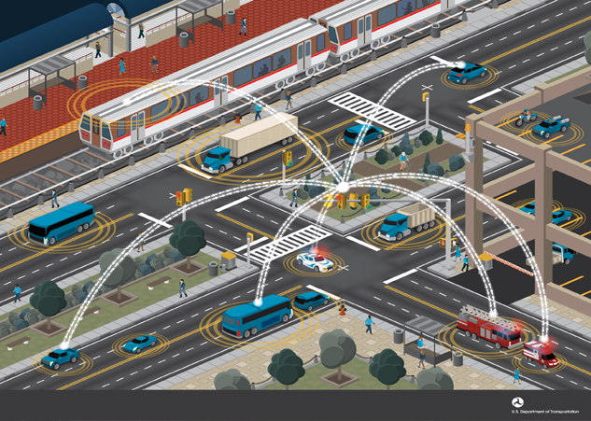
Communication: Connected Vehicles

Slide 6

Snapshot:
Overall Industry
Kay Das

Slide 7
New Opportunities in Industry and in Institutions
Car manufacturers
Electronics manufacturers
Software and Applications
Aftermarket product developers
Map developers
Component manufacturers
Insurance companies
Health industry
Driver education
Hospitality industry
…….

Slide 8
Industry Requirements
Cheaper sensors
Spectrum availability
Integrated systems (today’s luxury car has more lines of source code than a Dreamliner aircraft…)
More accurate GPS/ GNSS, more investment in terrestrial methods
Co-ordination between automobile and silicon systems designers
Security protection and information integrity assurance
Product Validation

Slide 9
Businesses..
Many are eyeing the world’s billion passenger vehicles as the next frontier of cloud computing, telematics, and Internet of Things (IoT) connectivity.
  Software and device makers: Apple, AT&T, Google, Intel, Qualcomm, Microsoft, Sprint, Verizon, Panasonic, Pioneer….
  Car manufacturers: BMW, VW/Audi, Mercedes, Toyota, GM, Ford, Hyundai, Tesla, Tata….
  Mapping and GPS companies: Trimble, Garmin, app developers….

Slide 10
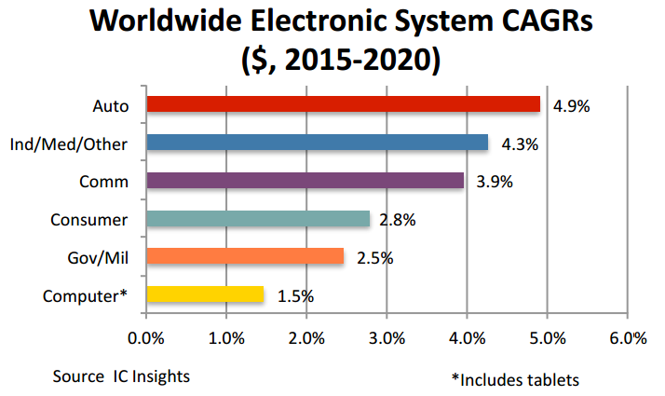

Slide 11
Snapshot:
Automobile Industry
Kay Das

Slide 12
The Automobile Industry - 1
Facing huge costs to keep up with tightening constraints on emissions and fuel efficiency.
Over-capacity and low profitability…. has rarely returned the cost of its capital over time.
Investment in connected cars and driverless technologies will add to costs.
Capital spending plus R&D costs have grown by 12% over last 5 years.
Source: The Economist 3 Oct 2015

Slide 13
The Automobile Industry - 2
Many participants ( e.g., compared to commercial aircraft) with parallel development costs.
Many “platforms”. Each will require validation before introduction to market.
Consolidation can reduce costs but bring in new problems.
  Obstacles: governments, unions, big share-holders, founding families.
New aspirants (Google, Tesla, Apple) developing capabilities to cause an industry watershed.
Google has created OAA (Open Automotive Alliance).
Nokia sold its mapping division ‘Here’ to a consortium of leading car manufacturers.
Companies like Uber, car sharing start-ups, insurance companies, telecom operators…want piece of the action
[Source: The Economist 3 Oct 2015]

Slide 14
Snapshot:
Communications/Consumer Industry
Kay Das

Slide 15
Apple: 22 November 2016
Apple’s letter to NHTSA on Federal Automated Vehicles Policy
  Executed properly under NHTSA’s guidance, automated vehicles have the potential to greatly enhance the human experience—to prevent millions of car crashes and thousands of fatalities each year ….
  It is vital that those developing and deploying automated vehicles follow rigorous safety principles in design and production. Such principles should not, however, inhibit companies from making consequential progress; there is no need to compromise safety or innovation.
  …..companies should share de-identified scenario and dynamics data from crashes and near-misses. Data should be sufficient to reconstruct the event, including time- series of vehicle kinematics and characteristics of the roadway and objects. By sharing data, the industry will build a more comprehensive dataset than any one company could create alone.
Apple's_Comments Full Text

Slide 16
Samsung:14 November 2016
Samsung purchases Harman for $8 billion. Although Harman is most widely known for its range of in-car audio products, the company is heavily focused on connected car technology, including a platform for rolling out over-the-air software updates to connected vehicles.
Samsung is looking to the automotive market as the next big growth sector for its hardware business…… there’s scope for Samsung to tie automotive in with its growing ecosystem of smart products and 3G/ 4G/ 5G smartphones. The acquisition of Harman propels Samsung near the top of the connected vehicle market.

Slide 17
Snapshot:
Aviation Industry
Kay Das

Slide 18
History: Humans vs Computers
1915:Early autopilots were used in WW I
1947: a USAF plane made the first trans-Atlantic flight with “no-hands” flying controls
Can we replace a human with tens of thousands of years of evolution with computer systems that have evolved over a hundred years!??
BUT: behavior of a computer system is predictable and less error-prone than a human!
  Faults can be corrected.
Can an connected/autonomous vehicle system be designed to behave on intuition like a human?

Slide 19
Airliners vs Automobiles
Airliners and supersonic fighters of today rely on multiple computer systems to get airborne, cruise, and land.
Computerized safeguards are designed to kick in automatically during emergencies such as engine failure at take-off
The automotive industry needs to build “use-cases” and demonstrate solutions in similar fashion.

Slide 20
Window from Aviation
Airplane automation can be calibrated to different levels by crew
Airlines require two pilots in cockpit:
  pilot manipulates controls
  co-pilot monitors the automated systems
Humans tend to be poor monitors
  So airliners have extensive visual and aural warnings for pilots for “out of limit” conditions[6]
  Automobile automation needs to monitor the enforcement of road rules and speed limits

Slide 21
Lines of Code
Space Shuttle: 500,000
Boeing 787 (Dreamliner): 7 million
Mercedes S: 100 million

Slide 22
Software Quality: ISO 26262
International standard for functional safety of electrical and/or electronic systems in automobiles applicable throughout the lifecycle defined in 2011.
Functional safety features for automotive product development phases:
  specification,
  design
  implementation,
  integration
  verification
  validation
  production release.
Lifecycle: management, development, production, operation, service, de-commissioning)
Defined in 2011

Slide 23
Software Quality: ISO26262
Software controls everything from safety critical systems like brakes and power steering, infotainment, to basic vehicle controls like doors and windows, and extending to V2V, V2I
ISO 26262 uses one of four Automotive Safety Integrity Levels (ASILs) - (A, B, C or D to specify the item’s or element’s necessary safety requirements for achieving an acceptable level of risk,
D is most stringent and A least stringent.

Slide 24
Validation/ Test Beds
Kay Das

Slide 25
The Need for Validation
A range of products and systems will compete for market entry from diverse sources and nations. The market is worldwide.
However, a significant challenge exists in validating prototypes and final systems productized for market entry.
The cost of failure is high as human life is in the loop. Systems need to be vetted for high reliability performance (probably with reliability specifications in the five to seven 9’s).
System complexity is very high due to the need for multiple technologies (laser, imaging, radar, cellular, WiFi, GPS) to deliver the required level of reliability.
It is possible that tailored operating systems will need to be designed due to the unique environment.

Slide 26
The Need for Validation (continued)
Existing approaches to validation are still in fledgling development.
There are two current approaches.
  The first, instituted by the US DOT and other entities in Europe and Asia, involves real life-sized test beds with real vehicles.
  The second approach relies on computer modeling and simulations of use cases, and there are currently several in development.
While the first approach is the most accurate possible, demands on cost, real estate, and logistics are very high.
The second approach is highly configurable and less expensive to develop but validation of the models themselves, with constant updating as newer systems are developed, will be a major challenge. Observing the totality of an event can also be severely limited by dependence on two-dimensional displays, even if more than one is employed. There would be no “touch and feel”.

Slide 27
Current and Developing Test Beds
Kay Das

Slide 28
Testbeds in Existence
M City, Ann Arbor, MI
US DoT Testbed, Ann Arbor, MI
Turner Fairbank Highway Research Center, McLean,VA
Partner Test Beds: Palo Alto CA, Orlando FL, Manhattan NY
Enterprise Network Operation Center, Oak Ridge, TN
Transportation Research Center, Ohio
AstaZero, Sweden
American Center for Mobility, Ypsilanti, MI

Slide 29
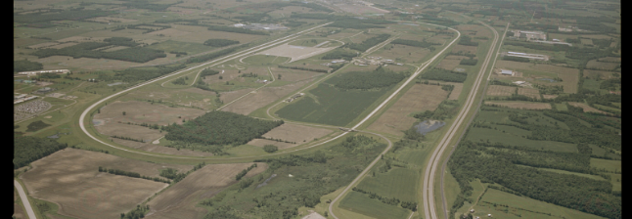
Transportation Research Center, Ohio - 2
(no current driverless testing):
Specializes in research and development testing services.
Brake, crashworthiness, emissions, durability, fuel economy, handling, driver training classes and performance testing
Independent automotive proving ground with 12 km test track, 450m x 450m vehicle dynamics area, skid pad, wet basalt and tile surfaces, emissions lab, dynamic handling courses, off-highway area, and crash test barrier and simulator sled.
www.trcpg.com

Slide 30
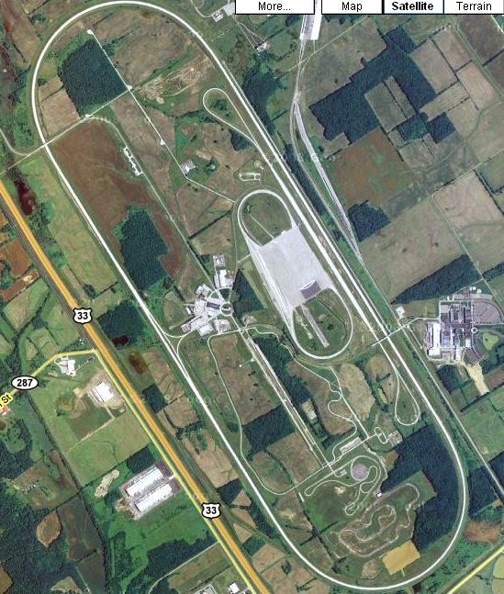
Transportation Research Center, Ohio - 2

Slide 31
Smart Tracks at AstaZero
Opened in August 2014, designed for studying
  vehicle dynamics
  driver behavior
  V2V and V2I technology
  functional reliability of automotive/ communications technology.
2,000,000 sq m, 250 sq m of paved surfaces.
Test environments:
  rural / multilane roads,
  city area
  high-speed area
  simulated hazards
  robot controlled “balloon cars”
Conduits for electricity, communications and fiber optics.
http://analysis.tu-auto.com/autonomous-car/track-autonomy

Slide 32
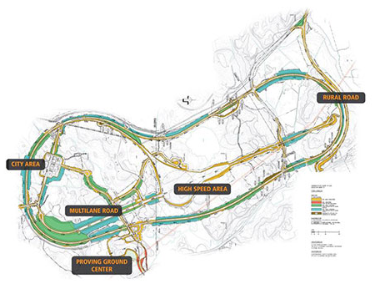
AstaZero Testbed
“AstaZero is the world’s first full-scale test environment for future road safety.The different traffic environments make it possible to test advanced safety systems and their functions for all kinds of traffic and traffic situations.”

Slide 33
M City
32-acre (130,000 sq m) simulated urban and suburban environment in partnership with Michigan DoT (MDoT)
Includes a network of roads with intersections, traffic signs and signals, streetlights, building facades, sidewalks and construction obstacles
Allows researchers to simulate environments where connected and automated vehicles will be most challenged.
Technologies: V2V or V2I and various levels of automation up to fully autonomous vehicles
MDoT facility is large scale: 3000 to 9000 vehicle capacity
Partners: automakers, top tier auto suppliers, traffic signal and traffic sensing companies, insurance providers, telecommunications, big data, IT companies, and with federal, state, and city governments

Slide 34
American Center for Mobility
A non-profit testing and product development facility (335 acres = 1150metres x 1150metres) at Ypsilanti MI designed to enable safe validation of connected and automated vehicle technology, and the development of standards
“Connected, Automated, Validated”
  https://youtu.be/6EgocO2qOEs
  https://youtu.be/cfsfeQq1bq0

Slide 35
New Testbeds Needed
The U.S. Department of Transportation through Dec. 19 is accepting applications for facilities that want to be designated as “qualified proving grounds for the safe testing, demonstration and deployment of automated vehicle technology.”
Facilities have to open for testing by Jan. 1, 2018, to be considered for the designation.

Slide 36
Technology Snapshots:
Current Technology
Kay Das

Slide 37
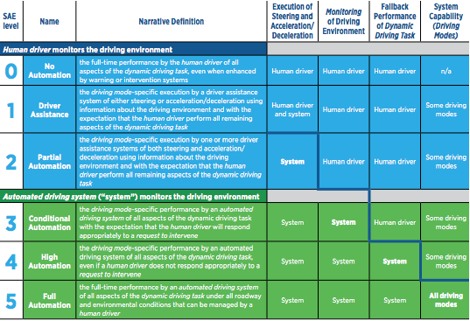
SAE: Levels of Driving Automation

Slide 38
Automated Driver Assistance System (ADAS)
CMOS sensors in digital cameras moving to 2Mpixels
ADAS: 8-12 vision sensors, 2 long range radar sensors, 4 LIDAR sensors, V2X connectivity, ultrasonics, 360 degree coverage
Applications:
  Parking
  Night Vision
  Lane Departure Warning
  Drowsiness
  Distance
  Blind Spot

Slide 39
Three Stages of Development
Automated Driving Assistance (ADAS)
Connected Vehicle
Autonomous Vehicle
SAE level 3
SAE level 4
SAE level 5

Slide 40
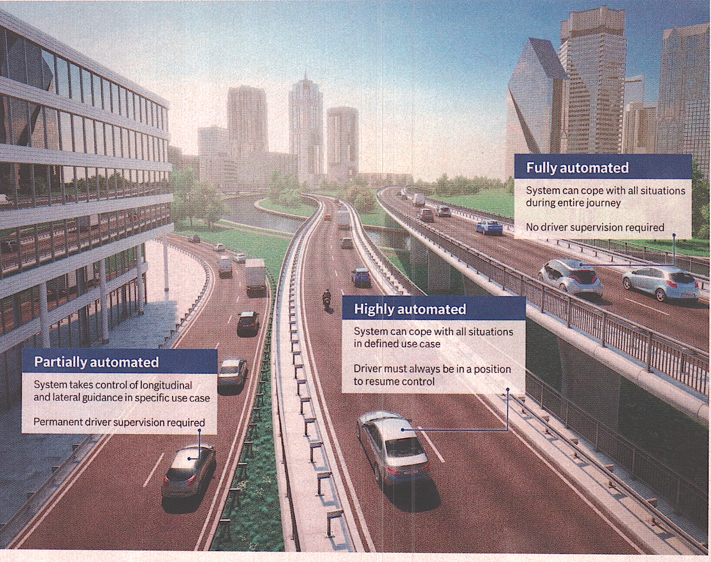
Progression?
Autonomous Vehicle
Connected Vehicle
Automated Driving Assistance (ADAS)

Slide 41
Approaches
No dependency on other vehicles or infrastructure, first to Autonomous Vehicle, computationally intense, line of sight
Dependency on other vehicles and infrastructure, first to Connected Vehicle, distributed control system, information sharing, non-line of sight
Automated Driving Assistant
(ADAS)
Autonomous Vehicle
Connected Vehicle
Automated Driving Assistant
(ADAS)
Connected Vehicle
Autonomous Vehicle

Slide 42
Technology Snapshots:
Data vs Computation
Kay Das

Slide 43
Computer Vision
Store and Align
Sense and Understand
Data driven
Match to database
Google approach
Sensors/camera
Algorithms/computation
Record nothing
Current industry approach
“Future of Computer Vision and Automated Driving”, Amnon Shashua, Mobileye, 16Jan 2016
https://youtu.be/kp3ik5f3-2c
38 min

Slide 44
Technology Snapshots:
More than Moore
Kay Das

Slide 45
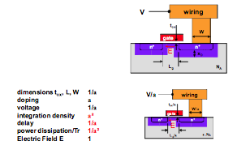
Constant Field Scaling
Reducing critical dimensions while keeping electrical field constant increases speed and reduces power consumption. Scaling realised has been by a factor of 0.7 (0.5√2) every 2 years, where “critical dimension” is “half pitch” between traces.
Source: IRC-ITRS- M2M – v2.3

Slide 46
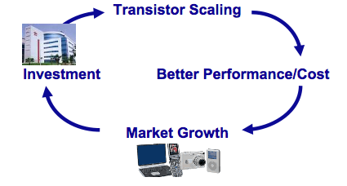
The Virtuous Cycle of the Semiconductor Industry

Slide 47
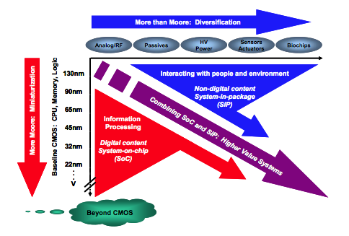
More than Moore: Diversification
Critical to Connected Vehicle
Progress in process technology and design is enhancing the integration of CMOS and non-digital technologies, enabling the migration of non-digital components into the package or chip
Source: IRC-ITRS- M2M – v2.3

Slide 48
Information Theory Snapshot:
Shannon’s Theorem
Kay Das

Slide 49
Shannon’s Law
Shannon's Law from information theory expresses the maximum possible data speed that can be obtained in a data channel: the highest obtainable error-free data speed, expressed in bits per second (bps), is a function of the bandwidth and the signal-to-noise ratio.
C = B log₂ [1+ SNR]
C = Maximum possible error-free data speed (bps)
B = Channel bandwidth (Hz)

Slide 50
Shannon’s Law Examples
SNR 30dB, Bandwidth 3 kHz
C = 3000 log₂ (1001)
= 30kbps
SNR 20dB, Bandwidth 10 MHz
C = 10⁷ log₂ (101)
= 65 Mbps

Slide 51
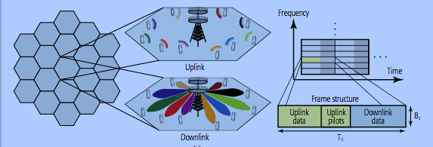
Massive MIMO

Slide 52
Massive MIMO/ Shannon’s Law - 1
Massive multiple-input multiple-output (MIMO) is a multi-user technology where
  each base station is has an array of active antenna elements
  utilizes these to communicate with single (or smaller number) antenna per terminal (Ue) over the same time and frequency band
  inserting phase delays to the elements of the array enables directivity in the antenna beam
  spatial multiplexing is thus now possible

Slide 53
Massive MIMO/ Shannon’s Law – 2
[6]
E = K . (1 – K/τ). log₂ [1+ (c _{CSI}. M. SNR _{u/d}) / K.SNR _{u/d} +1]
E = Spectral efficiency per cell (bits /Hz/ cell), Rayleigh fading*
K = number of single antenna terminals
M = number of active antenna array elements in base station
= number of symbols in TDD transmission frame
c _{CSI} = quality of estimated channel state information ( = 1 when perfect)
SNR _{u/d} = Uplink/downlink Signal to Noise Ratio
(* a reasonable model for radio signal fading in urban environments, no dominant line of sight radio signal path)

Slide 54
Massive MIMO/ Shannon’s Law – 3
E = K .(1 – K/τ). log₂ [1+ (c _{CSI}. M. SNR _{u/d}) / K.SNR _{u/d} +1]
(Spectral efficiency per cell (bits/Hz/cell)
C = B log₂ [1+ SNR]
(Maximum possible error-free data speed (bps)

Slide 55
Technology Snapshots:
Location Systems
Kay Das

Slide 56
GPS Error Sources in Navigation
Error Source | Potential Error | Mitigation Approach
Satellite geometry | ± 2.5 meter | The geometry of the positions of satellites in view of the receiver influence the accuracy of the calculated position.
Shifts in the satellite orbits | ± 2.5 meter | Although the satellites are positioned in very precise orbits, slight shifts of the orbits occur due to constantly changing gravitation forces. The sun and moon have a weak influence on the orbits.
Multipath effect | ± 1 meter | GPS signals can be affected by multipath issues, where the radio signals reflect off surrounding terrain, buildings, canyon walls, hard ground, etc. These delayed signals can cause inaccuracy.
Ionospheric effects | ± 5 meters | Frequency dependent and arises from ionized atmosphere. Can be calculated from measurement delay for two more frequency bands allowing delays at other frequencies to be estimated. The delays generally change slowly and can be averaged over time.
Tropospheric effects | ± 0.5 meter | Humidity causes a variable delay. The delays are more localized and changes more quickly than ionospheric effects
Errors in satellites' clocks | ± 2 meter | The satellite's atomic clocks experience noise and clock drift errors.
Calculation and rounding errors | ± 1 meter | Despite the synchronization of the receiver clock with satellite time during position determination, remnant inaccuracy still leads to an error of about 2 m in the position determination. Rounding and calculation errors of the receiver sum up approximately to 1 m.

Slide 57
Total Error
Aggregated error of ± 15 meters.
Corrections by systems like DGPS, WAAS and EGNOS, which mainly reduce ionospheric effects, but also improve orbits and clock errors, can reduce overall error to approximately ± 3 meters.
Need error to be contained to < 1 meter

Slide 58
Aquarius
Kay Das

Slide 59
ITS Technology Lifecycle
Research
Development
Adoption
Idea Generation
Concept Development
Definition of Scope
Prototyping
Testing
Optimisation
Technology to Market
Support and Training
Marketing

Slide 60
ITS Technology Lifecycle
Research
Development
Adoption
Idea Generation
Concept Development
Definition of Scope
Prototyping
Testing
Optimisation
Technology to Market
Support and Training
Marketing
Performance Management
(specifications, key performance indicators, metrics, use cases, improvement opportunities)
Technology and Market Tracking
(watchdog on technology innovations, regulations, industry and market trends)

Slide 61
AquariusTest Bed
There is justification for a third method. In this approach, a real world test bed would be built modularly, based on actual geography, geometry, and highway and town planning, but on a reduced scale.
1.Simulation
Platform
3. Aquarius Testbed
2. Real Testbed

Slide 62
ITS Technology Lifecycle
Research
Development
Adoption
Aquarius
Idea Generation
Concept Development
Definition of Scope
Prototyping
Testing
Optimisation
Technology to Market
Support and Training
Marketing
now
2019
2018
2021
2019
2022
Performance Management
(specifications, key performance indicators, metrics, use cases, improvement opportunities)
Technology and Market Tracking
(business planning, technology innovation watchdog, regulations, industry and market trends)

Slide 63
AquariusTest Bed
This would entail the building of reduced scale models of vehicles, lanes and highways, roads and slip-roads, buildings, and pedestrians. The principal benefit of Aquarius will be the enhanced observability of Dedicated Short Range Communication (DSRC) technology in action in exacting use cases to test existing and new products.
Vehicles and infrastructure may host more than one technology (laser, imaging, radar, cellular, WiFi, Bluetooth, GPS/GNSS).
Aquarius will comprise an integrated communications and control centre.
Aquarius will fit as an intermediate, natural, and less expensive stage between the two current approaches.
Once Aquarius is formulated, designed and built, it will be expected to be a real life validation platform to be installed with a minimum of real estate in multiple locations and with multiple configurations. Any new product or software update would first be tested on Aquarius and certified before market entry.

Slide 64
AquariusTest Bed: Continued
Products from multiple sources will be tested for interoperability.
Real time scenarios and use cases can be tested with high visibility and capacity for data analysis and for the gathering of Big Data.
Aquarius will maintain interfaces with the other two methods, for the purposes of exchanging data and information. Aquarius will be available to car manufacturers, technology providers, government agencies, insurance providers, and academia.
Scalability would be flexible depending on the nature of the use case or requirement being tested.
Aquariuses would be networked between themselves and with test agencies and other stake-holders.

Slide 65
Smart Car http://www.smart.com
  L = 2.7m, W = 1.7m, H = 1.6m
  acceleration: 0 to 60 mph in 11.5 sec,
  top speed 78 mph
Google car has approximately same dimensions
  top speed 25 mph

Slide 66
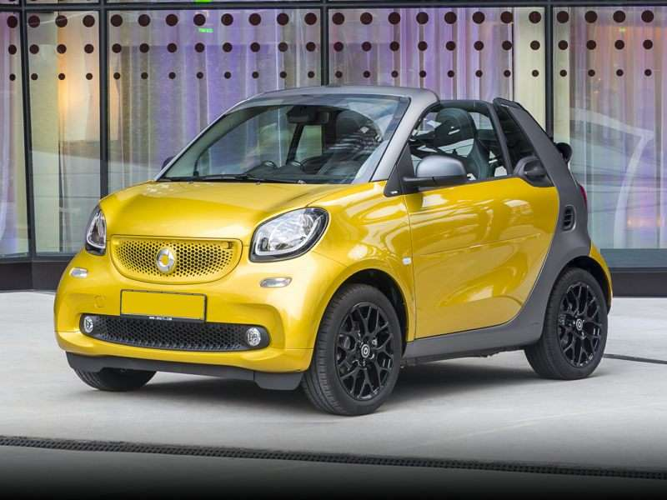
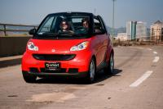
Smart Car

Slide 67
Tango http://www.commutercars.com
  L = 2.6m, W = 1.0m, H = 2.0,
  acceleration: 0 to 60 mph in 3.2 secs,
  top speed 150 mph,
  weight: 1500 kg (Toyota Corolla 1275 kg)
  Low centre of mass for good stability

Slide 68
To Scale or Not to Scale?
Average Sedan
Tango
5m

Slide 69
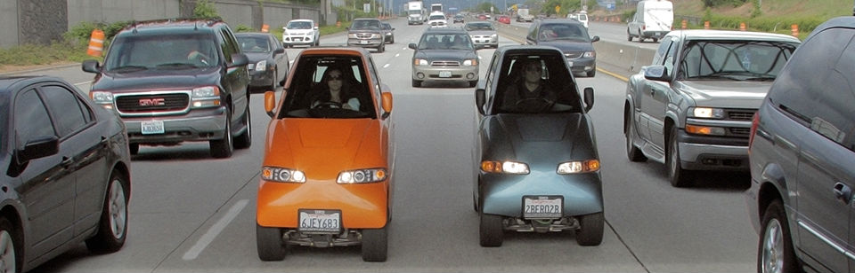
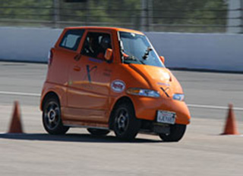
Commuter Cars: TANGO

Slide 70
Robots: Jackrabbot
The Jackrabbot is a robot designed by a team from Stanford University.
The robot is a self-navigating automated electric delivery cart capable of carrying small payloads.
In contrast to autonomous cars, which operate on roads, the Jackrabbot is designed to operate in pedestrian spaces, at a maximum speed of five miles per hour.
Jackrabbot is currently being tested on people walking around Stanford's campus, where its movements - including crashes - are used to create an algorithm that keeps the robot from making the same mistakes again.
Challenge: social robots have to understand human conventions and human etiquette. Humans have the innate ability to "read" one another. When people walk in a crowed public space they obey a large number of (unwritten) common sense rules and comply with social conventions. For instance, as they consider where to move next, they respect personal space and yield right-of-way.
Stanford researchers have developed a computer-vision algorithm that predicts the movement of people in a busy space. They trained a deep-learning neural network using several publicly available data sets containing video of people moving around crowded areas.
Now in the R&D phase, the complexity of the programming and machinery makes the Jackrabbot very expensive. However, the researchers say that in a few years, the cost could fall to around $500.
Read more: http://www.dailymail.co.uk/sciencetech/article-3630929/Robot-postmen-coming-Jackrabbot-navigate-tricky-pedestrians-make-local-deliveries.html#ixzz4MWn2DNyU Follow us: @MailOnline on Twitter | DailyMail on Facebook

Slide 71
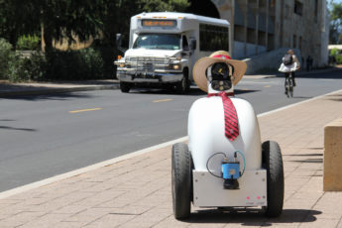

Slide 72
Aquarius Test Bed
200 m
200 m
Control Centre
Overall Area: 40,000 sq.m
Lane Area: 25,000 sq.m
(+ control centre)

Slide 73
Aquarius Test Bed (video-camera not to scale)
200 m
200 m
video-camera
Control Centre
Overall Area: 40,000 sq.m
Lane Area: 25,000 sq.m
(+ control centre)

Slide 74
Aquarius Test Bed (traffic lights not to scale)
200 m
200 m
Control Centre
Overall Area: 40,000 sq.m
Lane Area: 25,000 sq.m
(+ control centre)

Slide 75
Aquarius Test Bed (RSUs not to scale)
200 m
RSU
RSU
RSU
(Road Side Unit mounted on building, traffic light etc)
200 m
RSU
RSU
RSU
Control Centre
Overall Area: 40,000 sq.m
Lane Area: 25,000 sq.m
(+ control centre)

Slide 76
Aquarius Test Bed (5G towers not to scale)
200 m
200 m
Control Centre
Overall Area: 40,000 sq.m
Lane Area: 25,000 sq.m
(+ control centre)

Slide 77
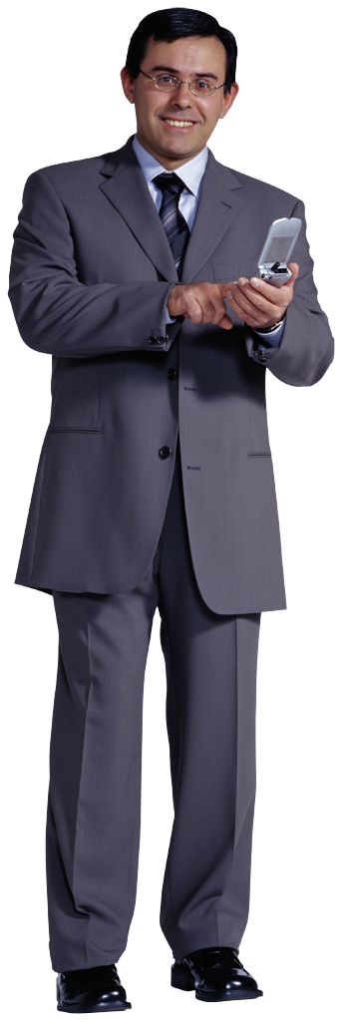


Aquarius Test Bed (cars, lights, people not to scale)
200 m
200 m
Control Centre
Overall Area: 40,000 sq.m
Lane Area: 25,000 sq.m
(+ control centre)

Slide 78
Example Safety Applications
Forward Collision Warning (FCW) – Warning if driver fails to brake when a vehicle in the driver’s path is stopped or traveling slower and there is a potential risk of collision.
Lane Change Warning/Blind Spot Warning (LCW/BSW) – Warning if driver tries to change lanes if there is a vehicle in the blind spot or an overtaking vehicle.
Emergency Electric Brake Light Warning (EEBL) – Notifies driver that there is a vehicle ahead (or several vehicles ahead) that the driver can’t see, but which is braking hard.
Intersection Movement Assist (IMA) – Warns driver when it is not safe to enter an intersection, e.g., when something is blocking the driver’s view of opposing or crossing traffic.

Slide 79
Cost of Lanes
Cost of urban 4-lane highway: $5.6M/km
Cost of urban single lane: $1.4M/km or $1400/meter
Lane width: 5 meters
Lane Cost: 1400/5 = $270 per sq. meter
Michigan Test Bed Lane Area: 120 lane-km or 600k sq.km
Aquarius Test Bed Lane Area: 25 sq.km
Lane Area is 1/24

Slide 80
Testbeds: Total Area
MCity: 130,000 sq. meters
AstaZero (Sweden): 2,000,000 sq. meters
Aquarius: 40,000 sq. meters

Slide 81
Technology:
Communication
Systems
Kay Das

Slide 82
Technologies for Roadside Communications
feature | Wi-Fi | 802.11p | UMTS | LTE | LTE-A
Channel Width (MHz) | 20 | 10 | 5 | 1.4 - 20 | 100
Frequency Bands (GHz) | 2.4GHz, 5.2GHz | 5.86 - 5.92GHz | 700MHz - 2.6GHz | 700MHz - 2.6GHz | 450MHz - 4.99GHz
Bit rate (Mbps) | 6 - 54 | 3 - 27 | 2 | 300 | 1Gbps
Range | 100m | 1km | 10km | 30km | 30km
Capacity | medium | medium | low | high | very high
Mobility support | low | medium | high | very high (350 kmph) | very high (350 kmph)
V2I support | yes | yes | yes | yes | yes
V2V support | ad hoc | ad hoc | no | no | D2D

Slide 83
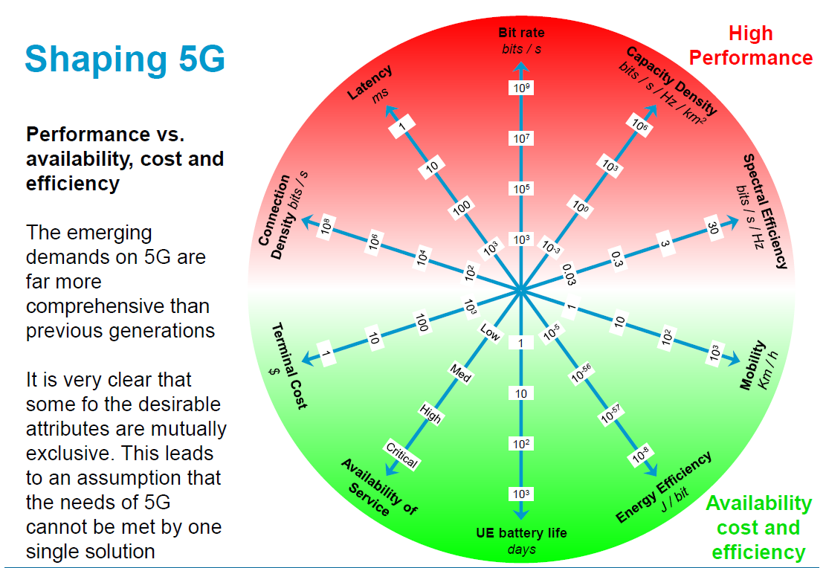
[2]

Slide 84
DSRC vs 4G
Off to a slow start, issues with 5.9 GHz spectrum allocation ….alternatives have emerged
4G/LTE/LTE-A based alternative:
    OFDM reaching its limitations (time and frequency sync)
    Latency and peak-to-average issues
4G LTE/LTE-A introducing device to device mode (D2D), will carry forward to 5G. [4]
4G LTE/LTE-A introducing Co-ordinated Multipoint (CoMP): enables a mobile device to communicate with multiple base stations at the same time. [5]
Challenge of multi-path and moving vehicles
5G promises latencies reduced from 4G by 10x
DSRC supported by many big names: GM, Nokia, NXP, Intel, Qualcomm, STMicroelectronics…..
http://www.its.dot.gov/factsheets/dsrc_factsheet.htm

Slide 85
Standards
Applications
  Safety
  Traffic Management
  Driver Assistance Systems
  Police and Enforcement
  Pricing and Payments
  Direction and Route Optimization
  Travel-Related Information
  General Information Services
  Automated Highways
DSRC (Dedicated Short Range Communications)
  5.850 – 5.925 GHz (7 channels – 10MHz)
  1000 M Range – 3 to 27 Mbps
WAVE (Wireless Access in Vehicular Environments)
Protocol Stack
Application | Layer 7
Presentation | Layer 6
Session | Layer 5
Transport | Layer 4
Network | Layer 3
Data Link | Layer 2
Physical | Layer 1
IEEE P1609
WAVE
IEEE P1556
IEEE 802.11p
DSRC

Slide 86
Standards
The automotive industry has been working to develop dedicated short-range communication (DSRC) technology, for use in vehicle-to-vehicle (V2V) and vehicle-to-infra-structure (V2I) communication. The effectiveness of this technology is highly dependent on cooperative standards for interoperability.
DSRC standards being developed:
  IEEE 802.11p amendment for wireless access in vehicular environments (WAVE)
  IEEE 1609.2 ( Security)
  IEEE 1609.3 (Network Services)
  IEEE 1609.4 (Multi-Channel Operation)
  SAE J2735 Message Set Dictionary
  SAE J2945.1 Communication Minimum Performance Requirements standard.
The DOT released its Report to Congress assessing the status of DSRC. The finding: DSRC is ready for deployment and DSRC-based technologies and applications offer a path to a safer and more efficient surface transportation system.
http://www.its.dot.gov/connected_vehicle/pdf/DSRCReportCongress_FINAL_23NOV2015.pdf

Slide 87
V2V, V2I and Vehicle to 4G/5G Scenarios
3G / 4G/5G
Road-Side
Unit (RSU)
DSRC V2I Link
DSRC V2V Link
DSRC V2V Link
15 m/sec
15 m/sec
15 m/sec
DSRC V2V Link
15 m/sec
Vehicle Networking Message Types
Broadcasting messages
  Periodic
  Periodic Permanent
  Time Limited Periodic
  Overtaking State
Cooperative awareness between vehicles
  Intersection collision warning
  Lane change assist
  Overtaking vehicle warning
  Head-on collision warning
  Cooperative forward collision warning
  Emergency Vehicle Warning
  Cooperative merging assistance
  Collision Risk warning
GPS Location
Uncertainty
+ 3 meters
DSRC V2V Link
DSRC V2V Link
GPS Correlation Data
Ranging Data
Vehicle to Vehicle (V2V)
Vehicle to Infrastructure (V2I)
Vehicle to 3G/4G/5G

Slide 88
Under the Hood…
Kay Das

Slide 89
Under the Hood…
SW/FW/HW:
SW/FW/HW: Infrastructure/Cloud
Sensors
phy
phy
apps/protocol
V2I
phy
phy
phy
phy
Actuators
apps/protocols
Vehicle #1
phy
V2V
phy
V2I
phy
Sensors
Vehicle #2
phy
d2d?
phy
3/4/5G
phy
Pedestrian Handphone
phy

Slide 90


Vehicle Safety Communications System
Safety Applications:
•
Forward Collision Warning
Actuators/Display
•
Electronic Emergency Brake Light
•
Slow/Stopped Vehicle Alert
Mapping of Vehicles in
Neighborhood
Vehicles GPS Time and Range Measurements
Digital Transmit Rate Control
Sensor Inputs
Safety Messages
Digital Transmit Power Control
Safety Messages
DSRC Radio (802.11p MAC/PHY layers)
Radio Channel

Slide 91
Highway Costs and Vehicle Growth
Kay Das

Slide 92
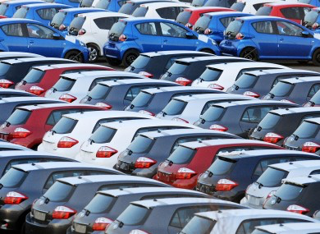
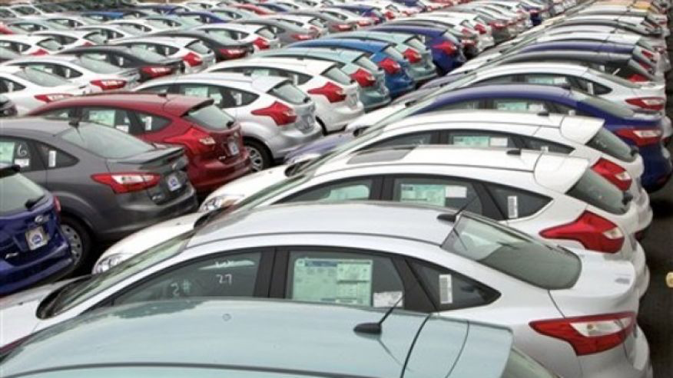
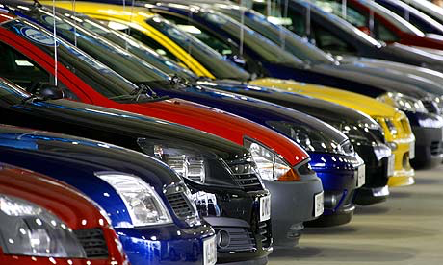
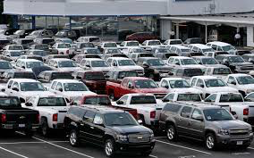
Waiting to get in….
Cars on US roads:
2016: 250M
2020: 300M

Slide 93
Highway Costs (USA)
Constructing a new 4-lane highway:
  $5M per mile (rural/suburban)
  $9M per mile (urban).
Milling or resurfacing a 4-lane road: $1.25M per mile.
4.12M miles of roads
  2.94M rural
  1.18M urban)
Interstate Highways: 47.5K miles, comprise 1% of highway mileage but carry 25% of all highway traffic.
Interstate Highways plus 180k miles of major roads comprise the National Highway System which carries most of highway freight and traffic.
Congress/President passed 5 year in Dec 2015 , $305B “Fixing America’s Surface Transportation (FAST) Act”

Slide 94
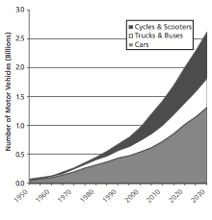
World Vehicle Population Growth
Source: Two Billion Cars: Driving Towards Sustainability, Sperling and Gordon, Oxford University Press 2009

Slide 95
Take-aways….
Kay Das

Slide 96
Lessons Learnt
Aircraft: With reliance on automation increasing, display complexity and crew training became important issues.
Automobiles: Marketing strategy has been technology-driven but safety is now the prime concern :
  cruise control
  collision avoidance alerts
  automatic braking
  steering assistance
Key Lessons:
  reducing risks takes time and a thorough systems approach
  educate drivers on how the automating system works
  understand technology limitations

Slide 97
Avoid Information Overflow
Connected Car systems need to avoid inundating the driver with non-essential data.
Air France Airbus A330 crashed into the Atlantic due to pilots being confused by automated warnings.
Need to give information that is critically needed and not merely “nice to have”.
Conserve communication bandwidth, reduce clutter
[10]

Slide 98
Required Approach: Systems Research, Development and Innovation - 1
Development must be under umbrella of IoT and 5G standards
Multiple research issues to be pursued to give industry good and early direction.
  Directional multicasting likened to throwing a rope….
The Internet and its wireless feeders require anatomical architectural and control protocol change in some areas. [1]
Management of this change with frugality, without over-design
The setting of standards and the cautious definition of system requirements with meaningful use cases from the multiple application areas
  The NGMN (Next Generation Mobile Network) is a good start [3]

Slide 99
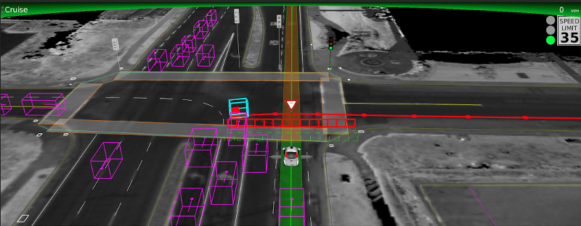
Use Case: Cyclist at Intersection
In this case, a cyclist (the light blue box) got a late start across the intersection and narrowly avoided getting hit by a car making a left turn (the purple box entering the intersection) who didn’t see him and had started to move when the light turned green. The Google Car predicted the cyclist’s behavior (the red path) and did not start moving until the cyclist was safely across the intersection. ( “The View From the Front Seat of the Google Self Driving Car”, Chris Urmson, Google)

Slide 100
Required Approach: Systems Research, Development and Innovation - 2
System reliability of 99.999% equates to one system failure per a million vehicles over a defined period of time. For 200 million vehicles on the road, we can anticipate 200 failures over that period!
Assurance of integrity of information and security in transactions will be system level challenges on top of those represented by technology innovation.
LIFE IN THE LOOP: Many “platforms”, each will require validation before market entry. Needs infrastructure….

Slide 101
Required Approach: Systems Research, Development and Innovation - 3
Requirement: A holistic, inventive approach to systems design

Slide 102
References
[1] | IEEE Communications, Feb 2014, “Five Disruptive Directions for 5G”, F. Boccardi et al
[2] | Agilent Technologies, Jun 2014,Taking 5G from Vision to Reality, Moray Rumney
[3] | NGMN Alliance Update on 5G Work Programme, Jul 2015, Klaus Moschner
[4] | “Internet of Vehicles”, IoT World Forum, Milan, Dec 2015, Mario Gerla, UCLA
[5] | IEEE Spectrum, December 2013: “LTE-Advanced is the Real 4G”, Ariel Bleicher
[6] | Wall Street Journal, 1 August 2016, “Aviations Lessons for Self-Driving Cars”, Daniel Michaels/Andy Paztor

Slide 103
Addenda
Google
Uber
Augmented Reality
Kay Das

Slide 104
The Google Car
Expensive solution?
Laser radar (LIDAR)
Relies on heavy image and motion processing
Computationally expensive
Car manufacturers are very sensitive to style and form… the LIDAR mount may not find market acceptance
Other location and communications technologies ( GPS, WiFi, Bluetooth, 5G) in the mix

Slide 105
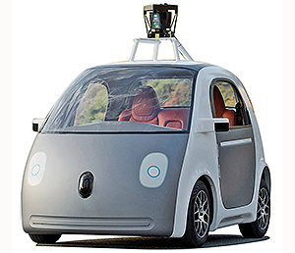
Ugly or Cute?

Slide 106
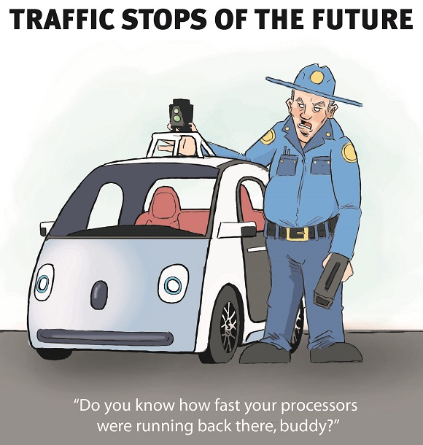

Slide 107
Uber’s Self Driving Car
Behind the wheel of Uber’s first self-driving car, 14 Sep 2016, (3:21 min)
  https://youtu.be/sljrbjOhD6U
CNN: Our ride in a self-driving Uber, 14 Sep 2016 (3:15 min)
  https://youtu.be/-hm9RP_8dvg
CBS: The accelerating future of self-driving cars, 17 Sep 2016,(4:53 min)
  https://youtu.be/Rxn1D6qZV-w?t=49

Slide 108
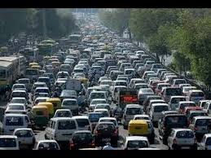
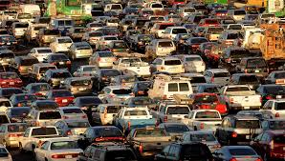

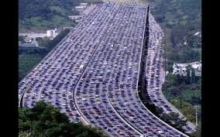
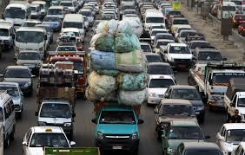
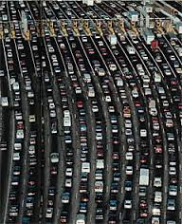
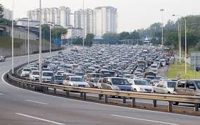
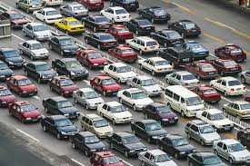

Slide 109
Augmented Reality: The Transparent Car
Created at the Graduate School of Media Design at Keio University in Japan:
  cameras fitted on outside of car feed video to projectors located on inside.
  video is projected onto system of mirrors, which display the live feed from the outside of the car onto the interior of the seats and doors
  provides view of the space directly on the other side.
  when drivers look backward while driving in reverse the rear of the car resembles a giant windshield, showing objects behind rear bumper.
https://youtu.be/gDk5HdGfuVI (2:33)
spectrum.ieee.org/video/transportation/advanced-cars/the-transparent-car

Slide 110
IEEE Symposium
ITS Society Symposium on Intelligent Vehicles, Redondo Beach, 11 – 14 June 2017
http://iv2017.org

