Slide 1
Thinking of Instrumentation Survivability
Under Severe Accident
NUCLEAR POWER INSTITUTE OF CHINA

Slide 2
Content
1
Background
Requirements of standard and statute
2
Instrumentation survivability under Severe Accident
3
4
Qualification procedure based on Severe Accident
NPIC

Slide 3
1.Background
Instrumentation survivability
Severe Accident
Three-Miles
Island Accident
Fukushima
Accident
NPIC
Notes:
主要是简要说明三里岛事故和福岛事故后大家意识到严重事故不是不可能发生的，各国都对严重事故越来越重视，这就引发出了严重事故条件下仪表可用性及其鉴定的问题

Slide 4
2.Requirements of standard and statute
IAEA NS-G-1.3
Consideration of severe accident conditions is not required in the equipment qualification program. However, equipment credited for response to severe accidents should be shown, with reasonable confidence and to the extent possible, to function under anticipated severe accident conditions
NPIC
Notes:
标准内容介绍

Slide 5
2.Requirements of standard and statute
RCC-E 2005 B7000
Qualification Procedure for Severe Accident Conditions
Acceptable methods (analysis,test,mixed methods)
Data required for equipment qualification
Successive of K1 and Severe Accident procedure
HAD102(2006)
3.15.5
Equipment credited for response to severe accidents should be shown, with reasonable confidence indicating capability of realizing design purpose under sever accident, to function by test or analysis under possible condition.
NPIC
Notes:
标准内容介绍

Slide 6
3.Instrumentation survivability under Severe Accident
Part I Present Situation
Nuclear power plant (Under construction or As-built)
The standard and statute have required that instrumentations used for mitigating Severe Accident should survive during or after Severe Accident.
There are no requirements for severe accident qualification test in instrumentation specification.
All instrumentations have not been stood any Severe Accident test.
NPIC
Notes:
对目前在建或已建成电厂的用于严重事故仪表的情况进行说明，主要说明法规要求可用，但是仪表的规格书中没有相应的要求，因此相关仪表也就没有做过相关的试验，因此无法说明仪表的可用性

Slide 7
3.Instrumentation survivability under Severe Accident
Part I Present Situation
Nuclear power plant (New)
The environment of Severe Accident has been included in specification.
The requirements of Severe Accident qualification procedure from standard and statute have not been clearly defined.
NPIC
Notes:
对于新建电厂如ACP1000我们在规格书中已经给出了严重事故的环境条件，但是标准对鉴定的程序没有明确的要求因此对于新建电厂严重事故的鉴定目前还没有一个清晰的思路和验收准则

Slide 8

3.Instrumentation survivability under Severe Accident
Part II Instrumentation survivability assessment
Parameter
Hydrogen burning
High
Temperature
Pressure
Environment
Parameters
Radiation
Humidity
NPIC
Notes:
介绍一下目前我们在没有条件进行严重事故鉴定的情况下所进行的一些工作，这里说明我们首先分析了影响仪表的主要环境因素

Slide 9
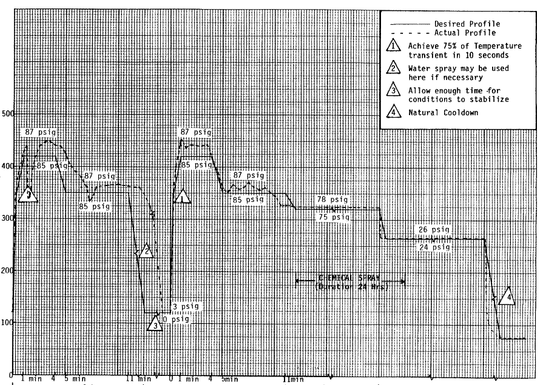
3.Instrumentation survivability under Severe Accident
Part II Instrumentation survivability assessment
Analysis
How much is the margin of performance capacity obtained by design-bases accident qualification test compared with instrumentation’s real capacity?
NPIC
Notes:
其次说明我们通过鉴定报告或者与厂家沟通来尽量挖掘仪表鉴定曲线与实际曲线的裕度

Slide 10

3.Instrumentation survivability under Severe Accident
Part II Instrumentation survivability assessment
Accident
LLOCA
SBO-1 (Depressurized)
Accident
SBO-2
SLOCA-1 (40mm)
SLOCA-2 (25mm)
NPIC
Notes:
事故序列说明

Slide 11
3.Instrumentation survivability under Severe Accident
Part II Instrumentation survivability assessment
Time window
Design basis Accident
Severe Accident
Rapid cladding
oxidation
Initiation
Core Uncovery
Vessel failure
Time0
Time1
Time2
Time3
NPIC
Notes:
时间窗口说明

Slide 12
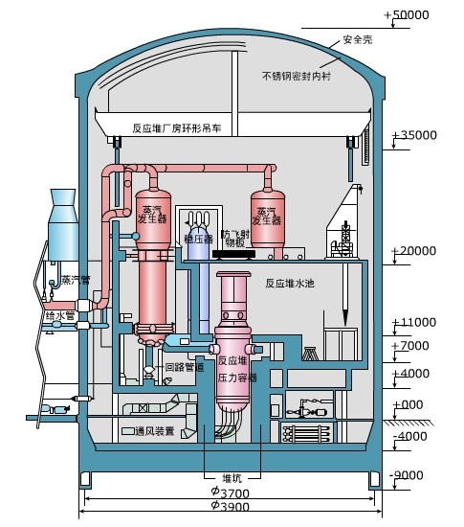
3.Instrumentation survivability under Severe Accident
Part II Instrumentation survivability assessment
Zone
Zone1:Core zone
Zone2:Annular zone
Zone3:Top zone
Zone4:Low zone
Zone 3
Zone 2
Zone 4
Zone 1
NPIC
Notes:
空间区域划分

Slide 13
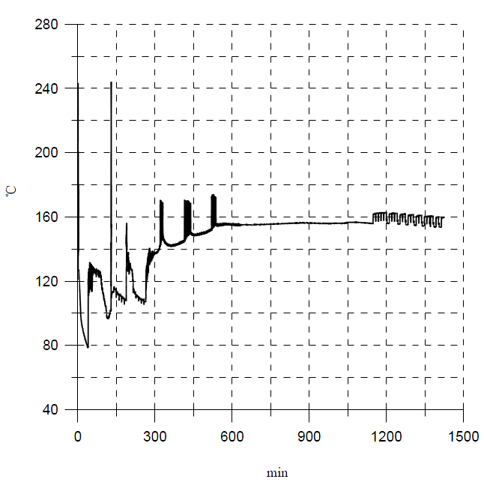
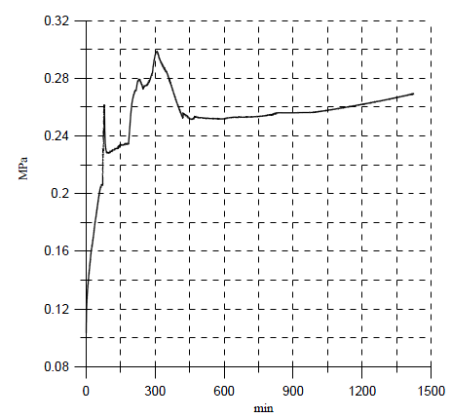
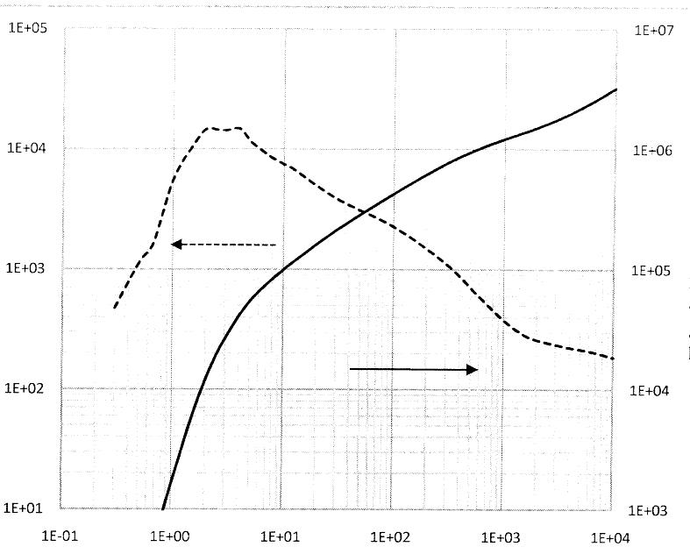
3.Instrumentation survivability under Severe Accident
Part II Instrumentation survivability assessment
Environment Profile
Temperature
Pressure
Radiation
Humidity 100%
NPIC
Notes:
获得的环境条件曲线

Slide 14
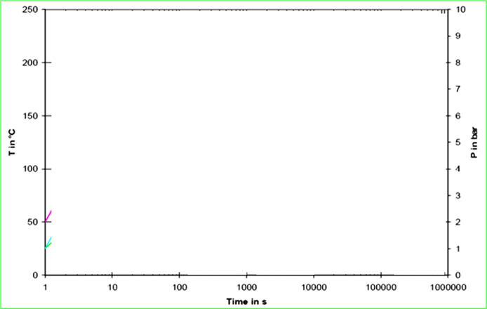




2.Instrumentation survivability under Severe Accident
Part II Instrumentation survivability assessment
Survivability assessment of instrumentation based on design-bases accident qualification test data.
Qualified T
S Accident T
Qualified P
S Accident P
NPIC
Notes:
通过上面两部分工作，我们将包含了欲量了鉴定条件曲线与严重事故环境条件进行对比，以此来分析仪表在严重事故下的可用性

Slide 15
3.Instrumentation survivability under Severe Accident
Part III Conclusion
Results of the assessment indicate that most existing plant instrumentation can provide the information required during various phases of severe accident.
Project | Required Quantity | OK | Not sure | NOK
Qing Shan | 20 | 11 | 4 | 5
For some instrumentation ,theory analysis could provide reasonable confidence for survivability ,so it is unnecessary to do any qualification test on instrumentation in order to prove its survivability.
NPIC
Notes:
结果表明大部分设备还是能够在严重事故条件下满足其可用性要求的，同时对于一些仪表不需要做任何的试验就可以说明其可用性

Slide 16
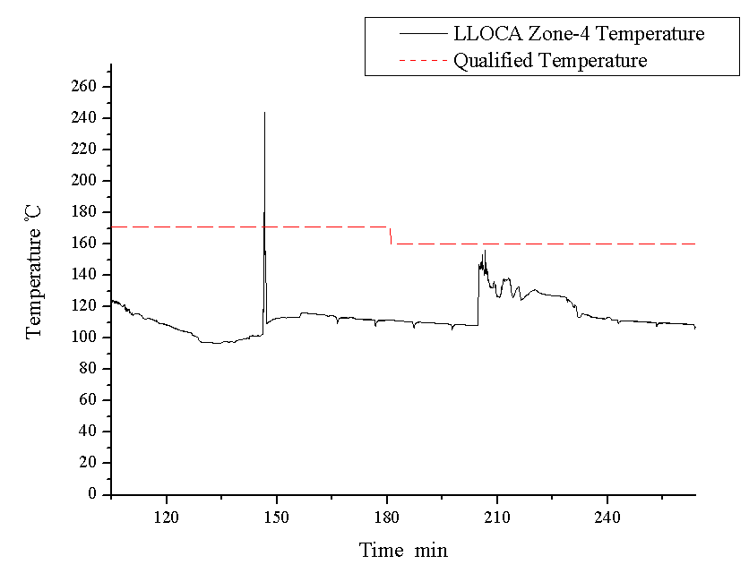
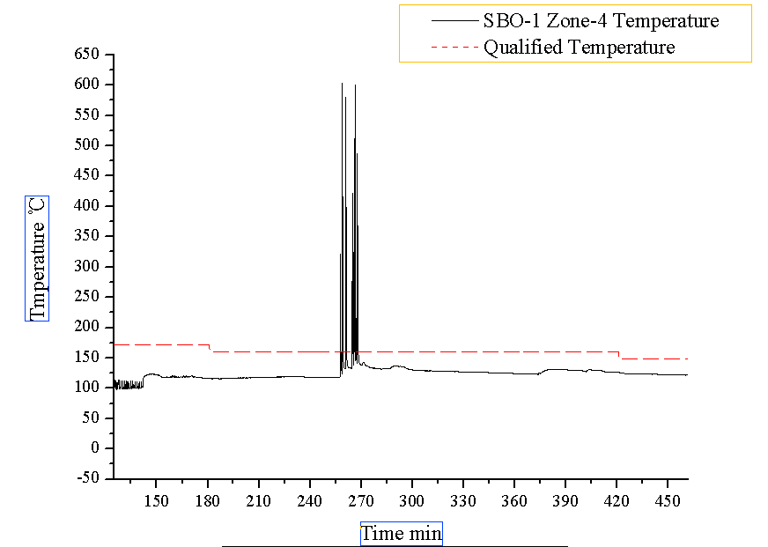
3.Instrumentation survivability under Severe Accident
Part III Conclusion
Typical environment condition
Transient high temperature
Frequent high temperature
How to consider about this situation?
NPIC
Notes:
热滞分析说明

Slide 17
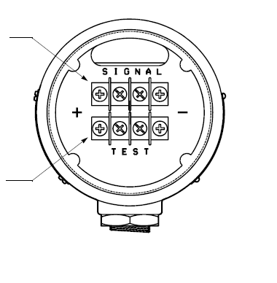
3.Instrumentation survivability under Severe Accident
Part III Conclusion
Thermal lag time T1
Thermal-Lag analysis
Duration time T2
T1
?
T2
NPIC
Notes:
热滞分析说明

Slide 18
3.Instrumentation survivability under Severe Accident
Part III Conclusion
Due to limitation of theory assessment ,survivability of some instrumentation remain in doubt.
NPIC
Notes:
结果由于理论分析的局限性，因此，部分仪表的可用性还处于未知状态，因此对于仪表进行严重事故鉴定应该是最终的道路。

Slide 19

4.Qualification Test based on Severe Accident
Qualification requirements of severe accident for power plant in different phase
In construction
Power plant
As-built
Power plant
New power plant
Sever Accident qualification requirements
NPIC
Notes:
说明目前对于在建、建成和新建电厂的严重事故可用性要求的介绍

Slide 20
4.Qualification Test based on Severe Accident
What we concern before set the requirements for Severe Accident qualification?
How to consider application feasibility of severe accident qualification procedure for power plant in different phase?
NPIC
Notes:
如何考虑鉴定标准在已建成和新建电站中应用的可行性问题？因为老电厂从技术上和实际情况商量来说都不可能重新做鉴定，但是标准中完全不考虑老的电厂也是不合适的，因此该问题需要高度重视。

Slide 21
4.Qualification Test based on Severe Accident
What we concern before set the requirements for Severe Accident qualification?
How to consider impact caused by uncertainty of duration of Severe accident?
72h
1 week
1 month
NPIC
Notes:
由于严重事故的持续时间没有一个明确说法，从72小时到一周到一个月甚至一年都有可能，因此在鉴定过程中如何考虑通过鉴定来覆盖较长的时间要求？

Slide 22
4.Qualification Test based on Severe Accident
What we concern before set the requirements for Severe Accident qualification?
How to consider impact caused by uncertainty of Severe accident environment condition?
The amount of uncertainty of Severe accident environment condition depend on how to divide containment area.
NPIC
Notes:
由于环境条件的计算是通过理论计算得来的因此存在一定的不确定，目前中国国内关于环境条件的计算有两种情况，一种是划分了区域，另外一种没有划分区域，对于没有划分区域的情况其包络曲线的不确定度就会很大，势必会造成鉴定的要求过高，造成虚假要求。

Slide 23
4.Qualification Test based on Severe Accident
What we concern before set the requirements for Severe Accident qualification?
The balance between economy and safety requirements when setting the rule for severe accident qualification test.
Severe accident are very low probability events.
There are strict requirement for Instrumentation performance under Severe Accident.
NPIC
Notes:
经济性和鉴定要求的平衡问题

Slide 24
5.Questions
2007. 01
Thank You !
NPIC
Notes:
问题清单

