Slide 1
Updated History of the Electrostatic Processes Committee of the IAS
G S Peter Castle, LFIEEE and William D Greason, LFIEEE
Department of Electrical and Computer Engineering
Faculty of Engineering, University of Western Ontario,
London, ON, Canada

Slide 2
Origins
IEEE formed in 1963; amalgamation of American Institute of Electrical Engineers (AIEE) and Institute of Radio Engineers (IRE)
Consisted of Societies and Groups
50th anniversary of the start of the Industry and General Applications Group (IGA) in IEEE (1964)
Evolved into Industry and Applications Society (IAS) in 1972

Slide 3
Electrostatic Processes Committee (EPC)
Electrostatic interests preceded both these organizations
Annual Winter meeting of the AIEE, 1949, Subcommittee on Electrostatic Processes
Became EPC, part of IGA Annual Meeting in 1968
Update of earlier history of EPC (1984)

Slide 4
EPC Early topics, 1950’s and 60’s
Primarily Electrostatic Precipitation, mostly industrial presenters
Electrostatic painting (liquid)
First inklings of Xerography (Haloid Corp)

Slide 5
EPC in the 1970’s
Expansion of topics to include; electrophotography, electrical coronas, applied electrostatics and fundamentals
Collaborative effort between academia and industry
Developed international presence
Very active meetings, typical 8 full sessions in IAS Annual meetings

Slide 6
What constitutes Electrostatics?
Professor A.D. Moore, U of Michigan vocalized the concern
“Static” – literal or practical interpretation
Lack of formal agreement led to formation of the Electrostatics Society of America (ESA)
First meeting in 1971

Slide 7
The “Static” Divide
IEEE: “the branch of science that treats the electric phenomena associated with electric charges at rest in the frame of reference”
ESA: “the class of phenomena recognized by the presence of electrical charges, either stationary or moving, and the interaction of these charges, this interaction being solely by reason of the charges and their positions and not by reason of their motion”

Slide 8
EPC and ESA up to 2003
Tended to live in splendid isolation
EPC annual meetings within IAS, interest broadened but emphasis on applications
ESA met every year (major and minor), interest more general, fundamental and more unconstrained
Papers less formal
Common feature was electrostatics (in its broadest definition!)

Slide 9
EPC in IAS
Gradually participation from industry declined
Departments redefined in 1993
IAS became restructured with split off of ECCE into separate annual meeting (2009)
EPC remains with IAS annual meetings

Slide 10
Past Chairs EPC

Slide 11
Development of joint meetings
2003, Little Rock, AR EPC/ESA
2006, Berkeley, CA EPC/ESA/IEJ/SFE
2009, Boston, MA EPC/ESA/IEJ/SFE/IEA
2012, Cambridge, ON EPC/ESA/IEJ/SFE/IEA

Slide 12
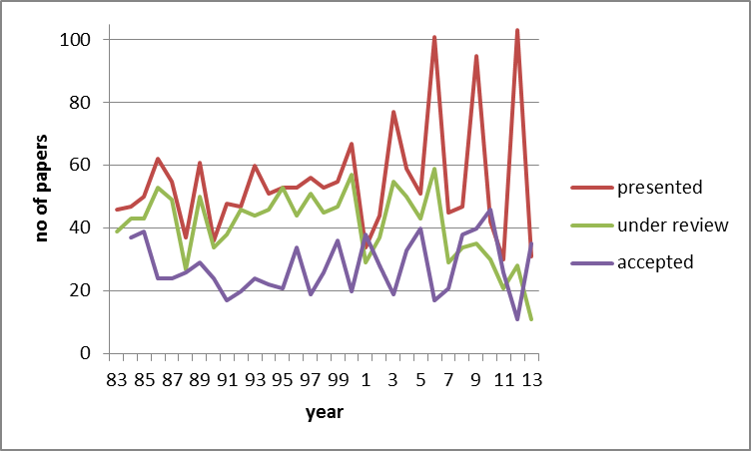
Number of Technical Papers; presented at EPC meetings, entered into review process, published in IAS Proceedings

Slide 13
Recent Meetings EPC-IAS

Slide 14
Recent Update
2014 Vancouver, BC IAS
(29 papers to be presented)

Slide 15
Evolution of interests
Mature; electrostatic precipitation, printing, copying, painting, separation
Developing; non-thermal processes, EHD, measurement/sensors, corona and discharge phenomena, ESD, particles and microscale phenomena, MEMS, dielectrophoresis etc
Emerging; nanotechnology, biotechnology, ultrafine particles

Slide 16
New Reality
Applied electrostatics by its nature has always been interdisciplinary but centered within electrical sciences
Many other disciplines e.g. chemistry, materials, biology etc have always considered these forces but are “rediscovering” the importance of electrostatic effects as element dimensions shrink
Recent development of specialty meetings

Slide 17
Future?
Open for discussion

