Slide 1
Distribution Operation Centers – Integrating Technology & Data Analytics
February 19, 2019
Speaker(s): | Mathew Tovar, PE Travis Kennedy, PE

Slide 2
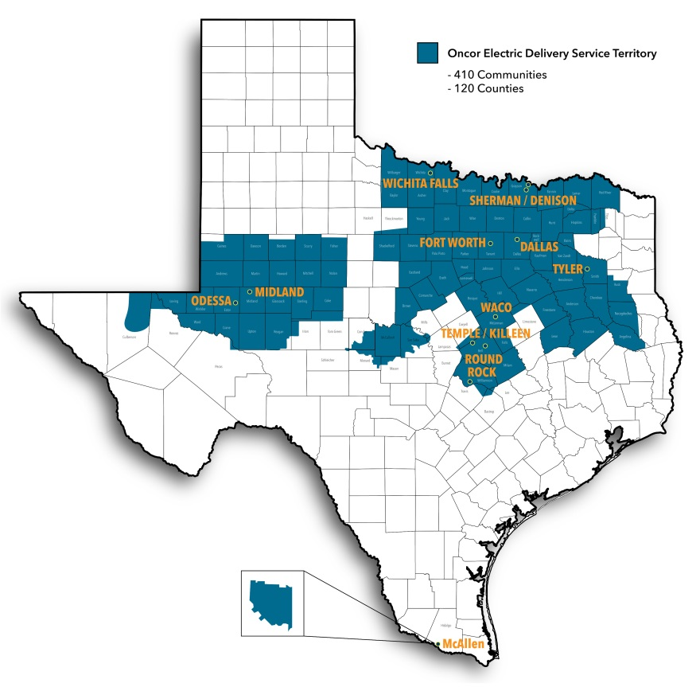
Distribution Operation Centers
Central hub for distribution outages
Every distribution power outage comes through the DOCs
An operator dispatches a resource to the ticket
An operator will direct switching & perform remote operations
East & West DOC
Oncor has 2 DOCs

Slide 3
Distribution Operation Centers
Agenda:
DOC Operations of Today
Data Analytics at the DOCs

Slide 4
Distribution Operation Centers – Historically
Outages reported via phone calls
Paper maps & one lines
Paper event tickets
Experience & gut feel to determine load
Priority switching to find faults

Slide 5
Distribution Operation Centers – Presently
Outages reported from AMS, SCADA, Text Messages, Calls
OMS (Outage Management System) maps
Tracking of trucks & resources
Electronic tickets
Real time SCADA load readings
Calculated load readings on EVERY device in OMS
Fault Maps from CYME & Fault Locating (FLOC)
Data Analytics
Predicting weather damage, overloads, equipment failures
Monitoring power quality, construction projects, and creating contingency plans
Creating helpful tools for the operators & districts

Slide 6
Distribution Operation Centers – AMS & SCADA
AMS DATA
Approx. 40TB daily (3.6 Million Meters)
15 minute intervals
Transmitted to OMS
Stored in Oncor’s Enterprise Data Warehouse (EDW)
SCADA DATA
Station RTUs
Approx. 5-10 second intervals
Transmitted to TMS & OMS
Stored in Oncor’s Enterprise Data Warehouse (EDW)

Slide 7
Distribution Operation Centers – AMS & SCADA
Smart Grid
Reports
OTS
Workstations
TMS
Workstations
DMS
Workstations
Mobile
Computers
DIS
OTS
Spectrum
TMS
Spectrum
DMS
Spectrum
OMS
In-Service
I/Dispatch
Net/Dispatch
Mobile TC
CC&B
Kubra
(iFactor)
Remote
Terminal
Units
Advanced Meter
System
Distributed
Automation
Web
TXT

Slide 8
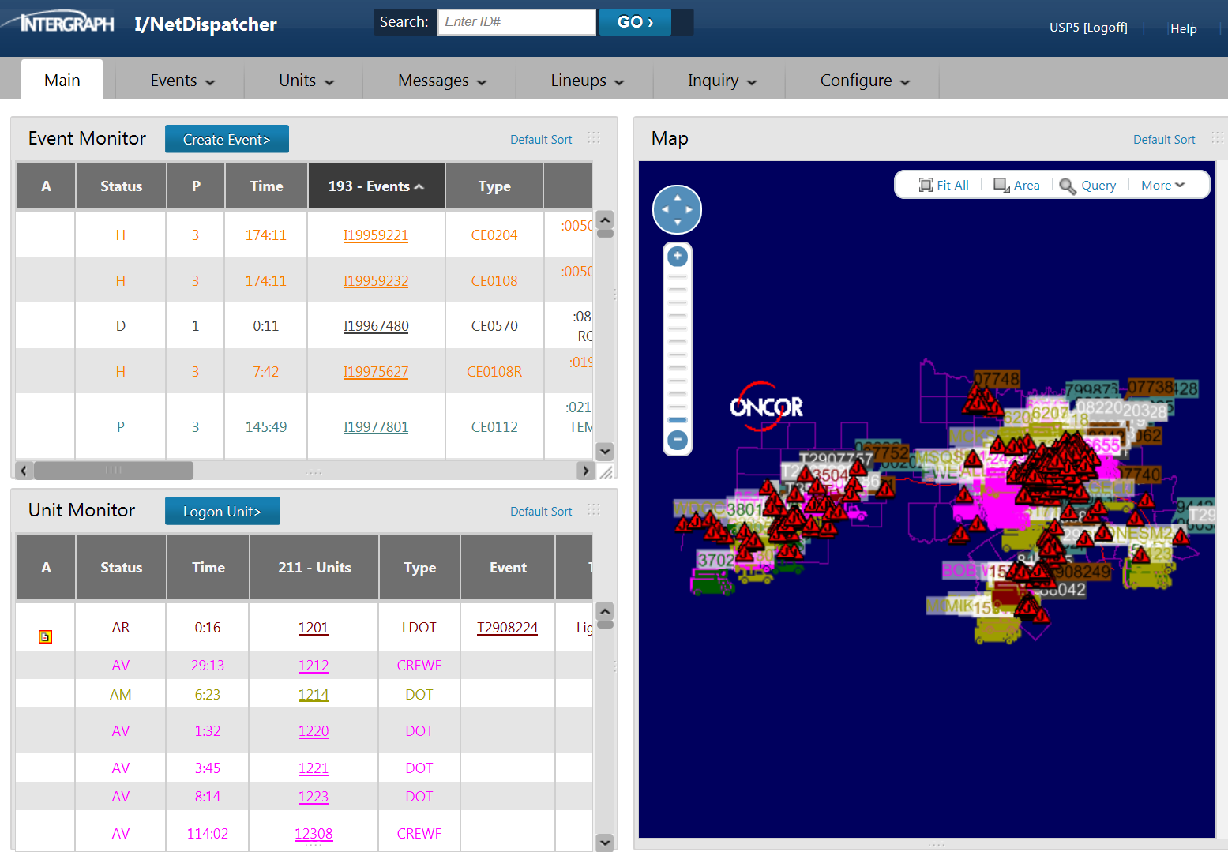
Distribution Operation Centers – OMS

Slide 9
Distribution Operation Centers – OMS
Features
AMS integration
Dynamic ETOR calculations
Event tickets & dispatching
Fault Locating

Slide 10
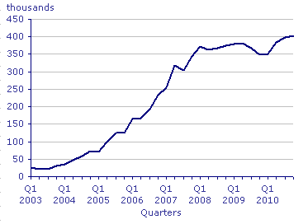
Distribution Operation Centers – ETOR
ETOR = Estimated Time of Restoration
Historical Data
Time to dispatch
First responder queue, travel, and repair time
Crew travel and repair time
Real-Time Data
Resource availability
Weather conditions
Location
Cause
Event workload

Slide 11
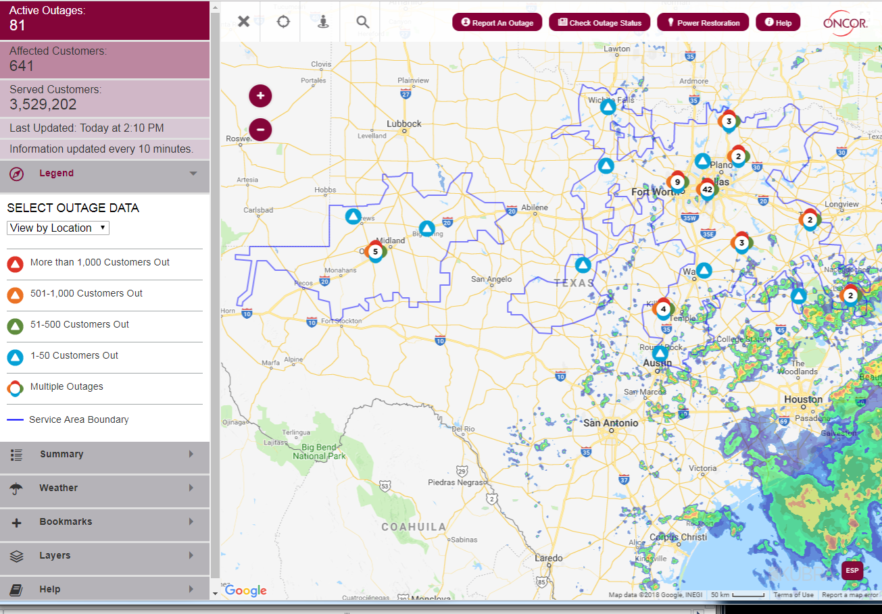
Distribution Operation Centers – ETOR Public Communication
Stormcenter.Oncor.com
Text Oncor
Interactive Voice Recognition (IVR)
Call Center (CTA)

Slide 12
Distribution Operation Centers – ETOR
ETOR = Estimated Time of Restoration

Slide 13
Distribution Operation Centers – Customer Photos
WUPIT = Wire down, Unit on Site Process Improvement Tool
New process for identifying and acting on potentially hazardous situations to the public.
Improves on existing communication between Operator and Customer
Enhances safety with provided photos submitted from customers or first responders associated with emergency ticket
Enhanced training for call center and affected Oncor employees and contractors
Improves distribution of Damage Evaluation resources

Slide 14
Distribution Operation Centers – Customer Photos
The ability to submit photos helps a customer feel empowered. We hear them, we see them, we respond to them.
14,843
4
6403
2,872
Number of photos submitted by customers
Average number of photos per event
Number of text messages sent
Number of events with photos
*Values from Feb 2018 – Jan 2019
Notes:
Average 3% of events have photos (goes up in storms)
Barrier: Dealing with FD dispatchers and they don’t want to give out fireman phone numbers

Slide 15
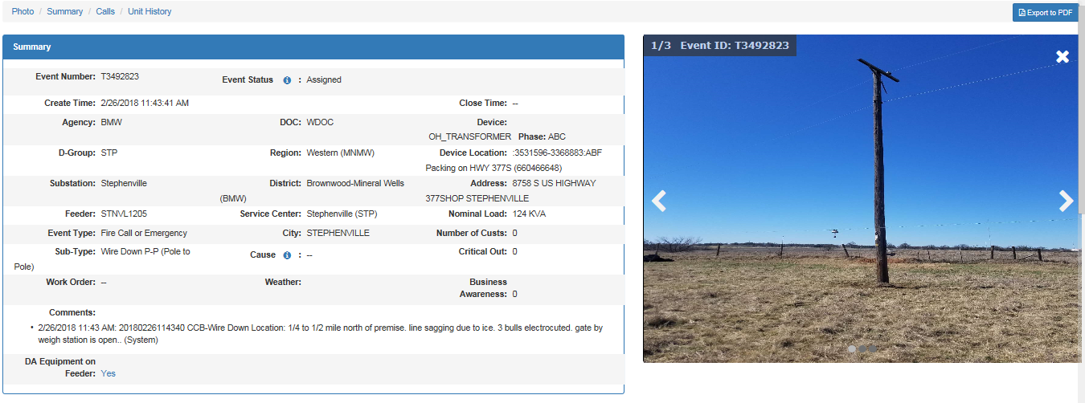
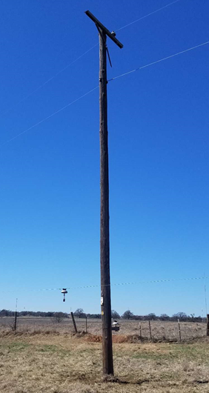
Distribution Operation Centers – Customer Photos
Notes:
Talking points this slide:
Remote disconnect for safety - operator could clearly see primary wire (25kv) was down, but was it energized?
Checked for outages in immediate area (none reported)
Located closest available field resource (at least one hour away)
Meter ping verification (meters indicated energized)
Open closest up line SCADA device (hazard removed)

Slide 16
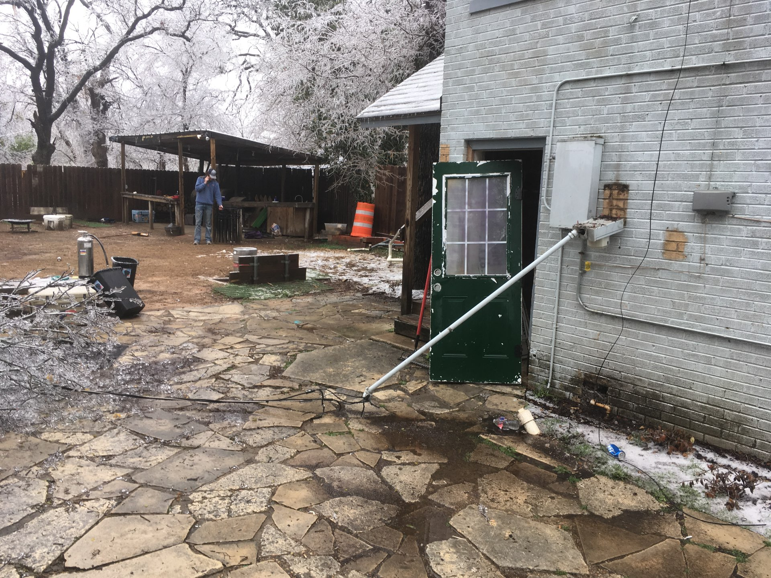
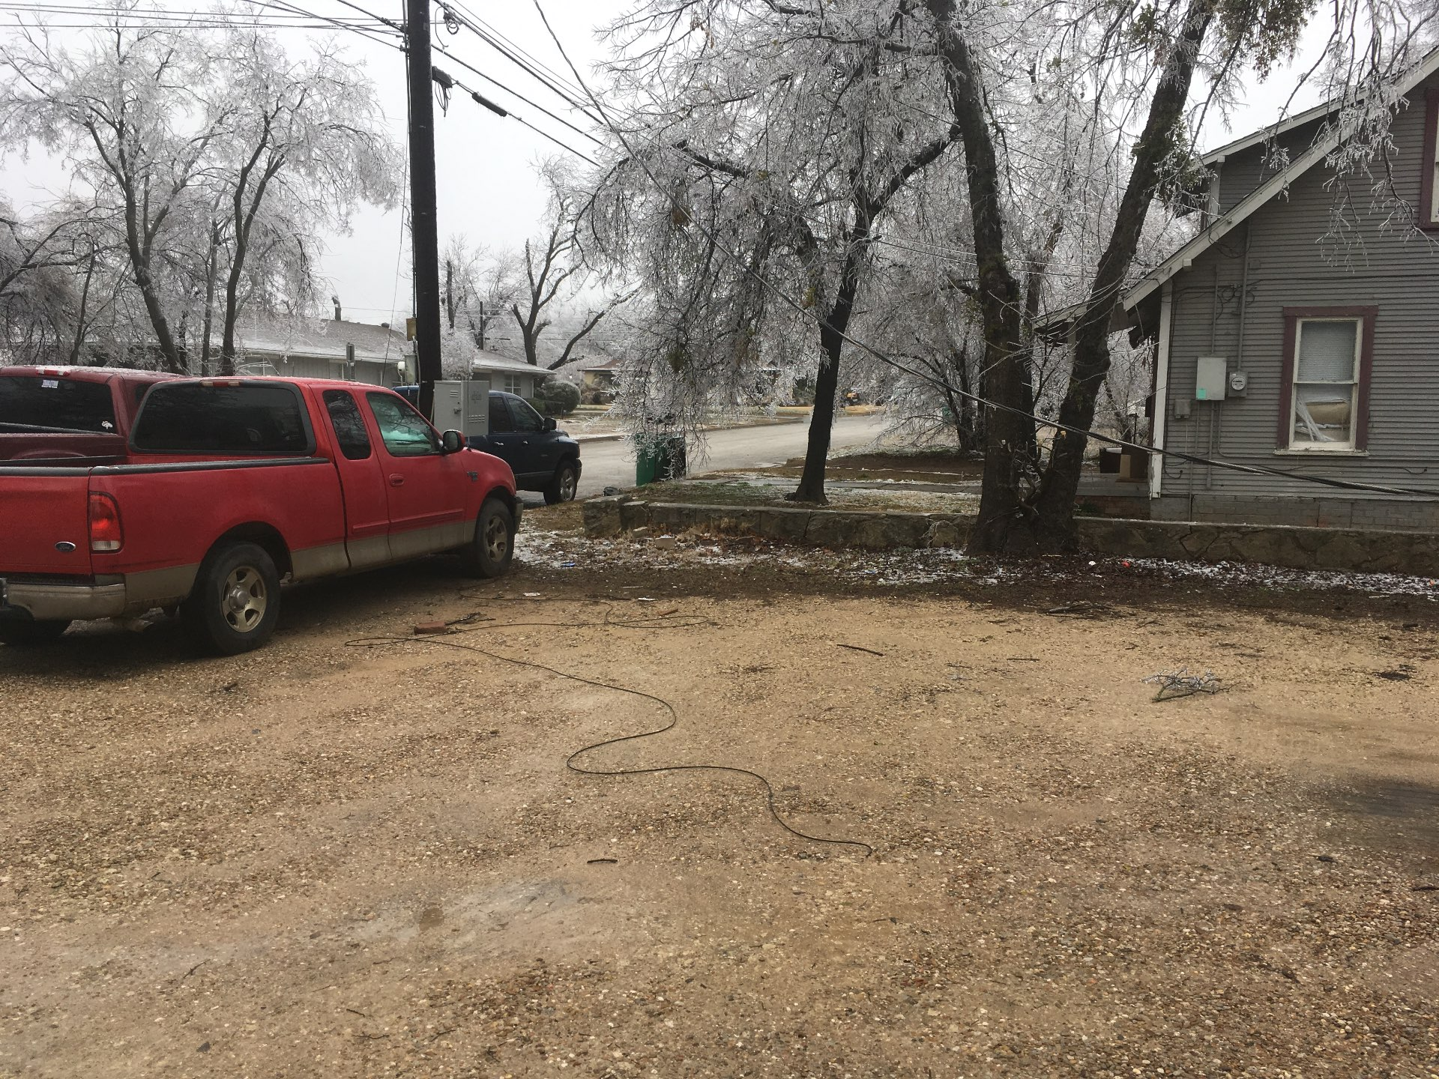
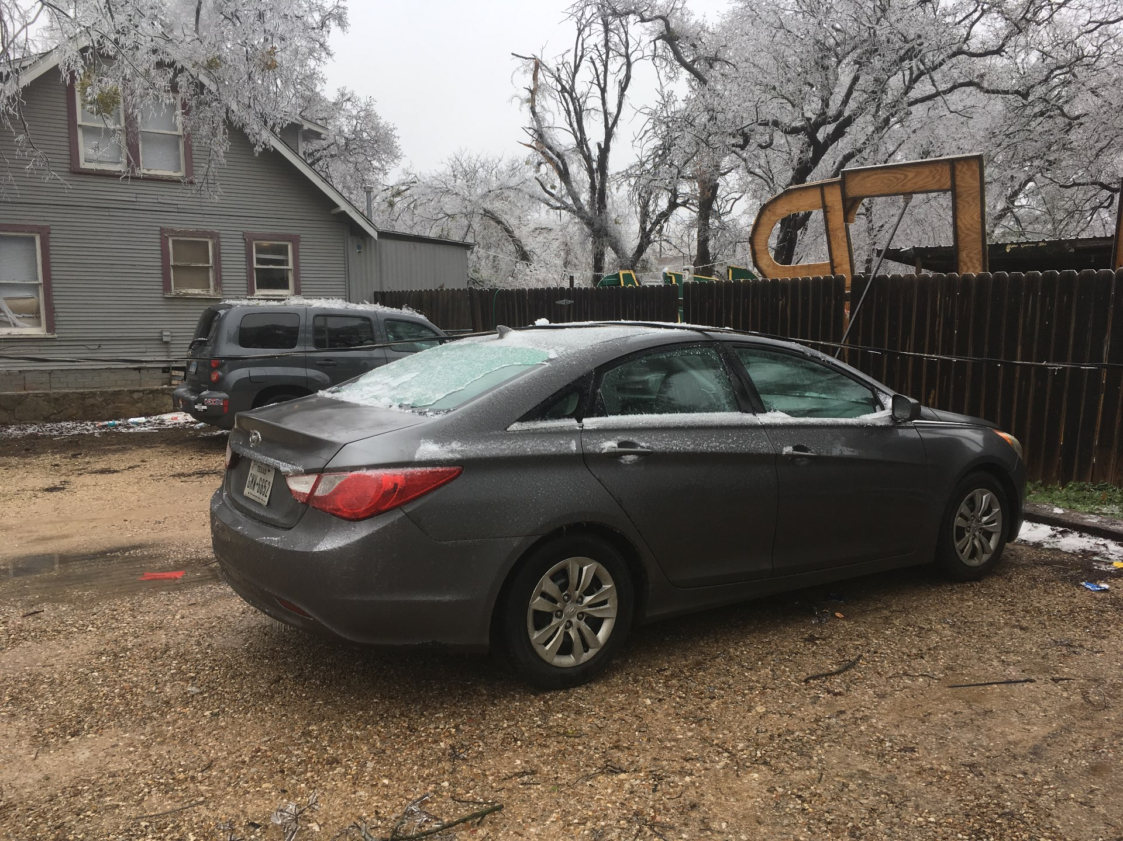
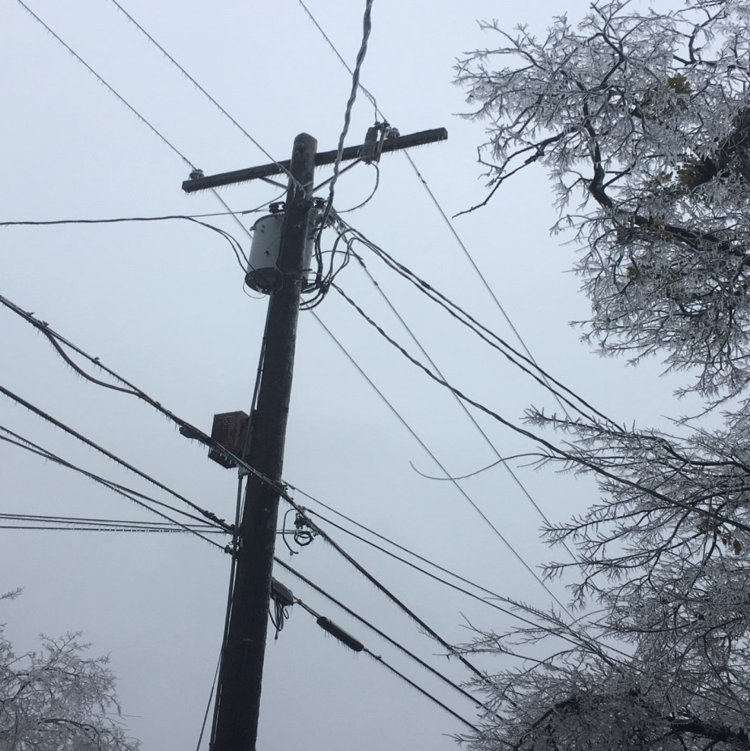
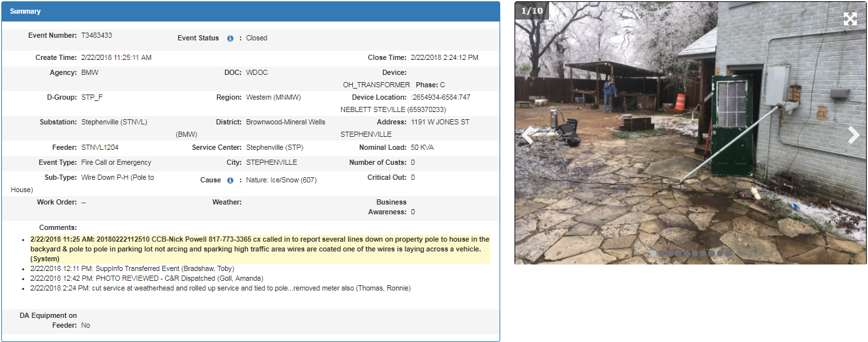
Distribution Operation Centers – Customer Photos
Notes:
Talking points this slide:
Wire down report pole to house
no sparking/arcing
high traffic area
across vehicle
Photo clearly shows:
meter base pulled off wall
Customer repairs required
Low wire across parking areas
Wire laying on top of customer’s car
Transformer fuse still closed
Is the service still energized?
Verified de-energized through meter ping
Right resource (cut and roll truck) was sent to location (eliminating multiple trips by different work groups) and customer was contacted and left with instructions

Slide 17
Distribution Operation Centers – Storms
Intelligent OMS
Self aggregating outages
Feeder lock out portal
Smart Grid Reports
One place to find all reports
Quickly assess any issues

Slide 18
Distribution Operation Centers – Data Analytics
One of the Oncor’s Guiding Principles
“Use data and science to manage our functions, operations, and deliver to our customers and stakeholders”
IBM Software Package:
Spark, R, SPSS, SAS, .Net, Scala
Machine Learning Tools
Use Cases:
Load Forecasting
SAIDI from AMS
Weather Damage Prediction
Unauthorized DG Detection
OMS Playback
Cold Load PU Prediction
Aerial Images Object Recognition

Slide 19
Data Analytics – Load Forecasting
Summer & Winter Reports:
Feeder Overload Predictions
Substation Transformer Overload Predictions
Tools:
Load predictions in OMS
Estimated Load Forecast (ELF) Tool for feeders
Estimated Load Forecast (ELF) Tool for substation transformers

Slide 20
Data Analytics – Load Forecasting

Slide 21
Data Analytics – SAIDI from AMS
SAIDI = SYSTEM AVERAGE INTERRUPTION DURATION INDEX
$SAIDI= \frac{SUM OF ALL CUSTOMER INTERRUPTION DURATIONS}{TOTAL NUMBER OF CUSTOMERS SERVED}$
Tracks interruptions greater than 5 minutes
Average Outage Duration For Every Customer
Traditionally:
Driven by the Connectivity Model through OMS
OMS: OUTAGE MANAGEMENT SYSTEM
Tracks customer, meter, and device reported outages
Can infer other customers affected based on the connectivity model
With AMS:
AMS/AMI (ADVANCED METERING SYSTEM)
15 minute interval data
Average Voltage
kWh +/-
Separate channels for consumed and generated energy
Status flags
Power Fails and Clock status
How much data in the interval
Unsolicited Power Status Events
Last Gasp (Lost Power)
Restoration (Restored Power)

Slide 22
Data Analytics – SAIDI: AMS vs OMSR

Slide 23
Data Analytics – Weather Damage Prediction
Data:
Historical Outage Data
Based on creation time, cause code, device, customer count, and geographic location
Historical Weather Data
Weather 4 hourly max, avg. and min based on customer density
Temp, wind chill, wind, wind gust, rain, and snow
Modeling Techniques
SPSS
Benefits:
Staging of Resources
Shorter Restoration Times

Slide 24
Data Analytics – Unauthorized DG Detection
Goal is to detect tampering and detection of DG is an ancillary benefit of the effort
Manual process with the use of spreadsheets for the data analysis
Identify all the meters with negative kWH readings across the system in last week
Include only the meters with increasing - kwH readings
Exclude all the customers who are authorized (agreement complete) and the customers who initiated the process
Identify any oil companies and exclude from the list
Extract only the residential meters based on meter type
Filter for customers whose -kWH is greater than 200kWH

Slide 25
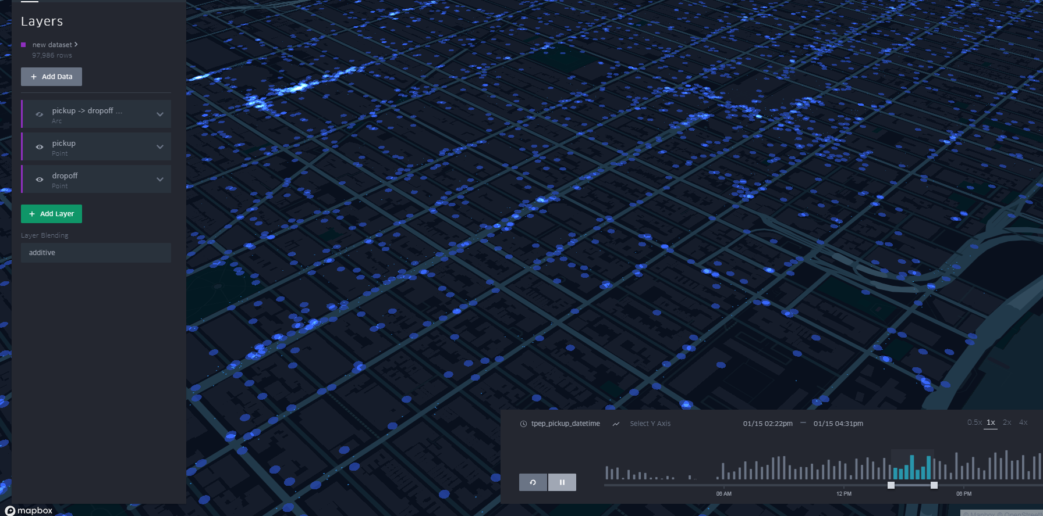
Data Analytics – OMS Playback
Digital Data Twin:
A replication of all data in OMS
Replay events & perform RCAs

Slide 26
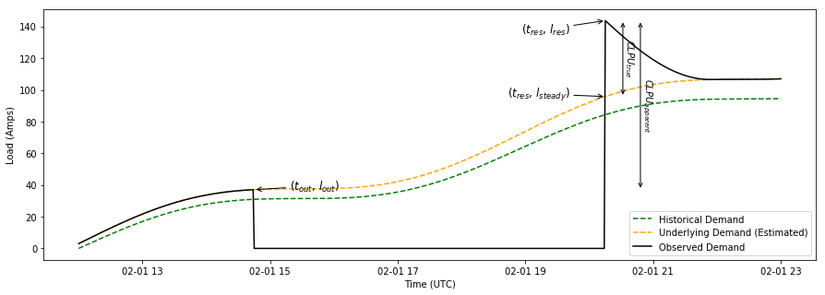
Data Analytics – Cold Load Pickup Prediction
Cold Load Pick Up:
When a typical load has been without supply for a period of time (hours) it loses its diversity. When power is restored the load is higher than usual.
Data & Relationship:
Ambient Temperature
Time of day
Season – Summer or Winter
Outage Duration – 30 minutes vs 4 hours
Type of Load – Residential, Non-Residential and Commercial/Industrial

Slide 27
Data Analytics – Aerial Imagery Object Recognition
Proposed Use Cases:
Post Storm Damage Assessment
Seasonal Wildfire Risk Assessment
Seasonal Structure Erosion Assessment
Post Storm Flood Detection
Annual Easement Intrusion Detection
Software:
Microsoft Azure Custom Vision
Working near the Cloud
Image Sources:
University of Texas
SkySat
Oncor Transmission
Google Earth

Slide 28
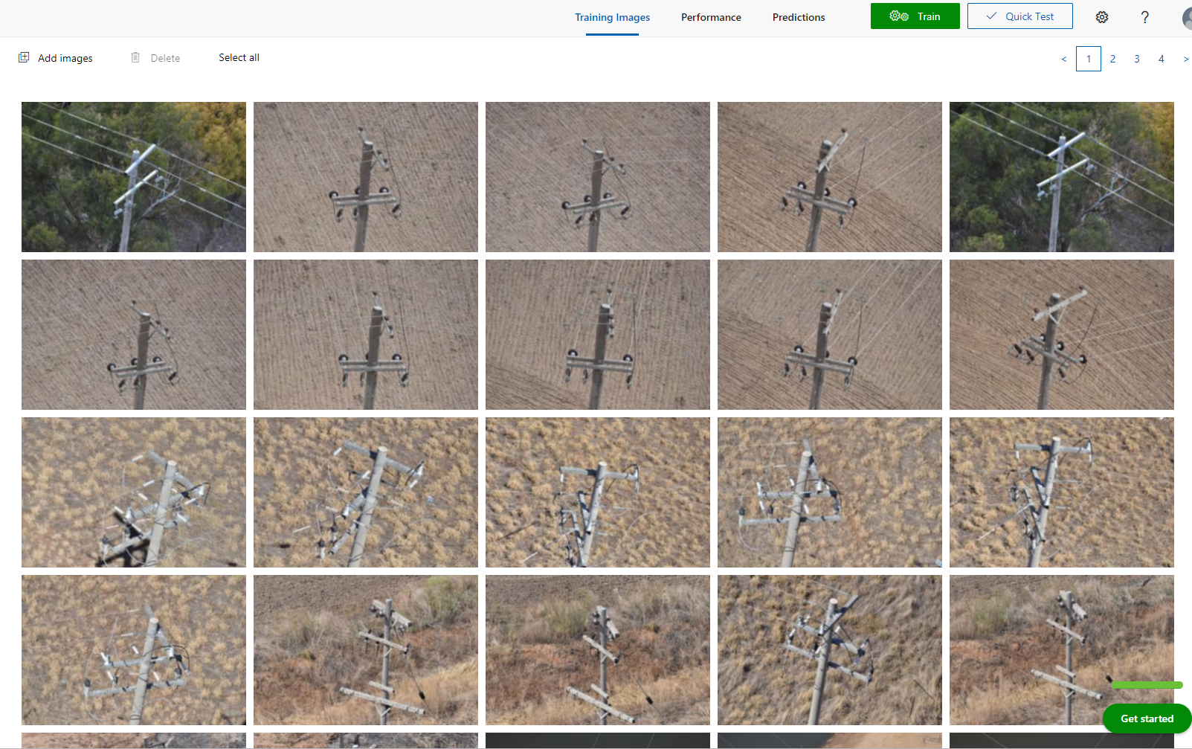
Data Analytics – Aerial Imagery Machine Learning

Slide 29
Data Analytics – Aerial Imagery Object Recognition

Slide 30
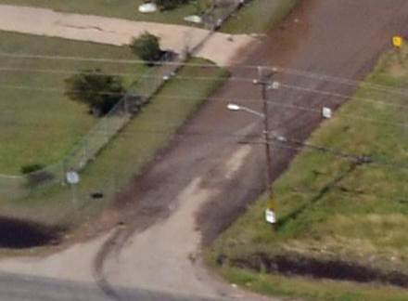
Data Analytics – Aerial Imagery Object Recognition
Image Type & Quality
Satellite (1 meter per pixel)
Refresh Rate: 2x a day - Once a quarter
Fixed Wing & Drone
Altitude & Angle
Turn Around: 3-5 days

Slide 31
Data Analytics – Aerial Imagery Object Recognition
Azure Custom Vision - Cloud Based Program
Oncor ARB (Architect Review Board) has approved
Images from source to Custom Vision
Download trained model via Docker container to run on prem.

Slide 32
Questions or Comments?

