Slide 1
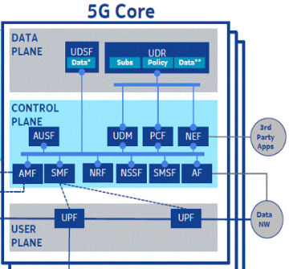
Mobile Edge Security
Edge Cloud
(Visited Network)
Third Party
App
Police/EMS
Security
Context
Fast
Handover
Cache Server
Internet
App4
Fire Department
Security
Context
Third Party
App
Cache Server
Fast
Handover
Security
Context
Cache Server

Slide 2
Mobile Edge Cloud Opportunities, Security Challenges, and Mitigation
5G Capabilities | Potential Security Challenges | Potential Mitigation
Server Computation at the edge of the network Security Context at the Edge of the network MEC Servers provide caching, local processing and application aware optimization Reduced handover time and Data off-loading Reduced Latency for authentication for time sensitive applications | If third party applications are run on the same platform as network functions, there are risks of poorly designed applications that allow the hackers to infiltrate the platform | Run both the edge computing applications and the network function(s) in robustly segregated virtual machines.
 | Sensitive security assets are compromised at virtualized functions at the edge. Man-In-The-Middle Attack at the Mobile Edge Server | Sensitive Security Assets stored at the mobile edge should be encrypted
 | Persistent caching of old Security Association by both the UE and visited network will weaken security by way of cache poisoning, cache overwhelming | Understand the security implications and take measures to protect these caches.
 | Attacker can gain connectivity or carry out a spoofing, eavesdropping or data manipulation attack during context transfer | Encrypted transfer of security context, IDS/IPS for proper monitoring and mitigation, proper security level
 | Subscriber authentication within the visited network gives rise to additional security vulnerabilities at the edge of the network. | Reuse old security association (SA), while in the meantime running AKA and acquiring a new security association. Delegate some of the HSS functions to the visited network such as Delegated Subscriber Server (DSS).
Potential Security Opportunities/Benefits
The Edge provides an opportunity to embed security detection and mitigation functions to stop and isolate attacks before they can impact other parts of the 5G network.

Slide 3
Network Slicing Security
Side Channel attacks
across slices
Slice # 1 (Ultra-Low Latency)
Data
Plane
Control
Plane
Edge
Cloud
vAUSF
EMS
vSMF
vUDSF
vAMF
Cloud RAN
VNF
vUDR
Sealing between
slices at the UE
Slice # 2 (Massive IOT)
Internet
VNF1
Fire
Slice # 3 (Massive content)
VNF2
Impersonation attacks
against a Network
slice instance
User
Plane
Slice # 4 (Mission critical)
vUPF
vUPF
vUPF
VNF
Police
Tactical User
Slice # 5 ( Non- Mission critical)

Slide 4
Network Slicing – Opportunities, Security Challenges, and Potential Mitigation
5G Capabilities | Potential Security Challenges | Potential Mitigation
Network slicing enables service differentiation and meeting end user SLAs. Allocates appropriate amount of network resources to a specific slice based on service (e.g. IOT, Priority services) Overcomes all the drawbacks of "DiffServ-based" QoS solution. Enables the operators to provide networks on an as-service-basis that minimizes CAPEX and OPEX. A single network can offer various services based on the requirements of the user and various use cases. Vastly improves operational efficiency and time to market for the delivery of 5G network services. | Controlling Inter-Network Slices Communications | Proper security mechanism to ensure operations within expected parameters and security needs
 | Denial of service to other slices – attacker may exhaust resources common to multiple slices, | Capping of resources for individual slices, Ring-fencing resources for individual slices to guarantee minimum level of resource
 | Attacker attacks the resources in slice A and in turn slice B’s resources get exhausted | Ring-fence the network resource for security protocols so that the slice has always has the ability in spite of resource exhaustion in other slices.
 | Side Channel attacks across slices extract information about cryptographic keys | Avoid co-hosting the slices that have very different levels of sensitivity on the same hardware. Hypervisor hardening
 | If UE is attached to several slices. UE may receive sensitive data via one slice and publish data via other slice. | Security mechanisms to address this should exist in the network and potentially in UE.
 | Impersonation attacks against a Network slice instance within an operator network | All virtual functions within a Network Slice instance need be authenticated and their verified.
Potential Security Opportunities/Benefits
Network Slicing provides a native approach to isolate highly sensitive contexts or applications which would be very beneficial for several security use cases. Slice specific SLAs enable a context-aware orchestration and optimization of security virtual functions.

Slide 5
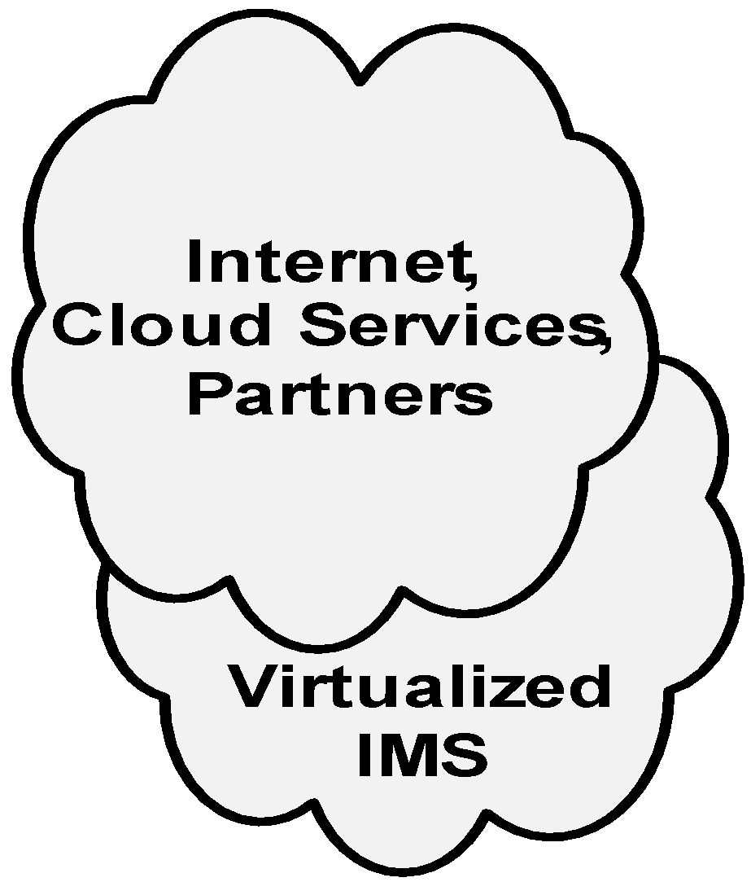
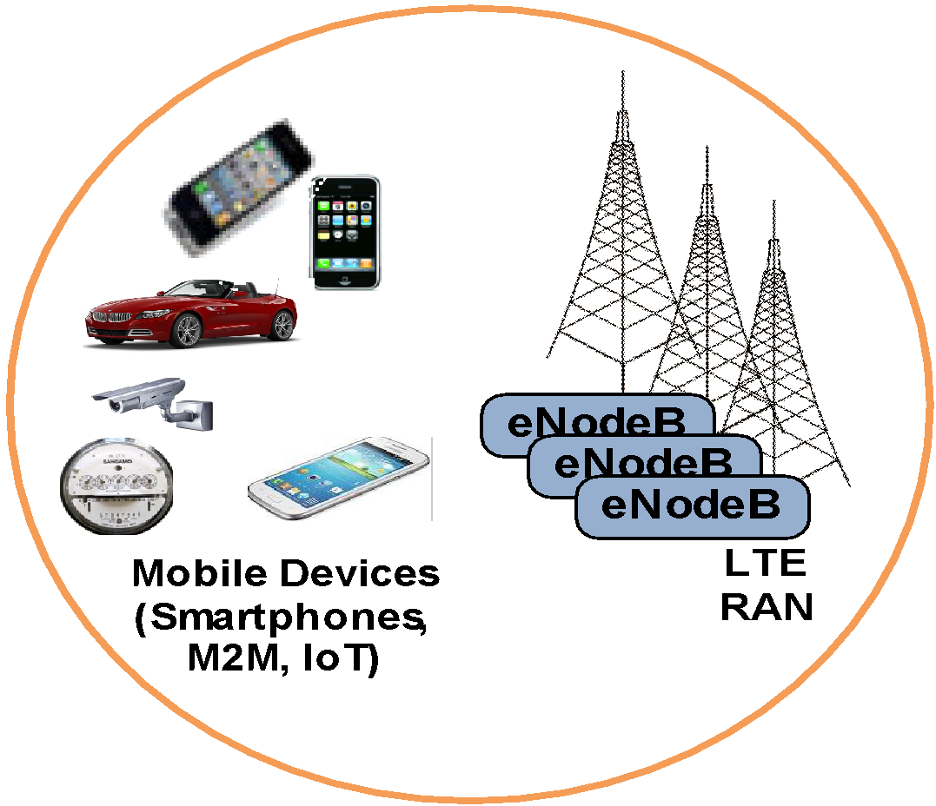
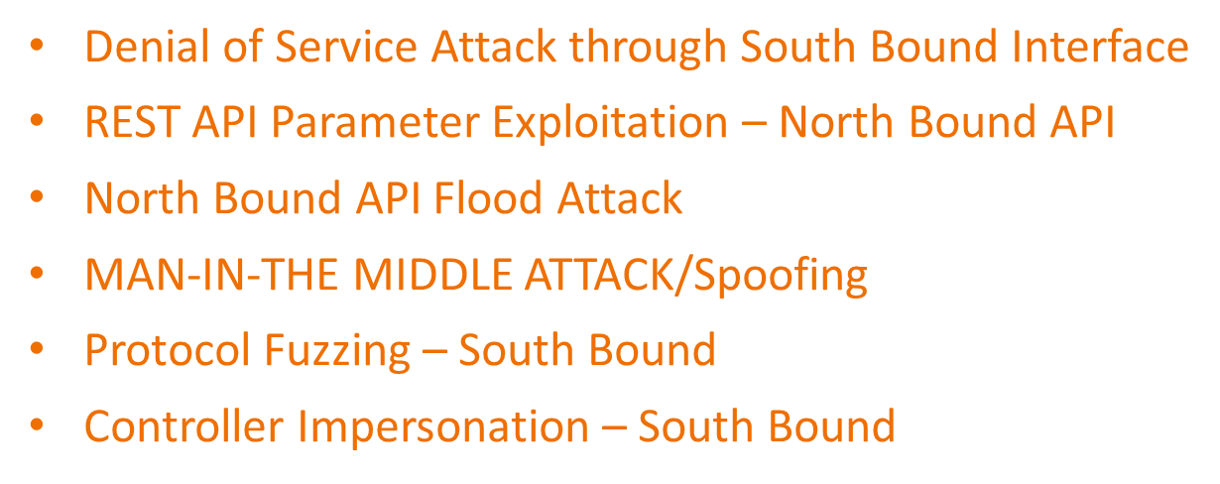
Security Vulnerability in ODL SDN Controller
2
Exploit: Using Northbound API hacker does XML External Entity (XXE) attack and exfiltration of configuration data from ODL SDN controller
1
Vulnerability: ODL controller did not disable external entity access to XML parser due to a bug in the ODL SDN controller code
Network Intelligence Layer
Customer Cloud Services
SDN Controller
S1-MME
SGi
S1-U
vRouters
vRouters
SDN
3
Mitigation Strategy: Open source community reported the problem, Patch was applied that disabled external entity access and fixed the problem.

Slide 6
Security Challenges from Virtualization Hypervisor Vulnerabilities
To prevent this type of attack, we must:
Conduct security scans and apply security patches
Ensure the Hypervisor is hardened and minimized (close vulnerable ports)
Ensure the access to the Hypervisor is controlled via User Access Management,
3
2
Tenant 1
Tenant 2
Tenant 3
Malware compromises VMs:
VM/Guest OS manipulation
Data exfiltration/destruction
VM
VM
VM
VNF
VNF
VNF
Guest OS
Guest OS
Guest OS
Hypervisor (Host OS)
Common Hardware (COTS)
1
Hacker exploits a vulnerability in the Open Source code and infects the Hypervisor with a Malware

Slide 7
Security Vulnerability in ODL SDN Controller
2
Exploit: Using Northbound API hacker does XML External Entity (XXE) attack and exfiltration of configuration data from ODL SDN controller
1
Vulnerability: ODL controller did not disable external entity access to XML parser due to a bug in the ODL SDN controller code
Network Intelligence Layer
Customer Cloud Services
SDN Controller
S1-MME
SGi
S1-U
vRouters
vRouters
SDN
3
Mitigation Strategy: Open source community reported the problem, Patch was applied that disabled external entity access and fixed the problem.

Slide 8
DNS Amplification Attacks Enhanced by Elasticity Function
2
Malicious DNS queries (spoofed source IP address set to the address of the victim)
Orchestrator instantiates new VM to scale-out vDNS function to accommodate more queries… becomes multiple recursive DNS severs responding to victim
1
vDNS
Orchestration
vDNS
vMME
vHSS
vPCRF
SGi
vS-GW
vP-GW
vPCEF
Victim
S1-MME
Hypervisor
S1-U
Common Hardware (COTS)
SDN
3
vEPC
Victim receives the DNS query response (large/amplified packets)
NOTE: we must implement vIDS/vIPS & vFirewalls to mitigate these types of attacks

Slide 9
Relevant SDN/NFV/5G Standards
Forum | Focus
IETF | Network Virtualization Overlay, Dynamic Service Chaining, Network Service Header
3GPP | Mobility and Security Architecture and Specification
ETSI ISG NFV | NFV Platform/Deployment Standards – Security, Architecture/Interfaces, Reliability, Evolution, Performance
IEEE | IEEE 802.11 ax/ac/ay. There are 42 societies to contribute to 5G Eco System
ONF | OpenFlow SDN Controller Standards
OPNFV | NFV Open Platform/eCOMP/OPNFV Community TestLabs
Open Air Interface (OAI) | 5G Open Source Software Alliance
OpenDaylight | Brownfield SDN Controller Open Source
ONOS | OpenFlow SDN Controller Open Source
Open RAN Alliance | Open and Interoperable RAN Virtualization
KVM Forum | Hypervisor
NSF PAWR Testbed | COSMOS (NYC), POWDER-RENEW (Salt Lake City), RENEW (NCSU)
Linux Foundation | Operating System, Container Security
ITU | The ITU Telecommunication Standardization Sector coordinates standards for telecommunications
ATIS/NIST/FCC/CSA | Regulatory Aspects of SDN/NFV
Notes:
IETF = Internet Engineering Task Force
ETSI ISG NFV = European Telecommunications Standards Institute/Industry Specific Groups/Network Function Virtualization
OPNFV = Open Platform For NFV
ONOS = Open Network Operating System
DPDK = Intel Data Plane Development Kit
KVM = Kernel-based Virtual Machine

