Slide 1
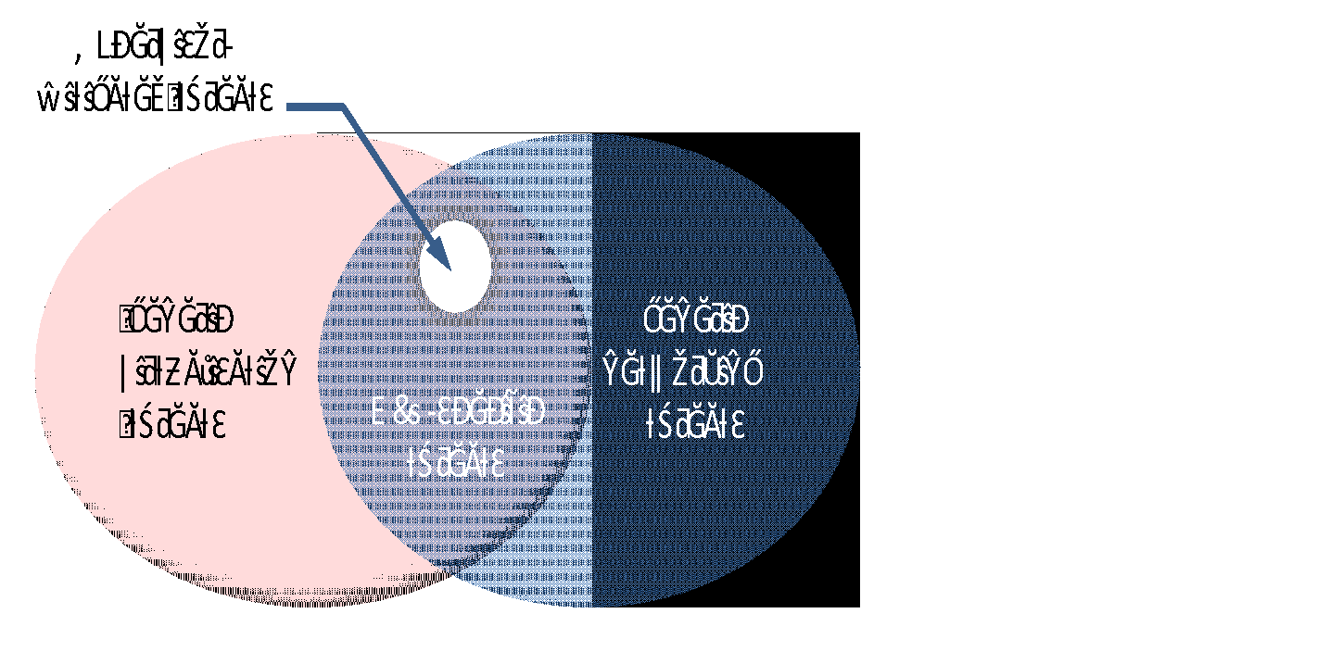
Security Challenges 5G and Beyond Environment
Hypervisor Vulnerability
API security
Orchestration Vulnerability
Virtual monitoring
Limited visibility to Mobility/EPC interfaces (e.g. S6a, S11, S8)
Virtualized firewalls
Secure boot
Secure crash
User/tenant authentication, authentication and accounting
Topology validation and enforcement
Performance isolation
Authenticated Time Service
Private Keys within Cloud Images
Detection of attacks on resources in virtualization infrastructure
Security monitoring across multiple administrative domains (i.e., Lawful Interception)

Slide 2
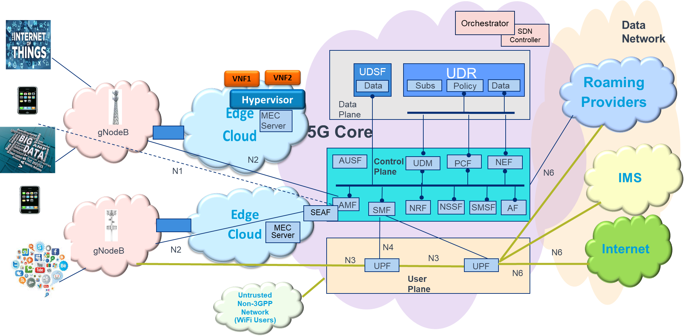
Threat Analysis in 5G Network
Insider Attacks
(Data Modification, Data Leakage)
API-based Attacks
Attacks with physical access to the transport network
(Man-in-the-middle attack, eavesdropping)
Virtualization Attacks by Third Party VNF
(Side Channel Attacks)
Attacks from
Roaming Network
Theft of Service
Eavesdropping
Attacks on the Radio interface
DOS by jamming
Attacks by Mobile End Points (DOS by Flooding)
Attacks from untrusted
Non-3GPP network
Attacks from Internet and other Networks
Compromise of Network Elements
Attacks from physical access to gNodeB

Slide 3
Mobile Network Security – 5G Core Threat Categories
 | Category | Threat | Description
T1 | Loss of Availability | Flooding an interface | Attackers flood an interface resulting in DoS condition (e.g. multiple authentication failure on N1, N2 interface)
T2 |  | Crashing a network element | Attackers crash a network element by sending malformed packets
T3 | Loss of Confidentiality | Eavesdropping | Attackers eavesdrop on sensitive data on control and bearer plane
T4 |  | Data leakage | Unauthorized access to sensitive data on the server (UDR, UDSF) profile, etc.)
T5 | Loss of Integrity | Traffic modification | Attackers modify information during transit in user plane N3 (SIP header modification, RTP spoofing)
T6 |  | Data modification | Attackers modify data on network element (change the NE configurations through Admin interface)
T7 | Loss of Control | Control the network | Attackers control the network via protocol or implementation flaw
T8 |  | Compromise of network element | Attackers compromise of network element via management interface
T9 | Malicious Insider | Insider attacks | Insiders make data modification on network elements, make unauthorized changes to NE configuration, etc.
T10 | Theft of Service | Service free of charge | Attackers exploits a flaw to use services without being charged

Slide 4
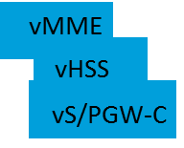
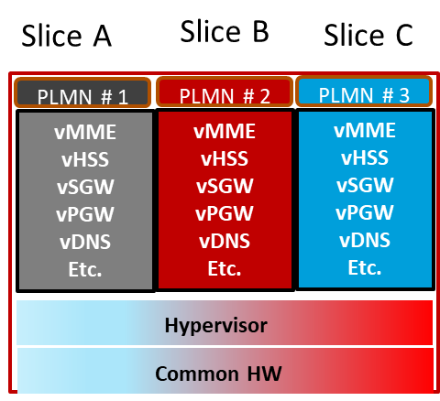
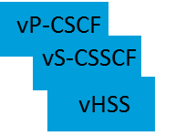
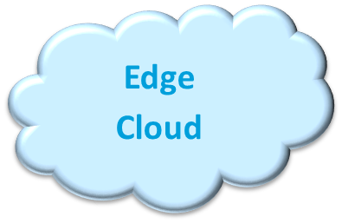
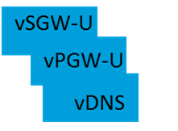
Key Pillars of 5G and Beyond Security
SDN Security
Cloud RAN Security
Open Source / API Security
Edge Security
PLMN # 1
5G Core
Edge
Cloud
Network
Slice 1
Control Plane
Network Slicing Security
Cloud RAN
Network Slice 4
Supply Chain Security
PLMN # 2
Cloud RAN
vIMS
Network Slice 2
Virtualization / Softwarization Security
PLMN # 3
Data Plane
Cloud RAN
Predictive Security / Monitoring and Analytics
Optimization / Orchestration Security
Data Security and Privacy

Slide 5
Security Advantages of SDN/NFV A Comprehensive View of SDN/NFV Security Advantages
Performance Improvements:
Streamline and Reduce Incident Response Cycle Time
Streamline and Reduce Patching Cycle Time
Orchestration
VM1’’
VM2’’
VM3’’
Data Analytics
Design Enhancements:
VM1’
VM2’
VM3’
SLA Mgmt
Analytics
Centralize Control and Management Functions
VM1
VM2
VM3
Usage Mgt
Monitoring
VM
Security Function Vendor 1
VM
Security Function Vendor 2
VM
Security Function Vendor 3
SDN Controller
Security Embedded at Design Time
Security that Exceeds Existing Perimeter
Hypervisor
Real-Time capabilities:
Common Hardware (COTS)
Real-Time Scaling to Absorb DDOS Attacks
Multivendor Security Service
SDN
Real-Time Integration of “Add-on” Security Functions

Slide 6
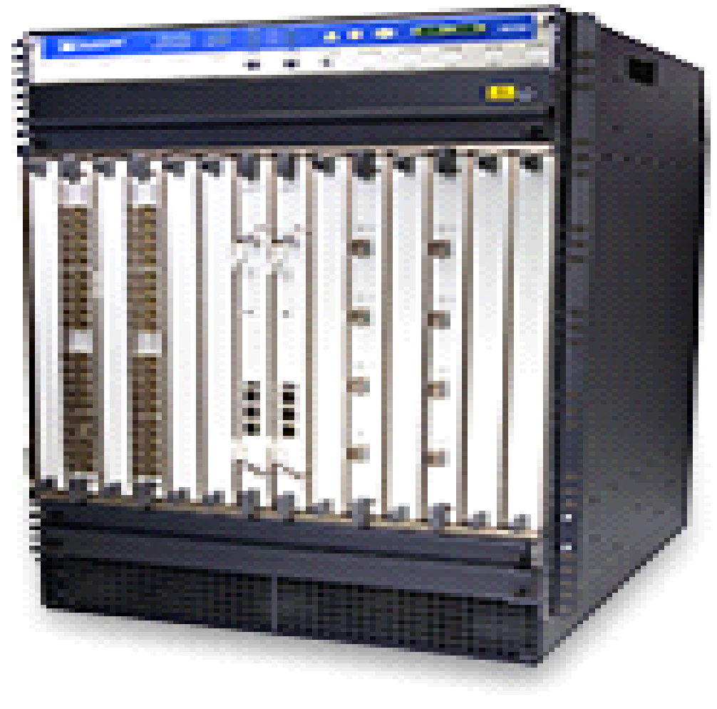
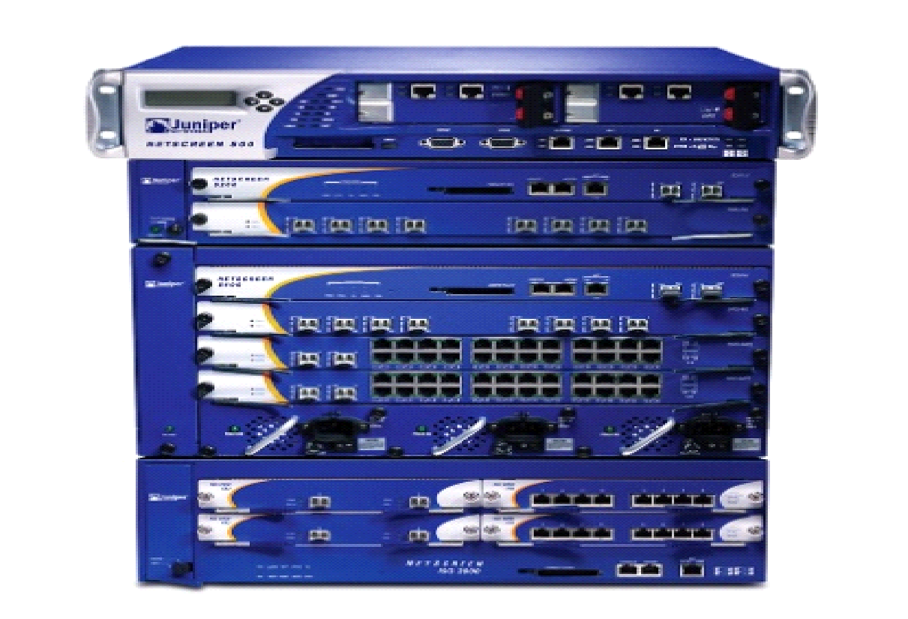
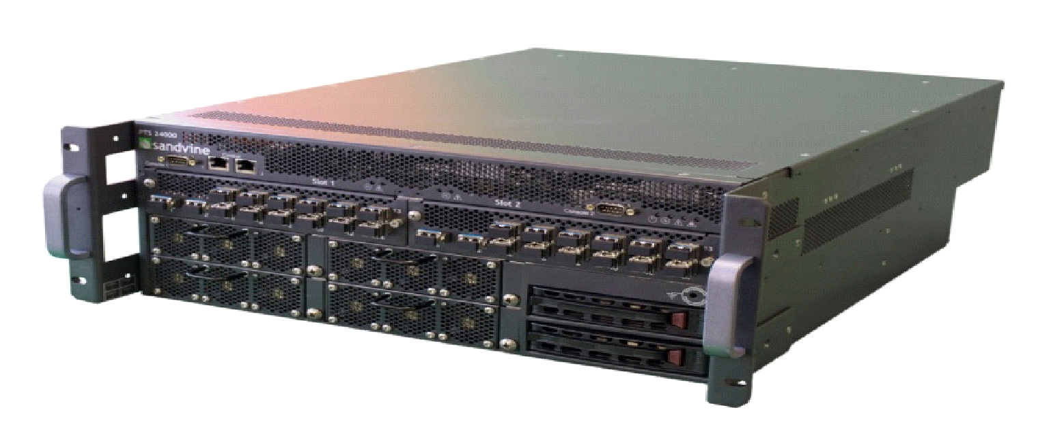
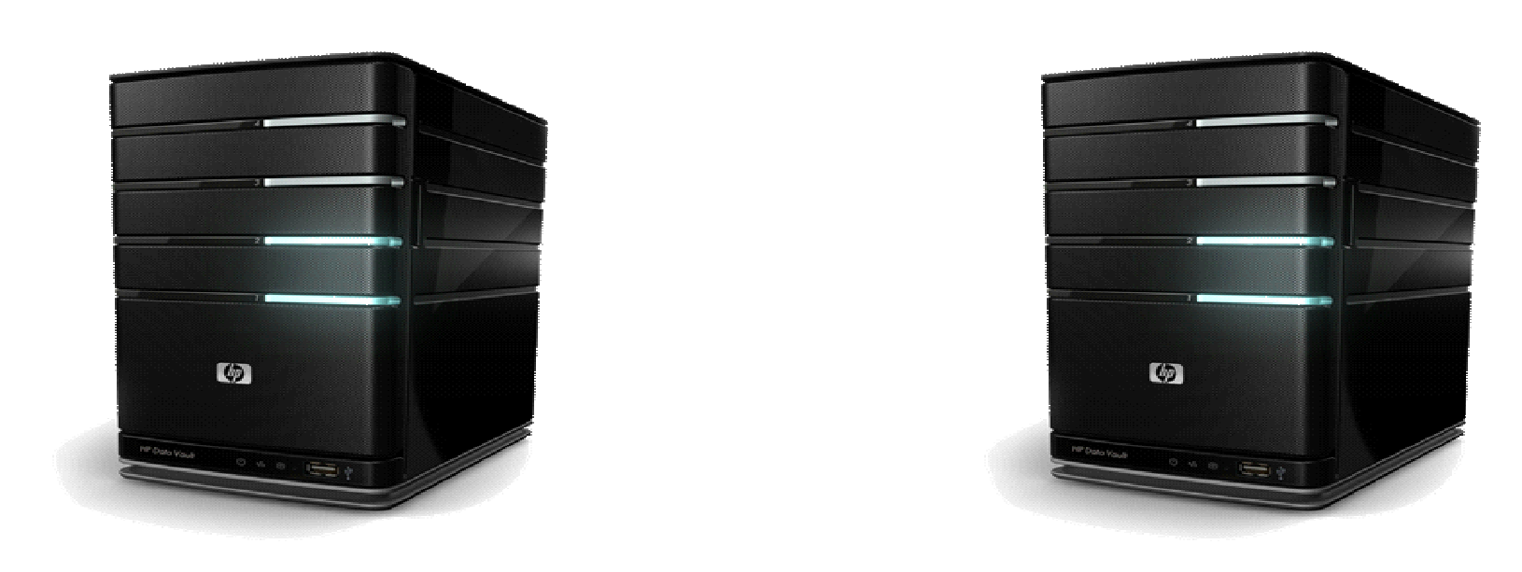
An Example - Security Transformation – Virtual Firewall/Virtual DDOS/Virtual IPS
Non-Virtualized Security
Virtualized Security Function
Intel
Security
Tektronix
f5
ARBOR
NETWORKS
Operational Management Framework
HP
GUAVUS
ALLOT
A10 NETWORKS
Infrastructure Controller
Network Controller
Application
Controller
NETSCOUT
NIKSUN
Check Point
paloalto
networks
radware
Alcatel-Lucent
FORTINET
JUNIPER
NETWORKS
m o v i k
Virtual Security Functions
sandvine
vDDOs
vFW1
vFW2
IDS1
IDS2
FireEye
Common Cloud Infrastructure
Security functions will be cloud-based
Security dynamically orchestrated in the cloud as needed
Streamlined supplier integration
Centralized common management platform
Creates a standard operations/support model
Wide variety of vendor specific security hardware
Requires vendor specific FW management platforms
Requires hands-on customized physical work to install
Multiple support organizations
No single operations model or database of record

Slide 7
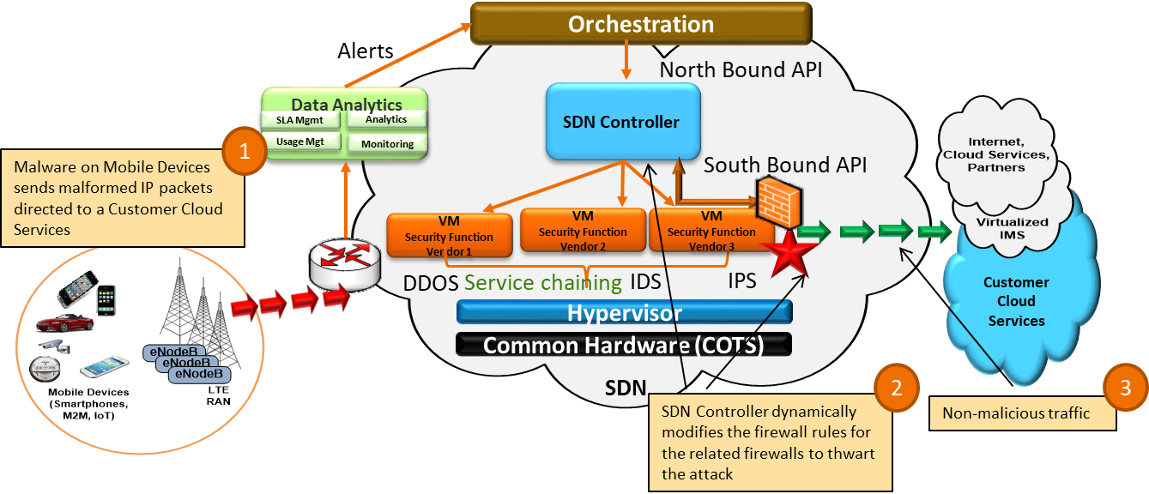
Security-As-a-Service Proposed Approach with Dynamic Service Chaining – An Opportunity Use Case - Malware Mitigation
Control Plane
Data Plane

Slide 8
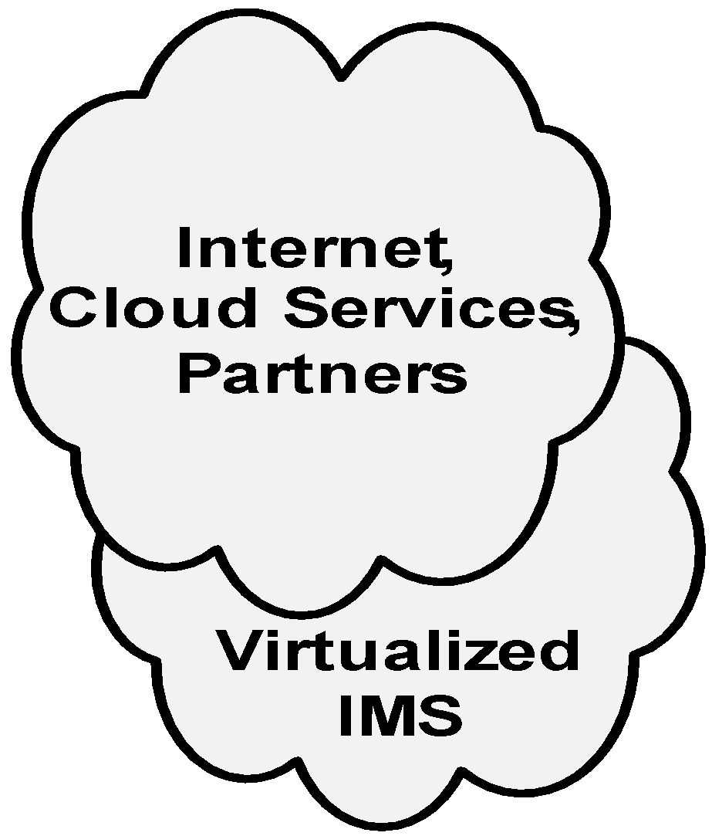
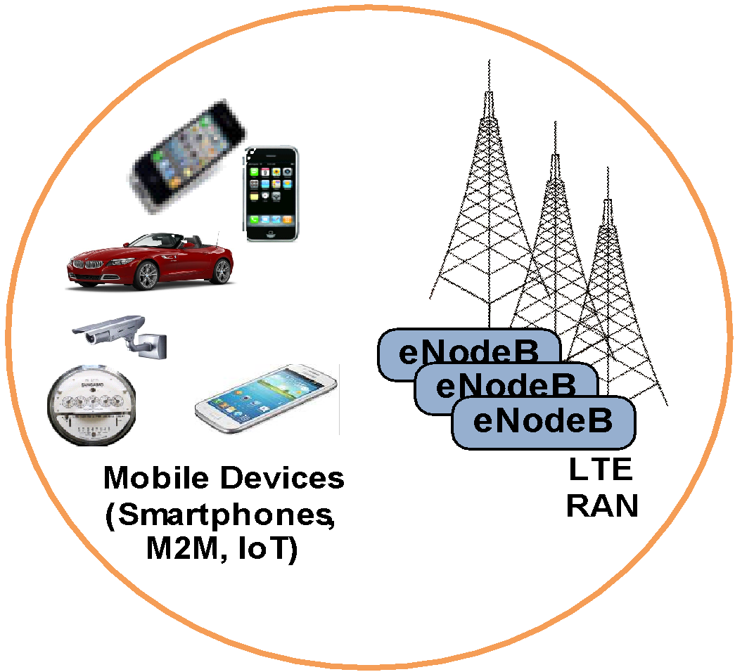
Security Opportunities from Virtualization DDoS Attack Resiliency – Control Plane
3
Orchestrator instantiates new VM to scale-out vMME function to sustain the higher traffic load while we investigate.
Attacker creates a Botnet army by infecting many Mobile devices with a ‘remote-reboot’ malware, attacker then instructs the malware to reboot all the devices at the same time, this will cause excessive malicious Attach Requests, creating a Malicious Signaling Storm.
2
1
vMME is under DDoS attack
Orchestration
vMME
vMME
vHSS
vPCRF
vS-GW
vP-GW
vPCEF
SGi
S1-MME
Hypervisor
S1-U
Common Hardware (COTS)
SDN

Slide 9
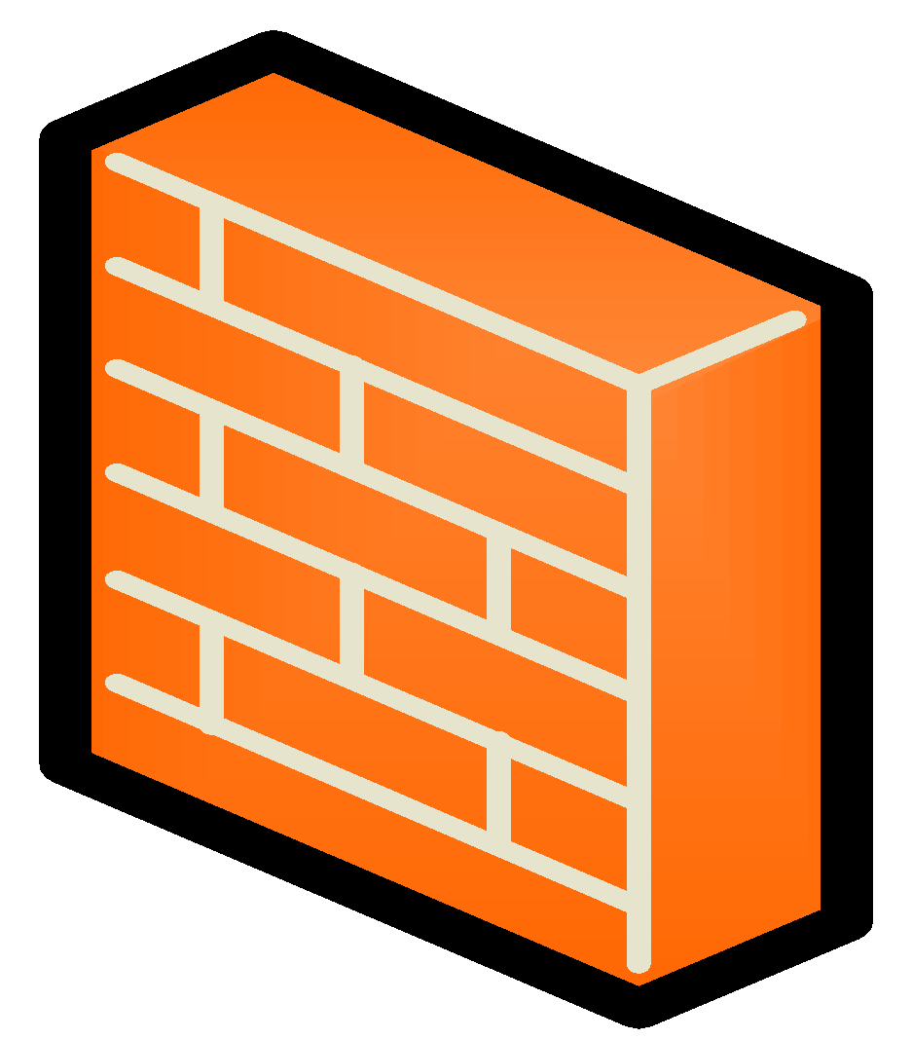
Security Opportunities from Virtualization SDN Controller Dynamic Security Control – Data Plane
1
Malware on Mobile Devices sends malformed IP packets directed to a Customer Cloud Services
Network Intelligence Layer
SGi
Customer Cloud Services
S1-MME
SDN Controller
vFirewalls
S1-U
vRouters
SDN
2
3
SDN Controller dynamically modifies the firewall rules for the related firewalls to thwart the attack
Non-malicious traffic

Slide 10
Cloud RAN Security

Slide 11
Example: CLOUD RAN Unique 5G Security Opportunities, Challenges, and Mitigation
5G Capabilities | Potential Security Challenges | Potential Mitigation
The 5G networks will facilitate many more devices (IoT) accessing the RAN with shared access. Programmability and Virtualization of RAN will adapt to dynamic nature of traffic and multi provider access | Huge number of infected M2M/IOT devices that attempt to gain access resulting in shared resource starvation, VM/Guest OS manipulation, data exfiltration | Hypervisor Separation Intelligent VM resource allocations vFirewalls
 | Programmable and Software RAN will increase the chance of Man-In-The-Middle Attack at the base station | Use of analytical techniques like anomaly detection can be leveraged for such analysis
 | Resource starvation at cRAN VNFs by additional vFirewall functions during DDOS attack | Hypervisor separation Capping of resources
 | External flooding attacks may be launched by a botnet consisting of large number of bots and Distributed Denial of Service (DDoS) | Develop DDoS detection and mitigation functions into Cloud RAN functions
 | Jamming can be launched against control-plane signaling or user-plane data messages | Deploy DDOS detection, IDS and vFirewall functions Dynamic Service Chaining
Potential Security Opportunities/Benefits
SoftRAN (cRAN) in 5G networks will have embedded DoS detection and mitigation functions Dynamic Radio Resource Scheduling would significantly reduce the risk of jamming attacks targeting mission critical devices Access to control plane and media plane at the base station will enable security monitoring of traffic

