Slide 1
TWIF-4: Opportunities and Challenges with Vehicular Networks IEEE Globecom 2015
DSRC – Ready for Prime Time!
December, 2015

Slide 2
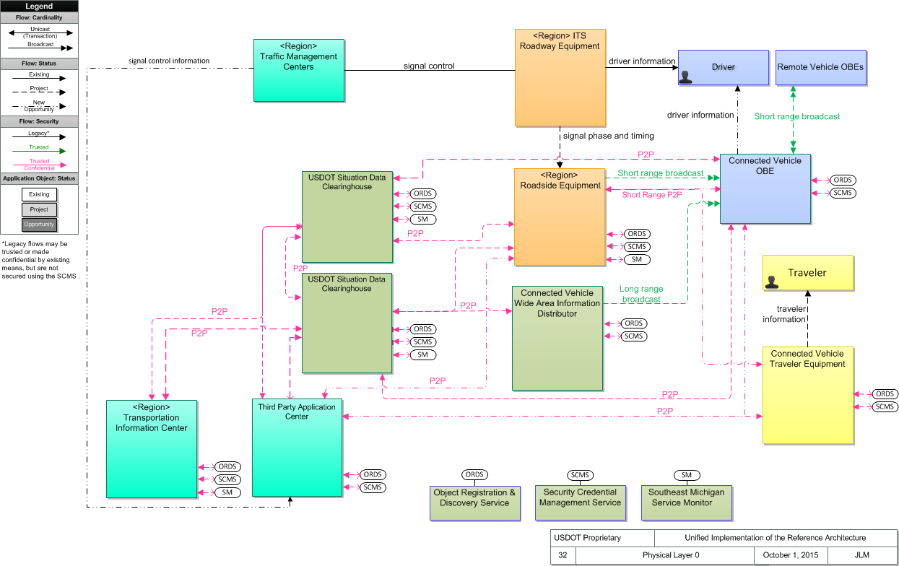
Unified Implementation of the CVRIA
Connected Vehicle Reference
Implementation Architecture
Makes use of all available communication media
Architecture site
http://standards.its.dot.gov/DevelopmentActivities/CVReference
SET-IT tool site
Version 2.1
Sample project
http://www.iteris.com/cvria/html/resources/tools.html
Notes:
The Southeast Michigan 2014 project embodies the fundamentals we need to work on:
All elements of a connected vehicle system – mobile, field, center.
Multiple communication media with a common process for assuring trust and protecting confidentiality.
Data abstraction points to facilitate data flow and aggregation. A place is provided for multiple application interest groups to connect up and use (and contribute to) the flow.
************
The things in the boxes are physical objects. Lines are information flows
The blue boxes (upper right) are inside the vehicle
Yellow boxes are travelers and their equipment
In the middle (orange and teal) exist at the boundary between moving and fixed elements. Bridge between wired and wireless
On the left side: fixed infrastructure – they exist somewhere at an IP address. Data are gathered and aggregated and synthesized
Black oval: facilitate the flow of the fundamental data that all travelers need.
Bottom (dark green): support services for overall concept – to make it all work
This is the kind of system that we think could be scaled up to national level

Slide 3
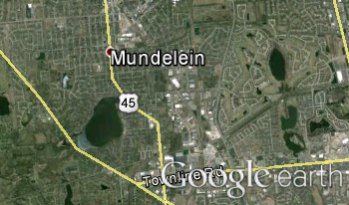
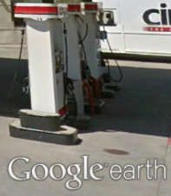
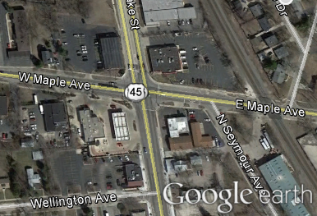
A Variety of Communication Media, Data Transport Needs
Resources: wired and wireless, the Internet
3,000 miles, 3,000 meters, 300 meters, 3 meters.
Continent-Wide
Wide Area Network
5.9GHz DSRC
Local Area
Network
Would like to be able to use the best medium for the communication purpose,
Be able to opportunistically use whatever medium is available as a traveler moves through their environment.
Notes:
We think that there are three things that if done well will project connected intelligent transportation systems into the “after” state:
To accomplish transportation application goals, we have a number of communication resources that have to be properly, efficiently melded together, and
There are two classes of data used in transportation systems.
Those two things can then be unified through well-organized tools.
*******************************

Slide 4
DSRC – a Key Part of Communications
Large-scale pilots are underway that will exercise the full capability of DSRC
Arrived at a consensus of interpretation of standards for the next generation of installations
Production programs are underway
Yes, DSRC is ready for Prime Time

Slide 5
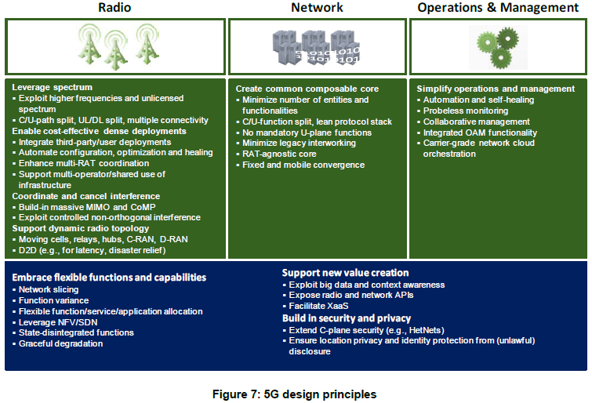
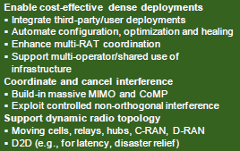
Looking Forward to the Next Generation
Better coordination of Radio Access Technologies
Opportunity of preserve the capabilities of DSRC in a portfolio of wireless services
DSRC could drop into 5G to cover significant vehicle-oriented use case needs
NGMN 5G White Paper, Next Generation Mobile Networks Alliance, 17 February, 2015

Slide 6
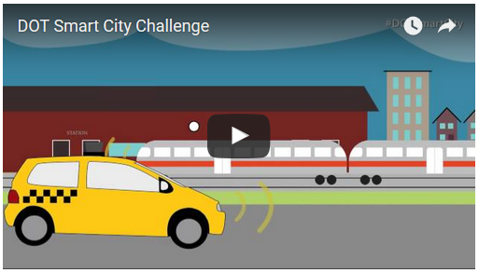
DOT Smart City Challenge
Designed to help cities begin to address the challenges of rapid population increases and rapidly growing demands on their transportation infrastructure
Up to $40M
https://www.transportation.gov/smartcity/
https://youtu.be/14adE8pVakI

Slide 7
“Make no little plans. They have no magic to stir men’s blood and probably themselves will not be realized. Make big plans; aim high in hope and work, remembering that a noble, logical diagram once recorded will never die, but long after we are gone will be a living thing, asserting itself with ever-growing insistency.”
- Daniel Burnham
“I have always believed in planning big, and I have always discovered after the fact that, if anything, we didn’t plan big enough.
- Alfred Sloan

