Slide 1
Accelerating embedded software development for new SOC
Nitin Garg, Principal Engineer, NXP Semiconductors, Austin

Slide 2
Introduction

Slide 3
Introduction to SOC
A system on chip is an integrated circuit that integrates all components of a computer or other electronic system.
These components always include a central processing unit (CPU), memory, input/output ports like Ethernet, USB, SATA, UART, PCIe.
Here is i.MX 8M PLUS SOC by NXP Semiconductors. It has Main CPU, secondary CPU, DDR, cache, Display controller supporting HDMI, DSI, LVDS, Video decoder, Vision Engine, DMA, Security, etc.

Slide 4
Embedded software development
Embedded software for SOC includes OS porting (interrupts, clocks, power, DMA), device driver development, system level applications.
Traditionally, system software development would begin after the first silicon sample.
Software development generally took months which isn’t acceptable in today’s fast pace world.
A shift-left approach needs to be taken where software development starts as early as possible and, even better, at the same time as the SoC hardware design
Also help identify SoC implementation bugs and potentially reduce the cost

Slide 5
Pre-silicon development types

Slide 6
System C models
C behavioral models can be built for each IP of the SoC
Each drivers can be tested on these behavioral models
But this requires huge software investment and maintenance
the accuracy of the behavioral models depends on developer’s interpretation

Slide 7
RTL testbench
Verilog testbench is based on the register transfer language (RTL) specification of the SoC, representing the full SoC, not just some IP blocks
Verilog testbench can also be used to develop software drivers
Developing software going to be extremely slow to develop and debug

Slide 8
FPGA prototypes
FPGAs are fairly fast, and since the FPGAs are built from RTL, they are cycle-to-cycle accurate
works with each separate IP block rather than the entire integrated SoC design
this approach limits the software from doing full SoC-level development
this method will lower the bring-up effort, gaps still exist since it misses pertinent SoC integration details

Slide 9
SoC emulators
Based on RTL, so they are accurate, and they are 100 times faster than Verilog testbench
Full OS porting and driver development can be performed in a reasonable amount of time
Can be used for prototyping, benchmarking, ROM development, firmware development, and IP or SoC-level verification
SoC emulators offer far more possibilities than other approaches

Slide 10
Comparison of different pre-silicon development environments

Slide 11
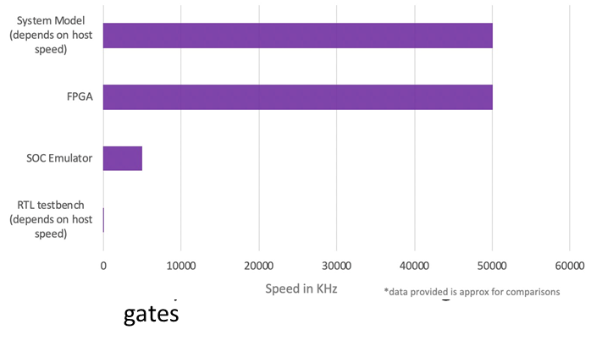
Performance comparisions
Per Moore’s law, the transistor count doubles every two years in an integrated circuit
Most of the ARM based 64-bit SoCs today have 100-300 million logic gates

Slide 12
References
https://www.embedded.com/optimizing-pre-silicon-software-development/
Trimberger, Stephen M. “Three Ages of FPGAs.” IEEE Xplore Full-Text PDF: 2015, ieeexplore.ieee.org/stamp/stamp.jsp?arnumber=7086413.
BRUNET, JEAN-MARIE. “Why Modern SoC Designs Embrace Emulation.” Embedded Computing Design, 5 Sept. 2018, embedded-computing.com/embedded-computing-design/why-modern-soc-designs-embrace-emulation.
“Soc Emulation.” Soc Emulation, 2019, www.aldec.com/en/solutions/hardware_emulation_solutions/co-emulation–soc-emulation.
“Cramming More Components onto Integrated Circuits.” http://www.cs.utexas.edu/, 2006, cs.utexas.edu/~fussell/courses/cs352h/papers/moore.pdf.
ITRS – Networking and Microprocessor (MPU) Driver by Fawzi Behmann

Slide 13
Q & A?

