Slide 1

Special Interest Groups（SIG） on sensing, communications, caching, and computing (C^3) in cognitive networks
Prof. Li Wang
Beijing University of Posts and Telecommunications, China
Prof. Yongpeng Wu
Shanghai Jiaotong University, China

Slide 2
Outline
1
Overview
2
Members of Our SIG
3
Finished Activities
4
Plan
2

Slide 3
Overview of this SIG
Scope and Objectives
  Interplay between Social science and Wireless Communications
    Mobility and Social behaviors of mobile users trigger more applications
  Exploit social behaviors and improve spectrum utilization to provide more flexibility in networking
Critical technical problems
  How to sense and understand social behaviours and diverse applications characteristics?
  How to formulate and utilize human-device interactions to boost communication performance?
  How to facilitate the benefits of considering social behaviours and application characteristics from mulit-dimensional resources, e.g., caching and computing?
Goal: Provide a platform for exploiting social science into cognitive radio networks by exploring and providing more new dimensions.
New goal: sensing, communications, caching, and computing (C^3) in cognitive networks.
Notes:
In this SIG group, we provide a platform on the development of the interplay among sensing, communications, caching, and computing (C^3) in cognitive networks, a more comprehensive way to boost the network performance.
Here we can discuss
How to sense and understand social behaviours and diverse applications characteristics?
How to formulate and utilize human-device interactions to boost communication performance?
How to facilitate the benefits of considering social behaviours and application characteristics from mulit-dimensional resources, e.g., caching and computing?

Slide 4
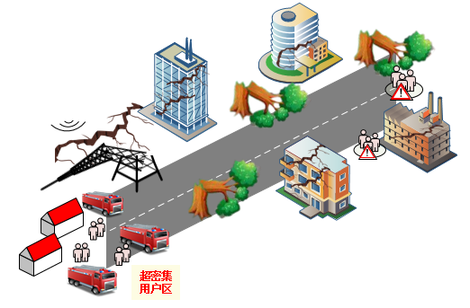
Emergency Management：Services and Challenges
Emergency disaster scenarios:
  Natural catastrophes: Earthquake, flood, etc.
  Others: Urban fire in mega-city, etc.
Relay / SBS/ Edge
Leader-UAV
Typical services and applications：
Mission cognition & timely decision-making
Follower-UAV
  Object recognition
    the severity of damage to infrastructures
    level of danger to rescuer/victims
    humans and animals in distress
  High-definition mapping
  Emergency live surveillance
Critical challenges：
  Diversified service needs: URLLC, eMBB, and mMTC
  Limitation of end devices: Storage space, computing capability, and battery
  Dynamic network topology and changing wireless environment
Notes:
Generally, 3C scheduling is very critical for some computation intensive services, like face recognition, and autonomous driving, and is also required urgently in some important applications, like emergency communication or smart grid.
In some typsical emergency cases, like earthquake, flood, .the network infrastrute usually damaged, we need establish dedidated network s,
However, hardly can we have enough spectrum and energy to have all those services or rescues done.
The Key challenge in emergency scenarios is to accomplish the mission cognition and provide timely decision and reaction within the limited golden window of rescue time for survivors.
To this end, we need some services like high definition mapping, object recognition since we may need to sense the damage level of infrastructures, and predict the danger level to rescuers.
IN addition, we also need the assistance of caching and computing.
To provide better service. Like high definition mapping or live surveillance.
To fulfil the services, there are more challenges we need to face with:
Like the limitation of storage space, computation capability, and battery for end devices.
Diversified service requirements in terms of latency, reliability, and bandwidth.
Or the dynamic network topology and changing wireless environment

Slide 5
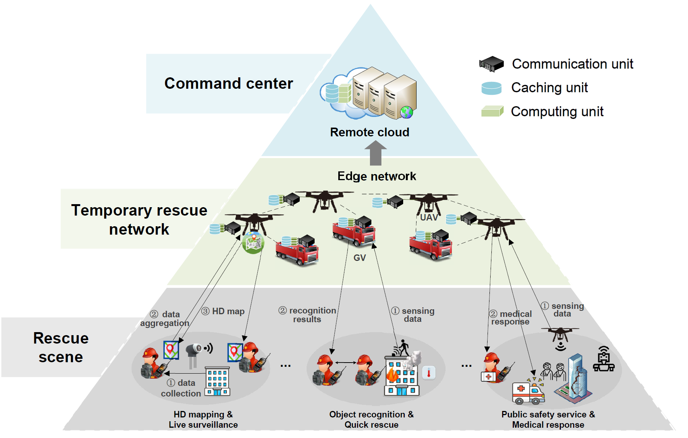
Mission Cognitive Wireless Emergency Network
L. Wang, J. Zhang, J. Chuan, R. Ma, and A. Fei, “Edge Intelligence for Mission Cognitive Wireless Emergency Networks,” IEEE Wireless Communications, vol.27, no.4, pp.103-109, August. 2020.
Notes:
To effectively carry out key tasks in emergency wireless networks, including sensing, data dissemination, map construction, and so on, the three-layer network architecture can be constructed, as we can see here.
By leveraging recent developments in edge computing and edge learning, rapid constructed edge network can play pivotal roles in this architecture. Moreover, thanks to their flexibility and the increasing capability, UAVs can assist various tasks, for example, data collection, acting as aerial BSs or edge servers.
Mission cognition involves the understanding of key features of various tasks, as well as the environment and available rescue resources, which relies on data collection, information extraction, learning and inference, and finally leads to effective decision making.

Slide 6
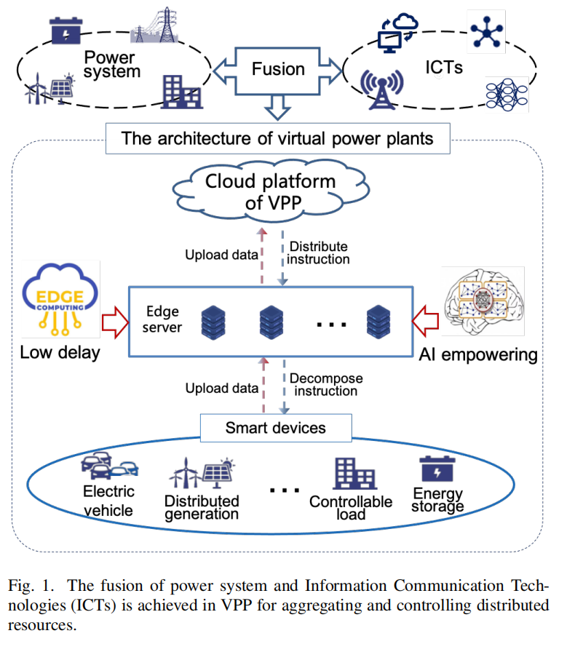
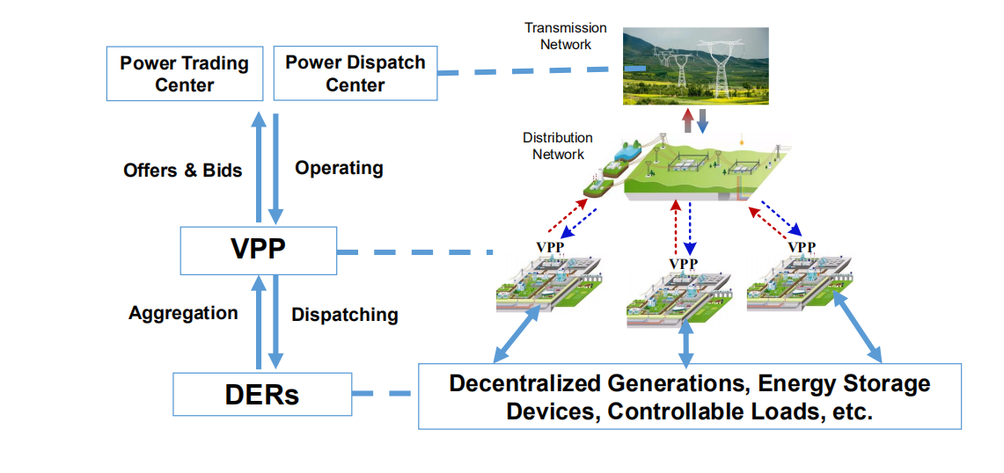
Another case：Virtual Power Plant
Virtual power plant (VPP) can aggregate the capacity of distributed
resources through the fusion of power system and Information
Communication Technologies
Notes:
Virtual power plant (VPP) can aggregate the capacity of distributed
resources through the fusion of power system and Information
Communication Technologies (ICTs) [3].
The fusion of power system and ICT is achieved in VPP for aggregating and controlling distributed
resources.
Here, the distributed resources (e.g., electric vehicle, distributed generation, controllable load, energy storage, etc.) are connected
and controlled through smart devices. A large number of data from smart devices is uploaded to edge server and
cloud platform. According to these data, the cloud platform makes decisions for scheduling instructions and sends them to
devices after decomposing in edge server. AI empowering for edge can help VPP achieve more flexible distributed energy
management.

Slide 7
Outline
1
Overview
2
Members of Our SIG
3
Finished Activities
4
Plan

Slide 8

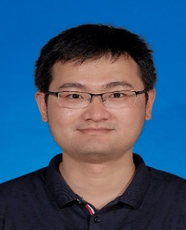
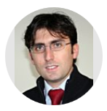
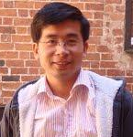
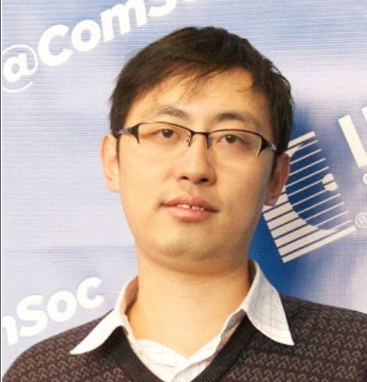
Members of SIG
Chair:
  Dr. Li Wang, Professor, liwang@bupt.edu.cn
  Beijing University of Posts and Telecommunications (BUPT), China
Vice-Chair
  Yongpeng Wu
    Shanghai Jiaotong University, China
    yongpeng.wu@sjtu.edu.cn
  Trung Q. Duong(PhD Sep. 2012)
    Queen's Uni. Belfast, UK
    trung.q.duong@gmail.com
  Giuseppe Araniti
    University Mediterranea of Reggio Calabria, Italy
    araniti@unirc.it
    Bo Bai
    Future Network Theory Lab, 2012 Labs, Huawei Technologies Co., Ltd., HongKong
    ee.bobbai@gmail.com ; baibo8@huawei.com

Slide 9
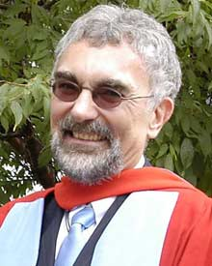
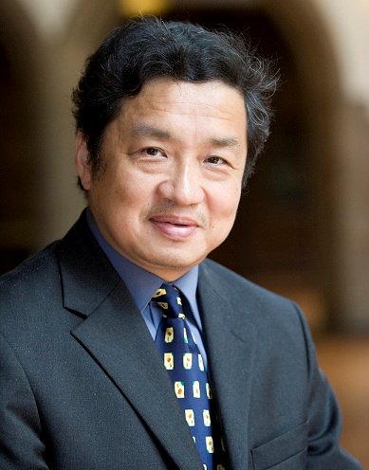
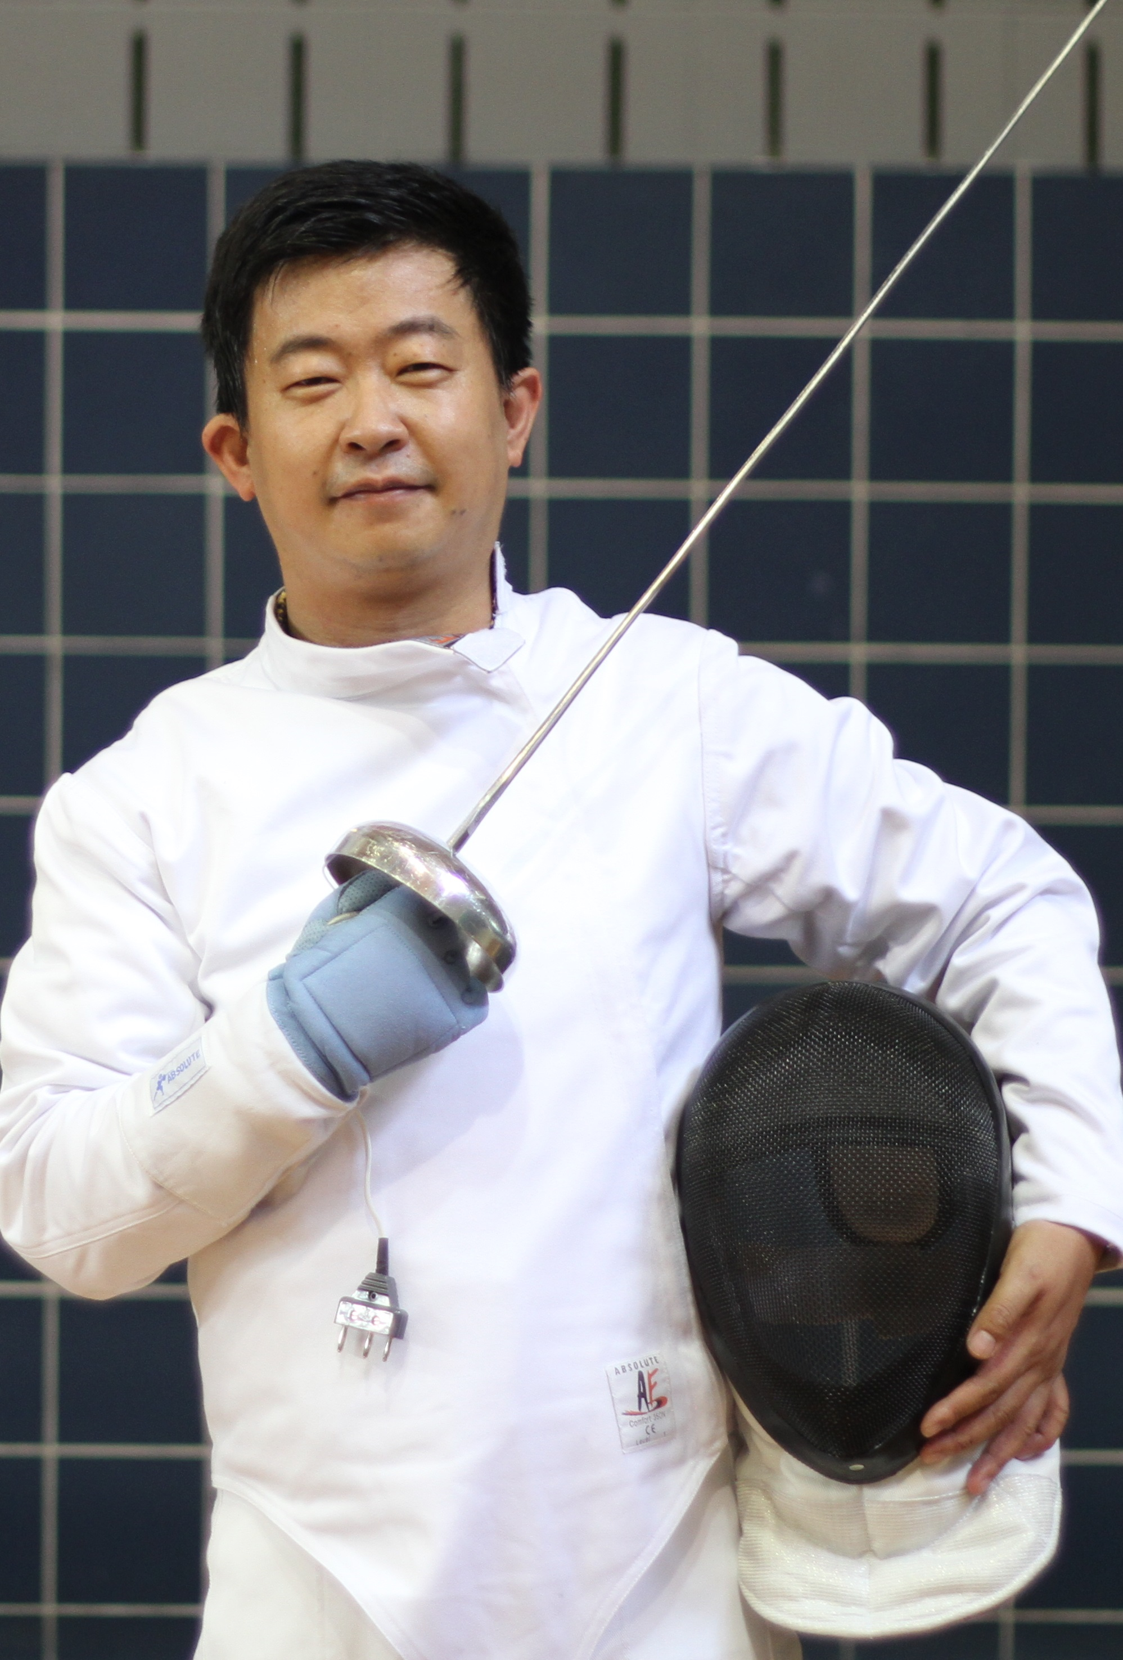
Senior Advisors
Prof. Lajos Hanzo, University of Southampton (Communications)
IEEE fellow and IEE/IET fellow;
Fellow of the Royal Academy of Engineering (FREng);
A Governor of the IEEE VTS as well as of ComSoc;
The Editor-in-Chief of the IEEE Press;
An IEEE Distinguished Lecturer of both the Communications Society and the Vehicular Society .
The Honorary Doctorate “Doctor Honaris Causa”.
The Doctor of Sciences (DSc) degree
Prof. Jie Wu, Temple University (Networking)
IEEE fellow
Director, International Affairs, College of Science and Technology (CST)
Director, Center of Networked Computing, CST
Laura H. Carnell Professor, Department of Computer and Information Sciences (CIS)
A CCF Distinguished Speaker
China Computer Federation (CCF) Overseas Outstanding Achievement Award
Prof. Zhu Han, University of Houston (Artificial Intelligence)
IEEE fellow
IEEE Distinguished Lecturer
An NSF Career Award in 2010,
The Fred W. Ellersick Prize of the IEEE Communication Society in 2011
The EURASIP Best Paper Award for the Journal on Advances in Signal Processing in 2015
IEEE Leonard G. Abraham Prize in the field of Communications Systems (best paper award in IEEE JSAC) in 2016, and several best paper awards in IEEE conferences

Slide 10











Founding Members
Tommy Svensson, Chalmers University of Technology, tommy.svensson@chalmers.se
Maurizio Murroni, University of Cagliari, Italy, m.murroni@ieee.org
Lei Chen, Georgia Southern University, USA, lchen@georgiasouthern.edu
Alessandro Raschellà, Liverpool John Moores University, Italy, ale.raschella@gmail.com
Qingzhong Liu, Sam Houston State University, USA, liuqzsc@gmail.com
Antonino Orsino, Ericsson Research, Finland, antonino.orsino@ericsson.com
Guoru Ding, Southeast University, China, dr.guoru.ding@ieee.org
Xiaojun Ruan, California State University, USA, xiaojun.ruan@csueastbay.edu
Qing Yang, University of North Texas, USA, Qing.yang@unt.edu
Massimo Condoluci, King’s College London, UK, massimo.condoluci@kcl.ac.uk
Zhonghong Ou, Beijing University of Posts and Telecommunications, China, zhonghong.ou@bupt.edu.cn
Kamel Tourki, Huawei, France, kamel.tourki@gmail.com
Yuen, Singapore University of Technology and Design (SUTD), Singapore, yuenchau@sutd.edu.sg
JakoChaub Hoydis，Nokia-Bell-Labs，France, jakob.hoydis@nokia-bell-labs.com
Symeon Chatzinotas, University of Luxembourg, Luxembourg, Symeon.Chatzinotas@uni.lu
Miaomiao Dong, City University of Hong Kong, mmdong2-c@my.cityu.edu.hk
Tianyang Bai, Qualcomm Corporate R&D, USA, tianybai@gmail.com
Yan Zhang, University of Oslo, Norway, yanzhang@ieee.org
Qihui Wu, Nanjing University of Aeronautics and Astronautics, China, wuqihui2014@sina.com
A. Nallanathan, Queen’s Mary University of London, UK, arumugam.nallanathan@kcl.ac.uk
Octavia Dobre, Memorial University, Canada, odobre@MUN.CA
Daniel Benevides da Costa, Federal University of Ceará, Brazil, danielbcosta@ieee.org
Marco Di Renzo, CNRS - CentraleSupelec - Univ Paris-Sud, France, marco.di.renzo@gmail.com
Himal A. Suraweera, University of Peradeniya, Sri Lanka, himal@ee.pdn.ac.lk
Nghi H. Tran, University of Akron, USA, nghi.tran@uakron.edu
Phee Lep Yeoh, University of Sydney, Australia, phee.yeoh@sydney.edu.au
Jinhong Yuan, University of New South Wales, Australia, jinhong@ee.unsw.edu.au
David López-Pérez, Bell Labs Alcatel-Lucent, Ireland, david.lopez-perez@nokia-bell-labs.com
George C. Alexandropoulos, Huawei Technologies France, alexandg@ieee.org
Kyeongjin Kim, Mitsubishi Electric Research Laboratories, USA, kkim@merl.com
George K. Karagiannidis, Aristotle University of Thessaloniki, Greece, geokarag@auth.gr
Le-Nam Tran, University College Dublin, Ireland, nam.tran@ucd.ie
Academic
Industries

Slide 11
Outline
1
Overview
2
Members of Our SIG
3
Finished Activities
4
Plan

Slide 12
Finished Activities
Finished Activities: 23 items
IEEE Access (2016.11) | IEEE SPAWC (2017.07)
IEEE JSAC (2017.08) | International School on 5G Systems (2017.10)
IEEE Communications Magazine (2017.12) | IEEE BTS Young Professionals 2018 (2018.04)
IEEE Access (2017.10) | IEEE INFOCOM 2018 Workshop (2018.04)
IET Communications (2018.01) | EUROPEAN WIRELESS 2018 (2018.05)
IEEE Access (2018.01) | IEEE HotICN 2018 (2018.08)
MONET Journal (2018.10) | IEEE/CIC ICCC 2018 (2018.08)
IEEE Access (2018.12) | IEEE GLOBECOM 2018 (2018.12)
IEEE JSAC (2018.12) | IEEE INFOCOM 2019 (2019.04)
IEEE Access (2019.03) | IEEE ICC Workshop 2019 (2019.05)
MONET Journal (2019.05)
IEEE Wireless Communications (2019.10)
IEEE JSTSP (2020.01)
13 Special Issues | 10 Workshops

Slide 13
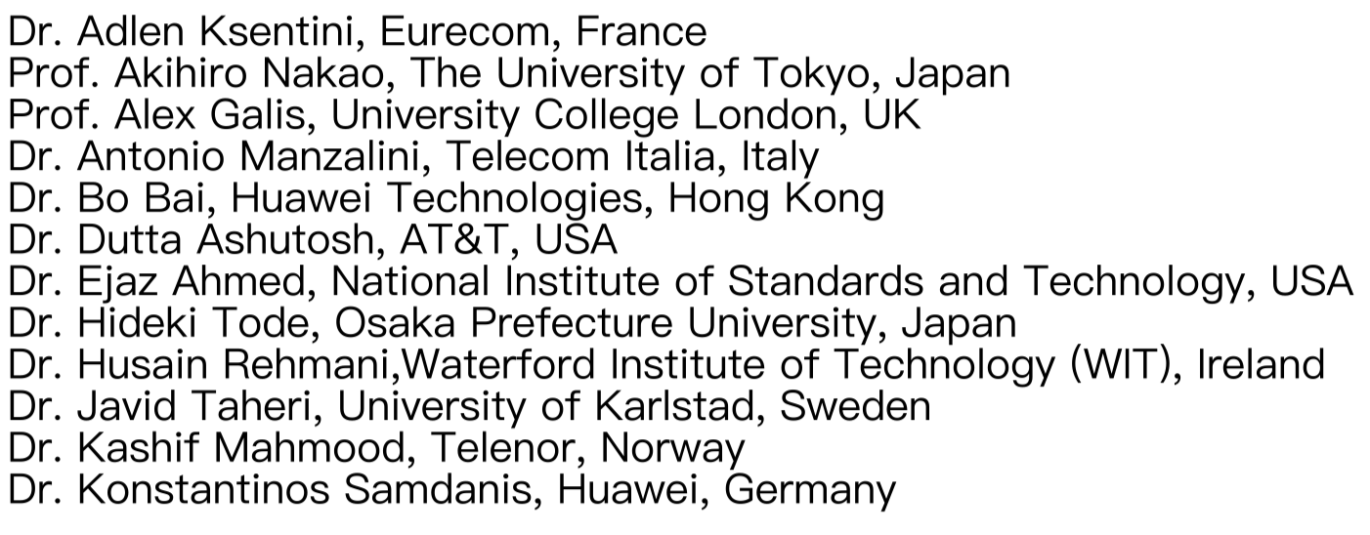
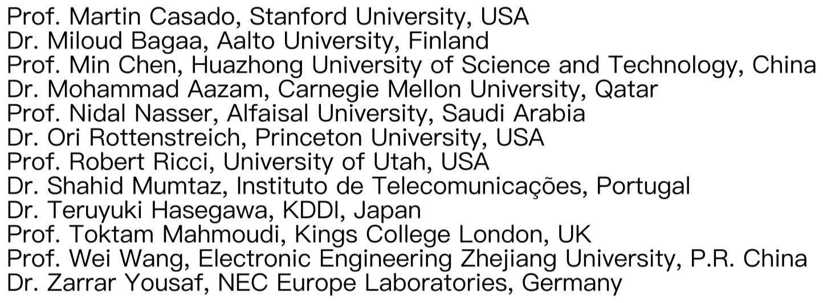
Finished activities
Special Issue: IEEE JSAC
IEEE JSAC:
  Special Issue Series on “Network Softwarization & Enablers”
Guest Editors
Vice Chair

Slide 14

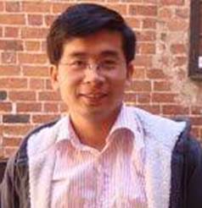
Finished activities
Special Issue: IEEE Wireless Communications
IEEE Wireless Communications:
  Special Issue on “Safeguarding 5G-and-Beyond Networks with Physical Layer Security”
Guest Editors
  Nan Yang，Australian National University, Australia
  Yongpeng Wu ，Shanghai Jiao Tong University, China
  Trung Q. Duong ，Queen’s University Belfast, United Kingdom
  Robert Schober， Friedrich-Alexander University Erlangen-Nrnberg, Germany
  A. Lee Swindlehurst，University of California, USA

Slide 15

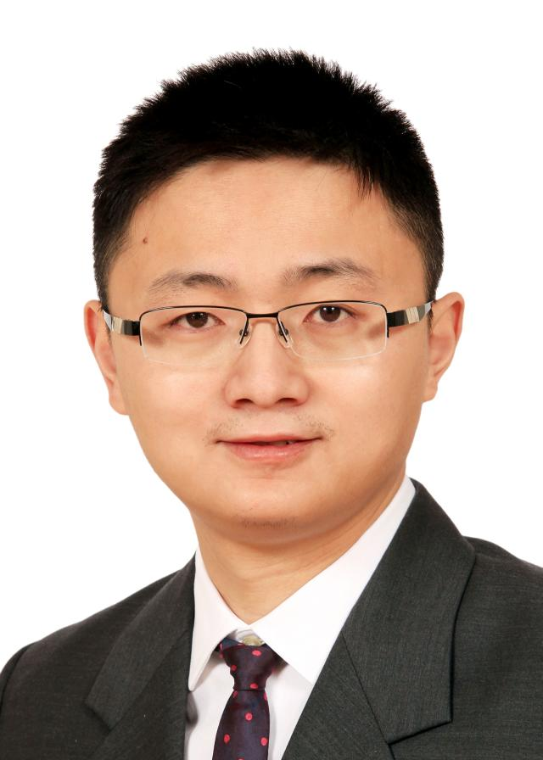

Finished activities
Special Issue: JSTSP
Guest Editors
  Mai Xu, Beihang University, Beijing,China
  Ali Borji, University of Central Florida Orlando, Orlando, USA
  Ce Zhu, University of Electronic Science and Technology of China, Chengdu, China
  Edward Delp, Purdue University, West Lafayette, USA
  Patrick Le Callet, Ecole Polytechnique l'Universit de Nantes, Nantes, France

Slide 16
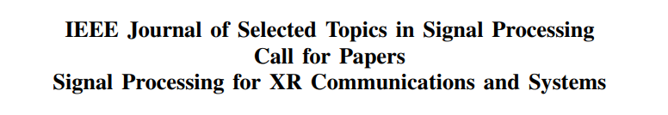
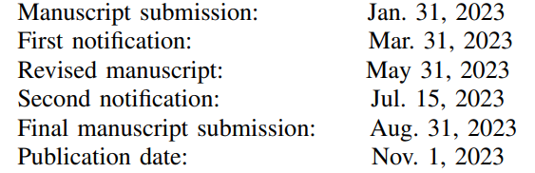
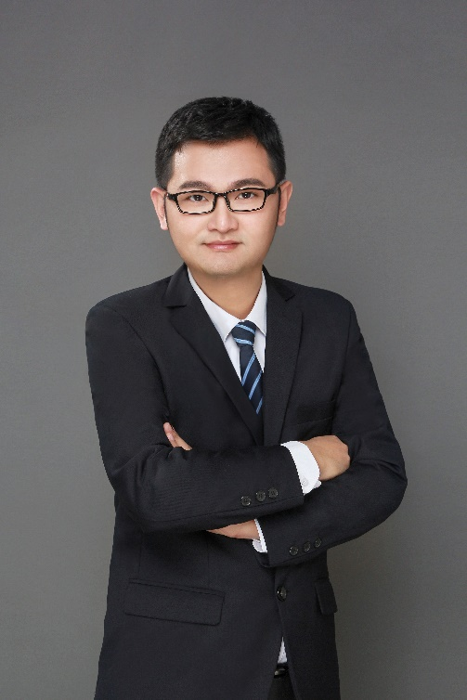
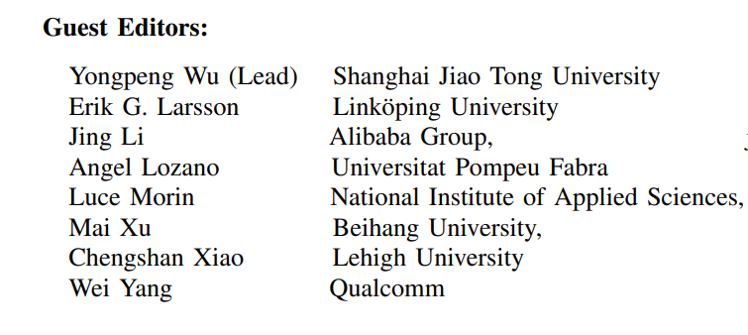
Finished activities
Special Issue: JSTSP

Slide 17
Finished Invited Talks
Invited talks in 2022
    Prof. ‪Geoffrey Ye Li at Imperial College London (Onsite, SJTU);
    Prof. Jiangzhou Wang at University of Kent (Onsite, SJTU);
    Prof. Cheng-Xiang Wang at Southeast University (Online, SJTU);
    Prof. Xiang-Gen Xia at University of Delaware (Online, BUPT)

Slide 18
Outline
1
Overview
2
Members of Our SIG
3
Finished Activities
4
Plan

Slide 19
Schedule for Our SIG
Workshops
  GLOBECOM 2023, ICC 2024, etc.
Special Issues
  IEEE JSAC, Trans. on Communications, Trans. on Wireless Communications, Trans. on Mobile Computing, Trans. on Vehicular Technology, Trans. On Networking, Communication Mag., Wireless Communications, IEEE Access, etc.
    The first SI on IEEE Access before Dec. of 2023;
    Two SIs on IEEE Transactions on Cognitive Communications and Networks, IEEE Wireless Communications, or IEEE JSAC before Dec. 2023, and at the beginning of 2024, respectively.
Organizing regular meetings
  During special sessions at related conferences (INFOCOM, ICC, GLOBECOM, etc.), on the personal web pages of the SIG organizers
  Through an email distribution list of potential members.
Invited talks
  The possible candidates are Professors listed as follows
    Prof. Giuseppe Caire, Technical University of Berlin
    Prof. Chengshan Xiao, Lehigh University
    Prof. Erik G. Larsson, Linkoping University
    Prof. Robert Schober, Erlangen University
    Prof. Zhi Ding, UC Davis

Slide 20

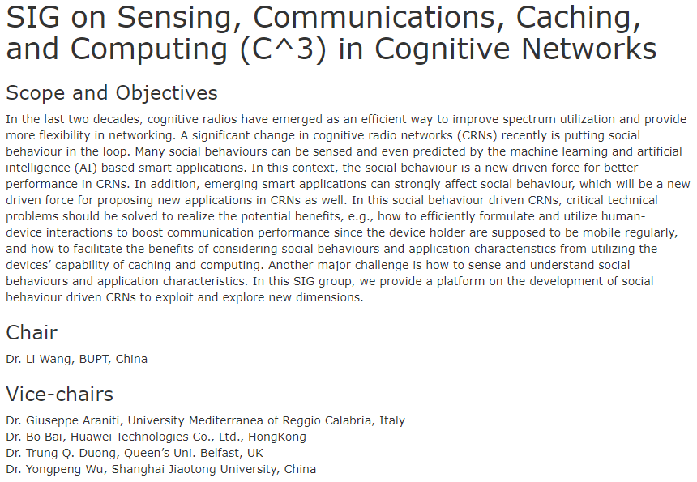
Thank you !
Welcome!

