Slide 1
TCCN Website Updates
https://cn.committees.comsoc.org/
Hongliang Zhang
Peking University

Slide 2
Between GC’22 and Now
Update on Websites
Virtual seminar announcement and content

Slide 3
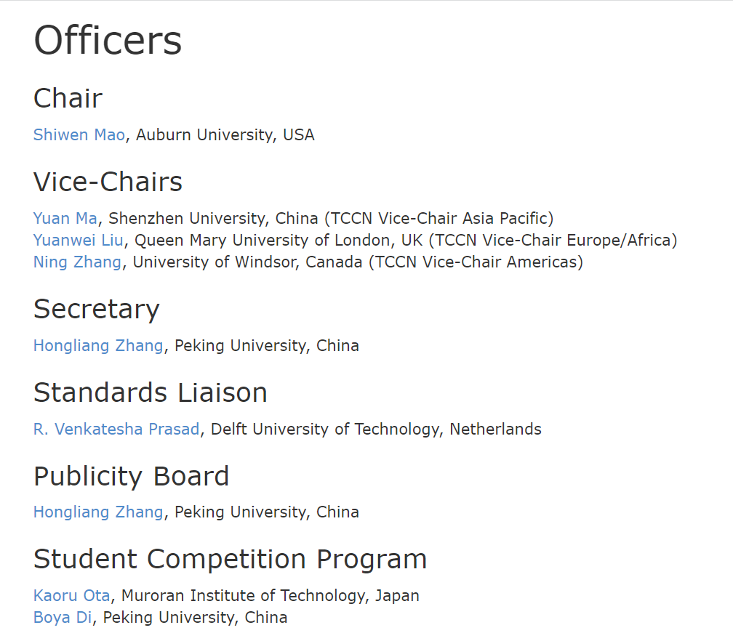
Updates

Slide 4
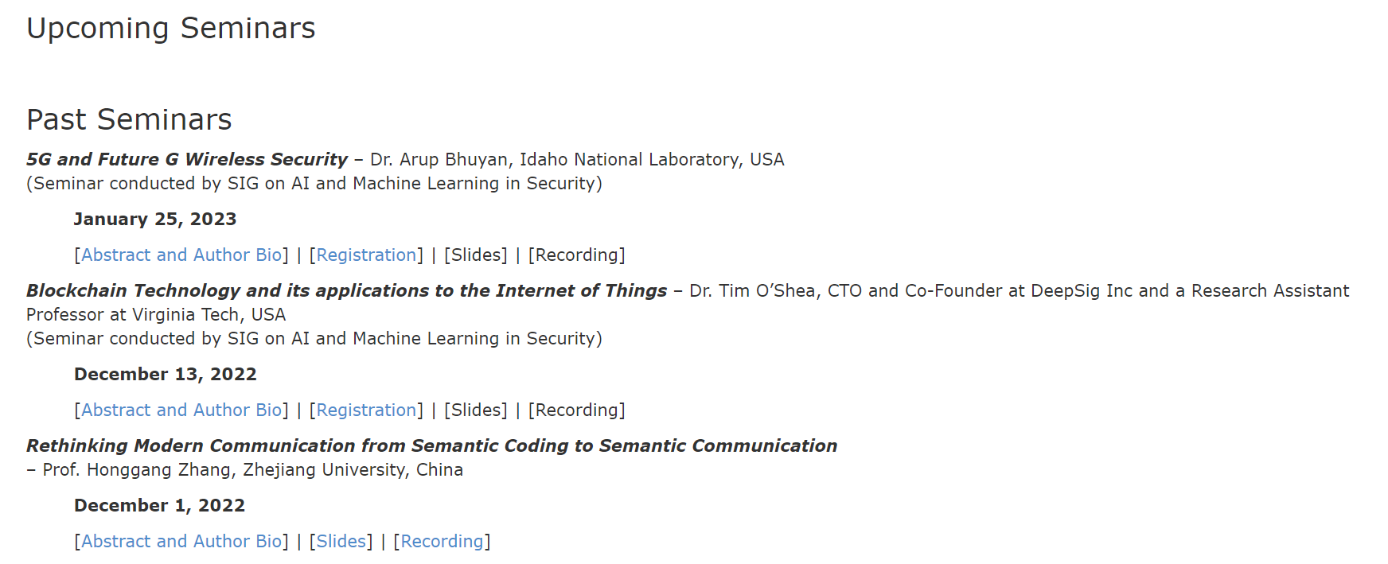
Virtual Seminars
3 seminars conducted
2 of these by SIG on AI/ML Security
https://cn.committees.comsoc.org/seminars

Slide 5
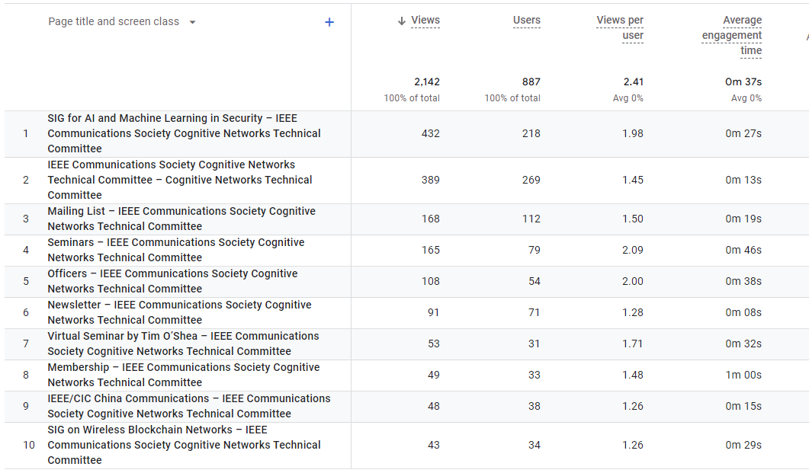
TCCN’s Web Traffic Statistics
Online seminars attract a lot of interest
Mailing list and membership

Slide 6
Open to New Content
CFPs, white papers, articles, and ideas that fall within the scope TCCN
Invite to use this as a platform
Please contact me by hongliang.zhang@pku.edu.cn

