Slide 1
TCCN Committee Meeting Status Report on IEEE Transactions on Cognitive Communications and Networking
ICC 2023, Rome Italy
Shiwen Mao
Editor-in-Chief IEEE Transactions on Cognitive Communications and Networking
Notes:
1
1
1
1
1
1
1
1
1
1
Prepared by Kwan, TCOM Admin.

Slide 2
IEEE TCCN Journal Scope
The IEEE Transactions on Cognitive Communications and Networking (TCCN) is committed to timely publishing of high-quality manuscripts that advance the state-of-the-art of cognitive communications and networking research. The focus of the Transactions will be on “cognitive” behaviors in all aspects of communications and network control, from the PHY functions (including hardware) through the applications (including architecture), and in all kinds of communication networks and systems regardless of type of traffic, transmission media, operating environment, or capabilities of communicating devices.
2
Notes:
2
2
2
2
2
2
2
2
2
2

Slide 3
Subject Areas
Area 1: Cognitive Radio
Area 2: AI-empowered Communications
Area 3: AI-empowered Networking
Area 4: AI-empowered Resource Management
3
Notes:
3
3
3
3
3
3
3
3
3
3

Slide 4
Topics of Interest
Topics of Interest (but not limited to)
Machine learning and artificial intelligence for communications and networking
Distributed learning, reasoning and optimization for communications and networking
Architecture, protocols, cross-layer, and cognition cycle design for intelligent communications and networking
Information/communications theory and network science for intelligent communications and networking
Ontologies, languages, and knowledge representation for intelligent communications and networking
Security and privacy issues in intelligent communications and networking
Cognitive radio and dynamic spectrum access
Cognitive technologies supporting software-defined radios, systems and networks
Emerging services and applications enabled by intelligent communications and networks
4
Notes:
4
4
4
4
4
4
4
4
4
4

Slide 5
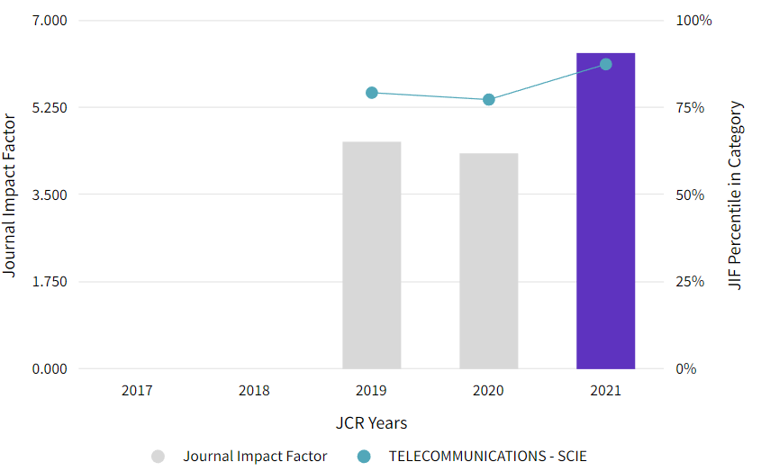
IEEE TCCN Impact Factor
The impact factor of IEEE TCCN is 6.359 on JCR Report 2021.
IEEE TCCN is ranked in Q1 TELECOMMUNICATIONS.
TCCN: IF 6.359; CiteScore 9.3
TCOM: 6.166; 11.3
TVT: 6.239, 11.9
TON: 3.796, 8
TWC: 8.346, 15.7
TNSE: 5.033, 5.7
IoTJ: 10.238, 17.1
TGCN: 3.525, 7.9
TMBMC: *, CiteScore 3.1
TNSM: 4.758, 7.2
JSAC: 13.081, 21.2
LNET: n/a, n/a
COMML: 3.553, 7.2
WCL: 5.281, 9.3
TMC: 6.075, 12.6
TPDS: 3.757, 7.2
TCC: 5.697, 11.3
IEEE Trans. on Cognitive Communications and Networking 6.359 4.341
IEEE Trans. on Communications 6.166 5.083
IEEE Trans. on Wireless Communications 8.346 7.016
IEEE Trans. on Vehicular Technology 6.239 5.978
5
Notes:
5
5
5
5
5
5
5
5
5
5

Slide 6
Number of Submissions:
Jan. 1, 2023 – Apr. 26, 2023
(as of Apr. 26, 2023)‏
Manuscript type | Original | Revised | Total
Transactions Paper Submissions | 157 | 82 | 239
Total | 157 | 82 | 239
6
Notes:
6
6
6
6
6
6
6
6
6
6

Slide 7
Number of Submissions:
Apr. 26, 2022 – Apr. 26, 2023
(as of Apr. 26, 2023)
Manuscript type | Original | Revised | Total
Transactions Paper Submissions | 410 | 211 | 621
Total | 410 | 211 | 621
7
Notes:
7
7
7
7
7
7
7
7
7
7

Slide 8
Paper Status Summary (Since 2016)
Submitted Year | Submitted | Accepted | Rejected (including EiC reject) | Withdrawn + Revision opt. Exp. | Still in Review Proccessing | Awaiting Revision | Acceptance rate
2016 | 130 | 48 | 75 | 7 | 0 | 0 | 36.92%
2017 | 177 | 80 | 85 | 12 | 0 | 0 | 45.20%
2018 | 185 | 97 | 75 | 13 | 0 | 0 | 52.43%
2019 | 278 | 123 | 149 | 6 | 0 | 0 | 44.24%
2020 | 345 | 110 | 229 | 6 | 0 | 0 | 31.88%
2021 | 366 | 120 | 240 | 6 | 0 | 0 | 32.79%
2022 | 352 | 89 | 204 | 5 | 38 | 16 | 25.28%~
2023 | 157 | 0 | 22 | 0 | 122 | 13 | n/a
Ave. Time to First Decision (In 2022) | Longest Time to First Decision (In 2022) | Ave. Time to Final Decision (In 2022) | Longest Time to Final Decision (In 2022)
76 (~11 weeks, 2.5 months) | 339 | 107 (~15 weeks, 3.5 months) | 365
8
Notes:
8
8
8
8
8
8
8
8
8
8
Golden Ratio: 1.61803398875

Slide 9
2022 Detailed Accept/Reject Numbers
Decision | Number of papers
Accept | 89
Reject (Including EiC Immediate Reject) | 204
Withdrawn | 1
Revision option expired | 4
Total | 298/352 (84.66% closed)
9
Notes:
9
9
9
9
9
9
9
9
9
9

Slide 10
TCCN Statistics
From First Submission to First Decision
(as of Dec. 31, 2022)‏
10
Notes:
10
10
10
10
10
10
10
10
10
10

Slide 11
TCCN Statistics
From First Submission to Final Decision
(as of Dec. 31, 2022)‏
11
Notes:
11
11
11
11
11
11
11
11
11
11

Slide 12
TCCN Statistics in 2015 - 2021
Average number of days in review
Average number of days from first submission to first decision:
2017: 74.55 days; std: 34.88 days
2018: 88.42 days; std: 44.80 days
2019: 63.89 days; std: 49.34 days
2020: 65.43 days; std: 40.01 days
2021: 72.44 days; std: 59.95 days
2022: 76.39 days; std: 52.73 days
Average number of days from first submission to final decision:
2017: 136.69 days; std: 95.33 days
2018: 159.88 days; std: 94.04 days
2019: 118.32 days; std: 94.50 days
2020: 105.42 days; std: 84.50 days
2021: 115.24 days; std: 98.95 days
2022: 107.92 days; std: 85.05 days
12
Notes:
12
12
12
12
12
12
12
12
12
12

Slide 13
Sub-to-ePub Statistics
 | 2022 Q1 | 2022 Q2 | 2022 Q3 | 2022 Q4
Average weeks | 33.4 | 33.6 | 32.6 | 33.2
Median weeks | 35.2 | 34 | 31.5 | 32.3
Number of Articles | 22 | 33 | 19 | 29
Average days from submission to 1st decision
To improve the ePublication time, the IEEE TCCN will be a bimonthly journal since 2023.
13
Notes:
13
13
13
13
13
13
13
13
13
13

Slide 14
Number of days first decision for all editors in 2022
14
Notes:
14
14
14
14
14
14
14
14
14
14

Slide 15
Number of longest days first decision for all editors in 2022
Review processing
If you have any difficulty in handling a specific manuscript, please timely ask the EiC for help.
15
Notes:
15
15
15
15
15
15
15
15
15
15

Slide 16
Regular Editor Flow
Subject Areas:
Cognitive Radio
AI-empowered Communications
AI-empowered Networking
AI-empowered Resource Management
1 EiC + 41 ED + 1 Admin.
10 in cognitive radio
10 in AI-empowered communications
11 in AI-empowered networking
10 in AI-empowered resource management
16
Notes:
16
16
16
16
16
16
16
16
16
16

Slide 17
2023 Editorial Board
Cognitive Radio
Nada Golmie (New)
Gregory David Durgin (New)
Mubashir Rehmani (New)
Yiyang Pei
Wei Feng
R.R. Venkatesha Prasad
Yue Gao
Chee Wei Tan
Zan Li
Yonghong Zeng
AI-empowered Communications
Jia (Kevin) Liu (New)
Dola Saha (New)
Zhengchun Zhou (New)
Ahmed Alkhateeb (New)
Le Liang (New)
Guoru Ding
Zhijin Qin
Dinh Thai Hoang
Li Wang
Zhenyu Xiao
17
Notes:
17
17
17
17
17
17
17
17
17
17

Slide 18
2023 Editorial Board
AI-empowered Networking
Jing Yang (New)
Avinash Srinivasan (New)
Nizar Zorba (New)
Celimuge Wu (New)
Xianfu Chen
Qiang Ye
Long Bao Le
Kai Zeng
Jiajia Liu
Ning Zhang
Kaoru Ota
AI-empowered Resource Management
Liping Qian (New)
Danda B. Rawat (New)
Yi Shi (New)
Guangjie Han (New)
Yalin Sagduyu (New)
Tao Chen
Kae Won Choi
Li-Chun Wang
Melike Erol-Kantarci
Jun Zhao
18
Notes:
18
18
18
18
18
18
18
18
18
18

Slide 19
Retired Editor
Cognitive Radio
Daniel Benevides da Costa
AI-empowered Communications
Dong In Kim
Riku Jäntti
Azadeh Vosoughi
AI-empowered Resource Allocation
Andrea Zanella
Walid Saad
19
Notes:
19
19
19
19
19
19
19
19
19
19

Slide 20
You Can Contribute
As an Author:
If you are working in the area of cognitive radio, AI, and machine learning for communications and networking, you cannot miss IEEE TCCN.
To promote the transactions
Please help to publicize the IEEE TCCN!
Welcome to submit your special issue proposal on Cognitive Communications and Networking!
20
Notes:
20
20
20
20
20
20
20
20
20
20

