Slide 1
IEEE ComSoc Technical Committee on Cognitive Networks (TCCN)
https://cn.committees.comsoc.org/
Chair: Shiwen Mao
szm0001@auburn.edu
Auburn University, Auburn, AL, USA
IEEE ICC 2023, May 2, 2023

Slide 2
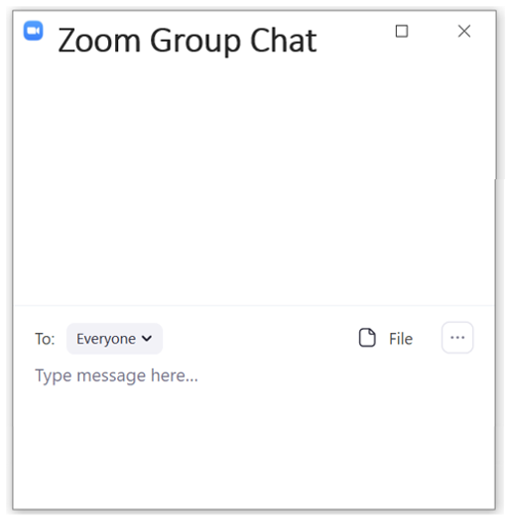
Registration – 1 min break
Step 1: find and click “Chat” icon at the bottom of Zoom meeting interface
Step 2: please write your information in the chat box:
your name + affiliation + email
Please enter here
Important for your active member status (for voting, election, and awards)

Slide 3
Meet the Officers (2023-2024)
Chair
Shiwen Mao, Auburn University, USA
Vice-Chairs
Yuan Ma, Shenzhen University, China (Asia Pacific)
Yuanwei Liu, Queen Mary University of London, UK (Europe/Africa)
Ning Zhang, University of Windsor, Canada (Americas)
Secretary
Hongliang Zhang, Peking University, China
Standards Liaison
R. Venkatesha Prasad, Delft University of Technology, Netherlands
Publicity Board
Hongliang Zhang, Peking University, China
Student Competition Program
Kaoru Ota, Muroran Institute of Technology, Japan
Boya Di, Peking University, China
Newsletter Coordinator
Dola Saha, University at Albany, USA

Slide 4
Agenda
Welcome and Introduction
Attendance Registration
Approval of the Agenda
Approval of the GLOBECOM 2022 (Nov. 2022) TCCN meeting minutes
Reports from the Chairs
Reports on TCCN Nominations
Reports on TCCN Awards and Subcommittee
Reports on TCCN Webinars and Journal Collaborations
Reports on Special Interest Groups (SIGs)
Reports on conferences
Reports on publications
TCCN publicity
TC restructure report
TC Innovation Project
TC Campaign Video Project
Next TCCN Meeting
Any other business

Slide 5
Introduction
TC Goal
Technical Committee on Cognitive Networks (TCCN) is to provide a platform for its members in particular, and the cognitive and artificial intelligence (AI) enabled networking research, development, policy making and standardization community in general, to interact and exchange technical ideas to identify major challenges and also drive solutions in the development of AI-enabled networking technologies
Technical Scope
Spectrum agile/dynamic spectrum access networks, related issues from PHY to application layers, security and privacy issues, policy issues, implementation technologies (e.g., embedded AI, software radio, middleware), economic considerations and standardization activities

Slide 6
How to Get Involved in TCCN
Many ways of getting involved
Subscribe to the mailing list to become a member
Attend two out of the past five TCCN meetings to become an active member (need to be IEEE and ComSoc member or student member)
Organize or participate in Special Interest Groups (SIGs)
Organize special issues for the TCCN Newsletter
Participate in TCCN related standardization efforts
Contribute to the publicity efforts of TCCN
Contribute to student competition program
Involve TCCN in ComSoc conference organization
Involve TCCN in ComSoc journal special issues
TC will reward excellent volunteers through various nominations and endorsements

Slide 7
TCCN membership
Joining TCCN
The TCCN mailing list
The TCCN mailing list is reserved for the most important TC announcements
To subscribe to the mailing list, please visit https://cn.committees.comsoc.org/mailing-list/
ComSoC Group
Go to http://community.comsoc.org/, and create your account by your email address (you can directly use your current IEEE account credentials).
Log in and choose “TC Cognitive Networks” as “My Groups”
Active Membership
Anybody can be a member of the TCCN. To become a member, it is necessary to subscribe to the TCCN mailing list.
A member becomes an Active Member if he/she has attended (physically present or by teleconference) two or more of the prior five regularly scheduled TCCN meetings.
Attendance Online Meeting Dec 2020 | Attendance Online Meeting July 2021 | Attendance Online Meeting Nov 2021 | Attendance Online Meeting Apr 2022 | Attendance Online Meeting Nov 2022
57 | 60 | 51 | 44 | 66

Slide 8
TCCN Special Interest Groups (SIGs)
What is a SIG?
SIGs are mini-TC, representing the hop and emerging research areas in the general field of cognitive networks
What does a SIG do?
Attract submissions to CRN symposium at ICC and GLOBECOM
Organize journal special issues for TCCN and others
Organize workshops and conferences
Organize other related technical activities (conference call, blogs, etc.)
Who are in a SIG?
Leadership team: a Chair, one or more Vice-Chairs, one or more advisors
10+ key members
Considering geographical and academia/industry balance
How to establish a SIG?
Fill in the form with the proposed SIG team and activities http://cn.committees.comsoc.org/special-interest-groups-sigs/application-for-special-interest-groups/
Send to TC Chair
Usually go through 1-2 rounds of feedback before official approval

Slide 9
Current Status of TCCN SIGs
Active SIGs
SIG on AI and Machine Learning in Security (K.P. (Suba) Subbalakshmi)
SIG on Sensing, Communications, Caching, and Computing $C^{3}$ in Cognitive Networks (Li Wang)
SIG on AI Empowered Internet of Vehicles (Ning Zhang)
SIG on Wireless Blockchain Networks (Zehui Xiong)
Inactive SIGs
SIG on Cognitive Network for 5G
SIG on Data-Driven Cognitive Networks
SIG on AI Embedded Cognitive Networks
SIG on Cognitive Communications and Networking in Cyber-Physical Systems
SIG on Energy-harvesting Cognitive Radio Networks

Slide 10
TCCN Nominations
ComSoc Distinguished Lecturers
ICC/GC Symposium Chairs
TCCN Awards
IEEE Fellows
Senior Member, paper and service awards

Slide 11
Nominations for ComSoc Distinguished Lecturer Program
TCCN can nominate up to 4 candidates
If you are interested, please send the following information
to: Shiwen Mao (smao@ieee.org),
cc: Hongliang Zhang (hongliang.zhang@pku.edu.cn)
with detailed CV, including your contribution/involvement to TCCN
list of potential DL topics
Deadline: Sept. 1, 2023

Slide 12
Nominations for Symposium Co-chairs for IEEE ICC 2025
TCCN can nominate up to 3 candidates
If you are interested, please email your nomination (in a single PDF file)
to: Shiwen Mao (smao@ieee.org),
cc: Hongliang Zhang (hongliang.zhang@pku.edu.cn)
including the following information
Your name, affiliation, contact information, bio and website, your ComSoc Member Number
A ranked list of up to 3 symposia or tracks that you want to chair
A list of all prior ICC/GLOBECOM symposia chaired or comparable experiences in other major conferences
Your past experience/contributions to TCCN
Your commitment of time/efforts, and your plans to increase submissions to the Cognitive Radio & AI-Enabled Networks Symposium.
Deadline: Apr. 25, 2023

Slide 13
Nominations for 2023 TCCN Recognition Award and TCCN Publication Award
IEEE ComSoc Technical Committee on Cognitive Networks (TCCN) sponsors:
IEEE ComSoc TCCN Recognition Award
IEEE ComSoc TCCN Publication Award
See the call for nominations for the TCCN Recognition Award and TCCN Publication Award
https://cn.committees.comsoc.org/awards/ (Will be updated after the meeting)

Slide 14
IEEE ComSoc TCCN Recognition Award
The recognition award is given to (up to) one individual who is deemed to have made significant and sustained contributions to cognitive network community.
Nomination Process
For each nomination, both the nominator and the nominee must be members of IEEE ComSoc. The nominator should send the nomination to the TCCN Recognition Award Committee in PDF format by Sep. 30, 2023.
A nomination must include a short CV of the nominee (no more than 5 pages), copies of supporting materials, and an advocacy statement by the nominator (no more than 300 words) detailing the reasons for nomination. No late and no self-­nominations will be considered.
Award Announcement
The selected award recipient(s) will be informed via e-mail. The award ceremony will take place in IEEE GLOBECOM 2023.

Slide 15
IEEE ComSoc TCCN Publication Award
The recognition award is given to (up to) one individual or group who are deemed to have made outstanding technical contributions to TCCN. the Awards committee may choose, at their discretion and based on nominations, to award it for a singular (Best Paper) achievement.
Nomination Process
For each nomination, both the nominator and the nominee must be members of IEEE ComSoc. The nominator should send the nomination to the TCCN Publication Award Committee in PDF format by Sep. 30, 2023.
A nomination must include a brief CV of the nominee, copies of supporting materials (publications in ComSoc journals and conferences) that form the basis for the nomination, and an advocacy statement by the nominator (no more than 200 words) detailing the reasons for the nomination.
Award Announcement
The selected award recipient(s) will be informed via e-mail. The award ceremony will take place in IEEE GLOBECOM 2023.

Slide 16
IEEE ComSoc TCCN Recognition Award Committee
TCCN Recognition Award Committee (2023-2024)
Chair:
Lingyang Song, Peking University, China
Members:
Marco De Renzo, Paris-Saclay University, France
Luiz DaSilva, Virginia Tech, US
Geoffrey Ye Li, Imperial College London, UK
Angela Yingjun Zhang, Chinese University of Hong Kong, China

Slide 17
IEEE ComSoc TCCN Publication Award Committee
TCCN Publication Award Committee (2023-2024)
Chair:
Lingyang Song, Peking University, China
Members:
Yusheng Ji, National Institute of Informatics, Japan
Petar Popovski, Aalborg University, Denmark
Dusit Niyato, Nanyang Technological University, Singapore
Jianwei Huang, Chinese University of Hong Kong (Shenzhen), China

Slide 18
TCCN Webinars
[12/01/2022] Rethinking Modern Communication from Semantic Coding to Semantic Communication – Prof. Honggang Zhang, Zhejiang University, China
[7/22/2022] Holographic Radio: A New Paradigm for Ultra-Massive MIMO – Prof. Lingyang Song, Peking University, China
[4/8/2022] Algorithmic Sensing in the Age of Artificial Intelligence – Prof. Jun Luo, Nanyang Technological University, Singapore
[1/13/2022] Distributionally Robust Optimization and Its Applications in Communications and Networking – Prof. Zhu Han, University of Huston, USA
[11/17/2021] Printable Smart Surfaces for IoT Communication and Sensing – Prof. Xinyu Zhang, University of California San Diego, USA
[10/15/2021] Adapting PBFT for Use with Blockchain-enabled IoT Systems – Prof. Jelena Mišić, Ryerson University, Canada
[8/13/2021] Reliable Federated Learning for Mobile Networks – Prof. Dusit Niyato, Nanyang Technological University, Singapore, August 13, 2021
[3/30/2021] MetaSensing: Reconfigurable intelligent surface Assisted RF 3D Sensing using Machine Learning – Prof. Zhu Han, University of Houston, USA
Slides and recordings at: https://cn.committees.comsoc.org/seminars/

Slide 19
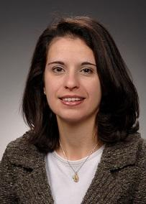
Upcoming TCCN Webinars
On Communication and Sensing Measurements and Modeling for Next “G”
Speaker: Dr. Nada T. Golmie
IEEE Fellow, NIST Fellow
National Institute of Standards and Technology, USA
When: 9:00am-10:00am, Thursday, June 15, 2023, US Eastern Time

Slide 20
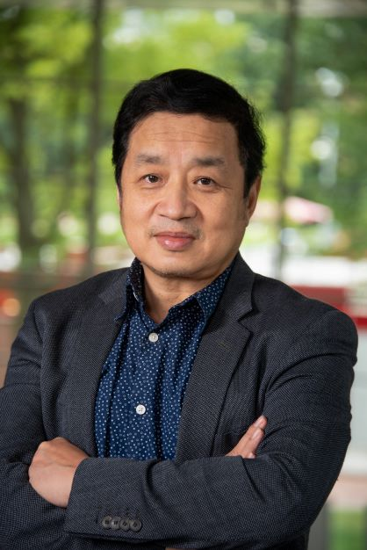
Upcoming TCCN Webinars
On Optimal Partitioning and Scheduling of DNNs in Mobile Edge/Cloud Computing
Speaker: Professor Jie Wu
IEEE Fellow, AAAS Fellow, Member of Academia Europaea (MAE)
Director of the Center for Networked Computing and Laura H. Carnell professor, Temple University, USA
When: 9:00am-10:00am, Friday, July 21, 2023, US Eastern Time

Slide 21
Journal Collaboration
Impact Factor 6.359
Impact Factor 3.17
Impact Factor 6.348
China Institute of Communications recommended top journals
Recommend AEs, submitting papers, serving as reviewers, and organizing special issues.
https://cn.committees.comsoc.org/journals/

Slide 22
Registration – last reminder
Before you leave the meeting, please check if you have written your information in the Zoom chat box:
your name + affiliation + email
Please enter here

Slide 23
Agenda
Welcome and Introduction
Attendance Registration
Approval of the Agenda
Approval of the GLOBECOM 2022 (Nov. 2022) TCCN meeting minutes
Reports from the Chairs
Reports on TCCN Nominations
Reports on TCCN Awards and Subcommittee
Reports on TCCN Webinars and Journal Collaborations
Reports on Special Interest Groups (SIGs)
Reports on conferences
Reports on publications
TCCN publicity
TC restructure report
TC Innovation Project
TC Campaign Video Project
Next TCCN Meeting
Any other business

