Slide 1
Distributed Energy Resources and the Impact to the Grid
IEEE Columbia Technical Session
Anthony E. Eason, PE Utility System Protection and Controls Engineer
September 19, 2017 @ 6:00PM – 8:30PM Columbia, South Carolina

Slide 2
Distributed Energy Resources
Basics and Challenges
NOTE: This presentation is from the perspective of a utility protection engineer. * NOT AFFILIATED WITH ANY SPECIFIC UTILITY
Notes:
This presentation is From the perspective of a utility protection engineer. * NOT AFFILIATED WITH ANY SPECIFIC UTILITY

Slide 3

What is DER?
Distributed Energy Resources
Also known as Distributive Generation
These tend to be small-scale compared to traditional generation
Examples:
  Solar (uses inverters to convert DC to AC)
  Wind (Could be inverter and/or rotating)
  Digesters (Organic Material, Food Products, etc.)
  Methane (Landfill Gas, etc.)
  Hydro
Notes:
Various types of DER

Slide 4
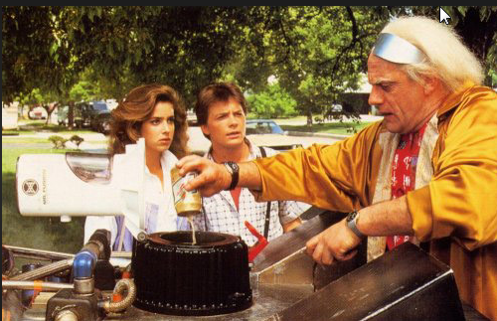
Digester?
What is a digester? A facility that produces power from converting organic waste into a biogas to fuel an engine driven generator.
Notes:
What is a digester? A facility that produces power from converting organic waste into a biogas to fuel an engine driven generator.

Slide 5
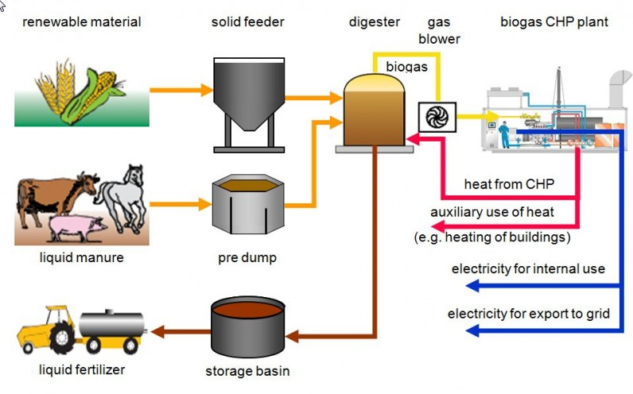
Fundamental Digester Representation
Notes:
Fundamental digester representation

Slide 6
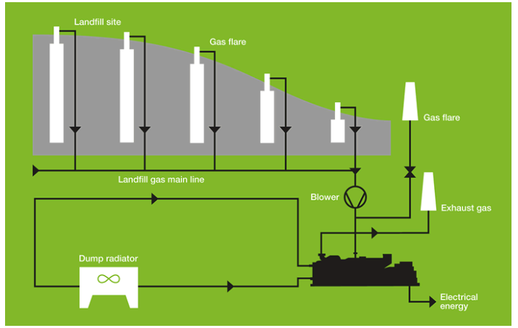
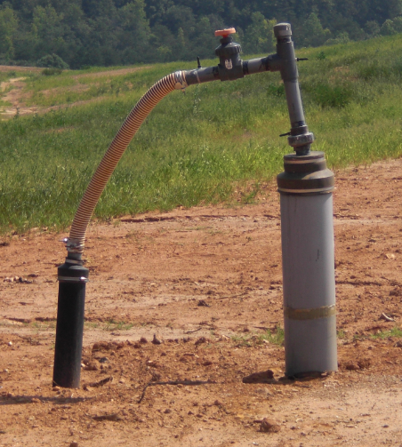
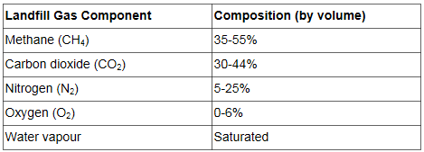
Landfill Dump Heat Radiator
Landfill - Layer of plastic, layer of waste, layer of dirt… repeat.
Notes:
Landfill - Layer of plastic, layer of waste, layer of dirt… repeat.
Dump Heat Radiator

Slide 7
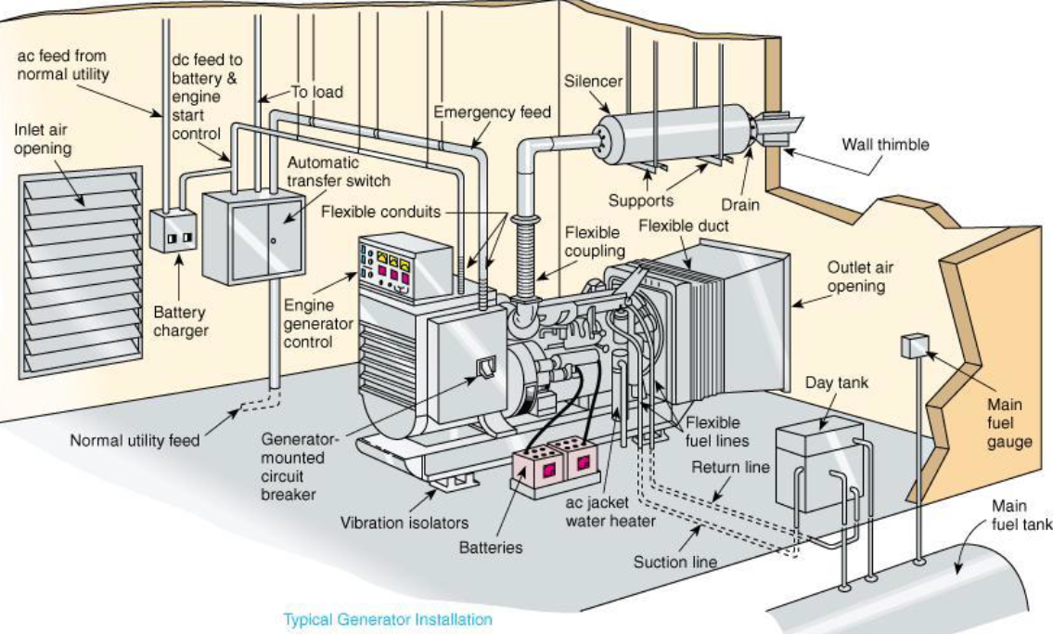
Typical Backup Generator
Figure 1 - Typical Engine Generator Set Installation (Figure complements of Caterpillar).
Notes:
Typical Backup generator

Slide 8
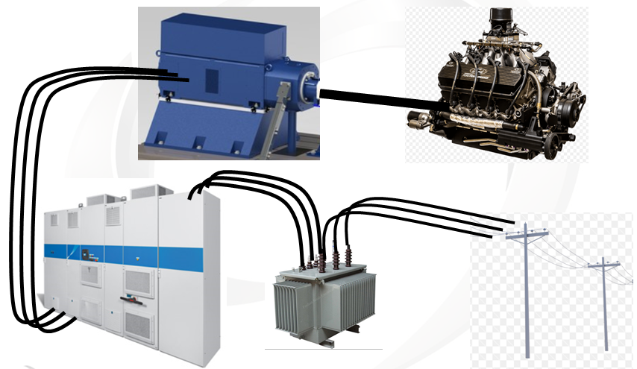
Dyno System Configuration
Notes:
Dyno…

Slide 9
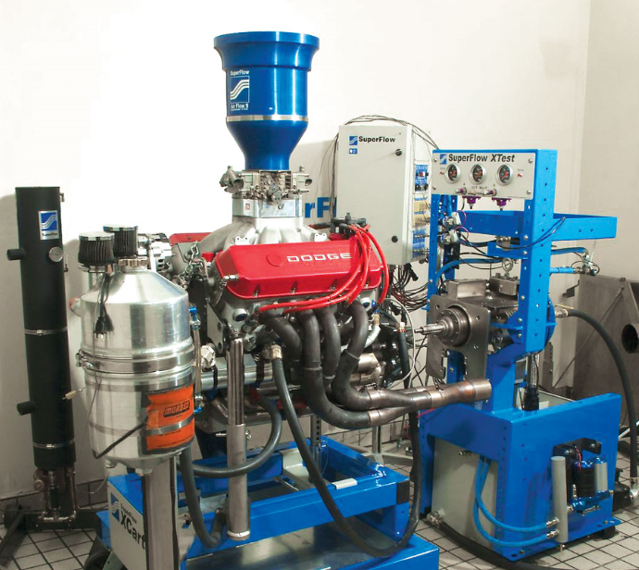
Engine Driven Dynamometer
Internet photo
Notes:
Internet photo

Slide 10
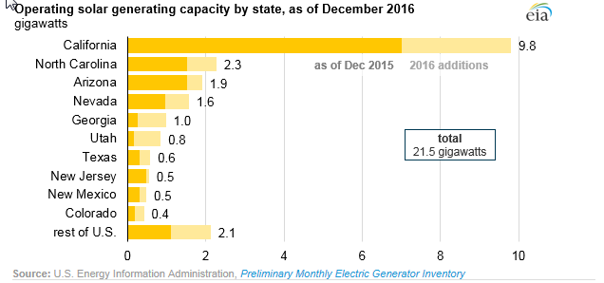
Solar Generating Capacity

Slide 11
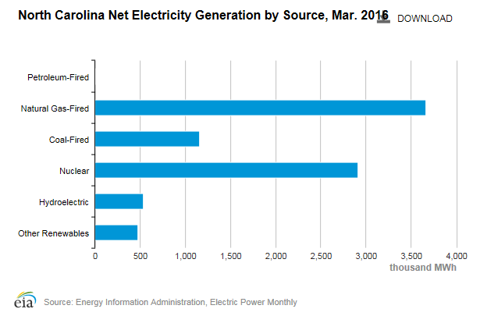
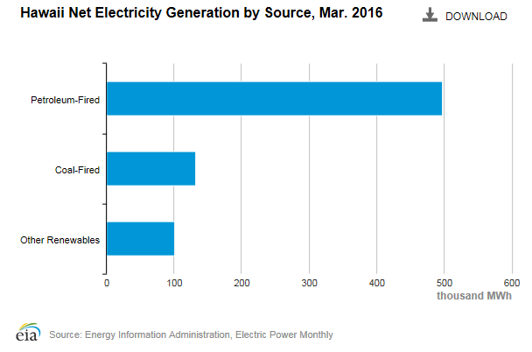
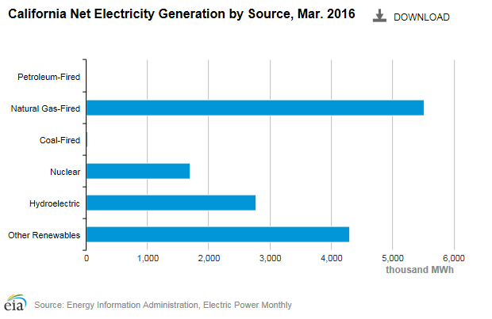
Solar
Generating
Capacity (cont’d)
Additional information from EIA as of March 2016: Please recall that even though NC is much less than CA, it is still third in the nation with solar. Hawaii has a lower amount of renewables but it reflects a large percentage of its overall generation.
Notes:
Additional information from EIA as of March 2016: Please recall that even though NC is much less than CA, it is still third in the nation with solar. Hawaii has a lower amount of renewables but it reflects a large percentage of its overall generation.

Slide 12
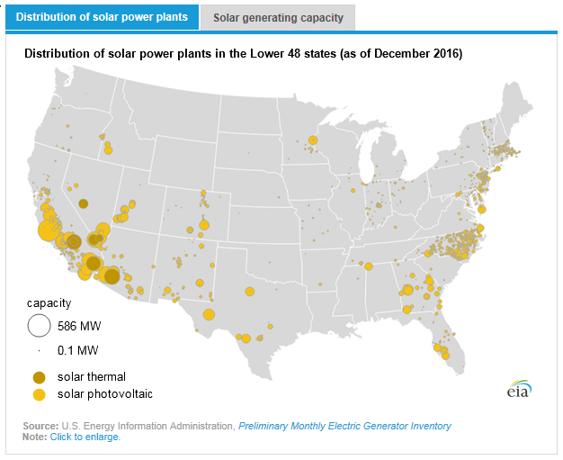
Distribution of Solar Power Plants
(Lower 48 States)

Slide 13
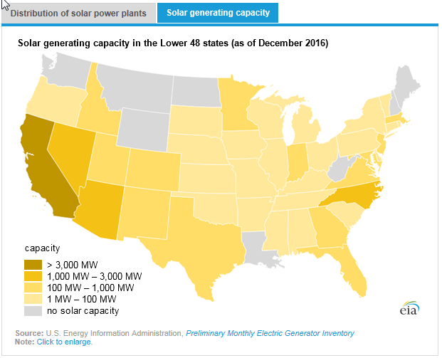
Solar Generating Capacity
(Lower 48 States)

Slide 14
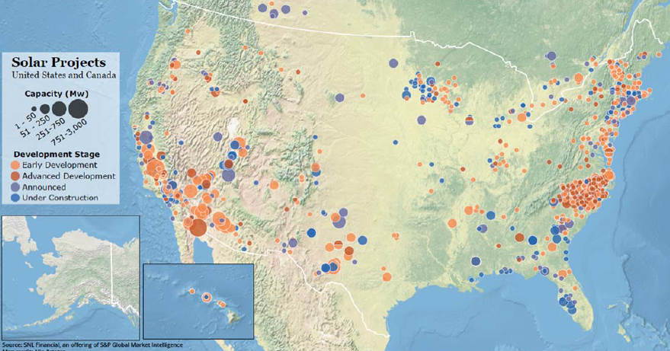
Solar Projects
(USA and Canada)
2017

Slide 15
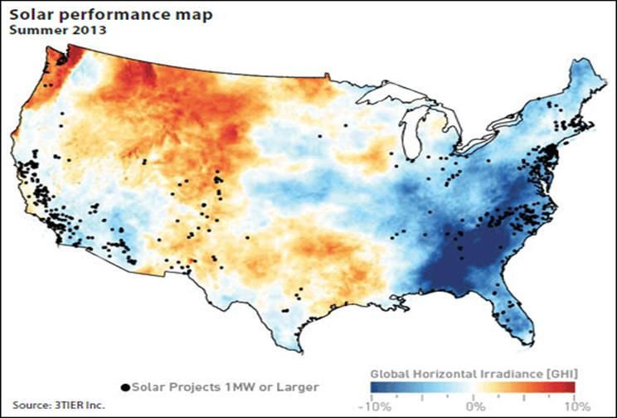
Irradiance vs. Solar Farm Locations
http://www.3tier.com/en/support/solar-prospecting-tools/what-global-horizontal-irradiance-solar-prospecting/
Look at this map. Why are California and North Carolina the largest solar power producers if this map is true? Government incentives.
Notes:
http://www.3tier.com/en/support/solar-prospecting-tools/what-global-horizontal-irradiance-solar-prospecting/
Look at this map. Why are California and North Carolina the largest solar power producers if this map is true? Government incentives.

Slide 16
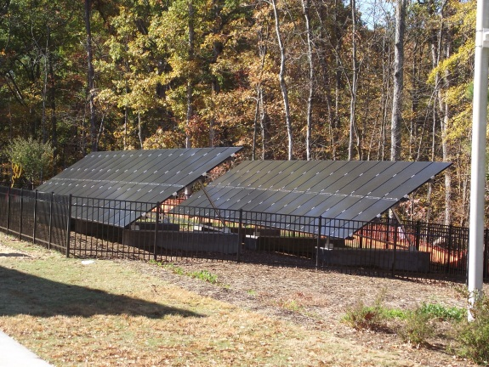
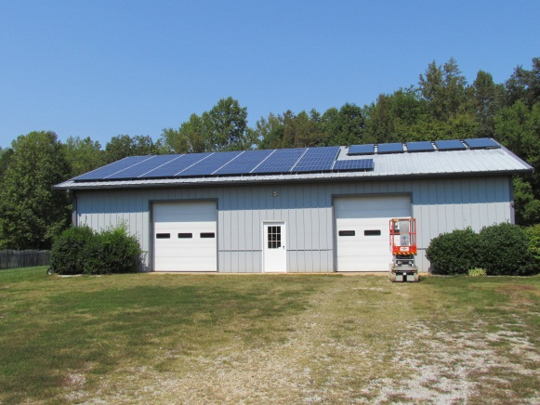
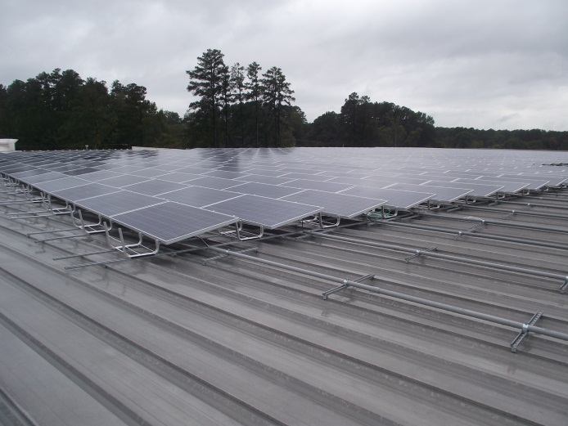
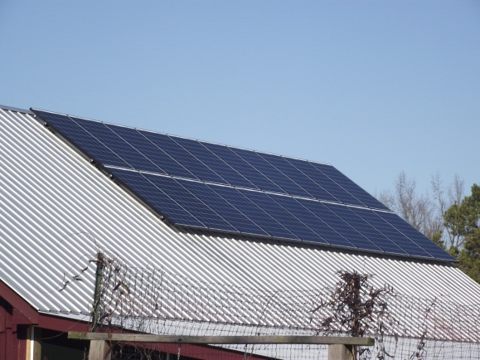
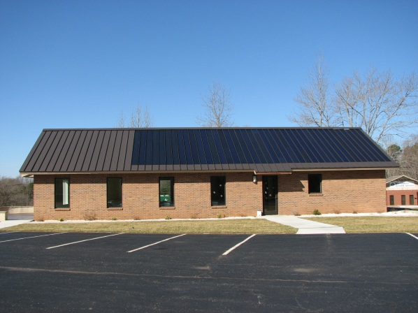
Location Examples

Slide 17
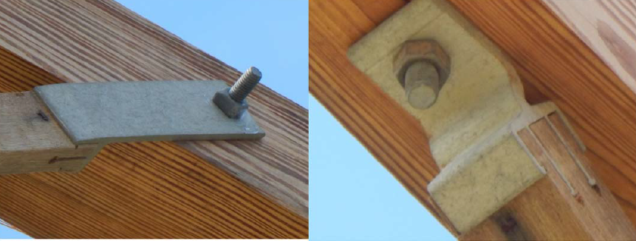
Medium Voltage Construction Quality
Crossarm brace bolts without washers

Slide 18
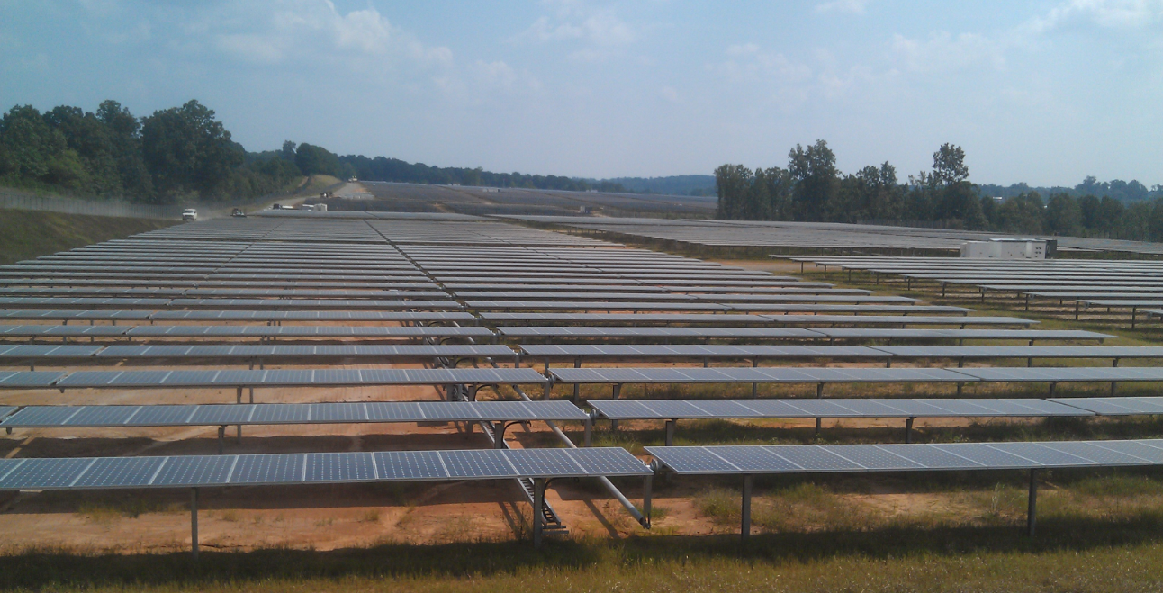
Solar Farm

Slide 19
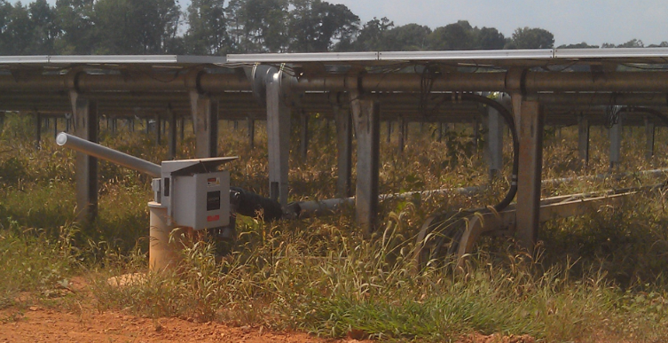
Solar Farm Challenges

Slide 20
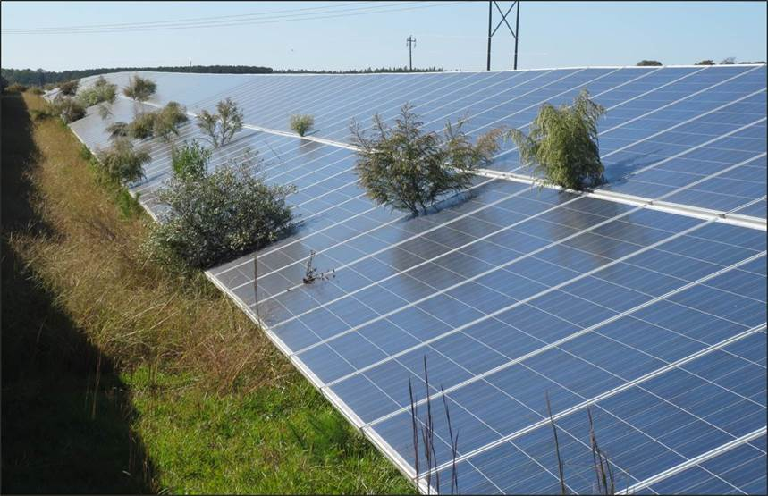
Solar Farm Challenges (cont’d)

Slide 21
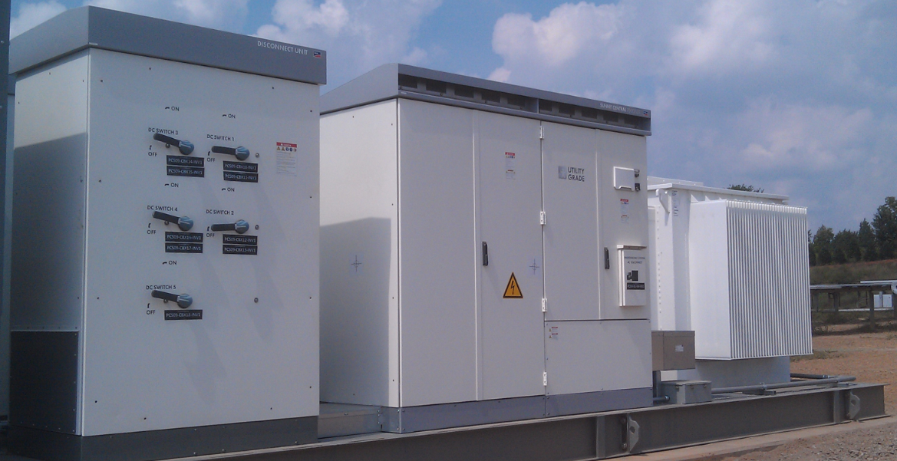
Inverter Manufacturer “Skid”:
Utility Grade Application
This image represents a typical “skid” that would be provided by an inverter manufacturer for a “utility grade” application. On the left are the sectionalized collection of DC inputs from the solar panel arrays, the inverter in the center, and the transformer to the right.
Notes:
This image represents a typical “skid” that would be provided by an inverter manufacturer for a “utility grade” application. On the left are the sectionalized collection of DC inputs from the solar panel arrays, the inverter in the center, and the transformer to the right.

Slide 22
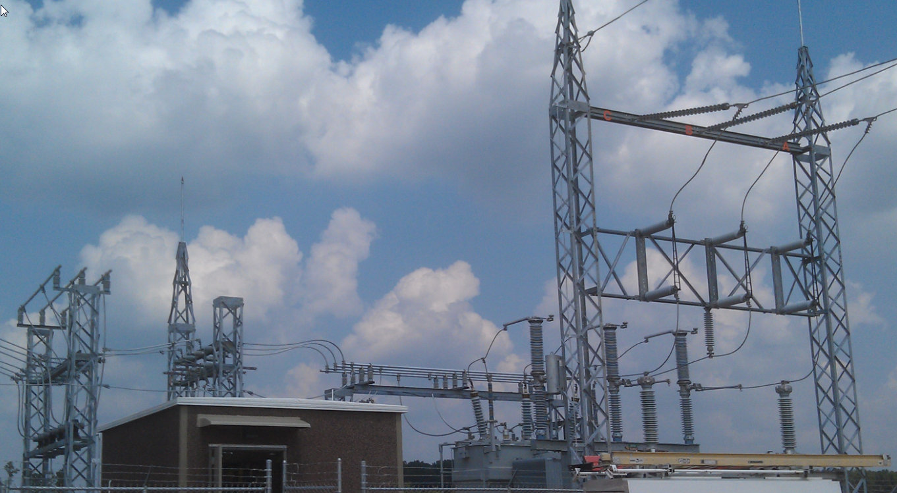
Area Electric Power System:
Typical Utility Substation
This image represents a typical utility substation. Transmission coming in from the right and delivery to the DER shown on the left. In the center would be the protective device(s), control house, and transformer.
Notes:
This image represents a typical utility substation. Transmission coming in from the right and delivery to the DER shown on the left. In the center would be the protective device(s), control house, and transformer.

Slide 23
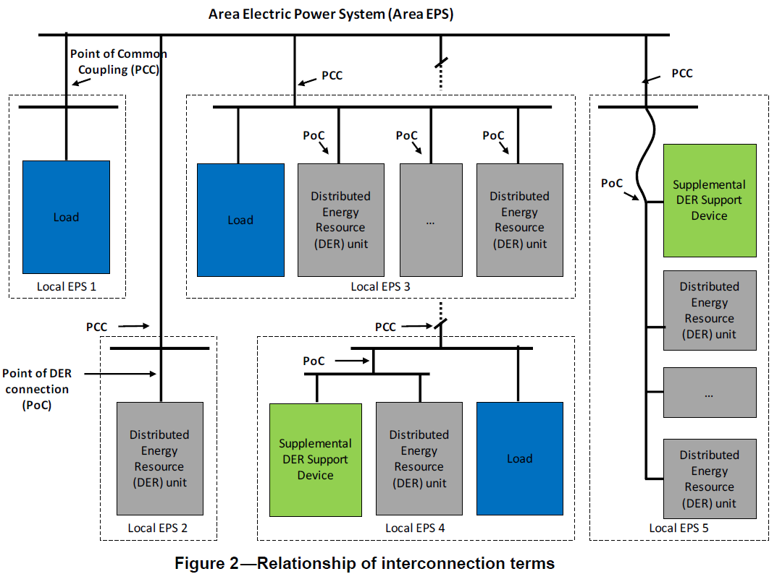
Area Electric Power System: POC vs PCC
Figure 2 – Relationship of interconnection terms.
POC vs. PCC discussion
Notes:
POC vs. PCC discussion

Slide 24
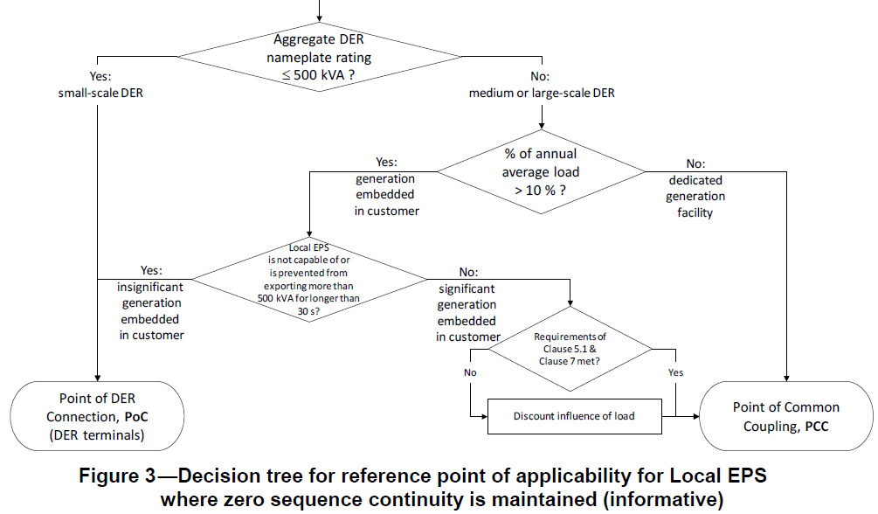
Determining PCC or POC
How do you determine PCC or POC for commissioning/ site testing?
Figure 3 – Decision tree for reference point of applicability for Local EPS where zero sequence continuity is maintained (informative).
Notes:
How do you determine PCC or POC for commissioning/ site testing?

Slide 25
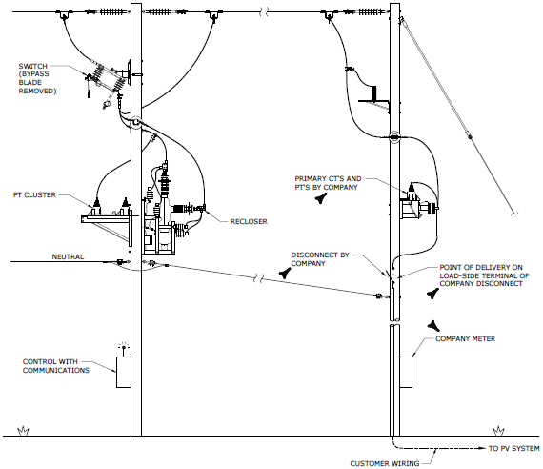
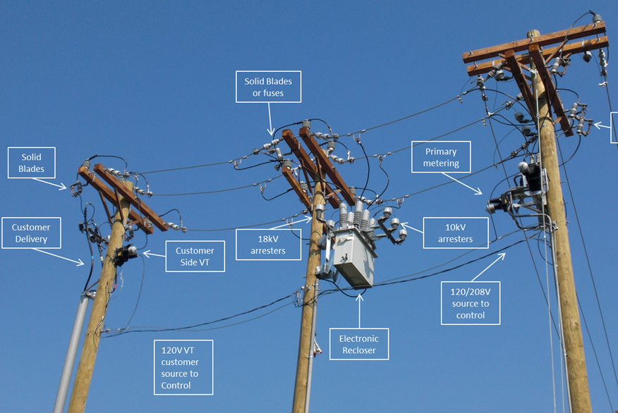
PCC for Most Utility Scale DER Sites
  Utility A (UG delivery)
Construction
  Utility B (UG delivery)
25
Notes:
What does a typical Utility “PCC” look like for most “Utility scale” DER sites?

Slide 26
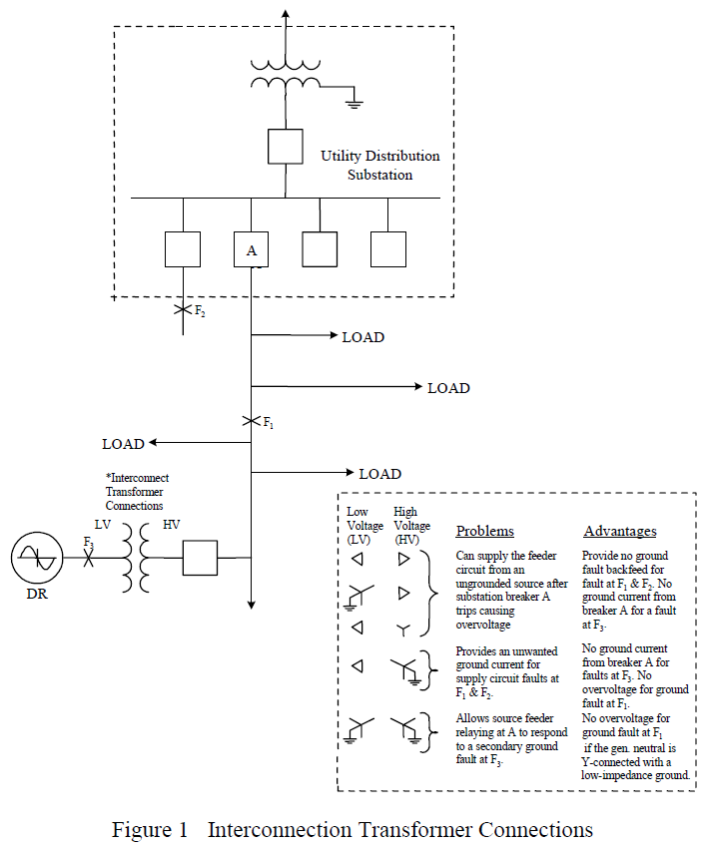
Interconnection Transform Connections
NOTE:
Consider effective grounding in this Figure.
(Reference Reigh Walling’s Overview of PC62.926 .)
Figure 4 – Interconnection transform connections.
Notes:
Also discuss effective grounding…
(reference Reigh Walling’s overview of PC62.926).

Slide 27
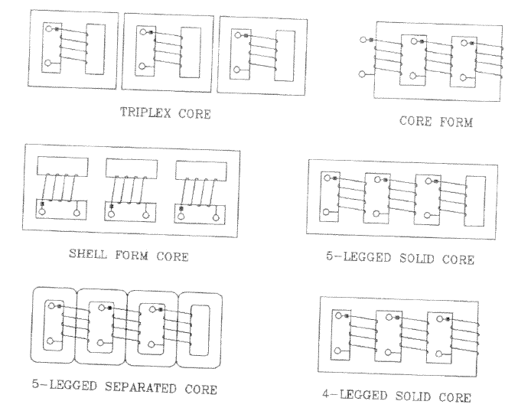
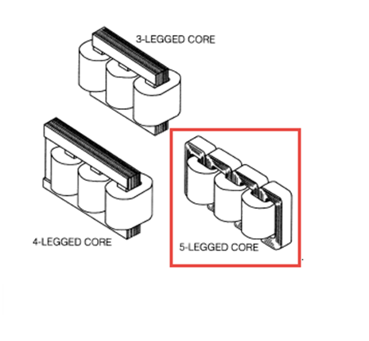
Core Design vs. Direct Flux
There are direct flux linkages between each phase for all types but Triplex Core that could induce voltage. This is most severe under situations with little neutral loading. Significantly inhibits DER from detecting an “open phase” condition at PCC. The 5 legged core is popular since it better handles stray flux generated due to typical unbalanced loads on the system.
Figure 5 – Three-phase three-, four- and five-legged core design.
Notes:
There are direct flux linkages between each phase for all types but Triplex Core that could induce voltage. This is most severe under situations with little neutral loading. Significantly inhibits DER from detecting an “open phase” condition at PCC. The 5 legged core is popular since it better handles stray flux generated due to typical unbalanced loads on the system.

Slide 28
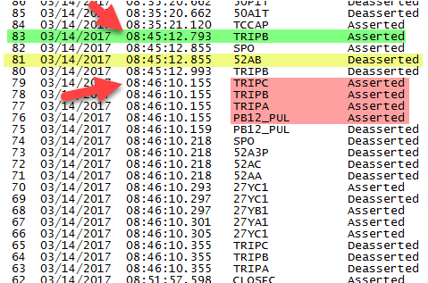
Wye-Delta Transformer
(1MW Rotating Site)
This was on a wye-delta transformer for a 1MW rotating site.
This test was supposed to Open the “B” phase on the primary side of the transformer and verify that the DER detected the open phase condition and shutdown.
1st step. TRIP B
Note time and mechanical contact response.
Note time on PB12 pulse (manual trip performed by utility recloser after obvious failure) and all phase trips….
Notes:
This was on a wye-delta transformer for a 1MW rotating site.
This test was supposed to Open the “B” phase on the primary side of the transformer and verify that the DER detected the open phase condition and shutdown.
1st step. TRIP B Note time and mechanical contact response
Note time on PB12 pulse (manual trip performed by utility recloser after obvious failure) and all phase trips….

Slide 29
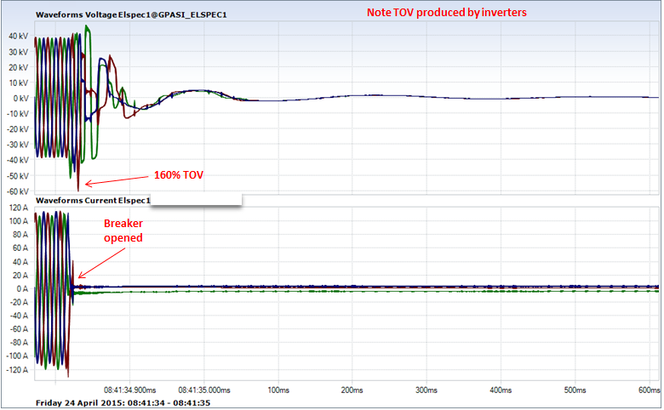
Instantaneous Voltage & Current
Breaker is opened at the station; the result is transient overvoltage on the system from an inverter driven DER facility.
Notes:
Breaker is opened at the station, result is transient overvoltage on the system from an inverter driven DER facility.

Slide 30
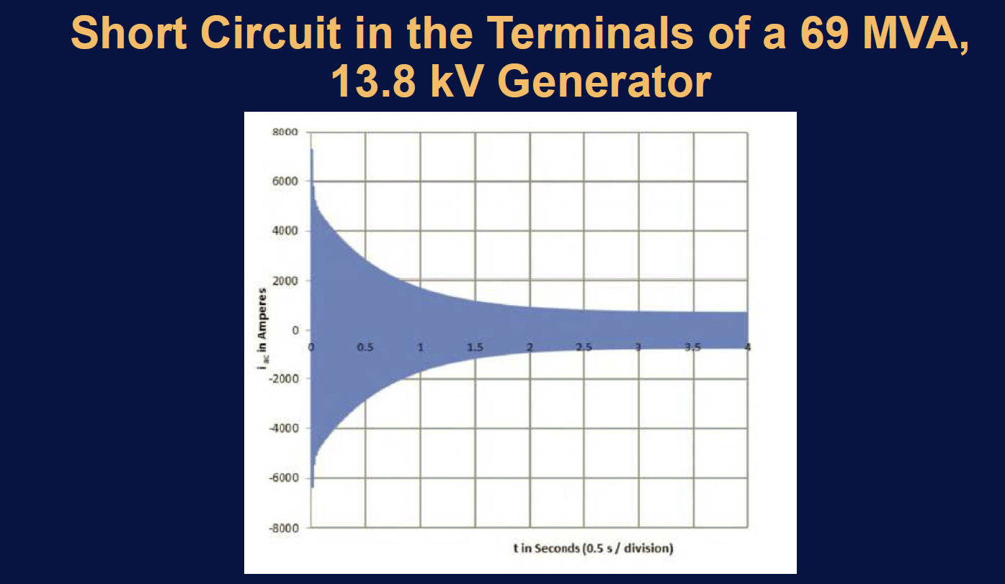
Short Circuit in Terminals of 69 MVA, 13.8 kV Generator
No Asymmetrical/DC offset in this example but very typical of rotating sources. Large Sub-transient and relatively large and lengthy transient current.
Notes:
No Asymmetrical/DC offset in this example but very typical of rotating sources. Large Sub-transient and relatively large and lengthy transient current.

Slide 31
Nonconventional DER sites
Do not generate significant fault currents
Do not generate zero and negative sequence currents during nonsymmetrical faults
Can have zero sequence at PCC pending transformer type
Not represented as voltage source behind an impedance

Slide 32
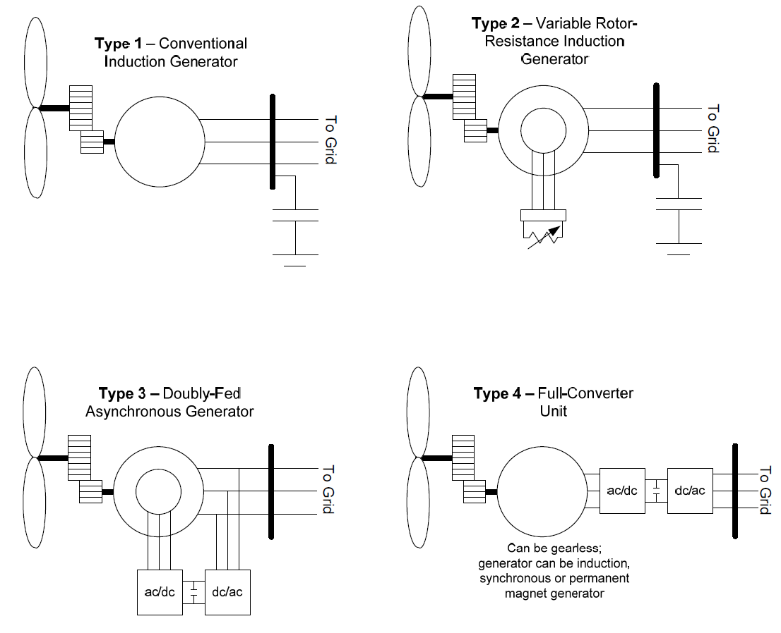
4 types of Wind Generation
Figure 6 – Four Types of Wind Generation.

Slide 33
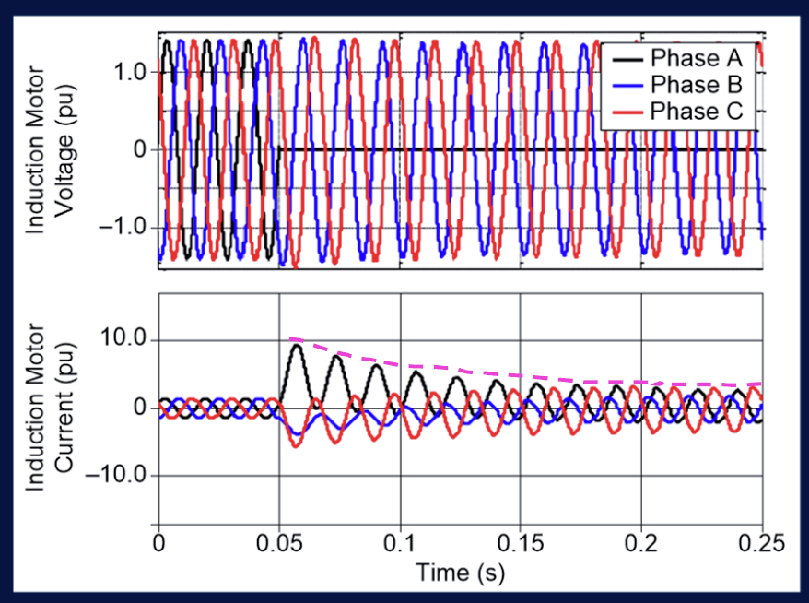
Type 1 Wind Turbine: AG Fault
Type 1 wind turbine seems to follow a typical rotating generation’s response to a fault, with some Asymmetrical/DC offset shown. Refresher: Magnitude of the DC offset is dependent on where in the cycle that the fault inception takes place. The decay rate is associated with the X/R ratio of the circuit.
Notes:
Type 1 wind turbine. Seems to follow a typical rotating generation’s response to a fault, with some Asymmetrical/DC offset shown. Refresher: Magnitude of the DC offset is dependent on where in the cycle that the fault inception takes place. The decay rate is associated with the X/R ratio of the circuit.

Slide 34
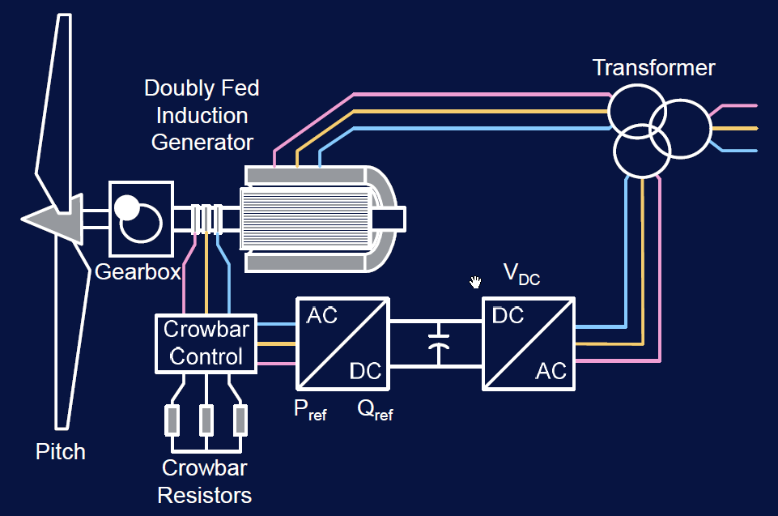
Type 3 Doubly Fed Induction Generator
NOTE:
These units have features that allow them to run at variable speeds slightly above or below their natural synchronous speed and allows the import & export of reactive power to the grid, to support voltage disturbances.
Figure 7 – Type 3 – Doubly Fed Induction Generator.
Notes:
These units have features that allow them to run at variable speeds slightly above or below their natural synchronous speed and allows the import & export of reactive power to the grid, to support voltage disturbances.

Slide 35
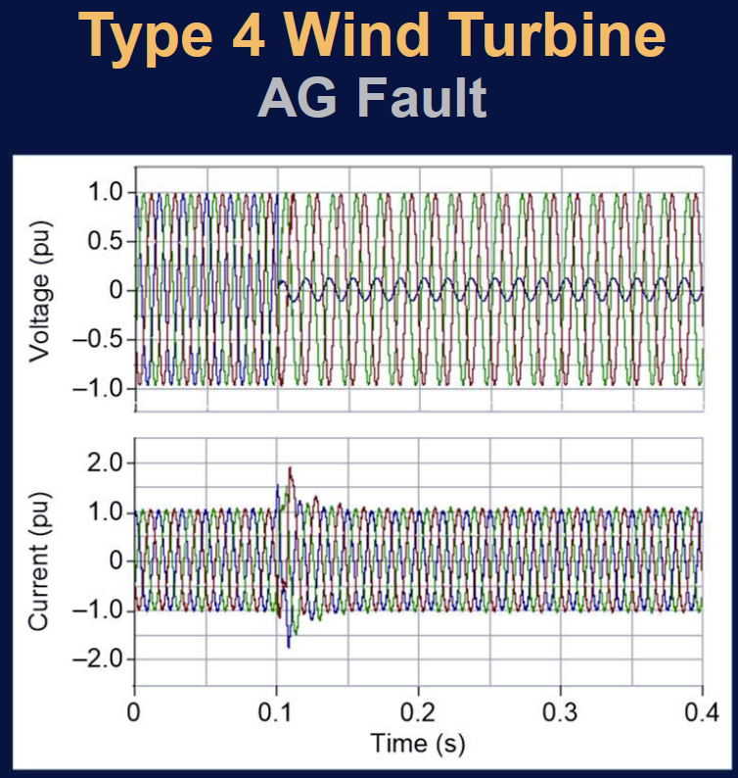
Type 4 Wind Turbine: AG Fault
Look at the reduced voltage on A phase during the fault. Now look at the current during and after the fault. Less than 2.0 per unit for 1-2 cycles.
Notes:
Look at the reduced voltage on A phase during the fault. Now look at the current during and after the fault. Less than 2.0 per unit for 1-2 cycles….

Slide 36
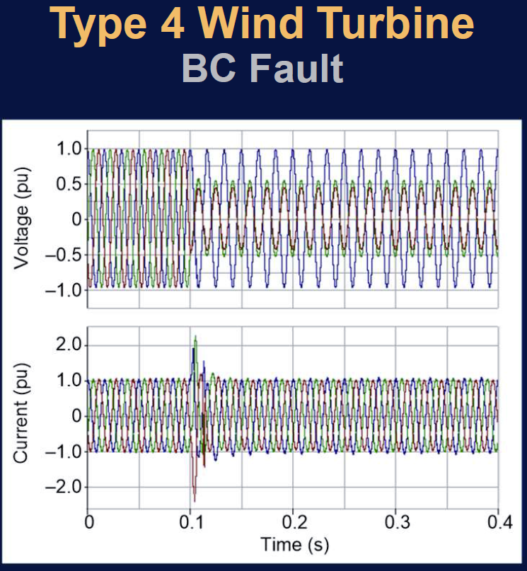
Type 4 Wind Turbine: BC Fault
Similar results for BC fault.
Notes:
Similar results for BC fault.

Slide 37
Conditions Where Ferroresonance Can Occur
Ferroresonance can cause over-voltages in order of 3.0 pu. Over-voltages are caused by discharging and charging of system capacitance thru nonlinear magnetizing reactances of transformers as they pass into and out of saturated condition. Seems to be more common at higher voltages.
Generator must be separated from utility source (islanded).
Real power load in island must be less than three times generator rating.
System capacitance must be greater than 25% and less than 500% of generator rating.
At least one transformer must be connected to island.
Notes:
Ferroresonance can cause over-voltages in order of 3.0 pu. Over-voltages are caused by discharging and charging of system capacitance thru nonlinear magnetizing reactances of transformers as they pass into and out of saturated condition. Seems to be more common at higher voltages.

Slide 38
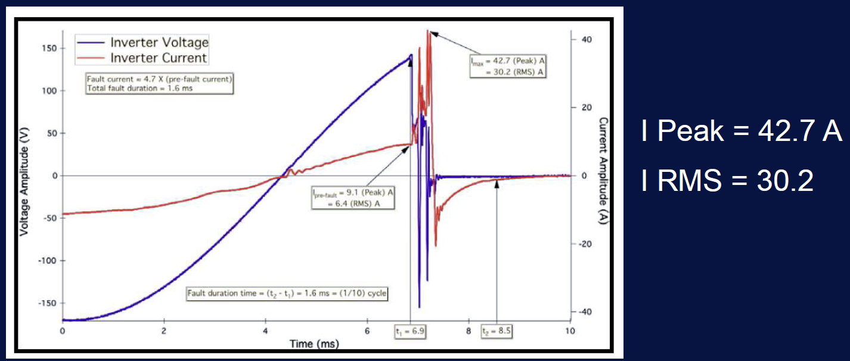
1 kW Inverter Faulted at Terminals (NREL)
NOTE: 5x pre-fault current but duration only 1.6 ms (1/10 of a cycle). Utilities can’t set a time delayed overcurrent (51) that will pick this up. Instantaneous OC’s (50) can be used but are often tripped from inrush. Some 2nd harmonic blocking techniques can be used to supervise inrush conditions for 50 elements but are not common practice for utilities.
Notes:
5x pre-fault current but duration only 1.6 ms (1/10 of a cycle). Utilities can’t set a time delayed overcurrent (51) that will pick this up. Instantaneous OC’s (50) can be used but are often tripped from inrush. Some 2nd harmonic blocking techniques can be used to supervise inrush conditions for 50 elements but are not common practice for utilities.

Slide 39
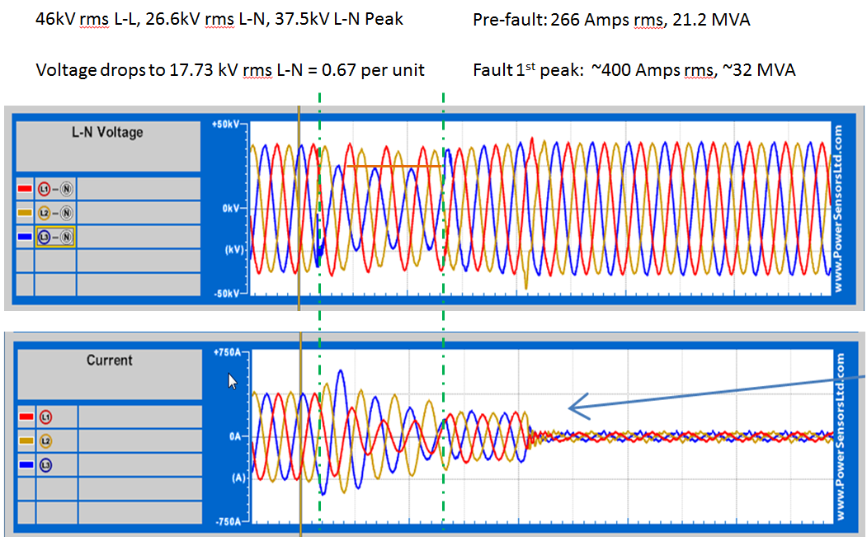
Inverter Driven DER Fault
Notes:
Inverter driven DER fault.

Slide 40
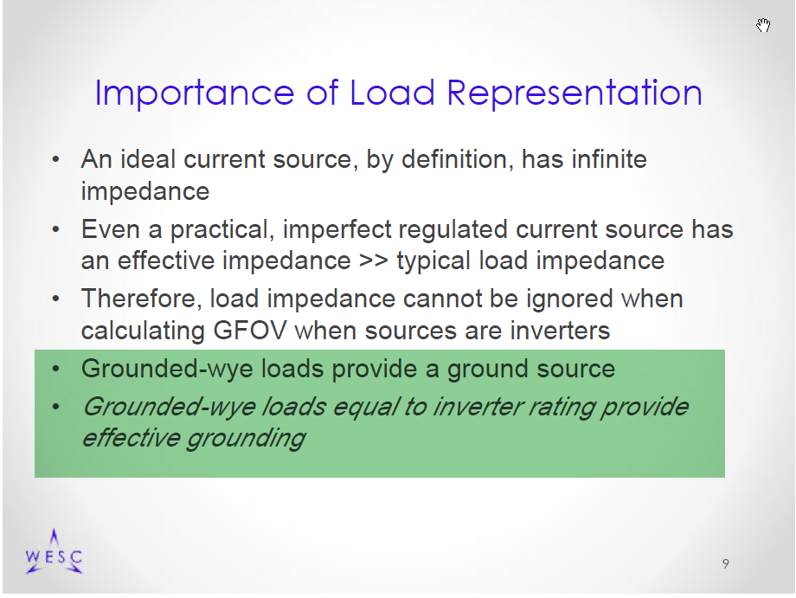
C62.92 update from Reigh Walling At IEEE 1547 working group meeting
“EFFECTIVE GROUNDING” has been redefined and can still be achieved via conditions described here. For an unintentional islanding condition, there would appear to be “effective grounding” for the segment of circuit involved in the condition.
Notes:
“EFFECTIVE GROUNDING” has been redefined and can still be achieved via conditions described here. For an unintentional islanding condition, there would appear to be “effective grounding” for the segment of circuit involved in the condition.

Slide 41
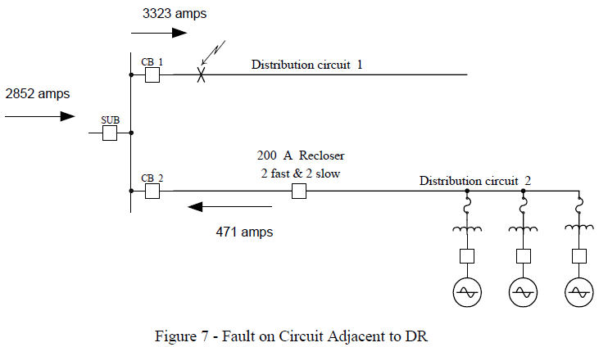
Fault on Circuit Adjacent DER
NOTE: See how the fault magnitude can increase on the adjacent circuit with the addition of the new DER. Also note that the 200A recloser typically trips on its fast curve at 400A, which would result in blinking the customers on CB 2.
Figure 8 – Fault on Circuit Adjacent to DER.
Notes:
See how the fault magnitude can increase on the adjacent circuit with the addition of the new DER. Also note that the 200A recloser typically trips on its fast curve at 400A, which would result in blinking the customers on CB 2.

Slide 42
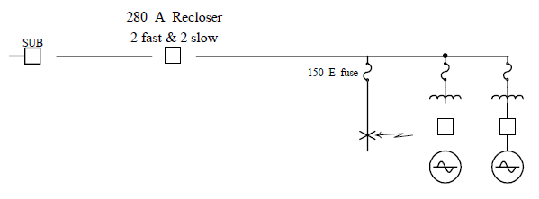
Fuse Saving
Figure 9 – Effect of DER on Fuse Saving.
NOTE: If the 150E fuse passes more fault current than the upstream 280A recloser, “fuse savings” coordination attempts may fail. “Fuse Saving” is an attempt to allow the fast curves of the upstream recloser to clear a temporary fault (lightning, tree limb falling, squirrel, etc.) without clearing the fuse which requires a “truck roll” to replace the fuse.
Notes:
If the 150E fuse passes more fault current than the upstream 280A recloser, “fuse savings” coordination attempts may fail. “Fuse Saving” is an attempt to allow the fast curves of the upstream recloser to clear a temporary fault (lightning, tree limb falling, squirrel, etc.) without clearing the fuse which requires a “truck roll” to replace the fuse.

Slide 43
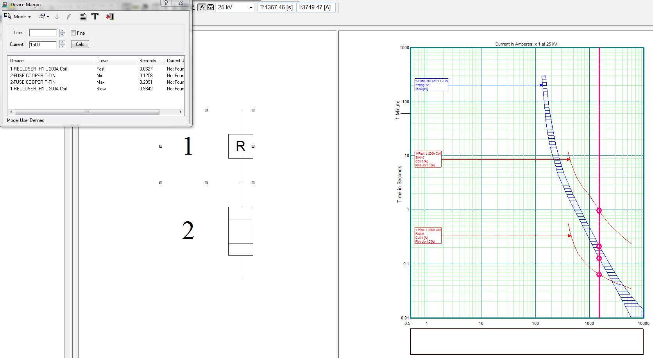
Coordination Software
Showing a Fuse
Here, coordination software is showing a fuse that is coordinated between the fast curve of a hydraulic recloser and the slow curve. This allows for fuse savings for temporary faults. Thus not blowing the fuse and requiring a truck to roll to restore service. A DER, strategically placed, will misalign this comparison and actually blow the fuse faster than anticipated.
Notes:
Here, coordination software is showing a fuse that is coordinated between the fast curve of a hydraulic recloser and the slow curve. This allows for fuse savings for temporary faults. Thus not blowing the fuse and requiring a truck to roll to restore service. A DER, strategically placed, will misalign this comparison and actually blow the fuse faster than anticipated.

Slide 44
Proposed Requirements:
Voltage Ride-Through – Category 1
Category I offers the fastest response times for protection needs with the least ride-through support.
Notes:
Category I offers the fastest response times for protection needs with the least ride-through support.

Slide 45
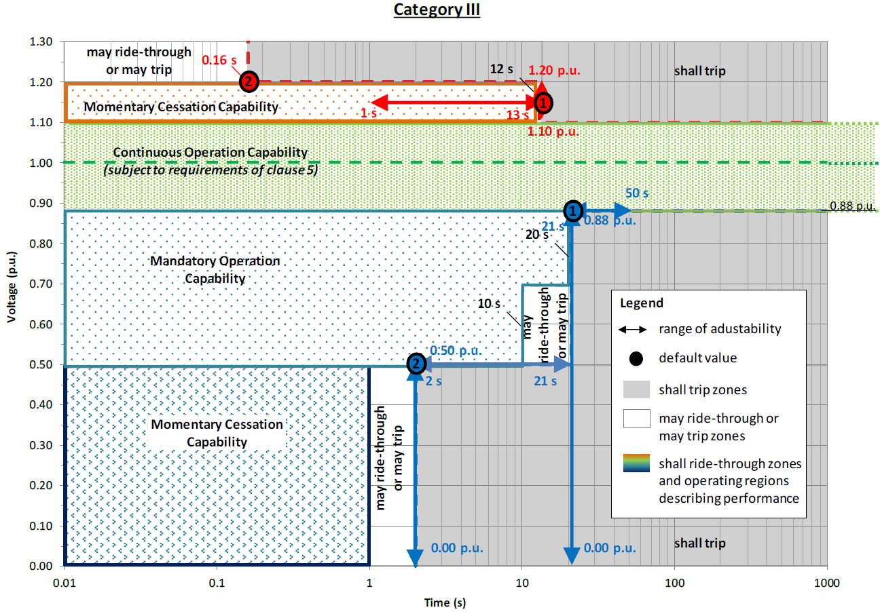
Category III
Category III offers the most ride-through support with a significant increase in protective response times.
Notes:
Category III offers the most ride-through support with a significant increase in protective response times.

Slide 46
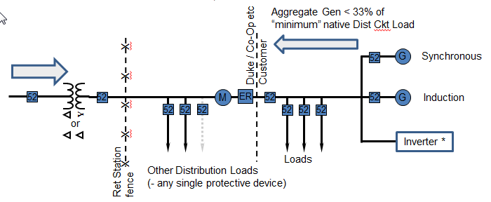
Unintentional Islanding
Unintentional islanding: Where could they occur on this slide? How does the industry attempt to prevent and/or mitigate these islands? Generation to load ratios, DTT, active islanding detection, etc.
Notes:
Unintentional islanding. Where could they occur on this slide? How does the industry attempt to prevent and/or mitigate these islands? Generation to load ratios, DTT, active islanding detection, etc.

Slide 47

Harmonics Before-After DER
Harmonic Content Before - After
Sometimes the unexpected occurs. The DER may increase harmonics, or in this case, help filter some of them out.
Notes:
Sometimes the unexpected occurs. The DER may increase harmonics, or in this case, help filter some of them out.

Slide 48

Typical Morning for 24 Solar Sites
(Various Sizes)
Why all the sags? Clouds. Why the variations in ramp rates? Fixed panels vs. rotating panels and some Solar sites grossly increase their DC capacity over their AC output capacity to increase output over the course of each day. Note the diversity of cloud cover impacts to the system as a whole, which minimizes adverse impacts of such fluctuations to the grid.
Notes:
Typical morning for 24 solar sites, various sizes.
Why all the sags? Clouds
Why the variations in ramp rates? Fixed panels vs. rotating panels and some Solar sites grossly increase their DC capacity over their AC output capacity to increase output over the course of each day.
Note the diversity of cloud cover impacts to the system as a whole, which minimizes adverse impacts of such fluctuations to the grid.

Slide 49

Loss of Diversity Reduction
What is this loss of diversity reduction that affected all sites around 2:40 PM in the afternoon? Solar Eclipse.
Notes:
This is a continuation of the previous slide. What is this loss of diversity reduction that affected all sites around 2:40 PM in the afternoon? Solar Eclipse

Slide 50

Self-Optimizing Grid (SOG)
1. Circuit 1 locks out due to vehicle accident.
OPEN
OPEN
Substation
2. CL FLISR automation reconfigures circuits.
1
3
3. Circuit 2 now has a segment of circuit 1.
4. Crew is dispatched to outage.*
2
5. Crew calls DCC and gives outage location.*
CLOSE
R
OPEN
CLOSE
R
6. DCC determines additional isolation points.*
7. Crew opens additional isolation points.*
R
8. DCC restores power back to isolation points.*
R
Self-Optimizing Grid, Self-Healing Circuits, Automatic Circuit Reconfiguration --this is called many things. Let’s walk through a scenario for some additional understanding, then we will discuss how it impacts DER.
R
9. Crew begins restoration work.
R
R
R
R
4
Substation
R
Substation
Click to Continue
5
Click to Begin
R
R
R
Notes:
Self-Optimizing Grid, Self Healing circuits, automatic circuit reconfiguration --this is called many things. Let’s walk through a scenario for some additional understanding, then we will discuss how it impacts DER.

Slide 51
Restoration of SOG
OPEN
CLOSE
Substation
1. Crew completes repairs and ready to restore power.
CLOSE
OPEN
1
3
2. DCC determines restoration process.*
2
3. Crew closes switch on circuit 1 to restore remaining customers.*
CLOSE
R
OPEN
CLOSE
OPEN
R
4. DCC determines if circuits ready to be returned to normal. *
R
5. Crew closes switch to tie circuits 1 and 2.*
R
R
6. DCC opens recloser at normal open point.*
7. Circuits 1 and circuit 2 returned to normal.
R
R
R
R
4
Substation
R
Substation
Click to Continue
5
Click to Continue
R
R
R
Notes:
Restoration of SOG.

Slide 52
Restoration From Loss of Grid
GENERATION
LOAD
Notes:
Consider having to rebuild the grid from blackout conditions and having DER sites return at staggering times (5 minute requirement of IEEE 1547) to strip away the load as you are trying to balance the system.

Slide 53

Questions?

Slide 54
References
Note: This presentation is not affiliated with any specific utility nor should it be construed to represent the opinions or requirements of any specific utility.
Resources referenced in this presentation include the following:
The author’s personal experiences,
Schweitzer Engineering Labs (SEL),
IEEE 1547 National Standard for Interconnecting Distributed Generation - Working Group,
Internet photos, and
Others, as indicated on slides.

